Slide 1
Uncertainty Estimates for
NUCAPS, NASA AIRS and EUMETSAT IASI Soundings
Using
GCOS Reference Upper Air Network (GRUAN) Radiosonde
Tony Reale¹
Bomin Sun², Michael Pettey² and Ryan Smith²
¹NOAA / NESDIS /STAR
²IMSG Corporation
Joint AMS/NOAA EUMETSAT Satellite Conference
Boston, MA.
Oct. 4th, 2019

Slide 2
Outline
NPROVS / GRUAN
GRUAN Uncertainty Measurement (GUM) Concept
GUM application in Sounding product Cal/Val
Results
Summary

Slide 3
25

Slide 4
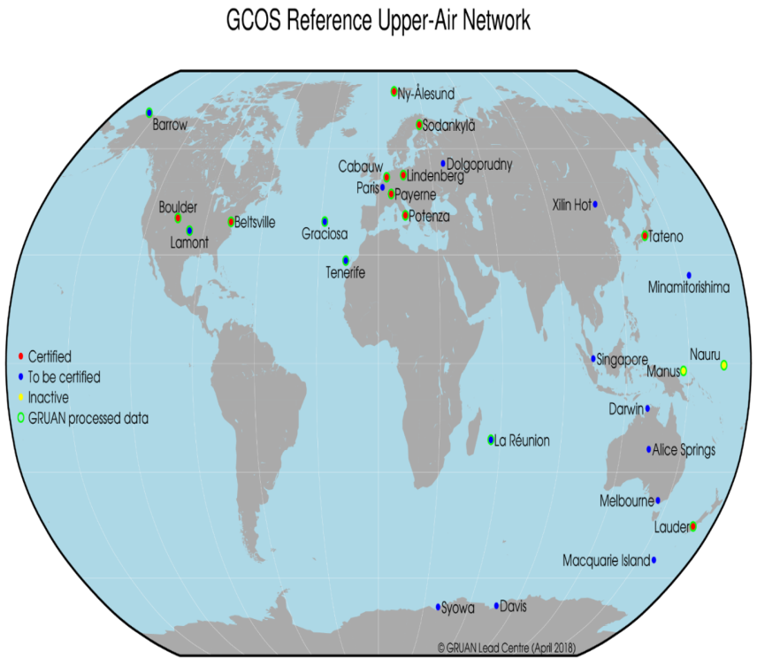
GRUAN & JPSS-funded Dedicated RAOBs: NPROVS Special
JPSS Dedicated RAOB
DOE ARM (SGP, NSA, ENA)
SSEC/Madison …
(2) per week
dual vs single, etc
AEROSE
CALWATER
El Nino Rapid Response
RIVAL (DOE funded)
25 Sites
15 Ref Raob
GRUAN
Ongoing coordination with “other” field experiments
Sterling Test Site
ARM Mobile Sites
CIRA/CSU
Global Climate Observing System (GCOS) Reference Upper Air Network
(GRUAN)
GRUAN provides fully characterized (uncertainty) Temp and RH profiles; Vaisala RS92, v2

Slide 5
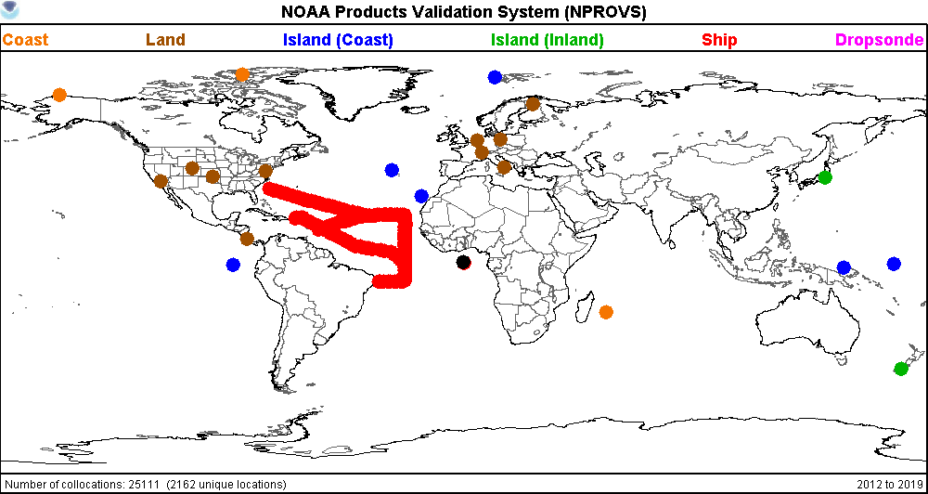
25,000+ since 2013
Collocation GRUAN radiosonde and satellite (and nwp) observations
available in NPROVS Special and VALAR

Slide 6
Strategy
GRUAN Uncertainty Measurement
(GUM)
ABS (m1 – m2) < k (σ² + u1² + u2²)^{1/2}
Reference Quality Upper-Air Measurements: guidance for developing GRUAN data products.,
F. J. Immler, J. Dykema, T. Gardiner, D. N. Whiteman, P. W. Thorne and H. Vomel1
Atmos. Meas. Tech.: 9 September 2010
(m1, m2) are Satellite, GRUAN geophysical profiles,
(u1, u2) the associated satellite and GRUAN uncertainty and
“σ” the uncertainty due to mismatch ... “time-alias”

Slide 7
CONCEPT
Consider two independent measurements m1 and m2 of the same measurand with standard uncertainties
u1, and u2, respectively. Assuming that the hypothesis that m1 =m2 is true and that the uncertainty (u) is normally distributed, the probability that
|m1−m2| > k (u1**2 + u2**2)^{1/2}
occurs only by chance, is roughly 4.5% for k =2 and 0.27% for k =3.
In statistical terms, if Eq. is true for k =2, the null hypothesis that m1 = m2 can be rejected at a significance level (risk) of 4.5%; it is very likely that the two measurements did not measure the same thing, probably due to some unrecognized or unaccounted for systematic effect; “σ”. We suggest to call data in this case “significantly different” and if Eq. (6) holds for k =3 (0.27% risk ) “inconsistent”.
If the results agree within k =1
|m1−m2|<k ·(σ² + u1**2 + u2**2)^{1/2}
the data are “consistent”
and within k =2 they are “in statistical agreement” … a reasonable target for satellite sounding !
Null hypothesis:
(in a statistical test) the hypothesis that there is no significant difference between specified populations, any observed difference being due to sampling or experimental error.

Slide 8
Strategy
2) Since σ and u1 are “unknown” they are initially set to zero and “k₀” is defined:
“k₀” = ABS (m1 – m2) / u2 … initial condition
u2 k₀ ~ ABS (m1 – m2) = k_{x} (σ² + u1² + u2²)^{1/2} … “k_{x}” denotes some target value
σ² + u1² = ((“k₀”/k_{x})² –1) (u2)²
Substituting k_{x} = 2 (“statistical agreement” with GRUAN) and ignoring the “σ ”term (small …)
(for derived soundings, “σ” relatively small compared to inherent error signal)
u1 = ((k₀/ 2)² –1)^{1/2} (u2) … uncertainty needed for “statistical agreement” with GRUAN
“u1” provides “high” estimate for the satellite product uncertainty since it includes “σ“ … ?

Slide 9
Strategy
Moisture
GRUAN Uncertainty defined in terms of Relative Humidity (RH)
Satellite sensors measure H20 vapour molecules / mixing ratio (MR)
RH uncertainty is converted MR uncertainty …
u2(MR) = u2 (RH) x Saturation (MR)
(at 300K, Saturation MR approximately 25 g/kg)
The impact of respective uncertainty in temperature (and pressure) is not included as it is “relatively” small:
At 300K (saturation MR 25g/kg), 1013 hPa, and “typical” GRUAN uncertainty values of 0.2K, 0.5 hPa and 3% RH,
MR uncertainty is estimated as 0.67 +/- 0.01 g/kg (or +/- 1.5%) … impact tends to decrease with height
(satellite sensor sensitivity to atmospheric water vapour 20 (to 40) ppm)

Slide 10
Enterprise Assessment
Comparing / assessing EDR products suites against the same “truth” … GRUAN reference radiosonde
Versus same radiosonde
Using same target “k” … uncertainty

Slide 11
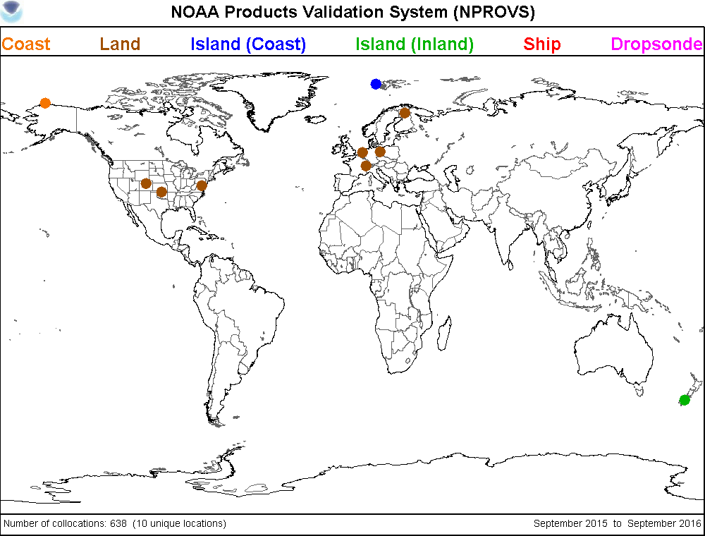
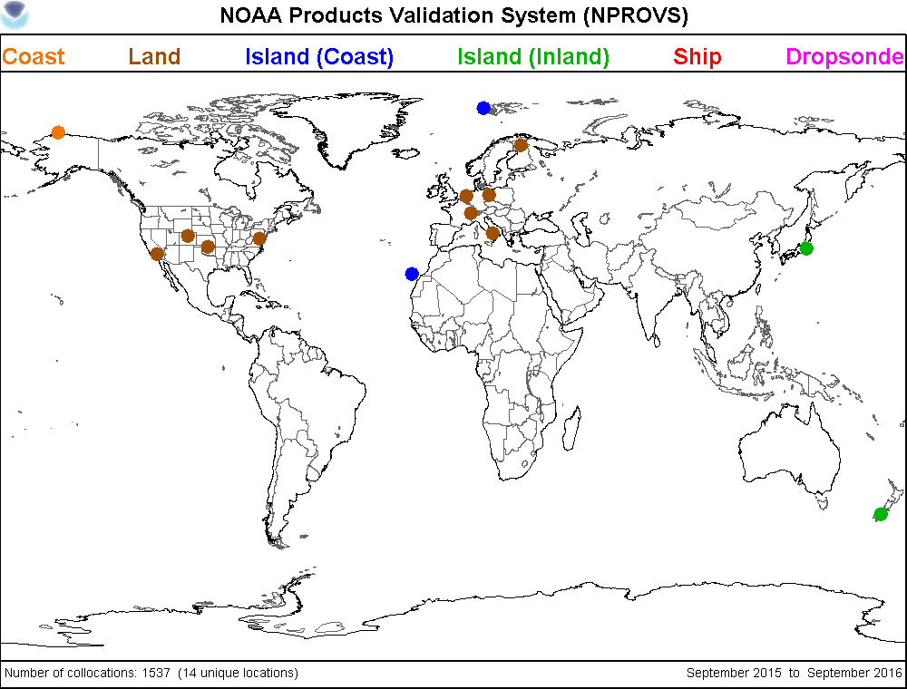
629 1519
Typical distribution of collocated AIRS (v6) and NUCAPS (v5) with GRUAN Radiosonde
(+/- 6hr (right), +/- 2hr (left); 50km)

Slide 12
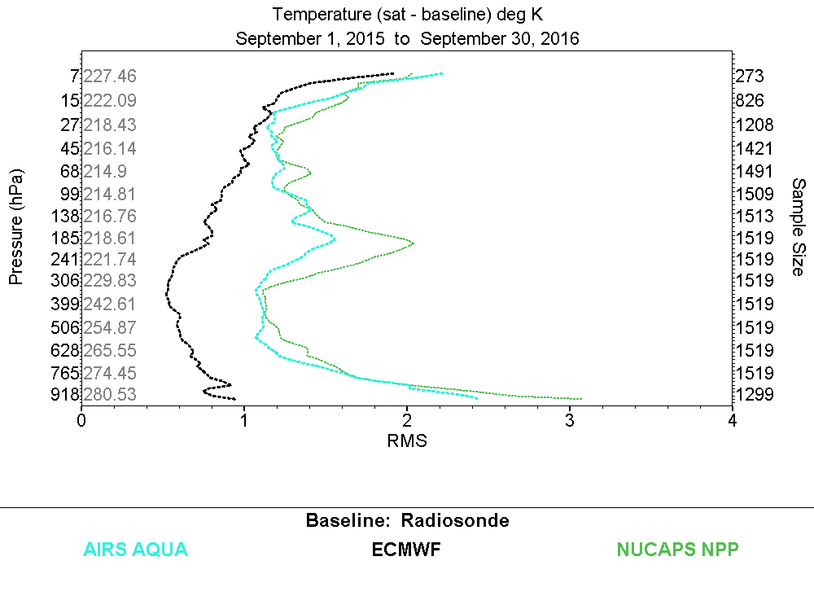
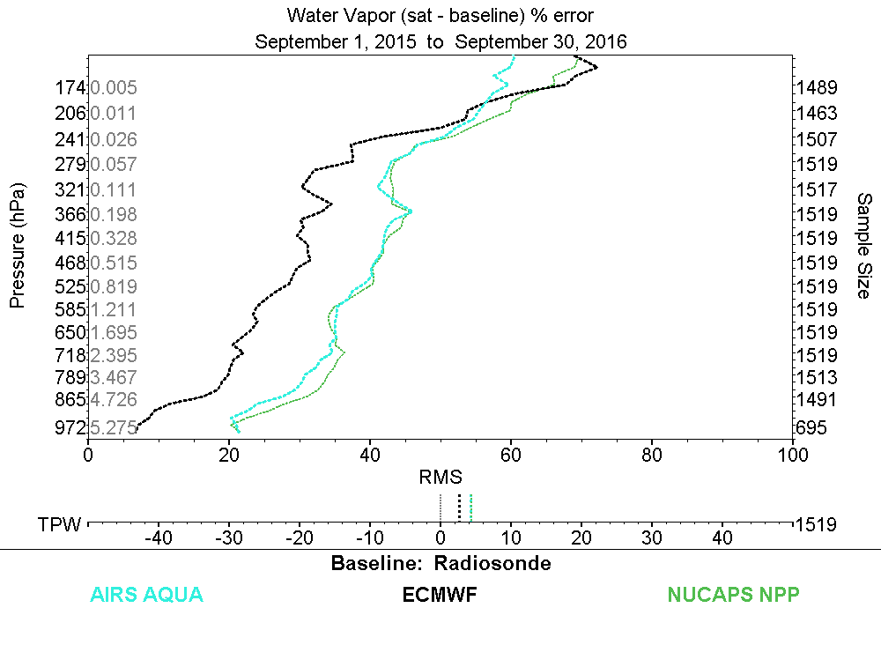
6 hour
6 hour
Collocated AIRS (v6) and NUCAPS (v5) with GRUAN Radiosonde

Slide 13
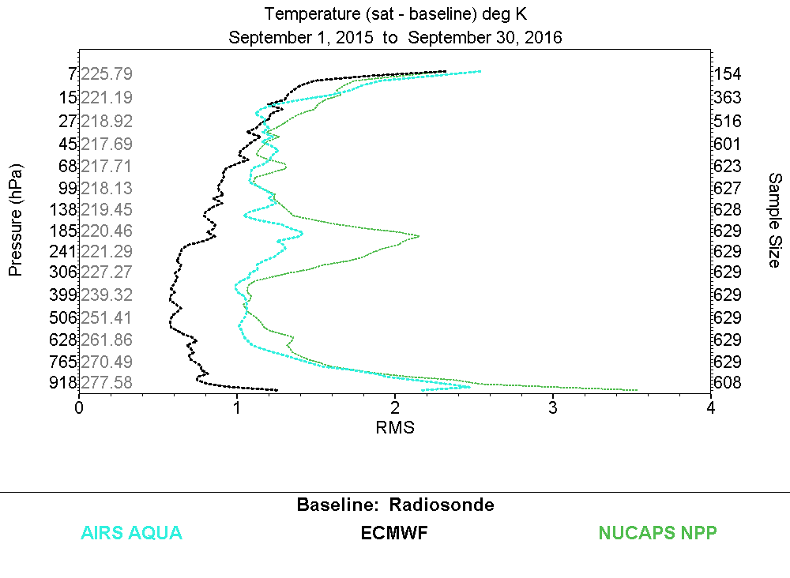
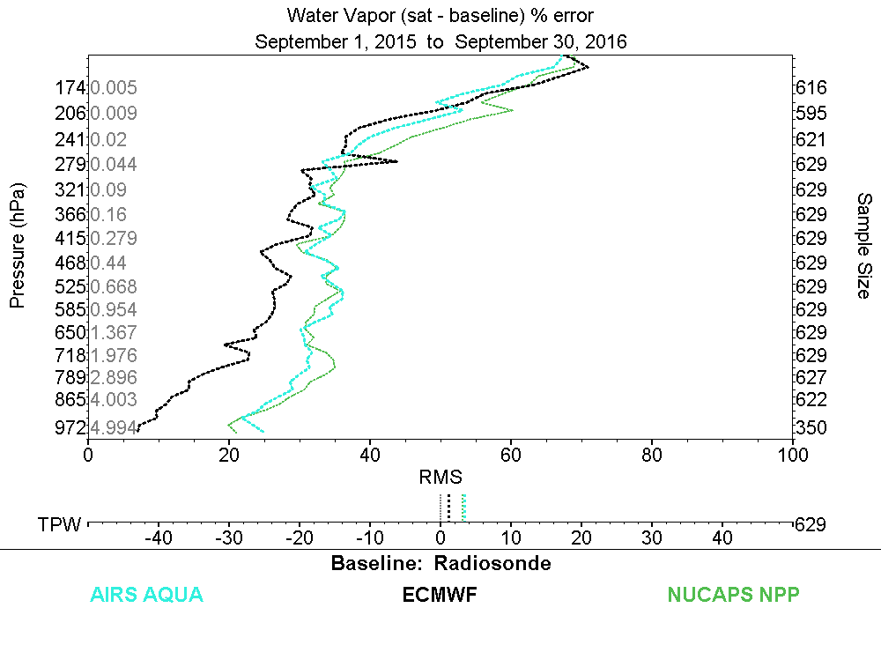
2 hour
2 hour
1.0 1.1 0.3 (K)
0.6 0.7 0.4 (g/kg)
Collocated AIRS (v6) and NUCAPS (v5) with GRUAN Radiosonde

Slide 14
“k₀” profiles
and
expected uncertainty estimates
for
Soundings, NWP
(+/- 2 hr; 50km)

Slide 15
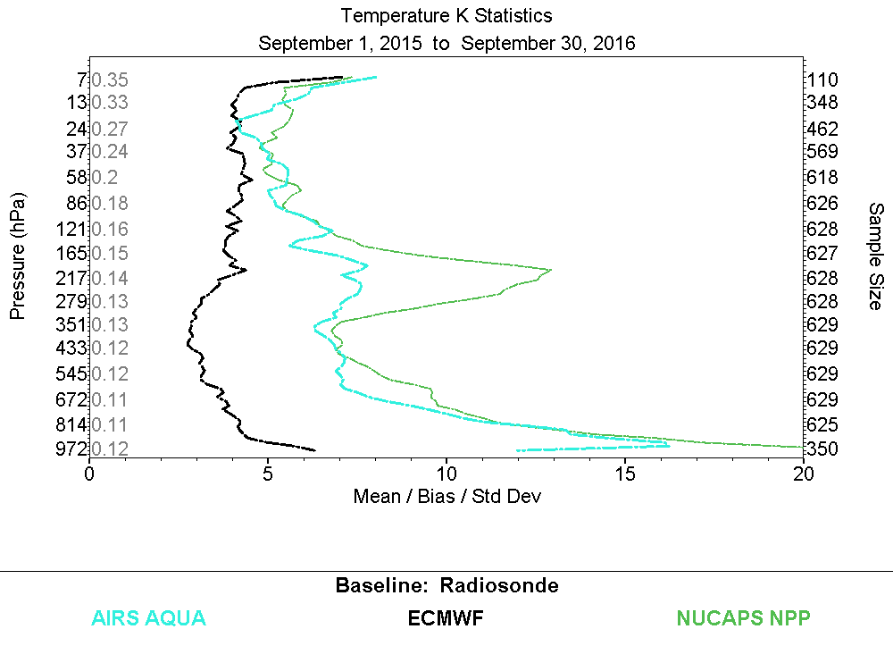
k_{x}
GRUAN uncertainty
mean u2 (k)
uncertainty
k₀
u1 = ((k₀/ 2)² –1)^{1/2} (u2)
0.6 0.6 0.5
0.5 0.8 0.2
0.4 0.5 0.2
0.5 0.6 0.3
0.9 1.1 0.4
from RMS
1.0 1.1 0.3 (K)
2
Sept. 1, 2015 to Sept. 30, 2016)
Collocated NUCAPS (NPP, v5), AIRS (v6) and ECMWF soundings with GRUAN Radiosonde
(+/- 2hour, 50km; IR+MW))

Slide 16
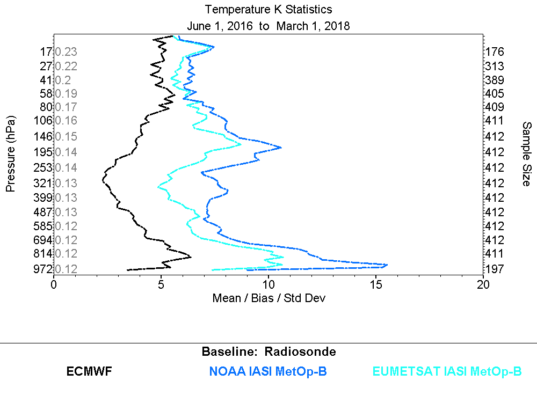
k_{x}
uncertainty
k₀
u1 = ((k₀/ 2)² –1)^{1/2} (u2)
0.5 0.5 0.4
0.6 0.7 0.2
0.4 0.4 0.2
0.5 0.6 0.3
0.6 0.9 0.3
2
June 1, 2016 to March 1, 2018
Collocated NUCAPS (v5), EUMETSAT MetOp-B (v6.2) and ECMWF soundings with GRUAN Radiosonde
(+/- 2hour, 50km)

Slide 17
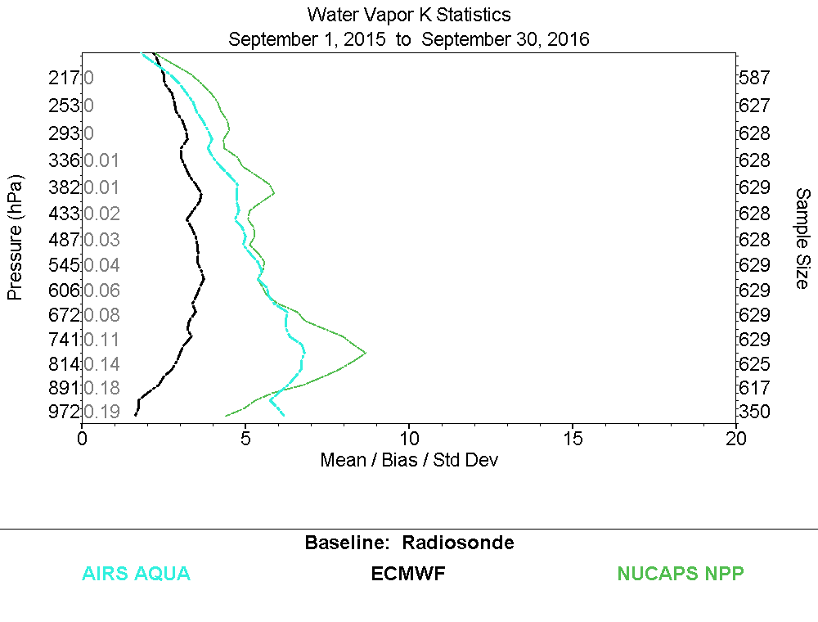
k_{x}
GRUAN uncertainty
mean u2 (g/kg)
Mean
(g/kg)
uncertainty
0.11
0.52
2.26
4.99
u1 = ((k₀/ 2)² –1)^{1/2} (u2)
.01 .02 .01
.07 .08 .03
.43 .53 .20
.54 .44 ---
from RMS
0.6 0.7 0.4 (K)
2
Collocated NUCAPS (NPP, v5), AIRS (v6) and ECMWF soundings with GRUAN Radiosonde
(+/- 2hour, 50km; IR+MW))

Slide 18
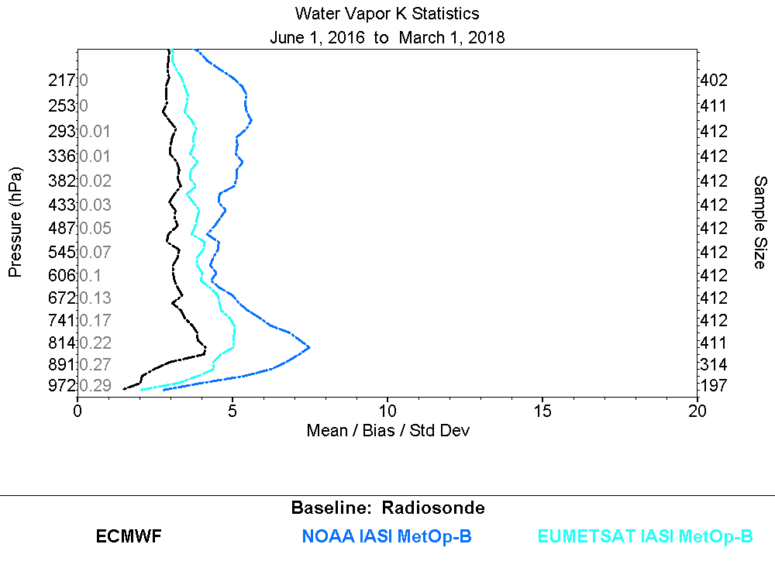
k_{x}
Mean
(g/kg)
uncertainty
0.16
0.66
2.99
7.14
u1 = ((k₀/ 2)² –1)^{1/2} (u2)
.01 .02 .01
.10 .11 .05
.46 .72 .28
.10 .31 ---
2
Collocated NUCAPS (v5), EUMETSAT MetOp-B (v6.2) and ECMWF soundings with GRUAN Radiosonde
(+/- 2hour, 50km)

Slide 19
NUCAPS Users (AWIPS-2)
NOAA Unique Combined Atmospheric Processing System (NUCAPS) sounding products are distributed to NWS forecast users in the field via the NOAA NWS Advanced Weather Information Processing System (AWIPS-2)
The ARM/GRUAN SGP (Oklahoma) site is a strategic location in the context of NOAA NWS AWIPS-2) forecast users …
Having estimates of “expected uncertainties of NUCAPS soundings (IR +MW pass QC) at SGP based on GRUAN reference radiosondes has potential value …

Slide 20
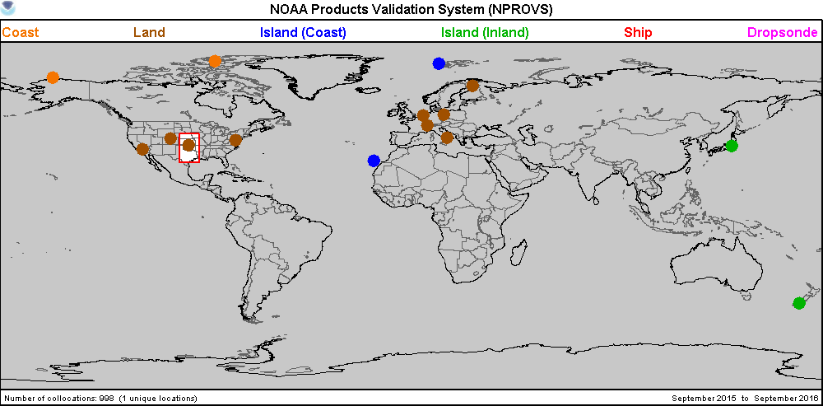
SGP is strategic assessment site for NWS AWIPS-2 users of NUCAPS …
(315m … 945 to 972 hPa)

Slide 21
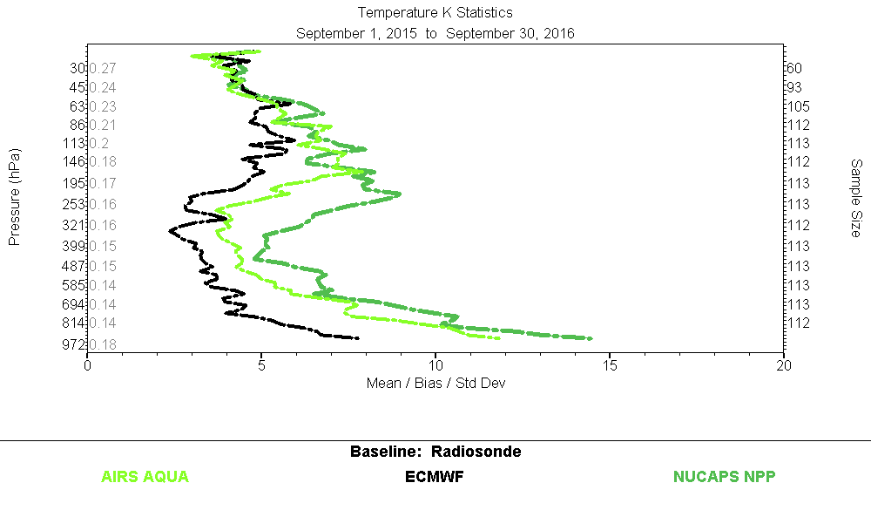
GRUAN
Temperature
Uncertainty u2
k_{x}
uncertainty
k₀
u1 = ((k₀/ 2)² –1)^{1/2} (u2)
0.7 0.7 0.5
0.4 0.6 0.2
0.3 0.4 0.3
0.5 0.6 0.3
0.8 1.0 0.5
2
Collocated NUCAPS (NPP, v5) and AIRS (v6) soundings with SGP Radiosonde
(+/- 2hour, 50km; IR+MW))

Slide 22
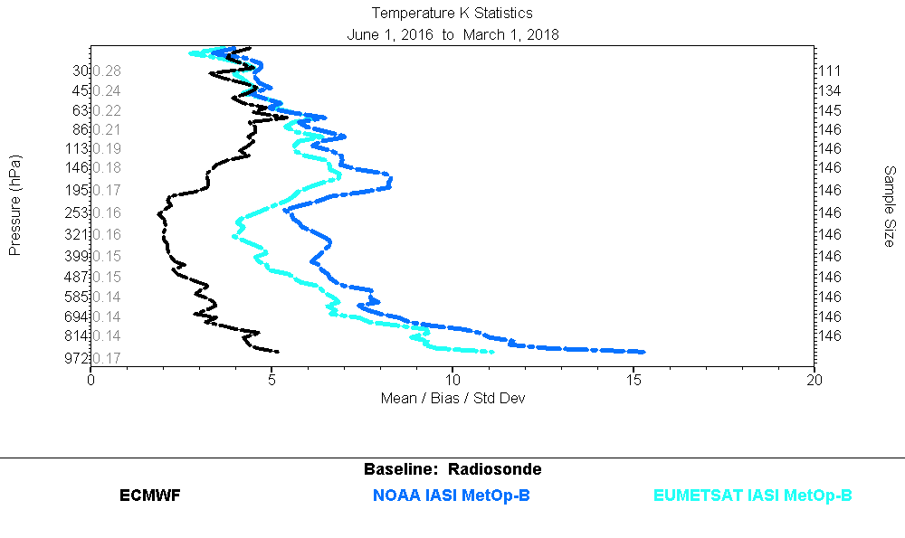
GRUAN
Temperature
Uncertainty u2
k_{x}
uncertainty
k₀
u1 = ((k₀/ 2)² –1)^{1/2} (u2)
0.7 0.8 0.4
0.4 0.5 0.1
0.4 0.5 0.2
0.5 0.6 0.2
0.8 1.0 0.4
2
Collocated NUCAPS (v5), EUMETSAT MetOp-B (v6.2) and ECMWF soundings with SGP Radiosonde
(+/- 2hour, 50km)

Slide 23
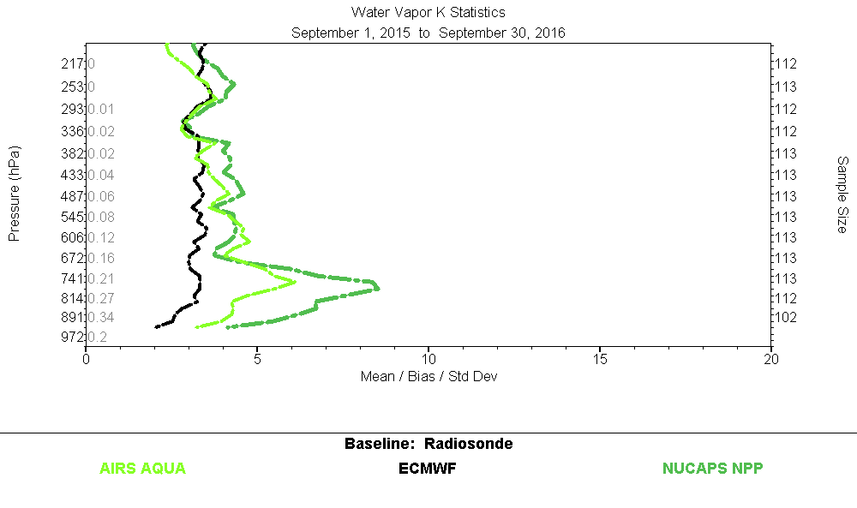
GRUAN
H20 Vapor
Uncertainty u2
k_{x}
uncertainty
Mean
(g/kg)
0.20
0.72
3.93
3.19
u1 = ((k₀/ 2)² –1)^{1/2} (u2)
k₀
.01 .01 .01
.11 .12 .07
.65 .88 .30
.48 .60 .10
2
Collocated NUCAPS (NPP, v5) and AIRS (v6) soundings with SGP Radiosonde
(+/- 2hour, 50km; IR+MW))

Slide 24
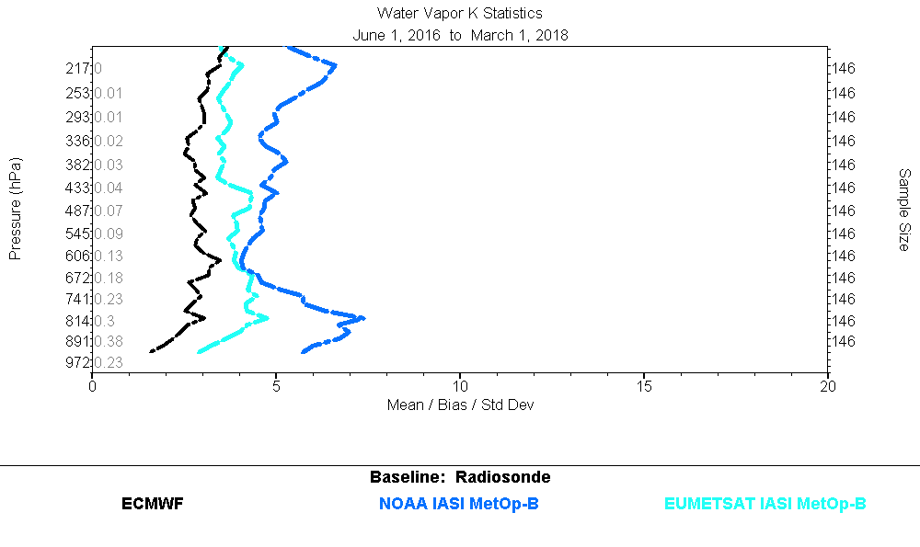
GRUAN
H20 Vapor
Uncertainty u2
k_{x}
uncertainty
Mean
(g/kg)
0.25
0.86
4.05
4.61
u1 = ((k₀/ 2)² –1)^{1/2} (u2)
k₀
.02 .04 .01
.11 .14 .05
.50 .67 .25
.42 1.0 ---
2
Collocated NUCAPS (v5), EUMETSAT MetOp-B (v6.2) and ECMWF soundings with SGP Radiosonde
(+/- 2hour, 50km)

Slide 25
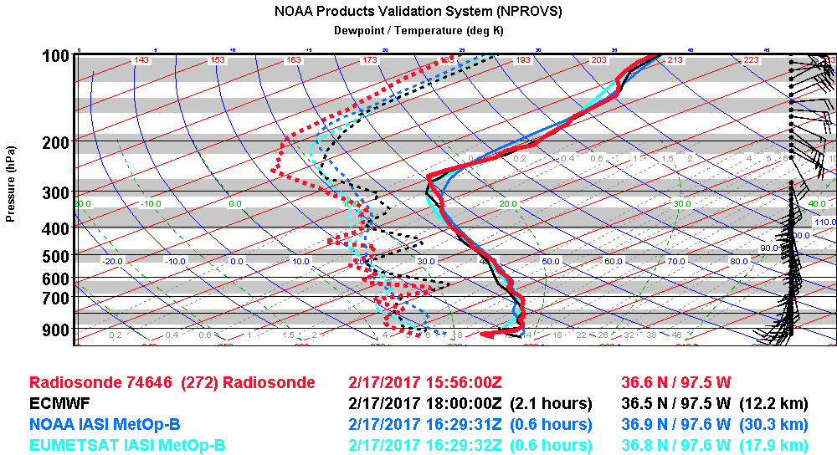
Collocated NUCAPS (v5), EUMETSAT MetOp-B (v6.2) and ECMWF soundings with SGP Radiosonde
(+/- 2hour, 50km)

Slide 26
Summary / Forward
NPROVS Special Dataset w/GRUAN pivotal for NOAA Cal/Val for soundings …
JPSS are GRUAN Users!
Uncertainty Application Strategy for geophysical sounding products presented
Strategy tested for respective “optimal” periods for 1) NUCAPS NPP vs AIRS and 2) NUCAPS versus EUMETSAT MetOp-B
Expected uncertainty estimates for soundings correlated with RMS but appear low (particularly Temp)
Expected uncertainty estimates at SGP relevant for NUCAPS Users via NWS AWIPS-2 and Provider …
Update results using GRUAN RS41 and latest Sounding products
Radiance Space…. GSICS; RT model and Satellite Sensor assessment
Publication …

Slide 27
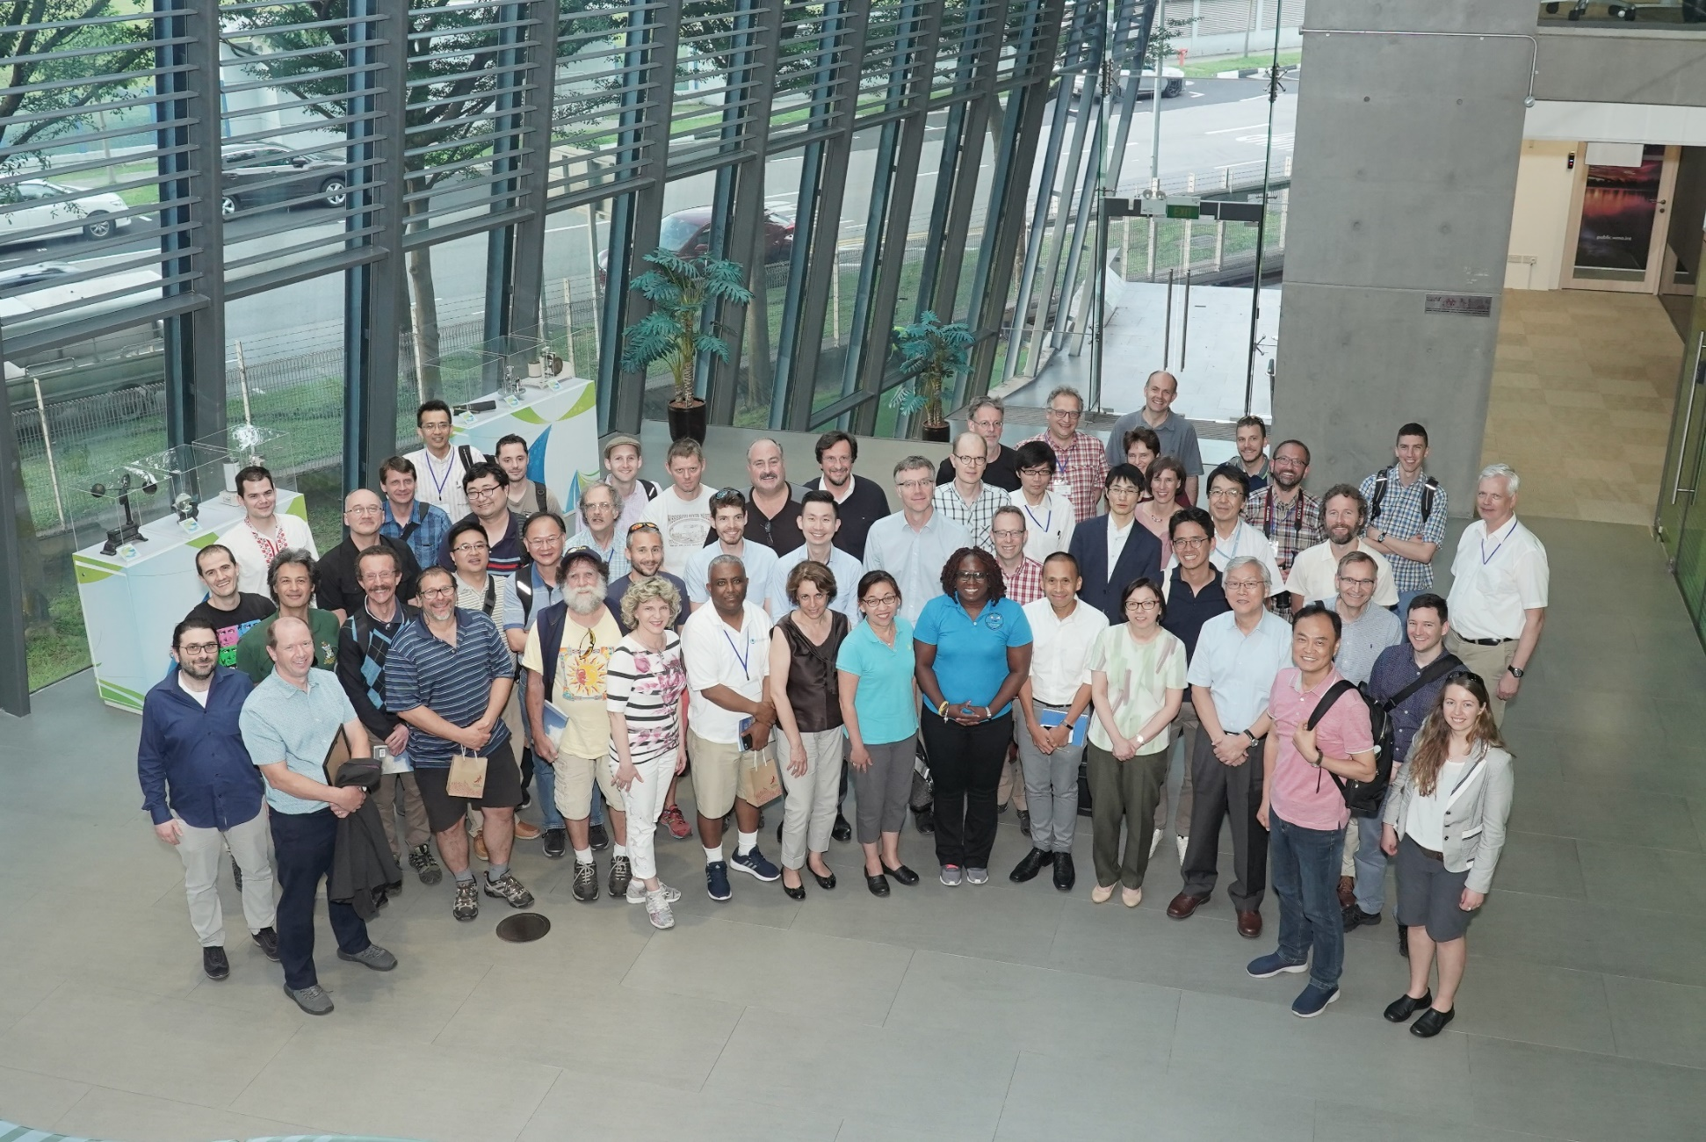
GRUAN ICM-19, Singapore, May 2019

Slide 28
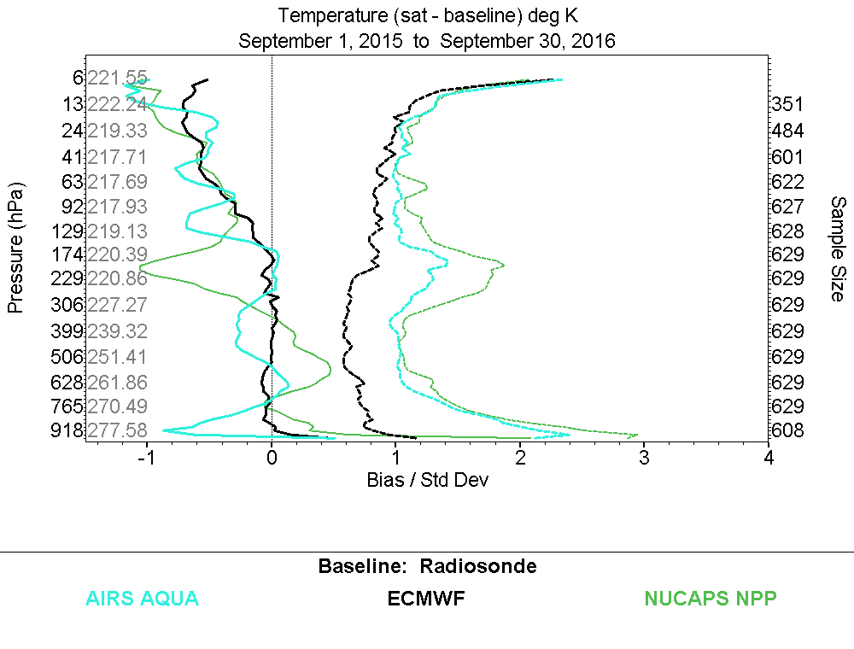
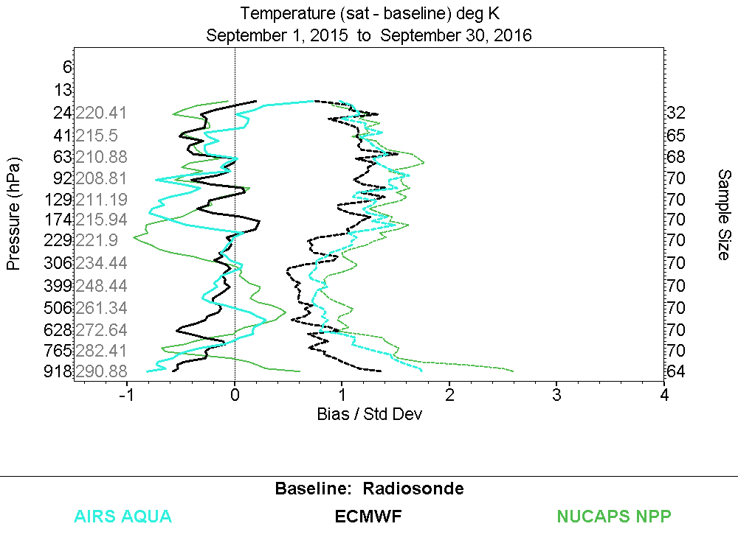
All GRUAN
SGP
Sdev lower
Collocated NUCAPS (NPP, v5) and AIRS (v6) soundings with GRUAN Radiosonde
(+/- 2hour, 50km; IR+MW)
see slides 14 vs 20

