Slide 1
Advances towards ingestion of multi-instrument cloud-cleared infrared radiances in a global data assimilation and forecast framework
Oreste Reale, Erica McGrath-Spangler, Manisha Ganeshan
(GESTAR/USRA and NASA/GMAO)
Will McCarty, Ron Gelaro
(NASA/GMAO)
Bryan Karpowicz, Niama Boukachaba
(GESTAR/USRA and NASA/GMAO)

Slide 2
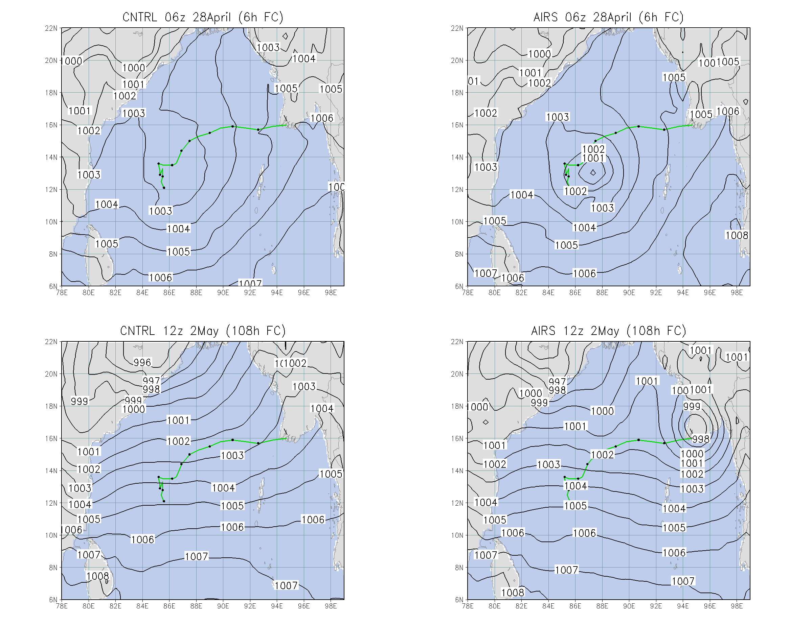
More than ten years ago (2008): first attempt to improve the representation of a tropical cyclone in a global data assimilation system using AIRS cloud-cleared retrievals
Catastrophic Tropical Cyclone Nargis (2008)
Missed in all operational analyses
when it was already at hurricane intensity level.
Assimilation of v5 AIRS cloud-cleared retrievals produced
a well-defined low from which successful 5-day forecasts
could be initialized. Horizontal resolution of the state-of-the-art GEOS was half a degree!
Unfortunately, in spite of subsequent studies by this team demonstrating the superiority of cloud-cleared retrievals against clear-sky radiances, operational centers did not consider the real-time assimilation of retrievals possible because of latency and external dependencies
Green:
Observed
Track
Reale, O., W. K. Lau, J. Susskind, R. Rosenberg, E. Brin, E. Liu, L.P. Riishojgaard, M. Fuentes, R. Rosenberg, 2009: AIRS impact on the analysis and forecast track of tropical cyclone Nargis in a global data assimilation and forecasting system. Geophys. Res. Lett., 36, L06812, doi: 10.1029/2008GL037122

Slide 3
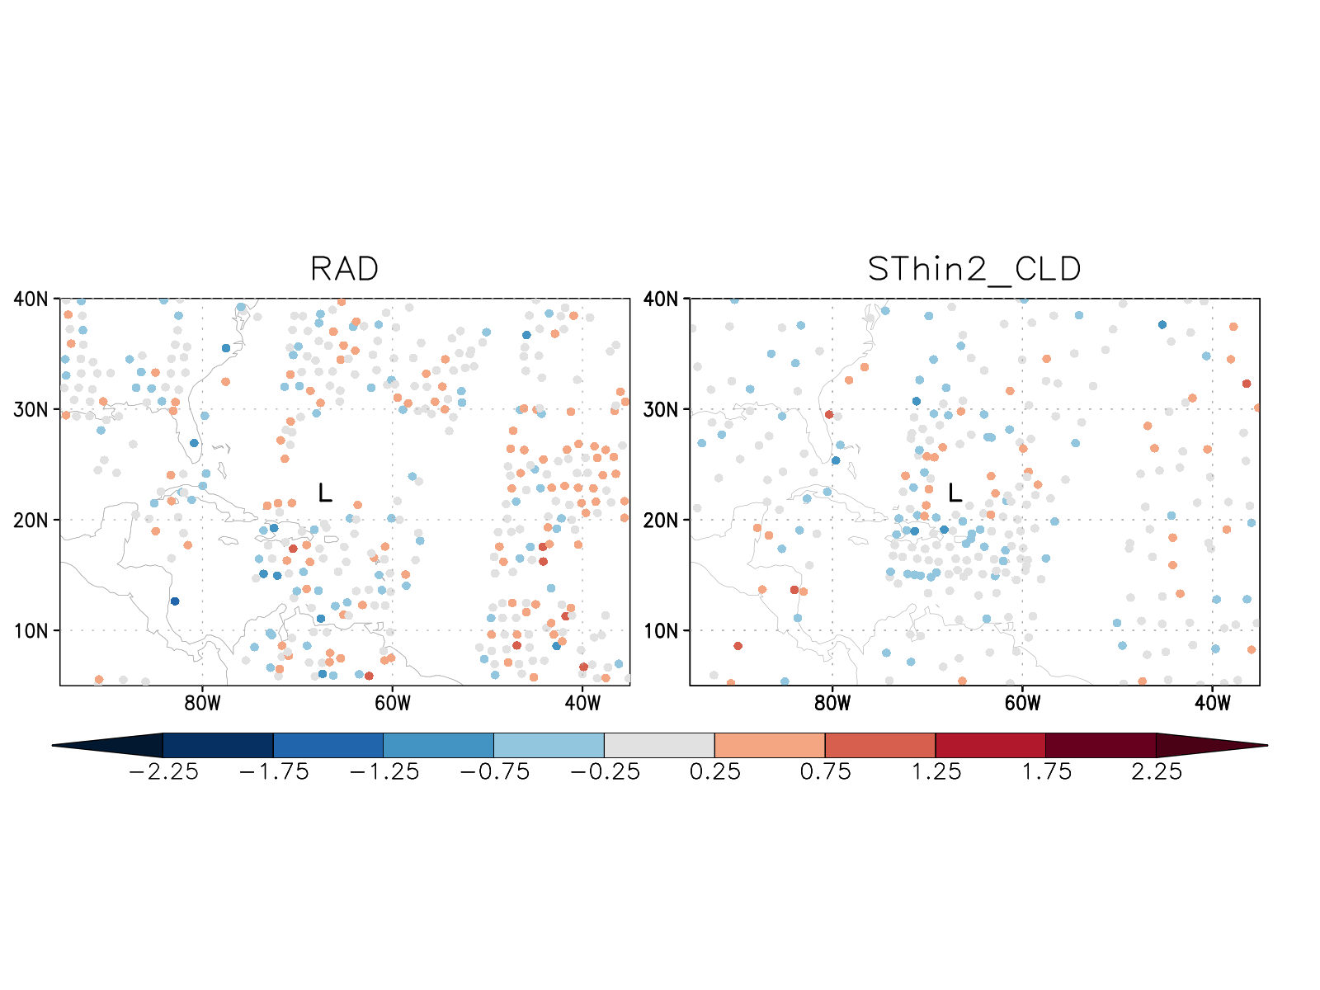
Ten years later (2018): major findings in the assimilation of AIRS radiances
Article published in August 2018 summarizes the work done by this team on the assimilation of adaptively thinned AIRS cloud-cleared radiances against homogeneously thinned clear-sky radiances.
Reale, O., E. McGrath-Spangler, W. McCarty, D. Holdaway, R, Gelaro, 2018: Impact of adaptively thinned AIRS cloud-cleared radiances on tropical cyclone representation in a global data assimilation and forecast system. Weather and Forecasting, 33, 908-931.
1) Cloud-cleared AIRS radiances are substantially superior compared to clear-sky radiances, as long as they are more aggressively thinned
2) An adaptive strategy that assimilates more data around
TCs, and less globally, improves TC structure and intensity
forecast, without damaging global skill.
Operationally used, clear sky
Variable density, cloud-cleared

Slide 4
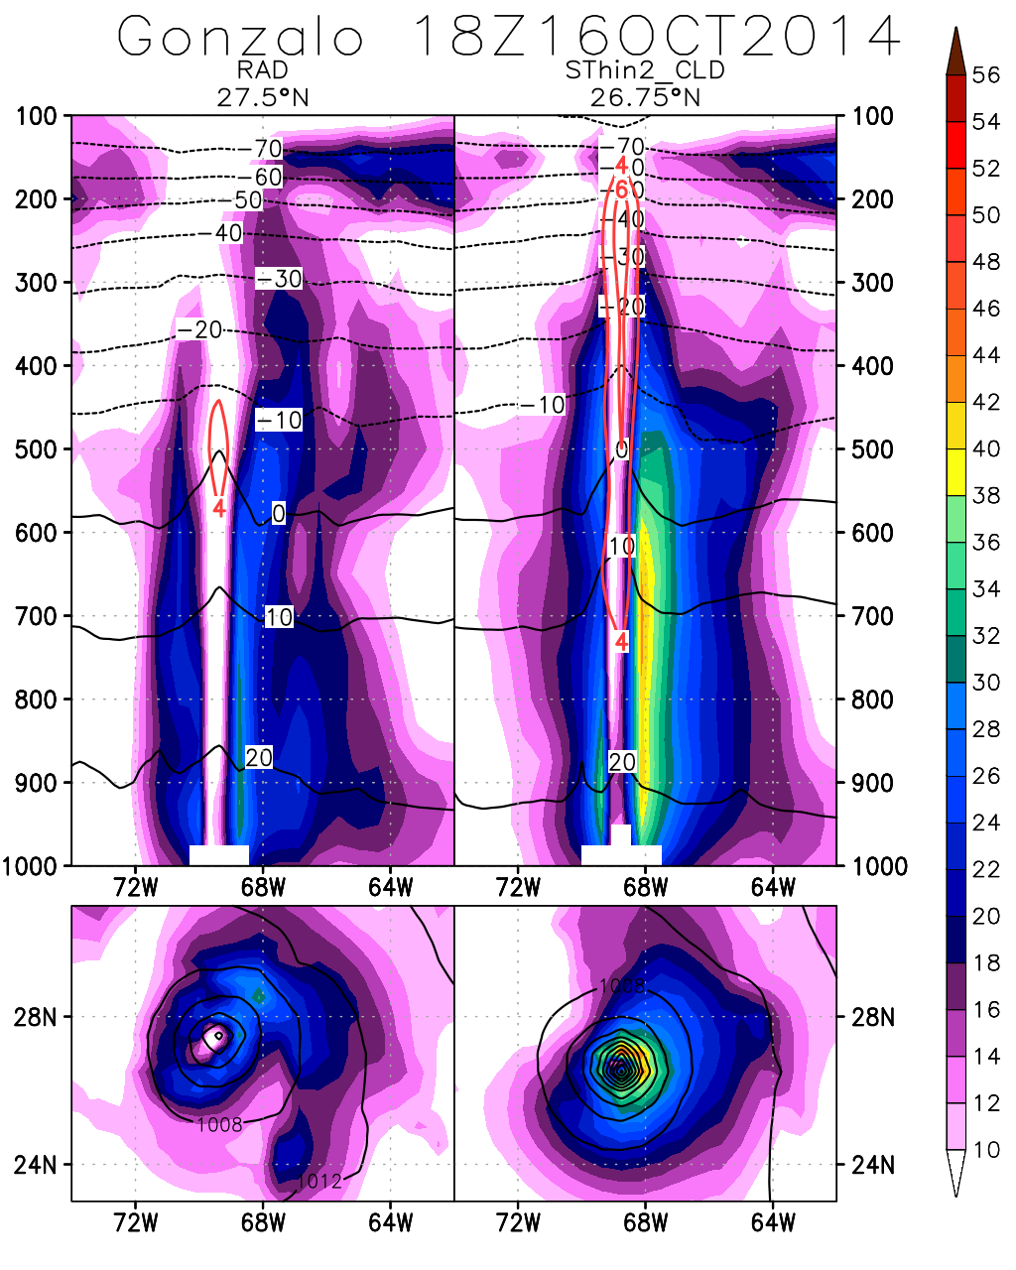
Shading: wind speed
Black contours: temperature (top), sea level pressure (bottom)
Red contours: temperature anomaly
Operational, clear-sky
Variable density, cloud-cleared
Reale et al (2018) shows that cloud-cleared radiances are a substantially better product than clear-sky radiances when assimilated with a global density of about 300 km.
An increased density only around TCs improves TC structure dramatically.
Caveats: limited by AIRS coverage; negligible impact on very small or very large TCs and on TC track forecast.
Question: What is the impact of this adaptive methodology if it is simultaneously applied to all hyperspectral sensors?
Next step: test an adaptive strategy on CrIS and IASI

Slide 5
New Experiments to evaluate the adaptively thinned procedure extended to all hyperspectral sensors
GEOS-5 DAS version 5-13.0p1
Assimilation from 1 Sep – 10 Nov 2014 of all observations assimilated operationally
10 day forecasts initialized daily at 00Z from 10th Sep – 9th Nov 2014
OPS: AIRS clear-sky radiances, regularly-spaced thinning
RAD: AIRS clear-sky radiances, regularly-spaced thinning, no vortex relocator
SThin2_CLD: Adaptively thinned AIRS cloud-cleared radiances (the best of the configurations resulting from our published work), no vortex relocator
SThin2_CLD_SThin2CriS_Sthin2IASI: adaptively thinned AIRS cloud-cleared radiances plus adaptively thinned clear-sky CrIS and IASI, no vortex relocator

Slide 6
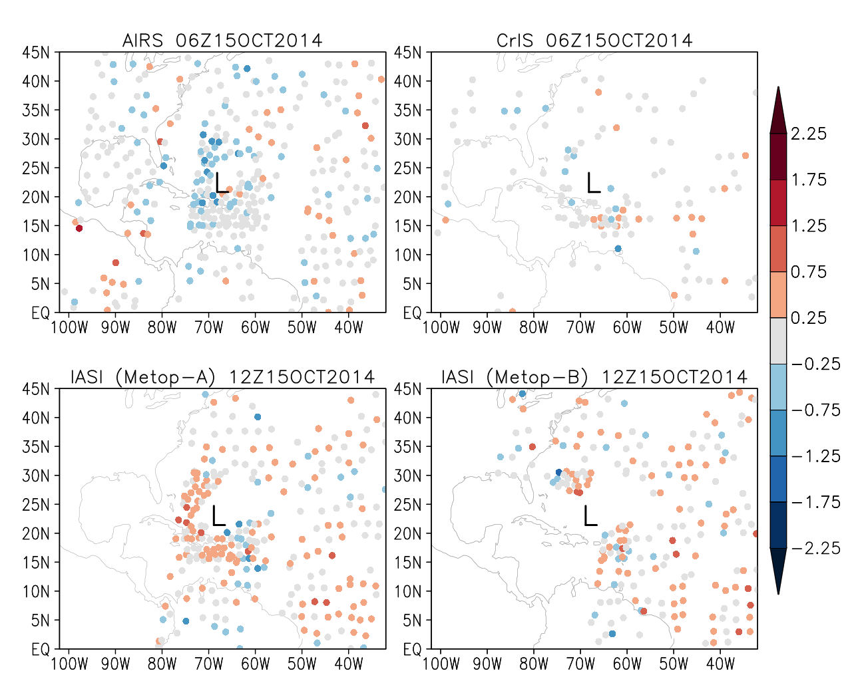
Hyperspectral observations around Hurricane Gonzalo
Different coverages around TCs
Cloud-cleared radiances
available only for AIRS
Clear-sky radiances have large data void areas corresponding to TCs circulations
AIRS
CrIS
IASI (Metop-A)
IASI (Metop-B)

Slide 7
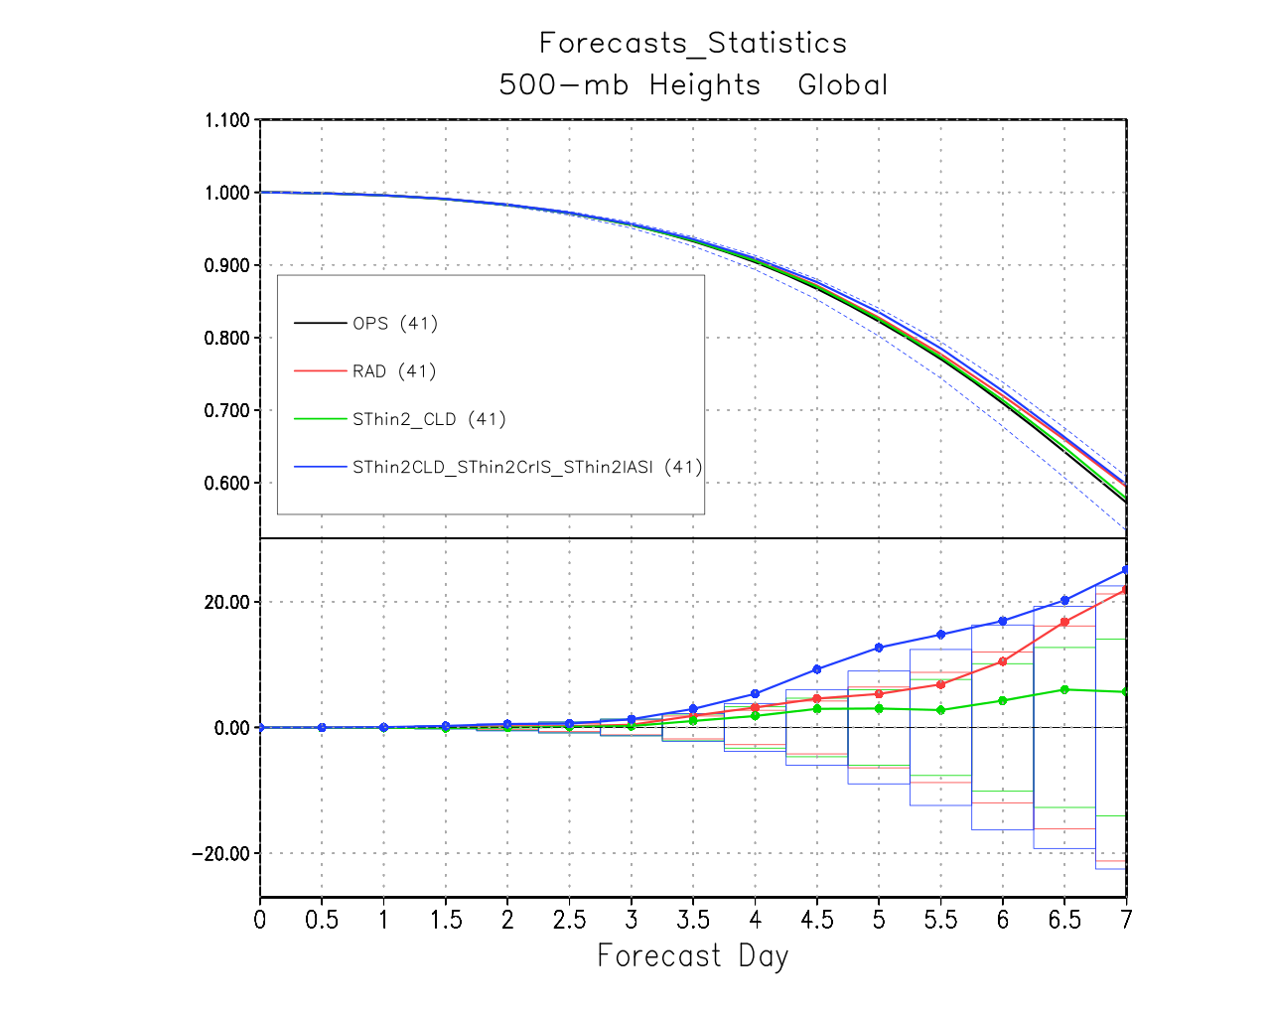
Global 500 hPa height anomaly correlation
Reference = OPS

Slide 8
Impact of assimilating adaptively AIRS CCRs + CrIS and IASI on slp: TCs worldwide are affected

Slide 9
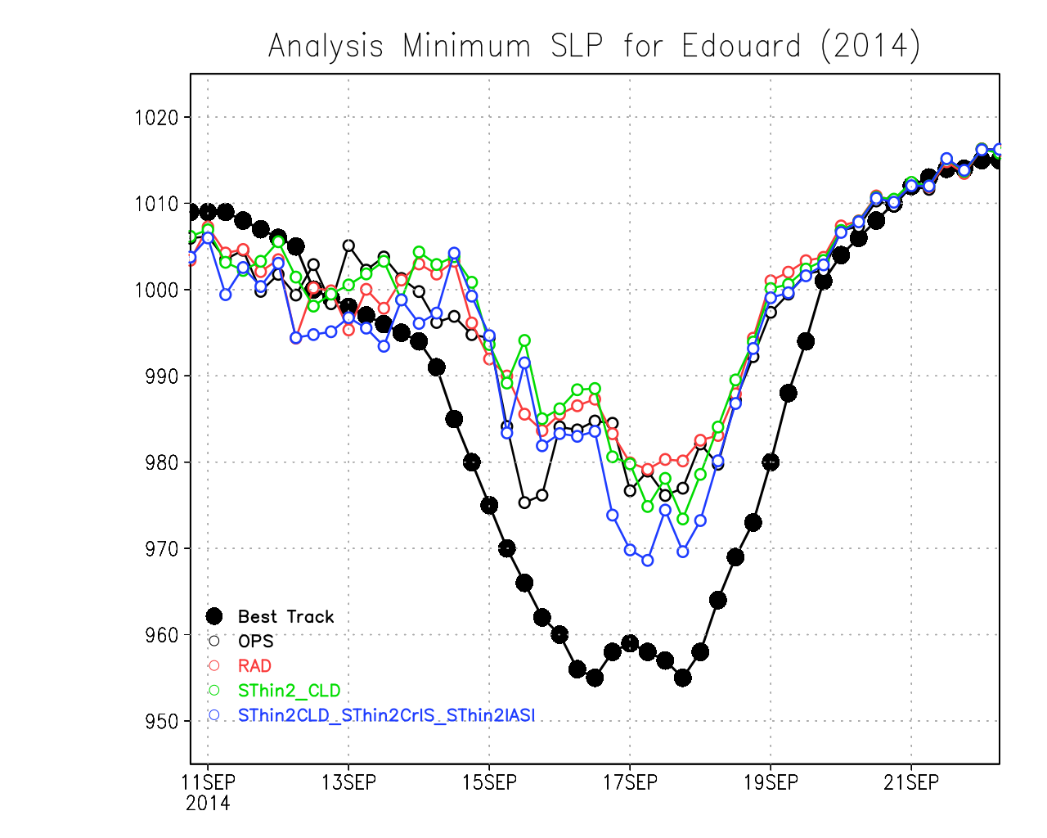
Hurricane Edouard center pressure analysis
10 hPa

Slide 10
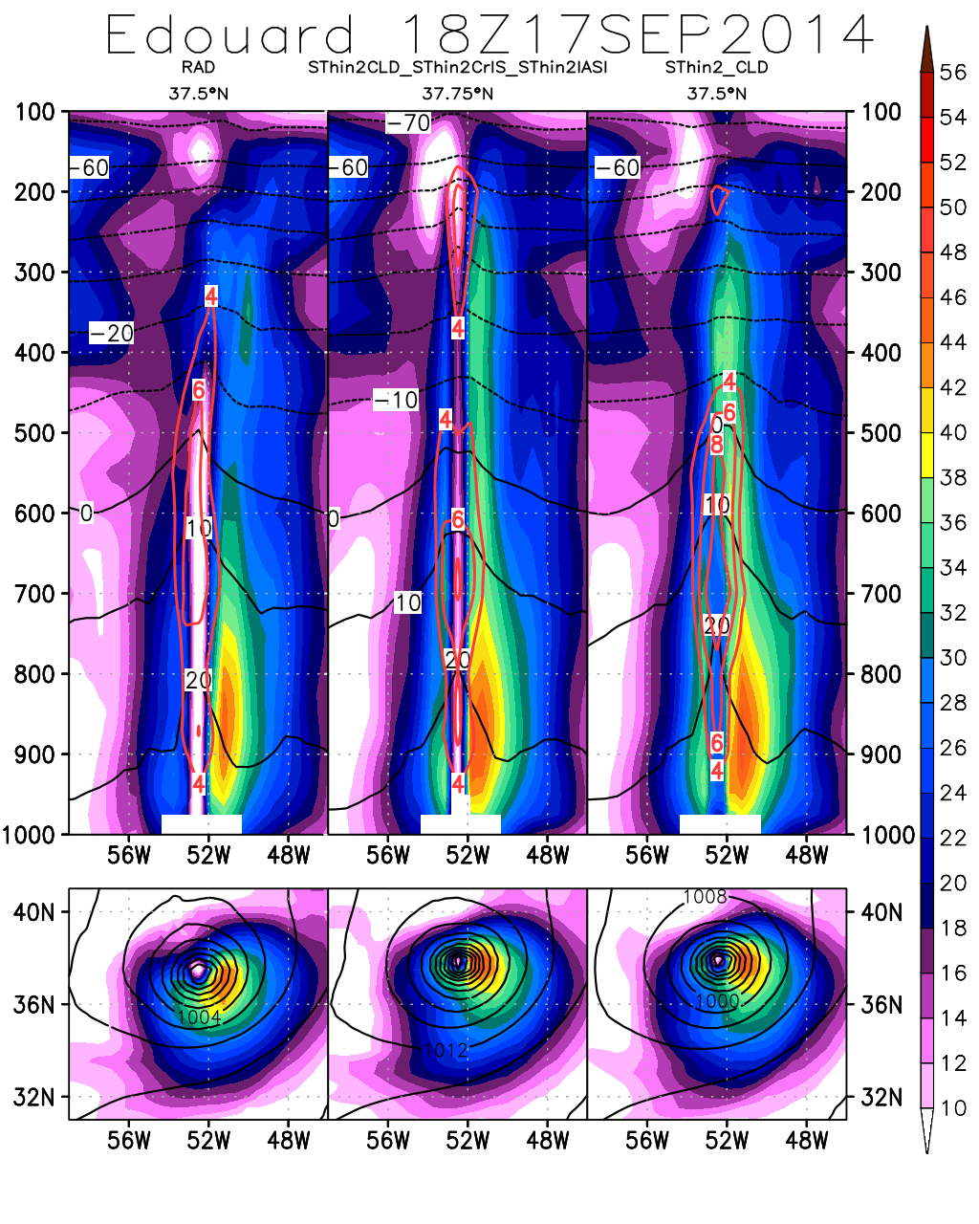
Vertical cross section
Wind magnitude (shaded)
Temperature (°C, black)
Temp. Anom. (°C, red)
850 hPa winds (shaded)
slp(contours)

Slide 11
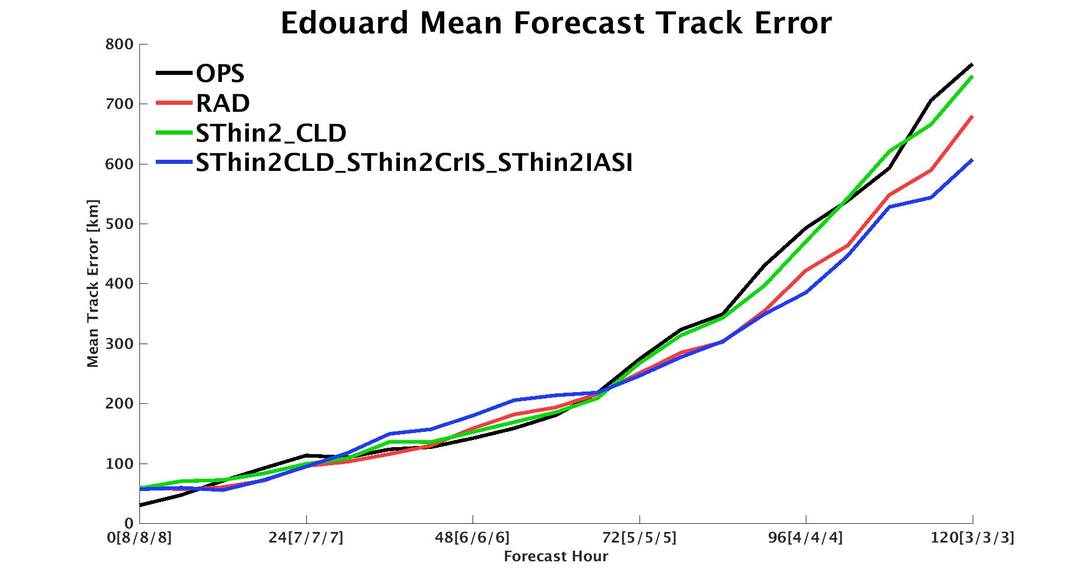
Comprehensive adaptive thinning improves track forecast skill (unlike when applied to AIRS alone)
Notes:
Improved analysis
For both clear-sky and cloud-cleared, comprehensive thinning results in improved intensity forecast
~4 hPa improvement over 48 hours

Slide 12
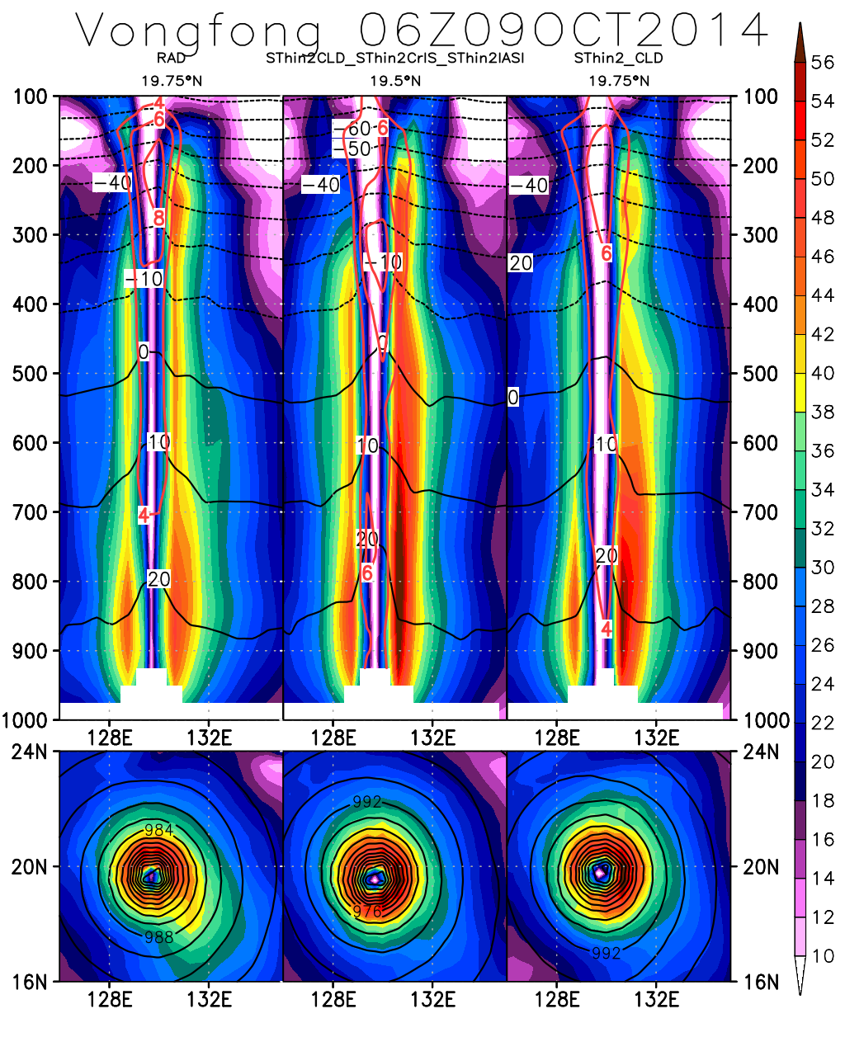
Improvement in structure also for very large TCs
Extreme large
typhoon,
previously
insensitive
to changes
in AIRS DA
strategy, now
positively
impacted by
combined
adaptive
thinning.

Slide 13
Roadmap towards an operational use of CCRs
In spite of the overwhelming evidence that cloud-cleared products are an immensely superior data type compared to clear-sky, cloud-cleared infrared radiances have not been operationally used because of: 1) lack of awareness that CCRs need to be much more aggressively thinned; 2) latency; and 3) external dependencies (ECMWF data; neural network) which are perceived by operational centers as not controllable
As part of this plan, with the goal of raising awareness and interest towards cloud-cleared AIRS products, the cloud-clearing algorithm developed by Joel Susskind and his team was analyzed in the attempt of making it customizable (thanks to Lena Iredell, Lou Kouvaris and John Blaisdell)
Selection of channels changed to match the one used by the GMAO
GEOS-originated fields replace the neural network training against ECMWF
Revised algorithm ported to NCCS
Produced CCRs from July to October 2017
Customized CCRs have been successfully assimilated in the new hybrid 4DEnVAR GEOS for the entire period

Slide 14
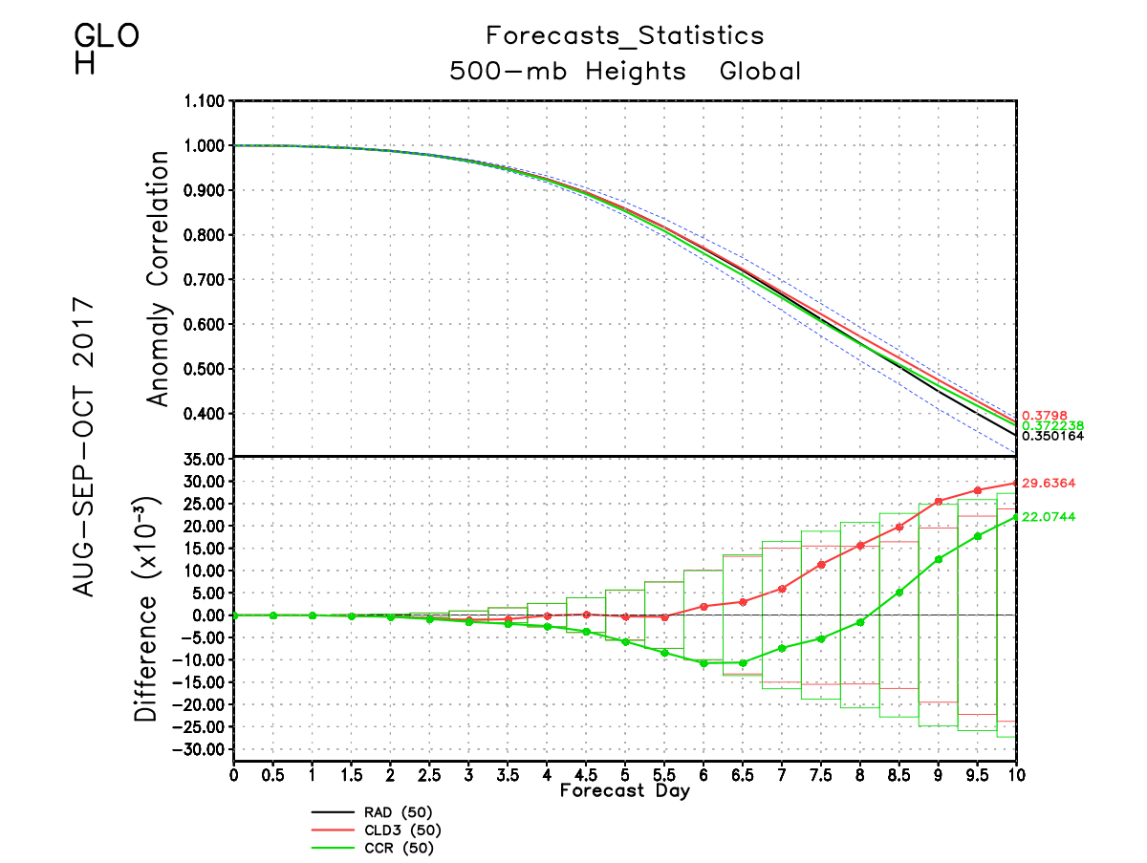
The comparison of two AIRS CCR products (the one produced by the DAAC and the experimental one generated within the GMAO), reveals no significant difference
This is the first attempt ever to create a GMAO-customized CCR product on NCCS and successfully assimilate it in the GEOS
These preliminary results are very encouraging because they indicate the feasibility of producing CCRS internally without any external dependency and controlling latency
Reference = Clear-sky
Clear-sky
DISC CCRs
GMAO CCRs

Slide 15
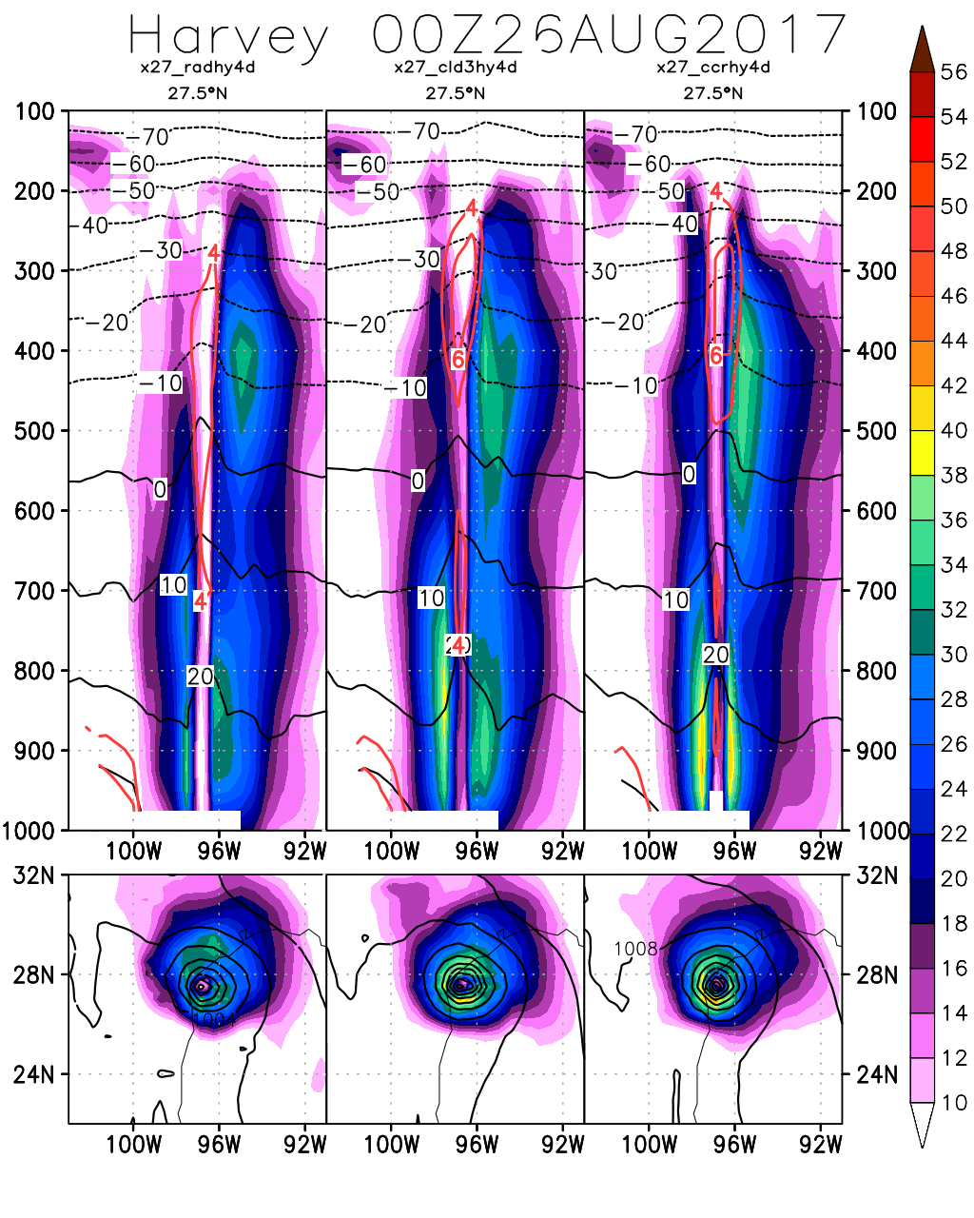
Clear-sky
DISC CCRs
GMAO CCRs
H. Harvey (2017)
Vertical cross section: Wind magnitude (shaded), Temperature (°C, black), Temp. Anomaly (°C, red)
850 hPa winds (shaded), slp (contours)
Increased warm core structure, stronger wind speeds and lower sea level pressure and an overall improvement in vertical and horizontal structure result from assimilation of cloud-cleared AIRS radiances against clear-sky radiances
The customized AIRS CCRs, tailored to the GMAO system, produce even better results

Slide 16
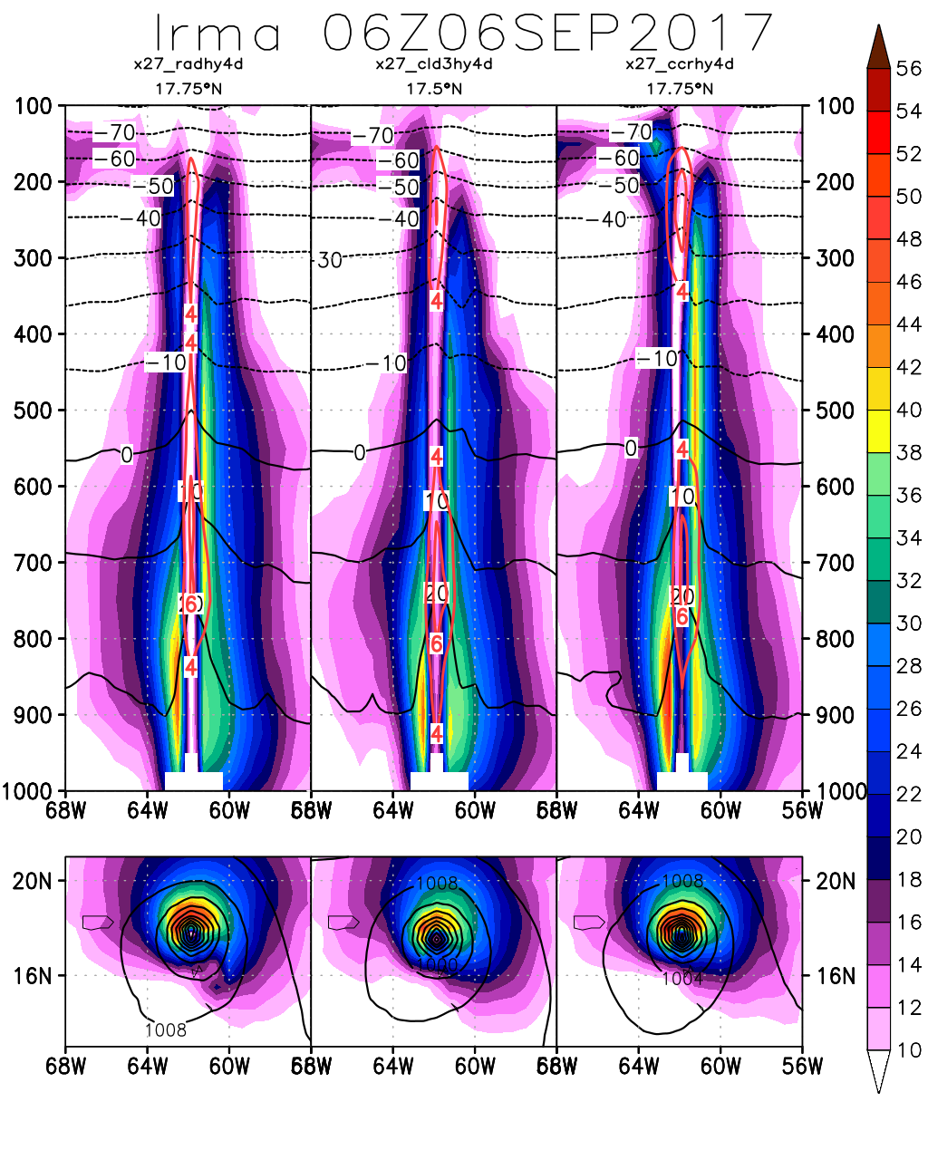
Clear-sky
DISC CCRs
GMAO CCRs
H. Irma (2017)
Vertical cross section: Wind magnitude (shaded), Temperature (°C, black), Temp. Anomaly (°C, red)
850 hPa winds (shaded), slp (contours)
The assimilation of customized CCRs brings improvements in Irma’s structure: stronger low-level winds and more compact eye

Slide 17
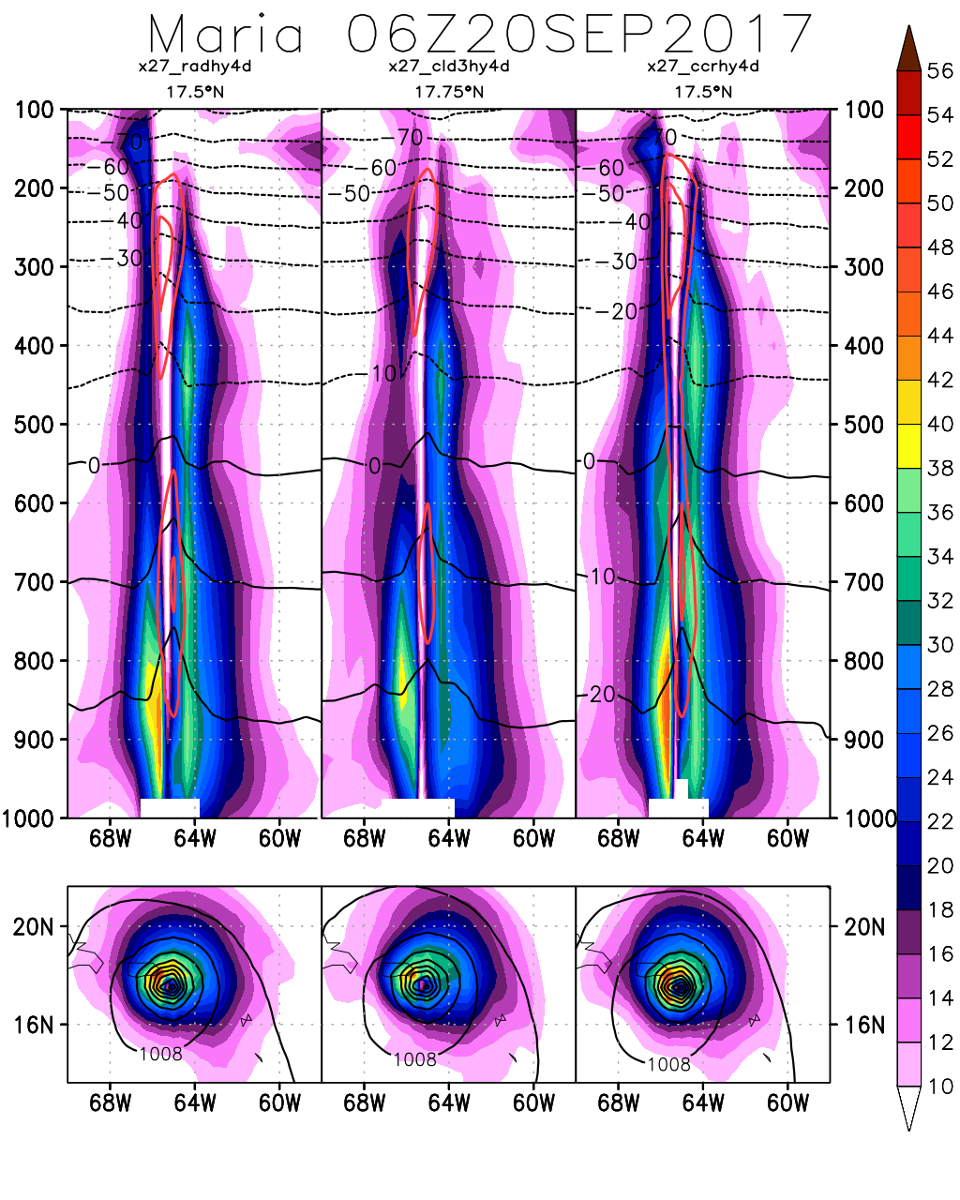
Clear-sky
DISC CCRs
GMAO CCRs
H. Maria (2017)
Vertical cross section: Wind magnitude (shaded), Temperature (°C, black), Temp. Anomaly (°C, red)
850 hPa winds (shaded), slp (contours)
Similar result with Maria, the customized cloud-clearing adapted to the GEOS is capable of improving the vertical and horizontal structure of the storm

Slide 18
Conclusions and future work
Long progress since first experiments with retrievals more than a decade ago
Demonstrated value of adaptively thinned AIRS cloud-cleared radiances
Expanding the concept towards other sensors
Comprehensive adaptive thinning strategy that consistently modifies the density of assimilated radiances for all hyperspectral instruments together (combining Cloud-clear AIRS, with clear-sky adaptively thinned CrIS and IASI) proves to be very promising
Demonstrated customizability of cloud-cleared radiances
Next 2 talks: hybrid 4DEnVAR (Erica), Polar lows (Manisha)
Future work: CrIS and IASI cloud-cleared radiances

Slide 19
Acknowledgements
Tsengdar Lee for current support through grant 80NSSC18K0927 “Using AIRS and CrIS data to understand processes affecting TC structure in a Global Data Assimilation and Forecasting Framework (2018-2021)” (PI: O. Reale) Ramesh Kakar for past support through previous grants NNX11AK05G and NNX14AK19G “Using AIRS Data to Understand Processes Affecting Tropical Cyclone Structure and Extreme Precipitation in a Global Data Assimilation and Forecasting Framework”(2011-2014, 2014-2018), PI: O. Reale
Tsengdar Lee for generous allocations of NASA High End Computing resources (NCCS)
Chris Barnet for his leadership on the development of cloud-cleared radiance algorithms.
Louis Kouvaris and Lena Iredell, with help from John Blaisdell, for porting to NCCS the CC algorithm originally developed by Joel Susskind’s team AIRS team at JPL and the Sounder Research Team at NASA GSFC
Amal El Akkraoui, Matt Thompson and Ben Auer for help with the GEOS
GES DISC for their outstanding service to the community

Slide 20
AIRS-related articles published by this team Reale, O., J. Susskind, R. Rosenberg, E. Brin, E. Liu, L. P. Riishojgaard, J. Terry, J. C. Jusem, 2008: Improving forecast skill by assimilation of quality-controlled AIRS temperature retrievals under partially cloudy conditions. Geophysical Research Letters, 35, L08809, doi:10.1029/2007GL033002. Reale, O., W. K. Lau, J. Susskind, E. Brin, E. Liu, L. P. Riishojgaard, M. Fuentes, R. Rosenberg, 2009: AIRS Impact on the Analysis and Forecast Track of Tropical Cyclone Nargis in a global data assimilation and forecasting system. Geophysical Research Letters, 36, L06812, doi:10.1029/2008GL037122. Reale, O., W. K. Lau, K.-M. Kim, E. Brin, 2009: Atlantic tropical cyclogenetic processes during SOP-3 NAMMA in the GEOS-5 global data assimilation and forecast system. Journal of the Atmospheric Sciences, 66, 3563-3578. Reale, O., K. M. Lau, J. Susskind, and R. Rosenberg, 2012: AIRS impact on analysis and forecast of an extreme rainfall event (Indus River Valley, Pakistan, 2010) with a global data assimilation and forecast system, J. Geophys. Res., 117, D08103, doi:10.1029/2011JD017093. Reale, O., E. McGrath-Spangler, W. McCarty, D. Holdaway, R, Gelaro, 2018: Impact of adaptively thinned AIRS cloud-cleared radiances on tropical cyclone representation in a global data assimilation and forecast system. Weather and Forecasting, 33, 908-931.

