Slide 1
The PWLR³: operational 3D statistical retrievals for hyperspectral sounders and error estimation
Tim Hultberg, Thomas August

Slide 2
Outline
PWLR³ statistical retrieval
Exploiting horizontal correlation
Cloud signal and surface emissivity
Validation in state and radiance space
Error estimation of PWLR³ retrievals
Statistical approach
Smoothing error + retrieval noise
In 19 minutes from now you will love statistical retrieval

Slide 3
PWLR³ (Pea-vee-el-are cube)
Statistical all sky retrieval from IASI, AMSU and MHS
“PWLR”: PieceWise Linear Regression
“³”: single field of view retrievals using data from four fields of view (exploiting horizontal correlation)
Retrieves temperature, water vapour and ozone profiles, surface pressure, skin temperature and emissivity as well as cloud-signal and error estimates
Fast, accurate and precise retrieval in its own right and additionally used as a-priori for the optimal estimation in clear sky
PWLR operational since September 2014 (EUMETSAT IASI L2 v6.0)
PWLR³ operational since 2nd June 2016 (EUMETSAT IASI L2 v6.2)
IASI Level 2 Regional Service: high timeliness dissemination on EUMETCAST (hdf5). Trial phase planned for end of September 2016

Slide 4
Training with real measurements and ECMWF
Supervised statistical learning
Training data based on real measurements and co-located ECMWF analysis from 23 days (1st and 17th of each month from July 2013 to June 2014) about 28 million cases
An ensemble learning method with some similarities to random forests
15*2*16*4 regression classes with individual regression coefficients
15 (symmetric) scan positions
2 Day/Night
16 K-means clustering on leading MW and IR PC scores
4 instances, different number of PC scores used for clustering
Final retrieval obtained as average of 4 ensemble retrievals, to reduce random noise
Special versions of the IASI EFOV eigenvectors are available for the case that the IASI measurements are flagged as bad in one or more of the four FOVs
- but the regression coefficients stay the same

Slide 5
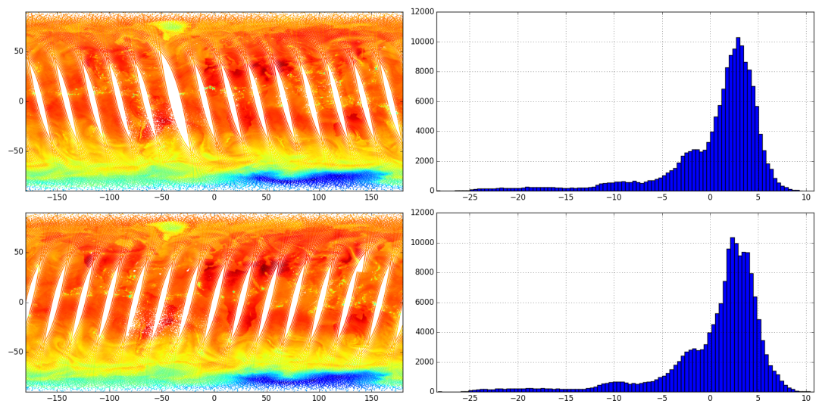
Measurement/predictor representation
For each of the four FOVs:
exp(-z/7000) (where z in the surface elevation in meters)
200 PC scores representing the IASI measurements in the four FOVs
derived from 1200 operational PC scores (90+120+90) times four
26 PC scores representing the MW measurements in the four FOVs
derived from 15 AMSU channels and four times 5 MHS channels
Simultaneous retrieval of individual profiles in four adjacent pixels
First microwave (AMSU+MHS) PC score
1
2
IASI
AMSU
MHS
4
3

Slide 6
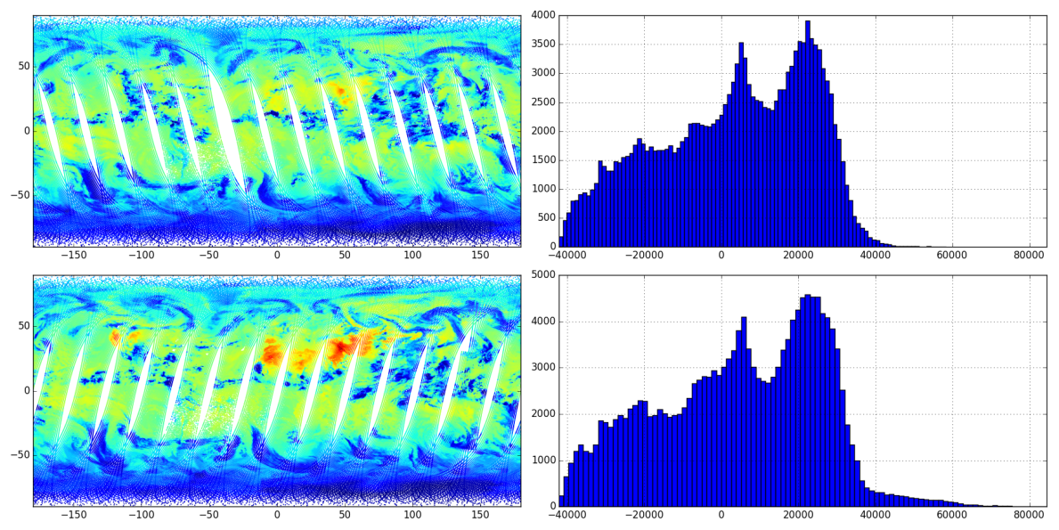
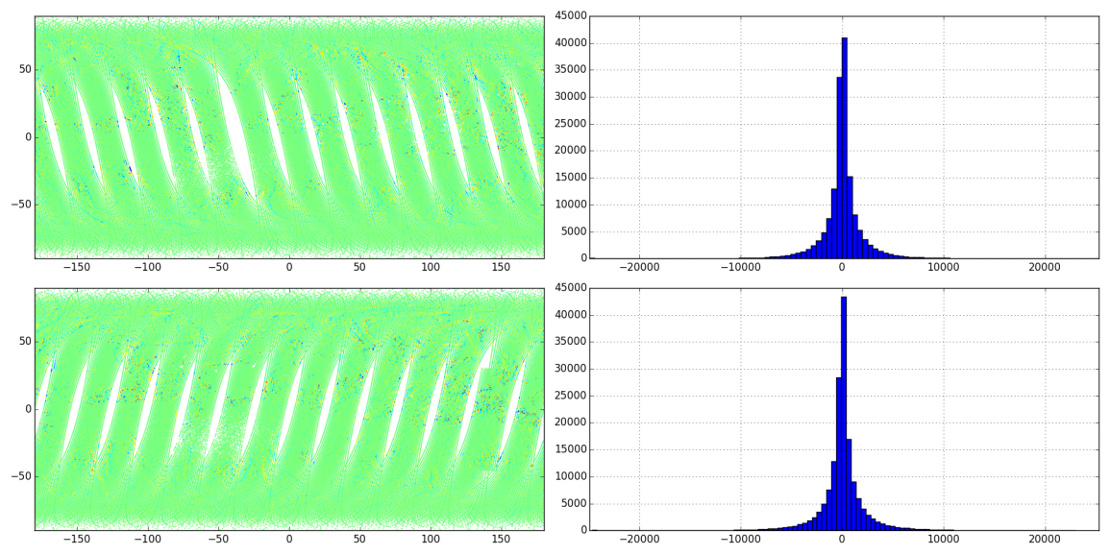
IASI EFOV eigenvector scores
IASI PC score #2
Common features
IASI PC score #3
Inter-pixel differences

Slide 7
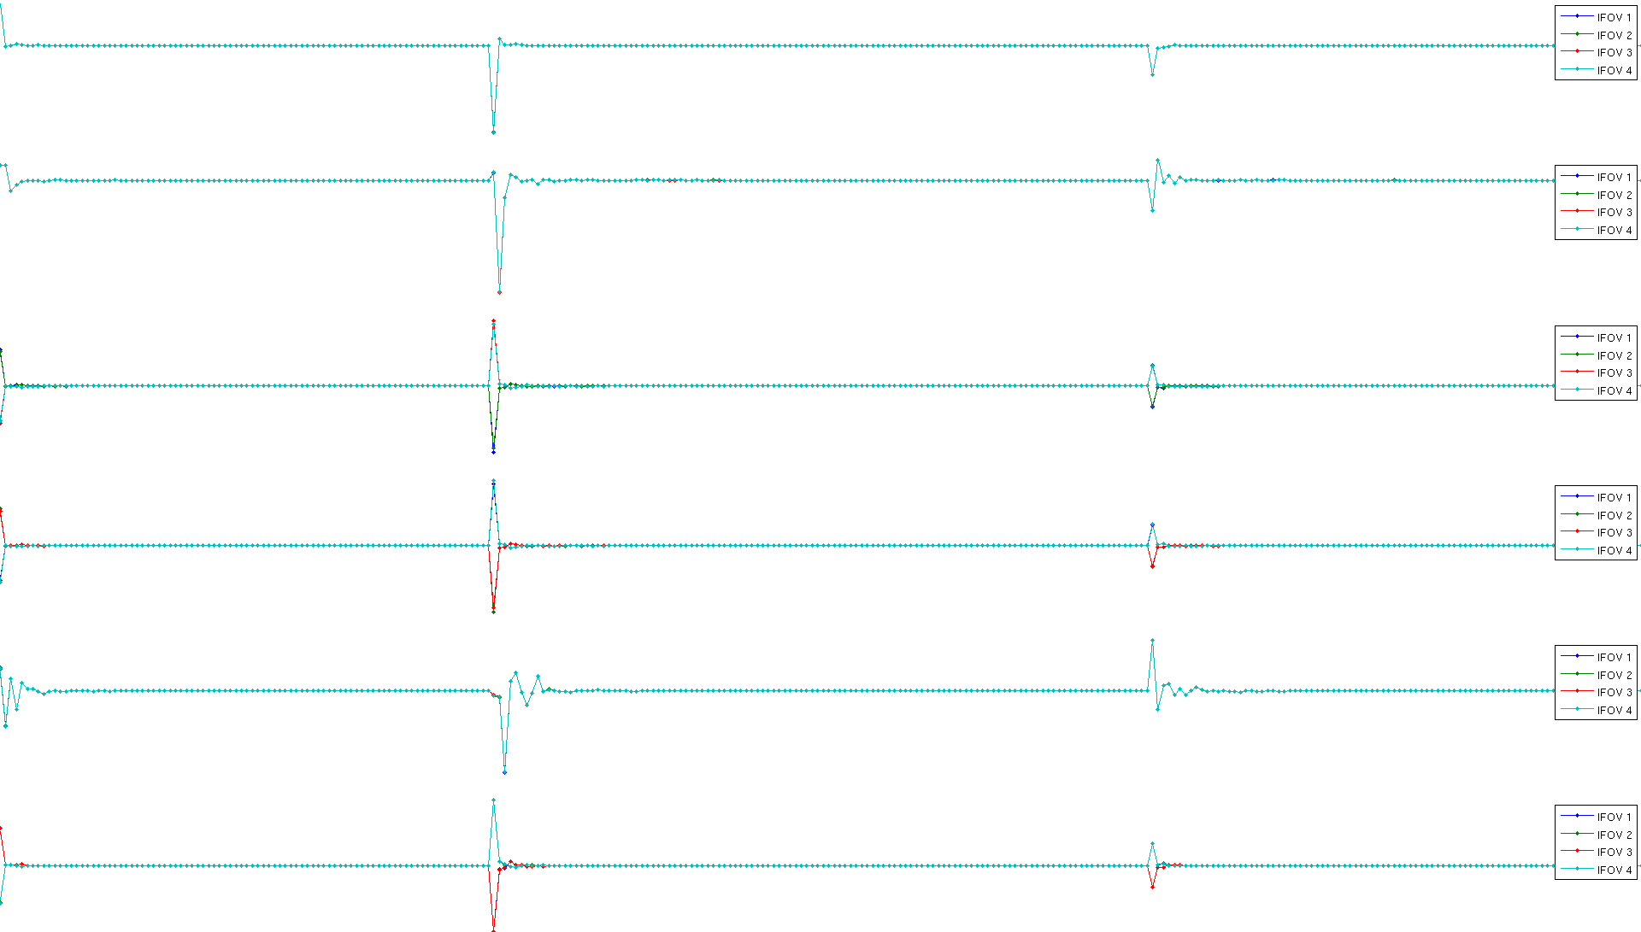
IASI EFOV eigenvectors
Some eigenvectors capture common features (#1,2,5) and others capture differences between IFOVs (#3,4,6)
EV1
EV2
EV3
EV4
EV5
EV6

Slide 8
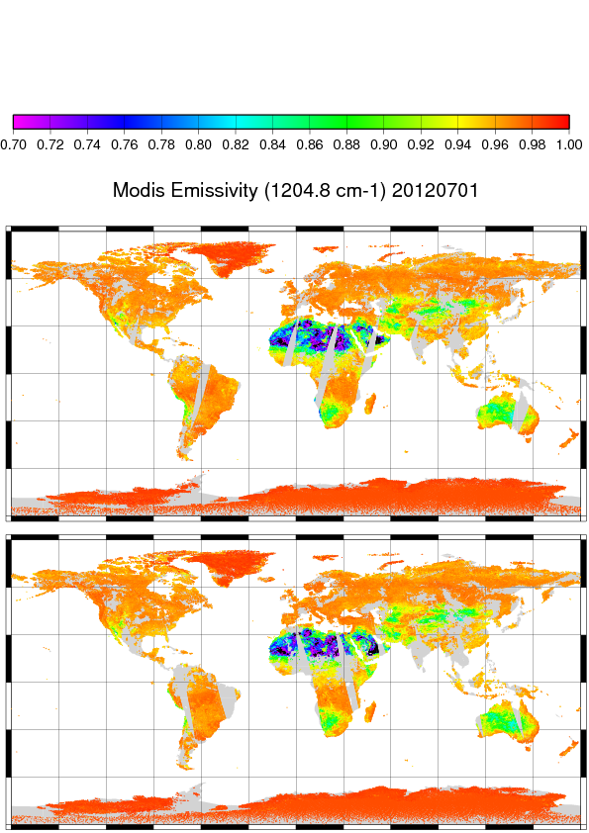
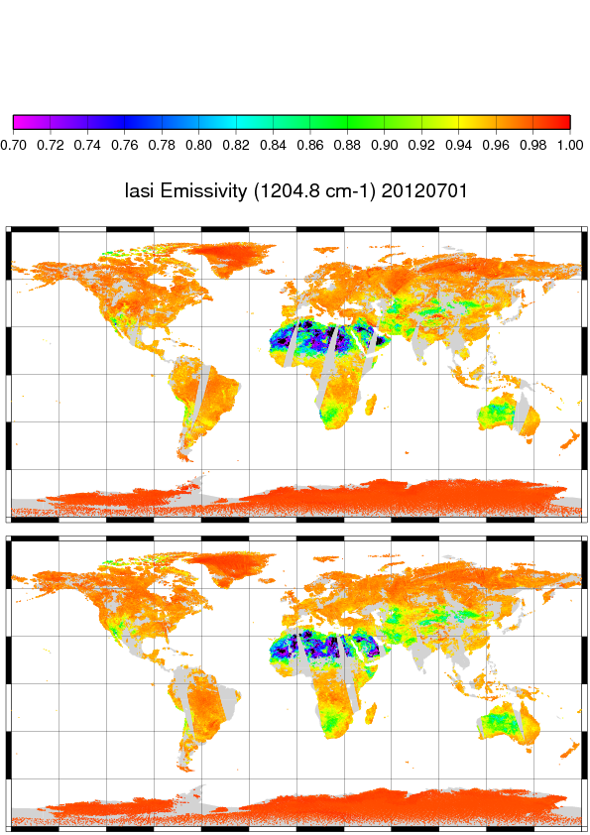
Surface emissivity
Trained with UW Baseline Fit Emissivity Database

Slide 9
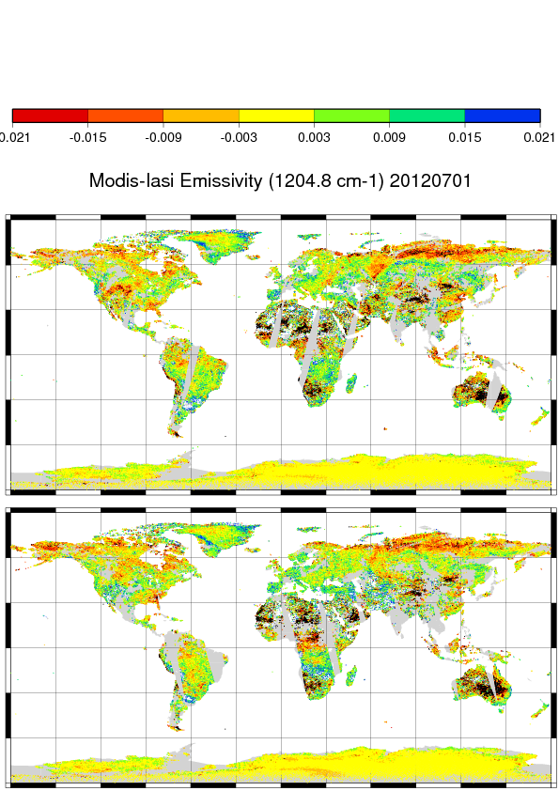
Emissivity difference wrt training atlas
Consistent differences between PWLR³ retrieval and training atlas
day and night
Do not simply get the atlas back
? But which emissivities are best ?
➔ Analysis of obs – calc for different emissivity sources gives the answer ➔

Slide 10
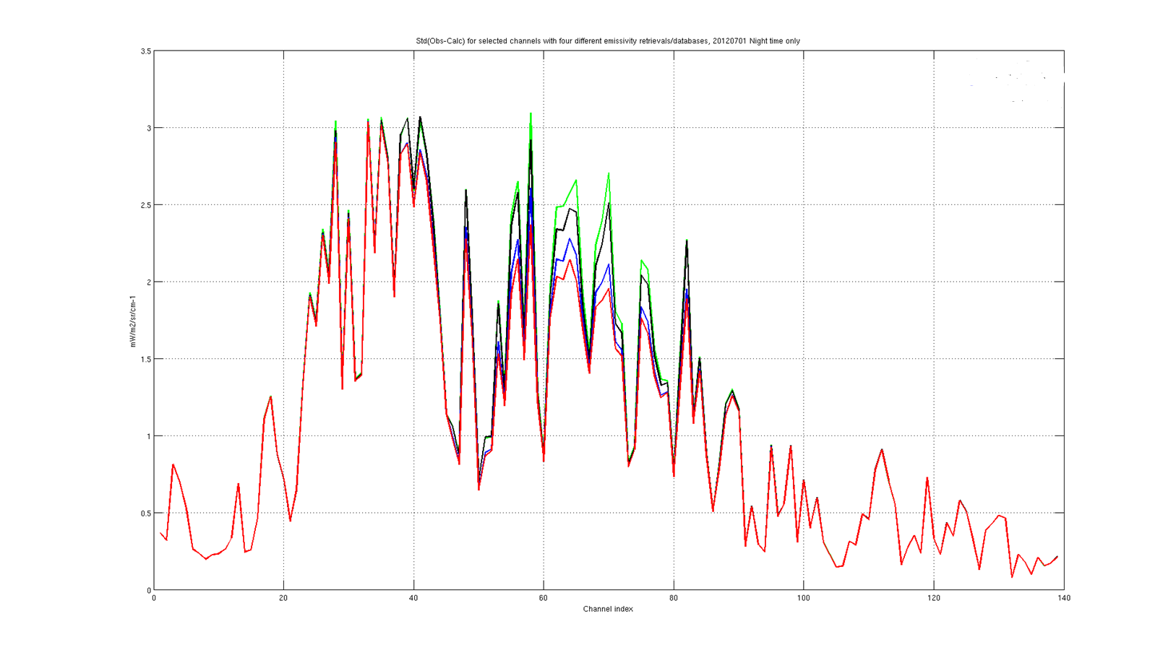
Emissivity performance comparison
Standard deviation of residual (obs minus calc) with different emissivity sources
UW static atlas
PWLR based on UW atlas
Channel index (139 selected channels)

Slide 11
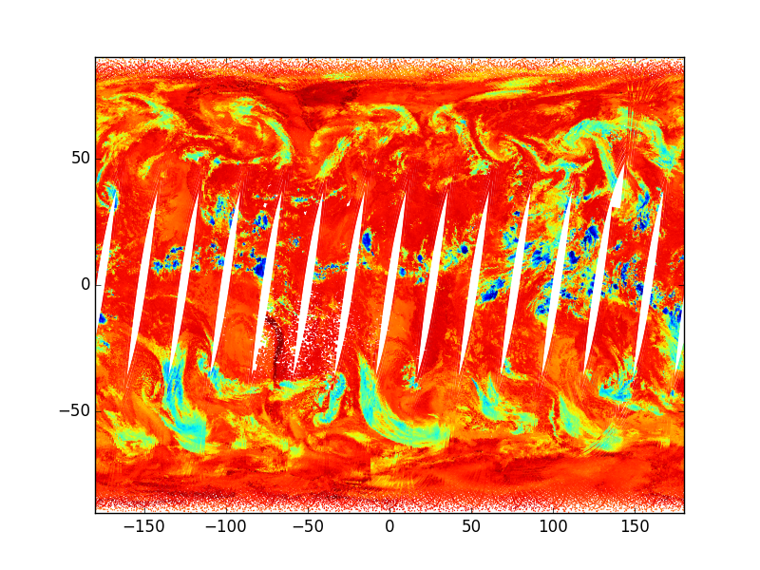
Cloud signal
Experiment to predict the window channel OBS minus CALC brightness temperature (average of five channels)
Cloud signal 2013.07.17
Traditionally OBS-CALC(NWP FCT) used for cloud screening
OBS-CALC(PWLR³) is better
PWLR³ (OBS-CALC(PWLR³)) is not only better but also faster

Slide 12
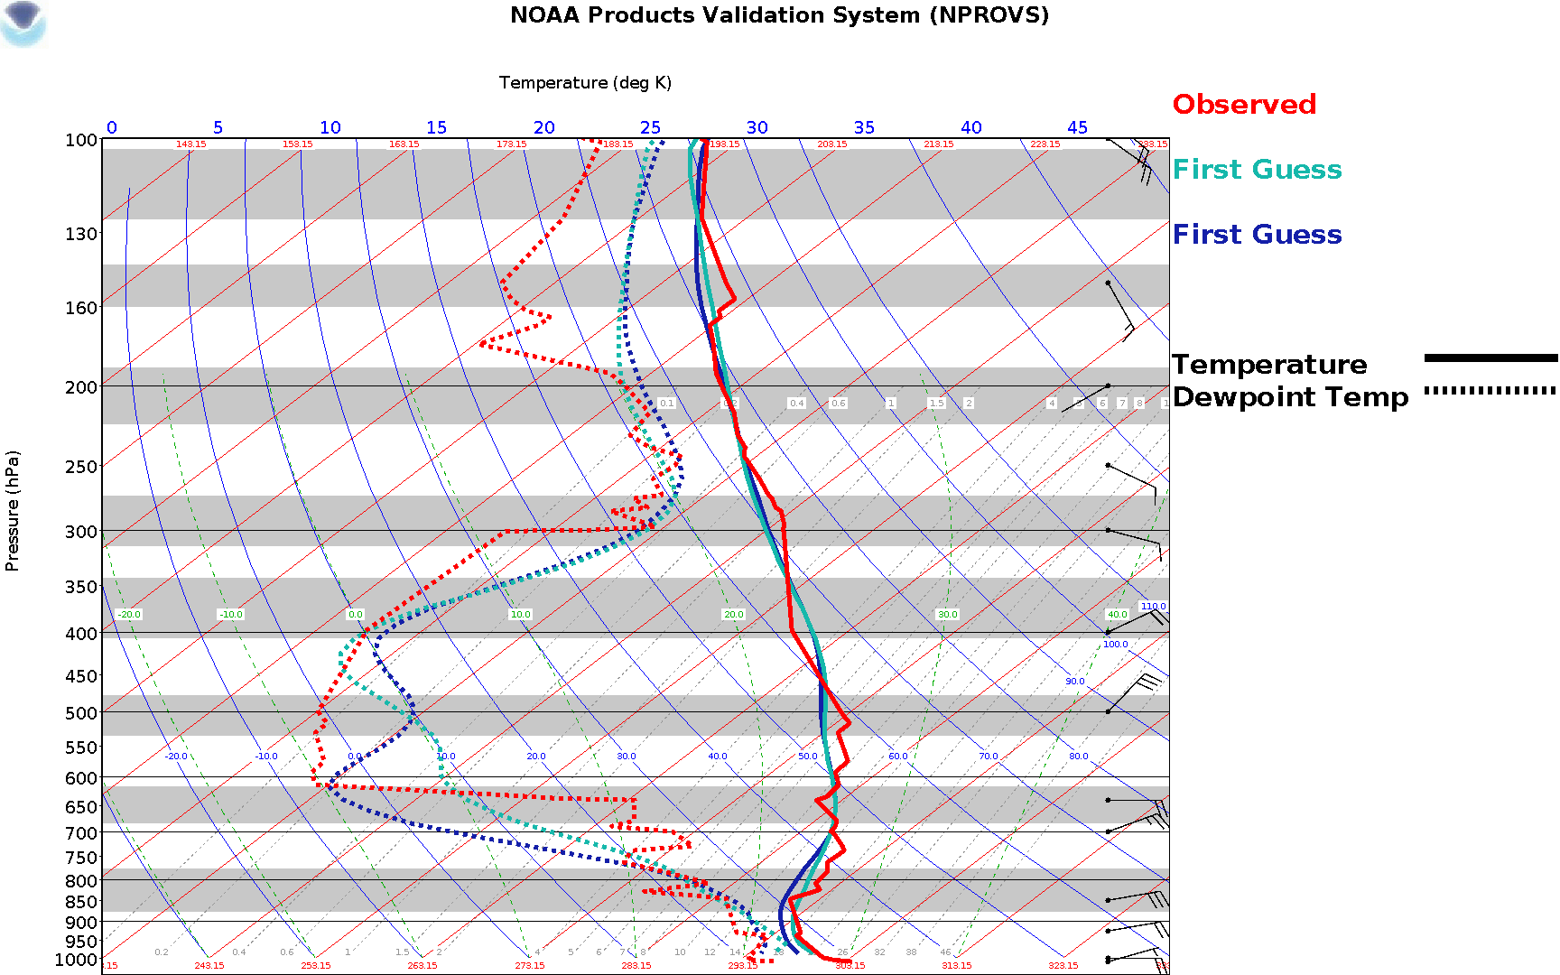
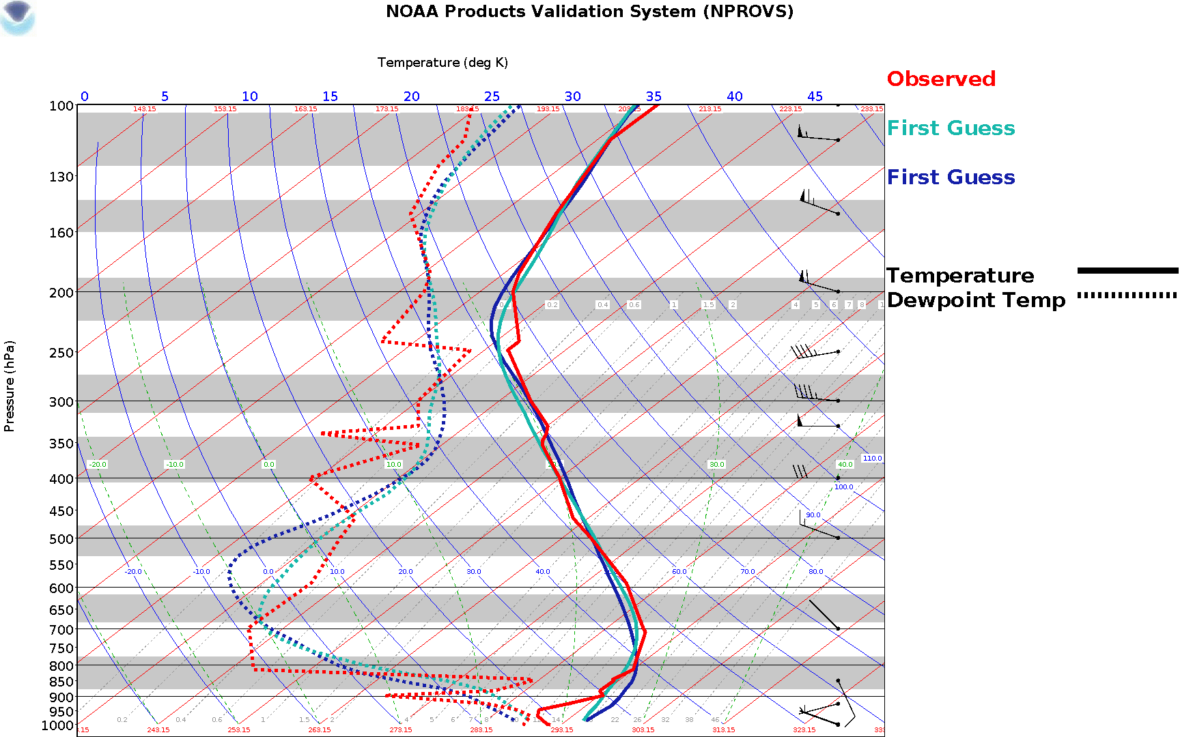
Validation in state space, NPROVS by NOAA
Comparison with sondes.

Slide 13
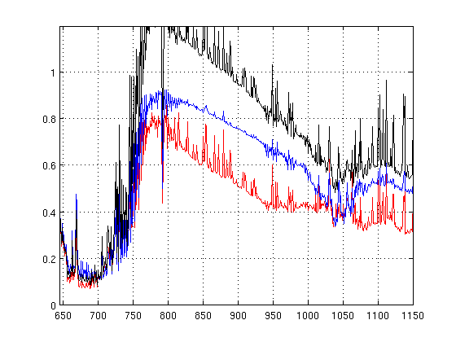
Validation in radiance space, Band 1
Clear sky ocean +-60 lat, 2016.03.15
OBS – CALC(ECMWF FCT)
OBS – CALC(ECMWF ANA)
OBS – CALC(IASI PWLR³)
stddev [mW/m²/sr/cm⁻¹]
Wavenumber[cm⁻¹]

Slide 14
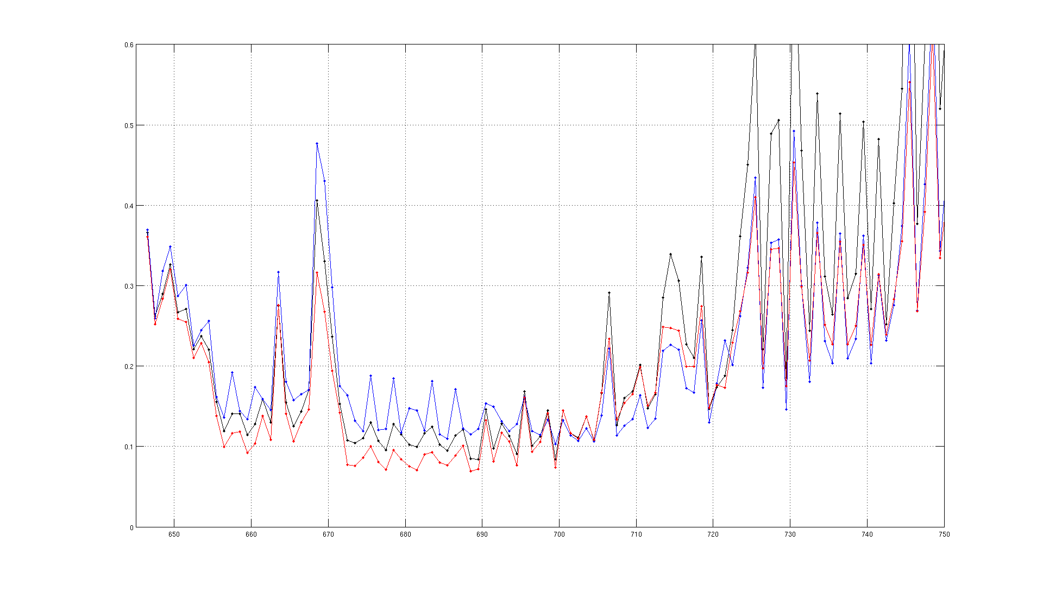
Validation in radiance space
Clear sky ocean +-60 lat, 2016.03.15
OBS – CALC(ECMWF FCT)
OBS – CALC(ECMWF ANA)
OBS – CALC(IASI PWLR³)
stddev [mW/m²/sr/cm⁻¹]
650 cm⁻¹
700 cm⁻¹
750 cm⁻¹

Slide 15
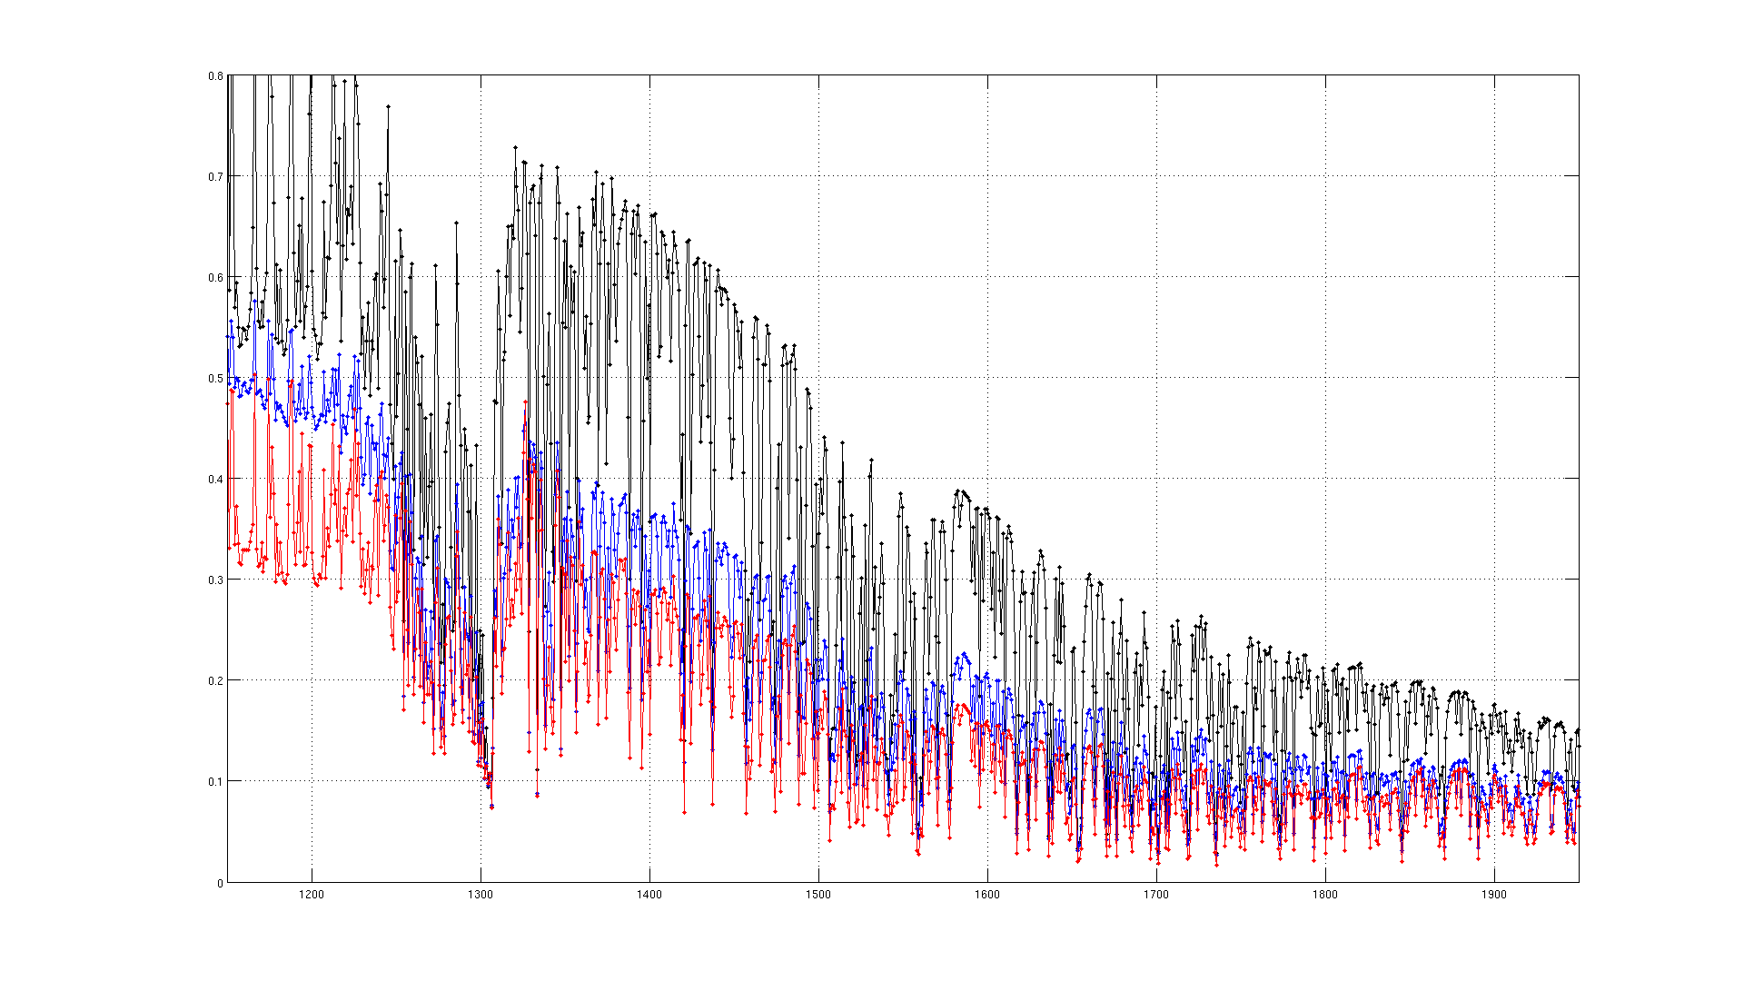
Validation in radiance space, Band 2
Clear sky ocean +-60 lat, 2016.03.15
OBS – CALC(ECMWF FCT)
OBS – CALC(ECMWF ANA)
OBS – CALC(IASI PWLR³)
stddev [mW/m²/sr/cm⁻¹]
1200 cm-1
1500 cm-1
1800 cm-1

Slide 16
Error estimation (statistical approach)
The regression learns to estimate parameters based on a training set. To estimate the errors we would need a training set of errors. Why not apply the regression to the training set and compute the actual errors to get such a training set?
If we could estimate the errors they would not be there in the first place.
So we estimate the absolute value of the errors instead.

Slide 17
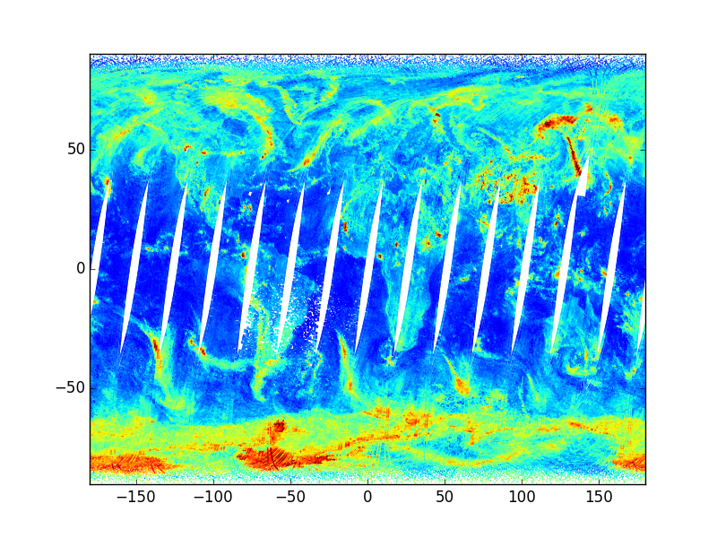
PWLR³ error estimates (Quality indicators)
Regression coefficients to predict the absolute value of the retrieval error used to derive quality indicators for all retrieved parameters
Cloud signal 2013.07.17
QT (Temperature error) 2013.07.17

Slide 18
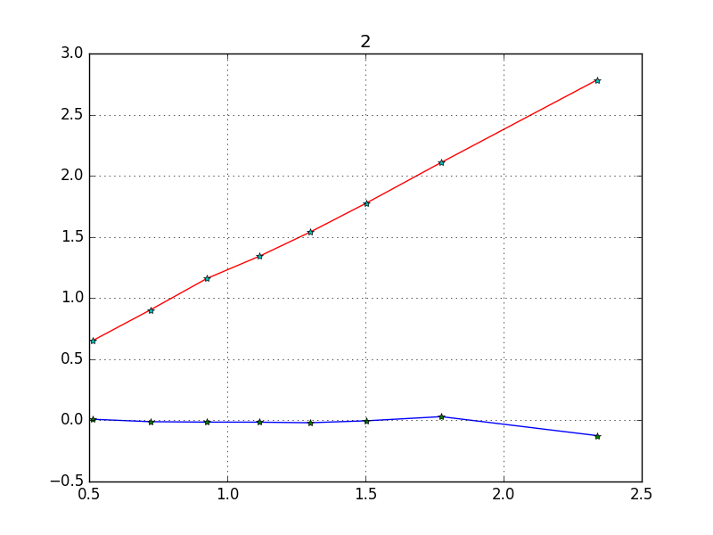
Actual error as function of error estimate
Surface air temperature Std(PWLR³ – ECMWF)
Surface air temperature Mean(PWLR³ – ECMWF)
Surface air temperature error estimate

Slide 19
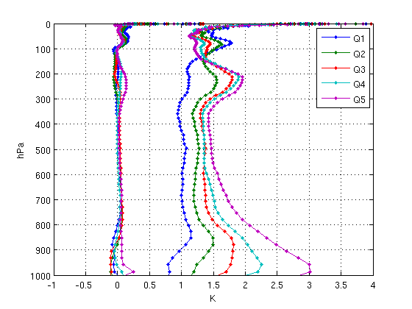
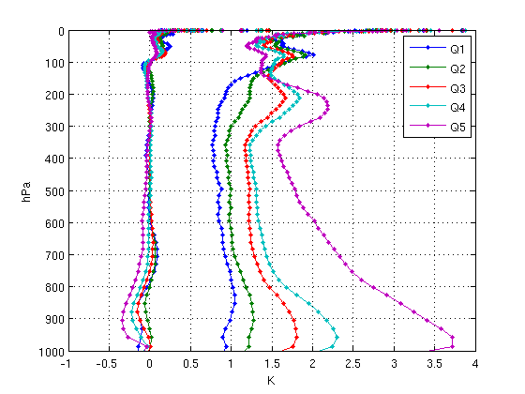
Global temperature retrieval minus ECMWF statistics
Quality classes defined by value of the quality indicator for Ta
MWIR
IRON
 | Q1 | Q2 | Q3 | Q4 | Q5
MWIR | 15.6% | 15.6% | 15.6% | 15.6% | 37.9%
IRON | 5.7% | 8.6% | 7.8% | 8.6% | 69.3%

Slide 20
Error estimation (retrieval noise + smoothing error)
where
Gain matrix and Jacobian both found by regression

Slide 21
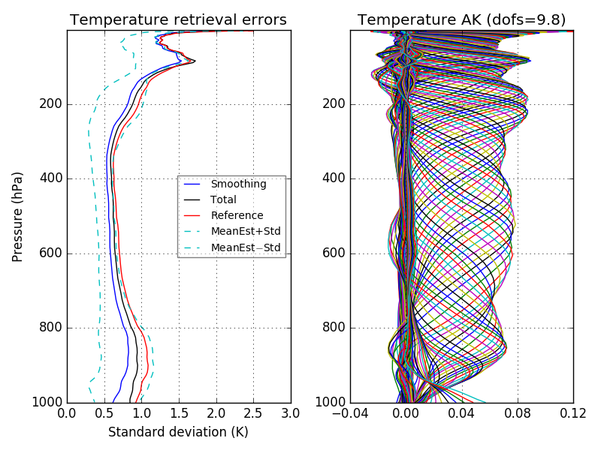
Temperature, a mostly clear sky regression class

Slide 22
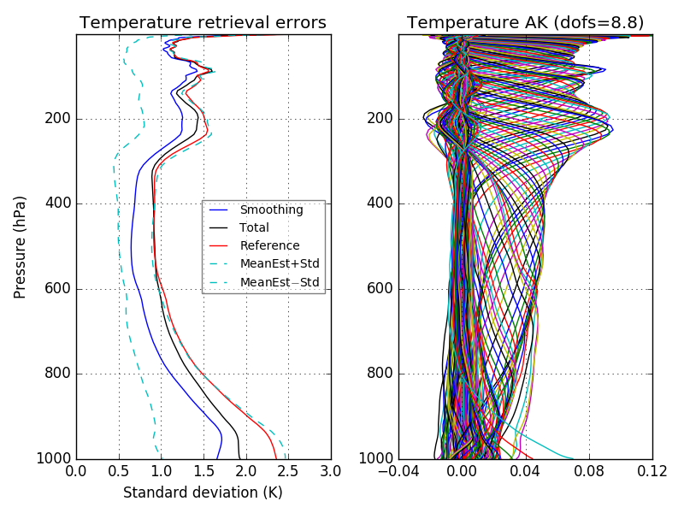
Temperature, a mostly cloudy regression class

Slide 23
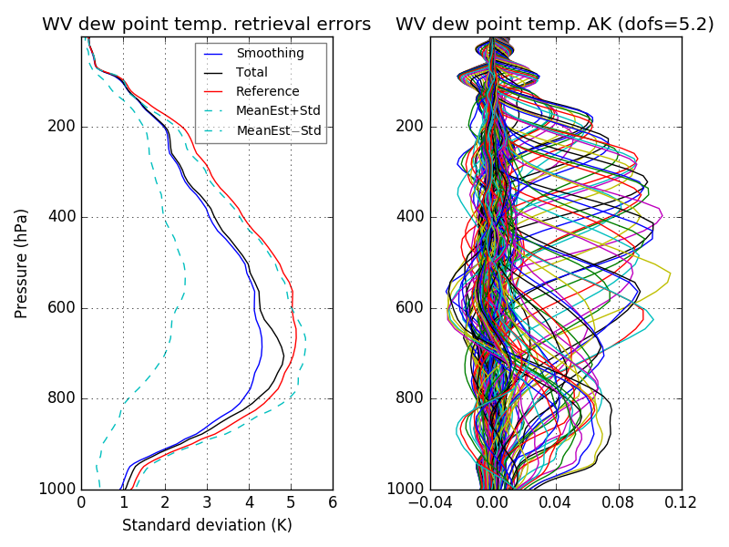
Water vapour, a mostly clear regression class

Slide 24
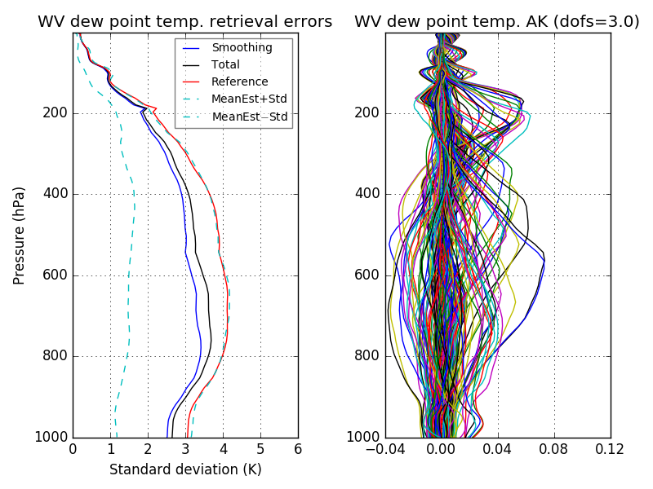
Water vapour, a mostly cloudy regression class

Slide 25
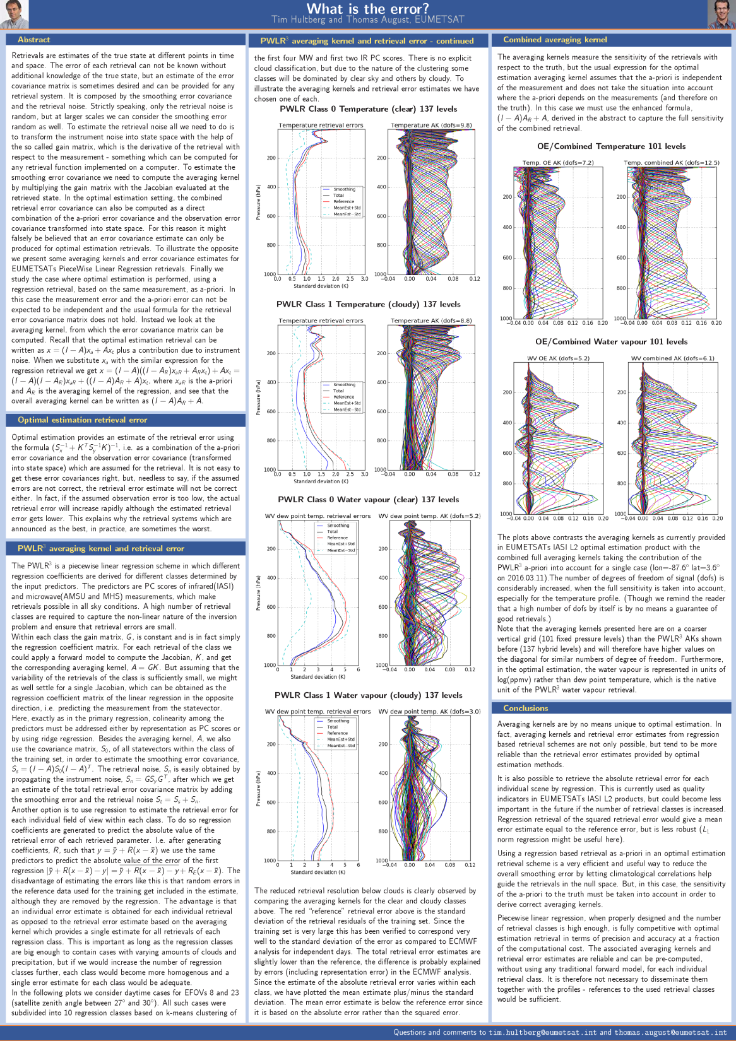
For more, see poster ➔
PWLR³ averaging kernels
PWLR³ smoothing error
PWLR³ retrieval noise
Combined averaging kernels for optimal estimation using PWLR³ as a-priori

Slide 26
Conclusions I
“No forward model, no problems” (not entirely true)
“The PWLR³ retrievals can never be better than the reference data” (wrong)
Any biases in the reference data will be preserved in the retrievals
(➔But forward model based retrievals also struggle with biases)

Slide 27
Conclusions II
PWLR³ is fast
Very competitive in terms of precision and accuracy
Synergistic use of IR and MW
Comes with reliable error estimates
Trained with real measurements ➔ Handles features not modelled by the RTM
Trained with BIG datasets ➔ Insensitive to random errors in reference data
Easy and efficient way to handle non linear response
Further improvement possible by increasing number of classes
Coefficient size currently about 1.2 GB for MWIR and IRON versions
Trained with ECMWF analysis, but retrievals do not use forecast in any way
No minimisation of residuals involved ➔ validation in radiance space possible

Slide 28
Spare slides

Slide 29
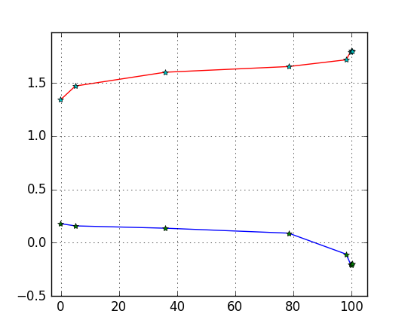
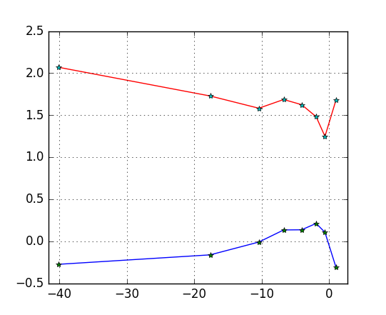
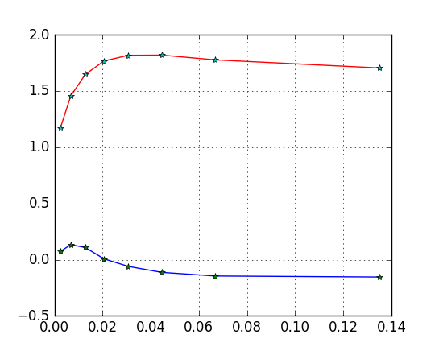
Diagnostics (surface air temperature 20160517)
Surface air temperature Std(PWLR³ - ECMWF)
Surface air temperature Mean(PWLR³ - ECMWF)
Cloud fraction (L1C)
Cloud signal
Inhomogeneity
Std(AVHRR radiance) / Mean(AVHRR radiance) [average of channel 4 and 5]

Slide 30
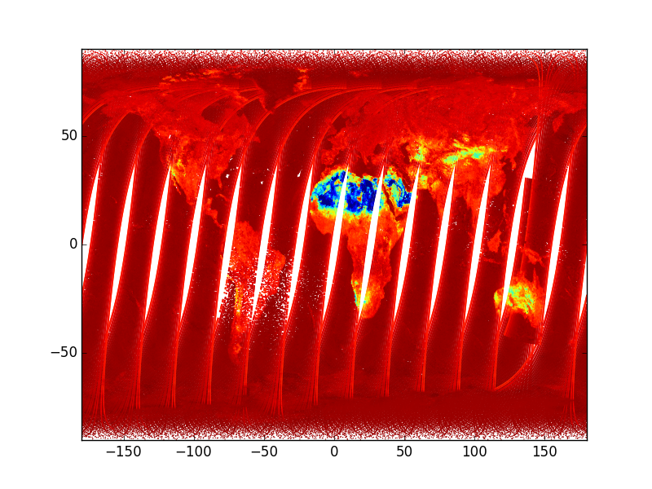
Emissivity conclusions
New emissivity databases available – to be tested
Any advantage of using retrievals rather than atlases for training?
Emissivity at 1204 cm⁻¹
Emissivity retrieved globally (i.e. also over sea and under cloud) at 10 wavelengths.
Any set of emissivity eigenvectors can be used to reconstruct full spectral resolution emissivity

Slide 31
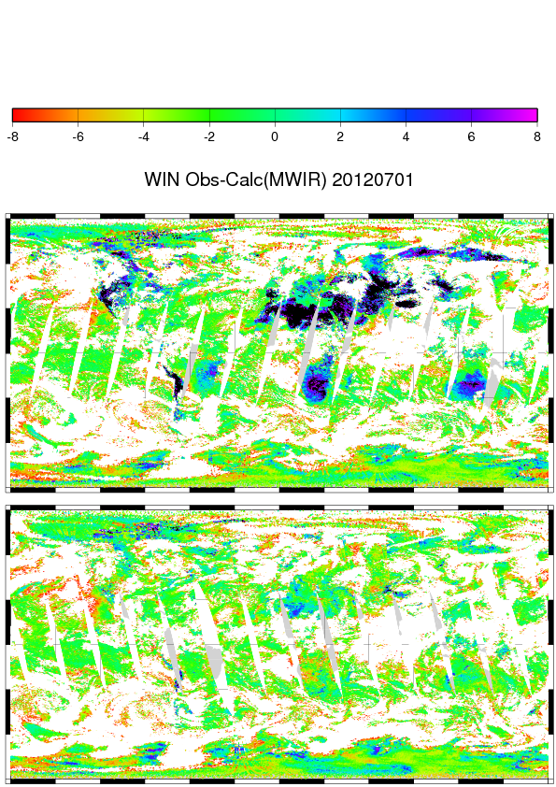
LST correction
Any systematic biases in reference data (ECMWF analysis) are retained
Problem for ECMWF LST over arid regions at daytime
LST in training set is replaced with 1DVAR LST, if at daytime, it is higher and there is no inversion

Slide 32
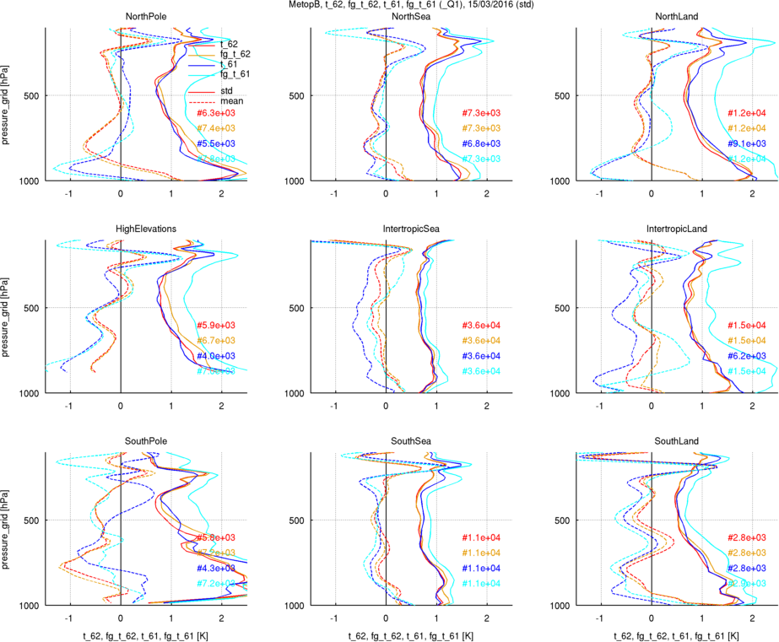
Validation in state space
Comparomatic

Slide 33
Why regression?
Rodgers page 113:
“is identical to the maximum a posteriori solution”
“implementing the MAP solution without having to characterise the instrument with great care and without having to implement an accurate forward model”
“features can be retrieved which comes from historical correlations and not from the measurements”
➔ But only if they are in the null space anyway
Any biases in the reference data will be preserved in the retrievals
➔ But forward model based retrievals also struggle with biases

Slide 34
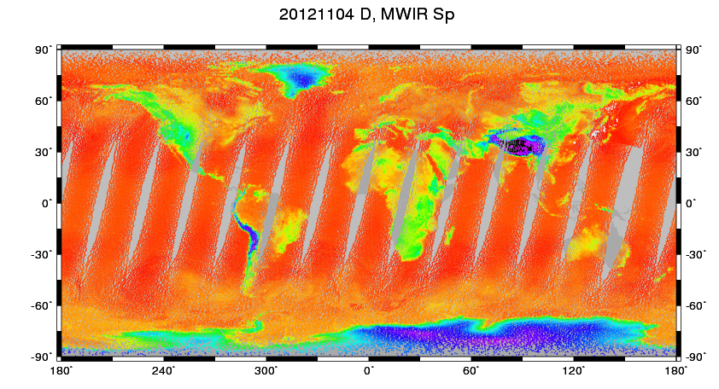
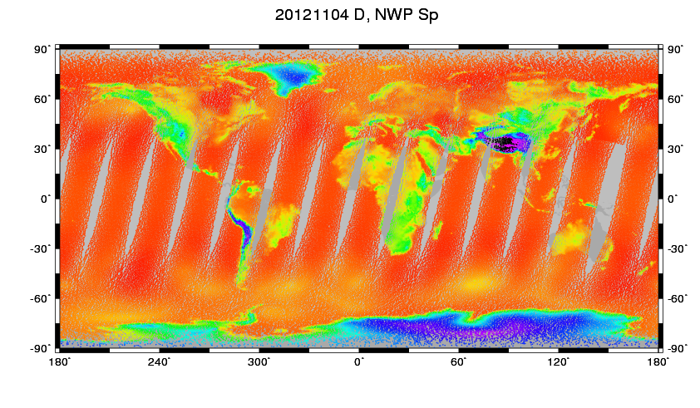
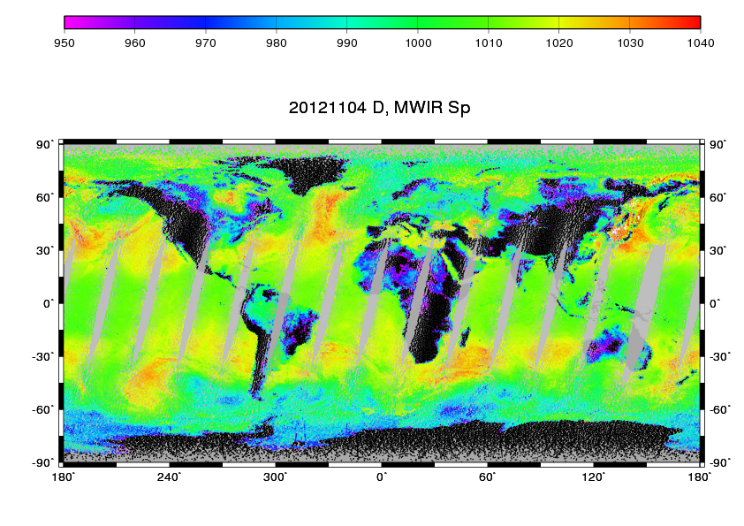
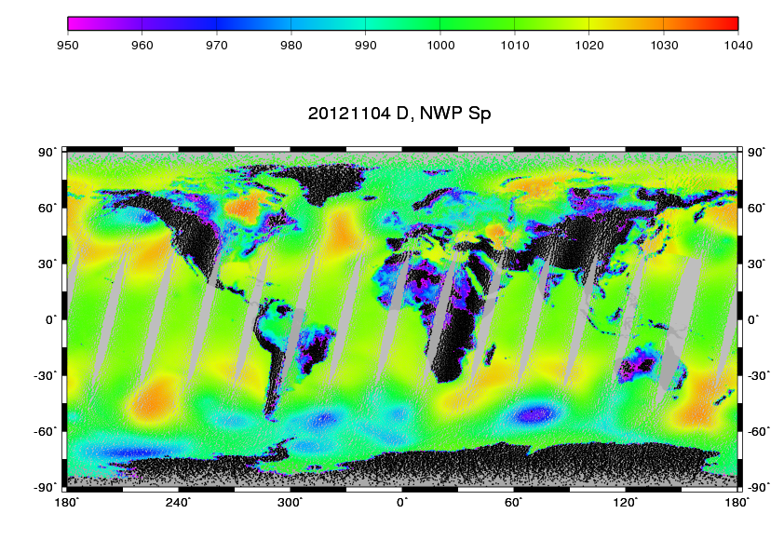
PWLR retrieved surface pressure
Used for interpolation of model levels to fixed pressure grid and as FRTM input in OE

Slide 35
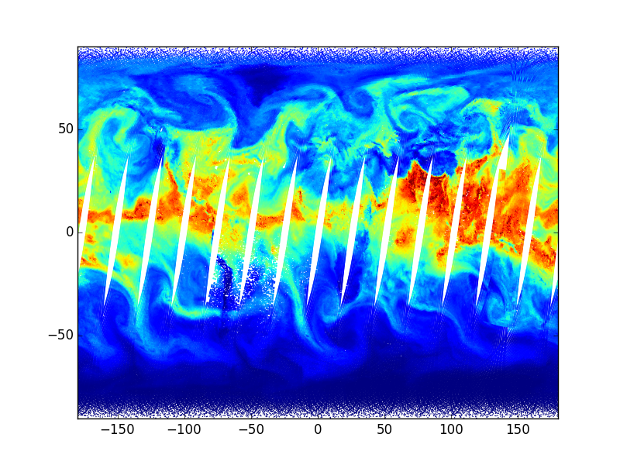
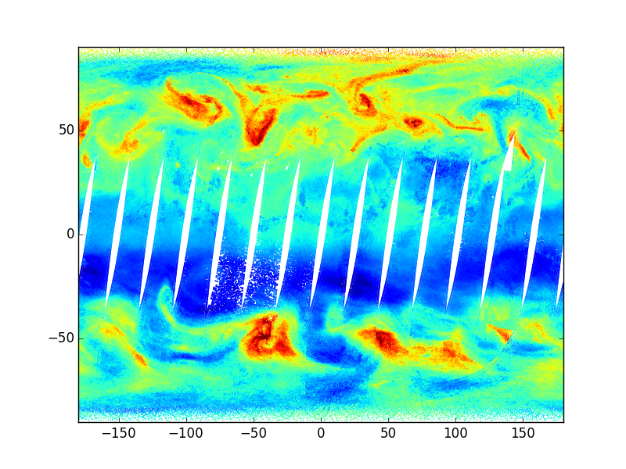
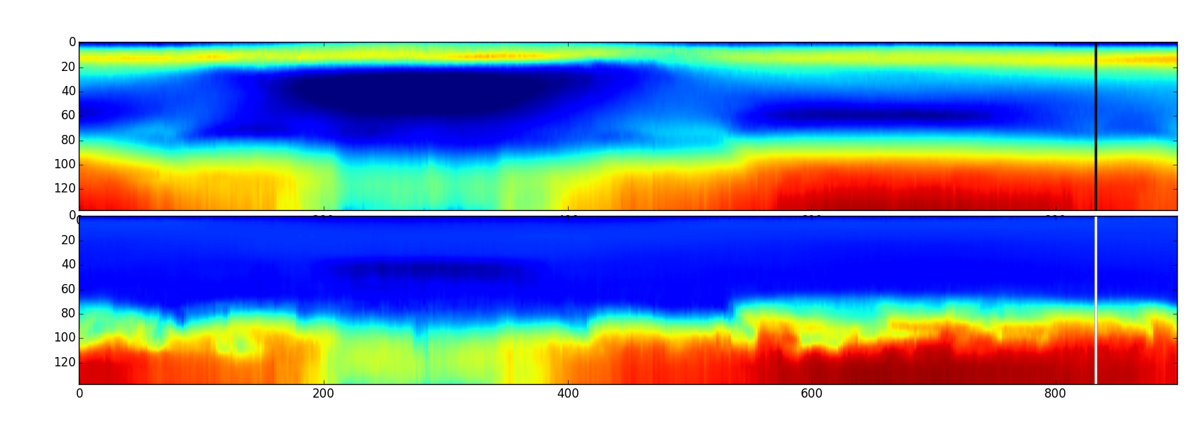
All sky products ➔ new possibilities
Total water vapour column
Total ozone column
Temperature and water vapour transect plots

Slide 36
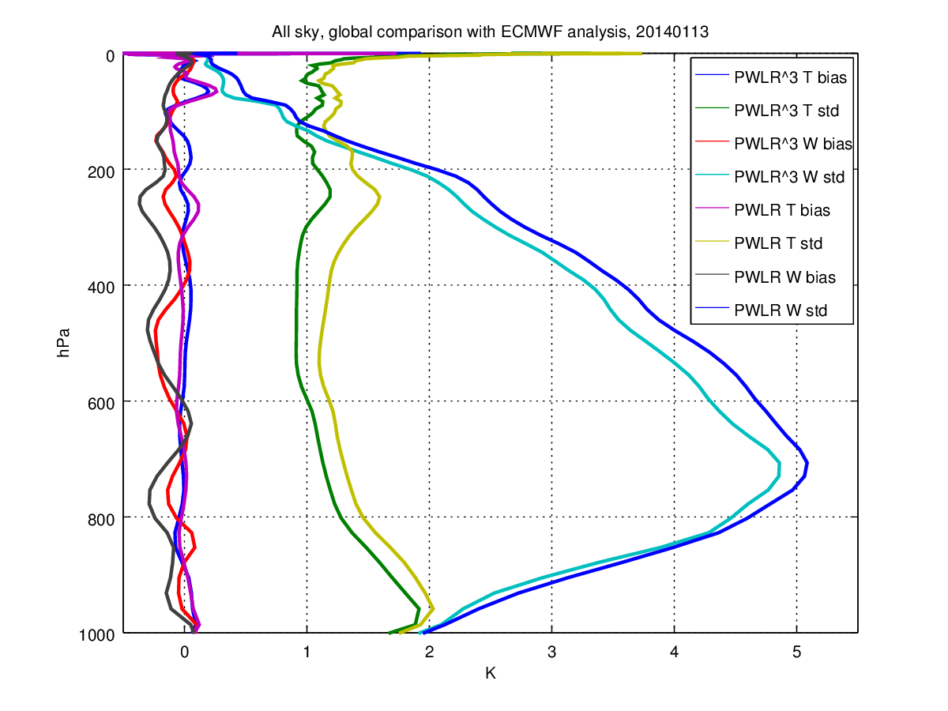
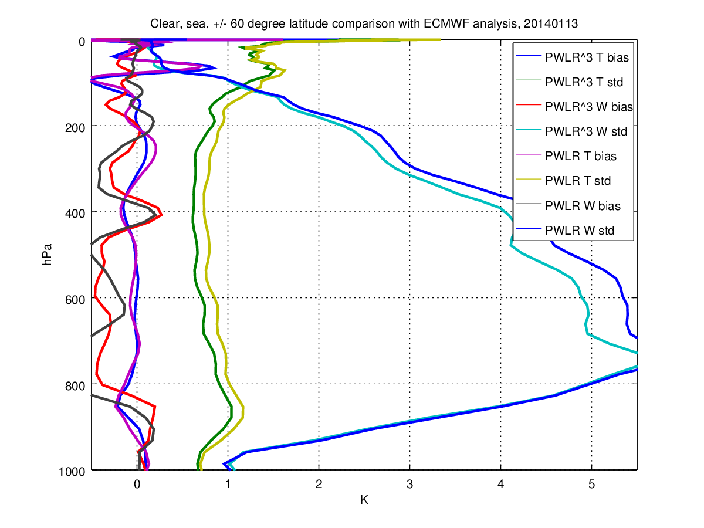
PWLR³ improvements over PWLR
Global, all sky, 20140113
Clear, sea, 20140113
Improvements achieved by
exploiting horizontal correlation
a better classification (based on k-means clustering)
ensemble learning (averaging four individual retrievals with partially uncorrelated errors)

Slide 37
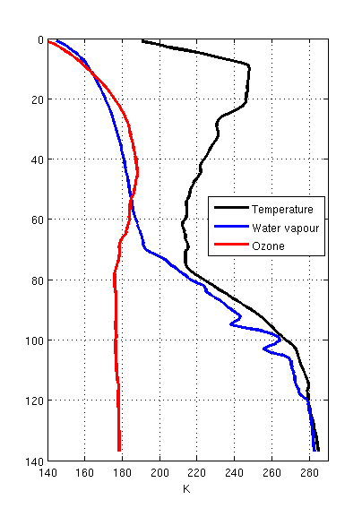
State-vector representation
For each of the four FOVs in an EFOV
Ps (hPa) Surface pressure
Ta (K) Surface air temperature
Wa (K) Surface air WV dew point temperature
Ts (K) Surface skin temperature
OmC (K) Cloud-signal (predicted Obs minus Calc)
100 PC scores for T and W profiles in all four FOVs
T (K) at 137 model levels
W (K) dew point temperature at 137 model levels
20 PC scores for ozone profiles in all four FOVs
O (K) “dew point temperature” at 137 model levels
20 PC scores for surface emissivity in all four FOVs
For each of the four FOVs in an EFOV
QP (hPa) absolute error of surface pressure
QT (K) absolute error of temperature profile
QW (K) absolute error of dew point profile
QO (K) absolute error of ozone “dew point” profile
QTs (K) absolute error of surface skin temperature

Slide 38
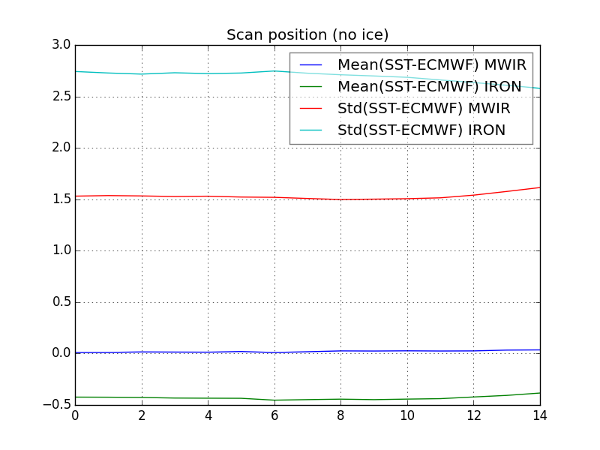
Further improvements / Premium SST
Trained for global / all-sky maximum performance
(clear sky) improvements by further refinement of retrieval classes
use of predicted SST for class separation
Analyse biases in order to determine opportunities for class splitting
Plot show that bias does not vary with scan position (not surprising as each scan position already has separate class)

Slide 39
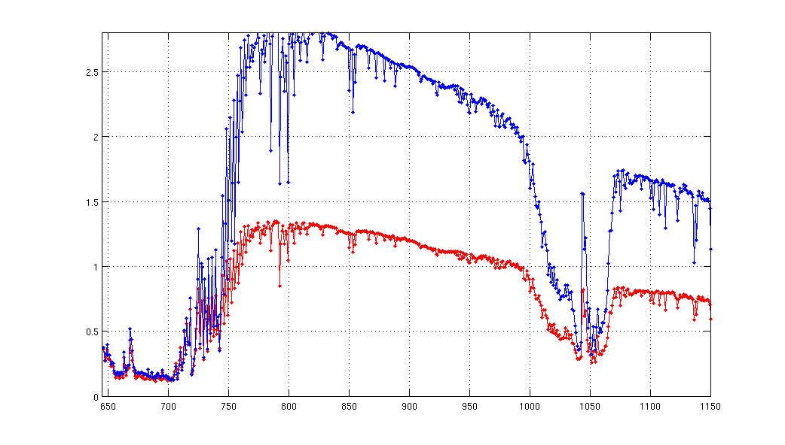
Validation in radiance space
Clear sky land and sea high latitudes only |lat|> 50 degree, 2016.03.15
OBS – CALC(ECMWF ANA)
OBS – CALC(IASI PWLR³)
stddev [mW/m²/sr/cm⁻¹]

