Slide 1
Tropical SNOs for comparison of AIRS and CrIS Calibration
Evan M. Manning
Hartmut H. Aumann
Jet Propulsion Laboratory, California Institute of Technology,
4800 Oak Grove Dr., Pasadena, CA 91109

Slide 2
Outline
Conclusions
Tropical SNO introduction
Analysis Approach
Broad bands in frequency
Statistical power
900 cm⁻¹ used to identify scene dependence
Results
Differences by scene type
Comparison with results from Likun Wang
Conclusions
Backup – plots as a function of signal level

Slide 3
Conclusions
TSNO is a powerful tool for comparing AIRS and CrIS in the 50% of the area of the globe that is most critical for weather and climate.
It has demonstrated statistical power at the 0.01 K level over the full range of observed brightness temperatures for these instruments.
It already has helped to diagnose temperature-dependent differences between the two instruments in­­ selected spectral ranges.
With more powerful metrics and statistical approaches, it will be possible to isolate the effects of scene inhomogeneity and gain better insight into both instruments.
We show that the two instruments generally agree at the better than 0.3 K level.
From an instrument specification viewpoint this is an excellent agreement. However, from a climate change viewpoint an 0.1K difference is the equivalent of one decades of global warming.
The agreement between AIRS and CrIS may improve with the release of an improved CrIS or AIRS calibration algorithm.

Slide 4
TSNO introduction
AIRS/CrIS comparisons can be done many ways: global stats, etc.
Traditional SNOs (Simultaneous Nadir Observations) take cases where both instruments are looking at nadir (+/- 1 degree) at the same time (+/- 10 minutes).
They are most common near the poles
We need tropical cases too
And maybe we don’t need polar – cloudy cases are just as cold
Tropical SNOs (TSNOs) are within 30 degrees of the equator but up to 10 degrees off nadir.
This gives good sampling

Slide 5
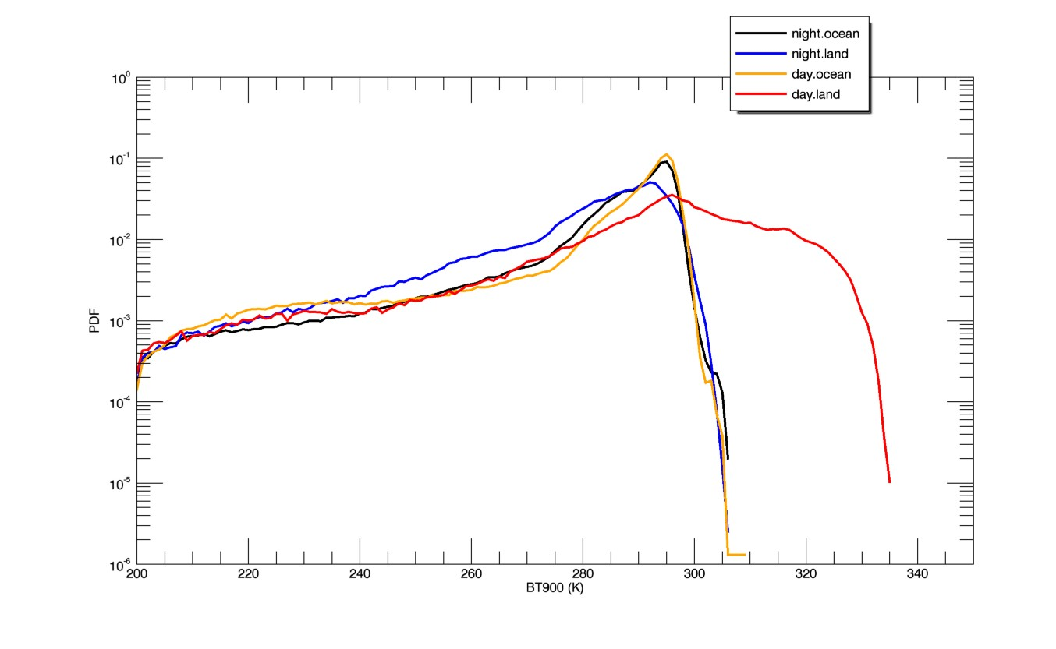
PDFs of BT900 for different subsets of TSNOs.
Temperatures above 307 K only occur for day land.
Temperatures below 290 represent cloudy cases.

Slide 6
Statistics
Even though most scenes have BT900 ~290 K this massive data set contains enough observations to reduce probable error <~ 0.01 K in all BT900 bins
Choosing the uniform ~1/3 of spectra reduces scatter but increases PE because of reduced yield.
Statistics for AIRS/CrIS TSNO data set by BT900 bin
Central BT900 (K) | BT900 range (K) | # observations (all/uniform) | AIRS-CrIS BT900 mean (K) (all/uniform) | AIRS-CrIS BT900 standard deviation (K) (all/uniform) | AIRS-CrIS BT900 probable error (K) (all/uniform)
210 | 200-220 | 32656 / 9803 | .11 / .05 | 1.9 / 1.8 | .011 / .018
230 | 220-240 | 60591 / 20822 | .20 / .15 | 2.3 / 2.1 | .009 / .014
250 | 240-260 | 104114 / 39500 | .16 / .13 | 2.4 / 2.1 | .007 / .011
270 | 260-280 | 285730 / 118573 | .08 / .07 | 2.1 / 1.7 | .004 / .005
290 | 280-300 | 1842440 / 651902 | .00 / .04 | 1.2 / 0.9 | .001 / .001
310 | 300-320 | 72649 / 25189 | -.20 / -.16 | 1.2 / 0.9 | .004 / .006
330 | 320-340 | 14124 / 4285 | -.26 / -.23 | 0.9 / 0.7 | .007 / .011

Slide 7
Mean AIRS spectrum – original and smoothed
AIRS BT (K)

Slide 8
Mean smoothed BT differences (K) for AIRS-CrIS tropical night
AIRS – CrIS BT (K)

Slide 9
Mean smoothed BT differences (K) for AIRS-CrIS tropical night
Differences are generally <~ 0.2 K.
Exceptions:
1475+ cm⁻¹
2370 cm⁻¹
There’s a bias throughout the midwave
Because the data is heavily weighted toward BT900 = 290 K, these all-scene means largely reflect that subset of the data.
AIRS – CrIS BT (K)

Slide 10
BT900
BT900 is Brightness Temperature at 900 cm⁻¹
Since these are tropical cases where surface temperature is almost always ~295 K, variation in BT900 mostly represents variation in cloudiness.
BT900 is a good indicator of signal strength throughout the thermal IR.
We separate observations into bins of 20 K in BT900 to probe the signal-level dependence of instrument differences.

Slide 11
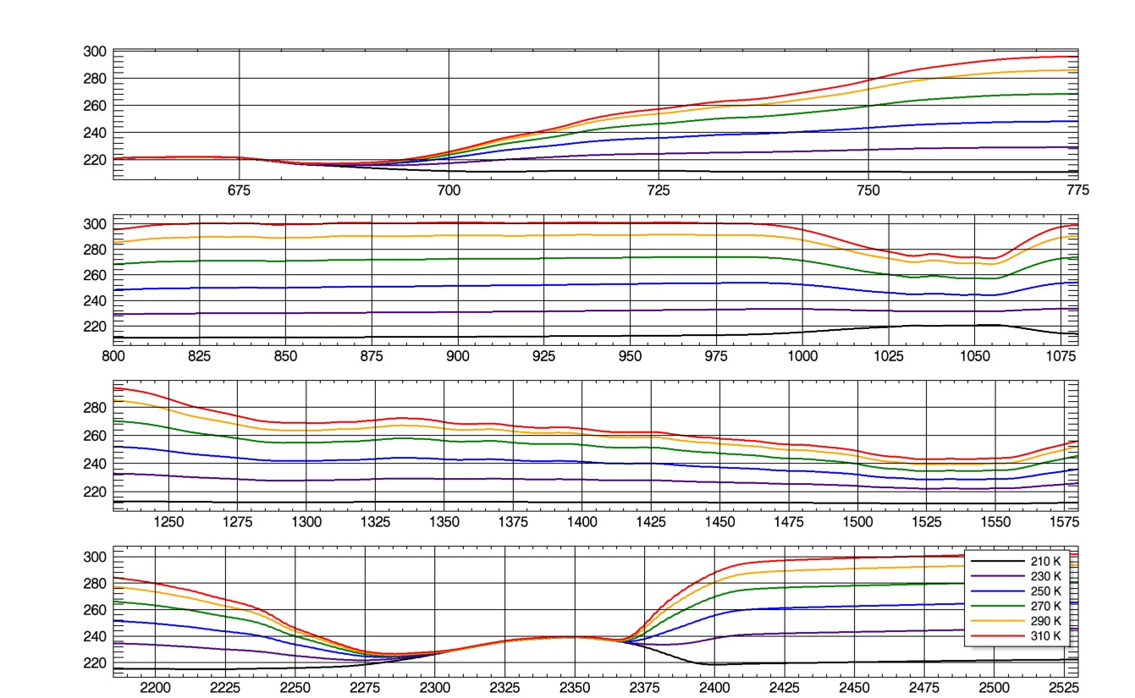
Spectra by BT900
Smoothed AIRS night ocean spectra for each 20-K BT900 bin. At this scale AIRS and CrIS are indistinguishable.
Differences reduce for the water and ozone bands and disappear for stratospheric regions.
AIRS BT (K)

Slide 12
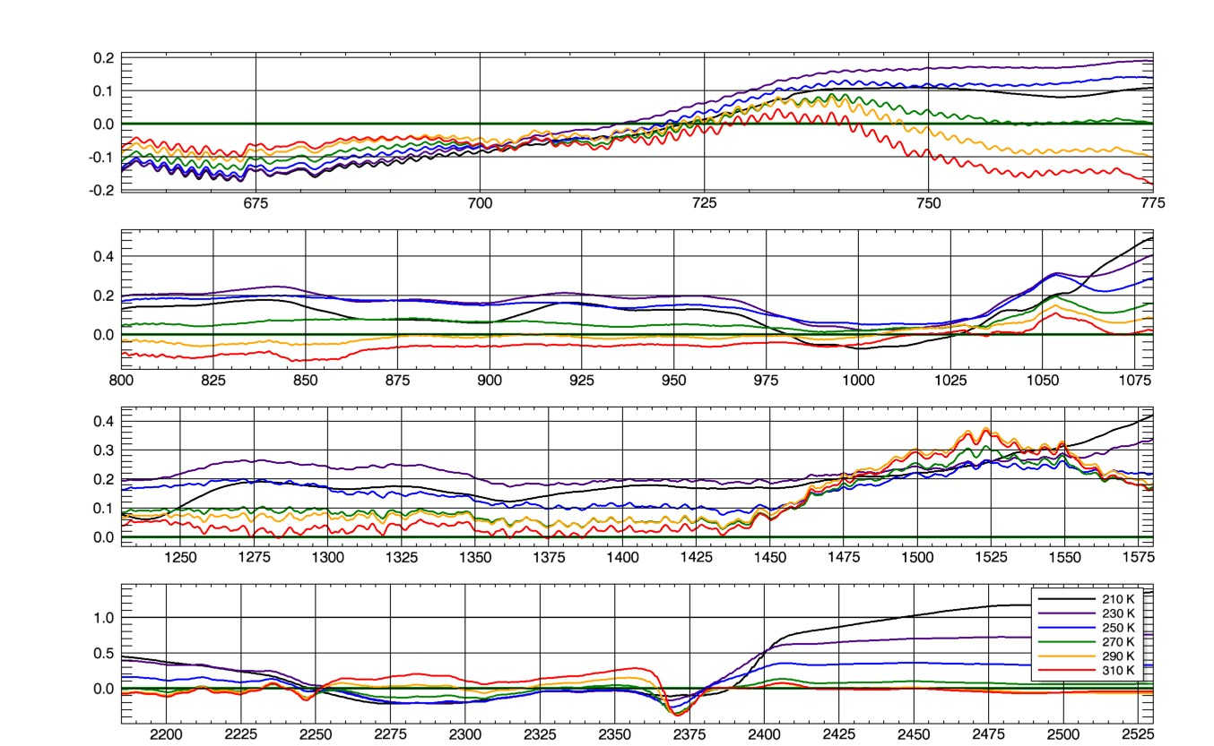
Tropical night ocean BT (K) AIRS-CrIS differences broken out by BT900 bin
AIRS – CrIS BT (K)

Slide 13
Tropical night ocean BT (K) AIRS-CrIS differences broken out by BT900 bin
There are coherent patterns of bias with BT900
Differences can be much larger than the mean difference for individual BT900 bins
The general pattern through the warmer “window” parts of the spectrum is that AIRS is colder for warm scenes and warmer for cold scenes
In the coldest spectral regions of each band the pattern is reversed.
These regions should not vary with BT900 because they sense stratospheric regions above the clouds.
AIRS – CrIS BT (K)

Slide 14
BT diffs and mean spectra by BT900 bin
AIRS – CrIS BT (K)

Slide 15
BT differences from tropical night ocean uniform TSNOs with comparable data from Wang
AIRS – CrIS BT (K)

Slide 16
BT differences from tropical night ocean uniform TSNOs with comparable data from Wang
Wang et al. (AMT 2015) compared AIRS and CrIS (and IASI) in a few broad bands.
They separated tropical SNOs and polar SNOs from each pole
Mean BT900 for tropical is near 290 K
Mean polar BT900s are near 230 and 250 K
We display their results with ours for similar BT900
There is broad agreement
AIRS – CrIS BT (K)

Slide 17
BT differences from tropical night ocean uniform TSNOs with comparable data from Wang
AIRS – CrIS BT (K)
Through the warm parts of the longwave, both analyses agree that the bias is more positive for the polar cases by about 0.1 K, but the two analyses disagree about the basic level, also by about 0.1 K.
Both agree that in the coldest region near 665 cm⁻¹ and the ozone band near 995 cm⁻¹ there is greater agreement but a sign reversal in the BT900 dependency

Slide 18
BT differences from tropical night ocean uniform TSNOs with comparable data from Wang
AIRS – CrIS
BT (K)
In the midwave band, Wang doesn’t have a band near 1525 cm⁻¹ where we show the biggest discrepancy.
Elsewhere all differences are <~ 0.2 K and all BT900 dependencies are <~ 0.1 K
There is a weak similarity in how the warm yellow moves above and below the cold blue/purple

Slide 19
BT differences from tropical night ocean uniform TSNOs with comparable data from Wang
AIRS – CrIS
BT (K)
In the shortwave band, the largest differences are seen.
The two analyses agree well near 2275, 2325, and 2380 cm⁻¹
Near 2225 and 2460 cm⁻¹ Wang sees much smaller differences than we do.
Agreement is pretty good for the warm case, especially at 2460.
Solar effects could account for differences between polar and cloudy tropical scenes.

Slide 20
Tropical night ocean BT (K) AIRS-CrIS differences broken out by BT900 bin
AIRS – CrIS BT (K)

Slide 21
Conclusions
TSNO is a powerful tool for comparing AIRS and CrIS in the 50% of the area of the globe that is most critical for weather and climate.
It has demonstrated statistical power at the 0.01 K level over the full range of observed brightness temperatures for these instruments.
It already has helped to diagnose temperature-dependent differences between the two instruments in­­ selected spectral ranges.
With more powerful metrics and statistical approaches, it will be possible to isolate the effects of scene inhomogeneity and gain better insight into both instruments.
We show that the two instruments generally agree at the better than 0.3 K level.
From an instrument specification viewpoint this is an excellent agreement. However, from a climate change viewpoint an 0.1K difference is the equivalent of one decades of global warming.
The agreement between AIRS and CrIS may improve with the release of an improved CrIS or AIRS calibration algorithm.

Slide 22
References
[1] Aumann, H. H., Chahine, M. T., Gautier, C., Goldberg, M., Kalnay, E., McMillin, L., Revercomb, H., Rosenkranz, P. W., Smith, W. L., Staelin, D. H., Strow, L. and Susskind, J., "AIRS/AMSU/HSB on the Aqua Mission: Design, Science Objectives, Data Products and Processing Systems," IEEE Trans. Geosci. Remote Sensing, 41, 253-264 (2003).
[2] Glumb, R. J., Williams, F. L., Funk, N., Chateauneuf, F., Roney, A., and Allard,R., "Cross-track Infrared Sounder (CrIS) development status," Proc. SPIE 5152, (2003).
[3] Tobin, D. et al. "The Cross-track Infrared Sounder (CrIS) on SUOMI NPP: Intercalibration with AIRS, IASI and VIIRS," 93rd AMS Annual Meeting. Austin, TX, January (2013).
[4] Evan M. Manning, Hartmut H. Aumann, Ali Behrangi, "AIRS Level-1C and applications to cross-calibration with MODIS and CrIS," Proc SPIE 9218, (2014)
[5] Wang. L., Y. Han, X. Lin, and D.A Tremblay “Radiometric consistency assessment of hyperspectral infrared sounders” Atmos. Meas. Tech. Discussion, 8, 7161-7199, (2015).
[6] Evan M. Manning, Hartmut H. Aumann, " Tropical simultaneous nadir observations for IR sounder evaluation and comparison,” Proc. SPIE 9607, (2015); doi:10.1117/12.2187151; http://dx.doi.org/10.1117/12.2187151

Slide 23
Backup Material

Slide 24
670 cm-1 dRad by scene radiance

Slide 25
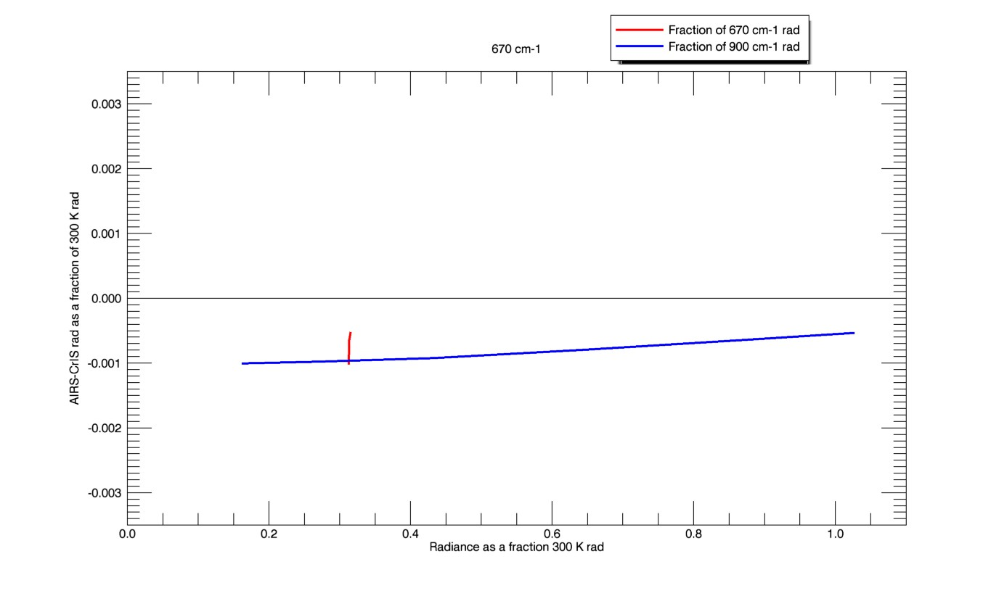
670 cm-1 dRad by scene radiance
To understand the possible instrument effects it is useful to look at scene signal and signal difference in radiance units instead of brightness temperature.
We scale as a fraction of 300 K radiance
Full scale is 0.0035 * 300 K, ~~ 1 K
Some issues will show up best as a function of same-frequency radiance: hot & cold cal issues, nonlinearity
Some issues will show up best as a function of 900 cm⁻¹ radiance, which represents overall scene signal level: signal leakage from other bands
At 670 cm-1 we have essentially no variation in same-frequency radiance because this is a stratospheric region.
But there is variation with 900 cm⁻¹ signal – possible leakage

Slide 26
dRad by scene radiance

Slide 27
Longwave a dSignal by signal level
As discussed above, the stratospheric region <700 cm-1 shows possible signal leakage
At 730 and 750 cm⁻¹ we see a different pattern:
Curvature with scene signal -- possible nonlinearity problem?
Error may go to ~zero at space signal levels
750 cm⁻¹ clearly has a bias (AIRS colder) at the hottest signal levels

Slide 28
Longwave b dSignal by signal level
All have similar shape
900 cm⁻¹ has only one curve visible because they are identical
Biases differ significantly

Slide 29
Midwave dSignal by signal level
1250 and 1400 cm⁻¹ resemble the longwave window pattern
At 1550 cm⁻¹, in the coldest part of the water band, we again have a strong slope with out-of-band signal level

Slide 30
Shortwave dSignal by signal level
2225 cm⁻¹ resembles the longwave window pattern
Stratospheric 2350 cm⁻¹ has a slope with out-of-band signal level
Window region 2500 cm⁻¹ has curvature as with other window regions but this levels off for the warmest scenes

Slide 31
Variation of AIRS-CrIS BT900 as a function of scene inhomogeneity metric Inhomo850

