Slide 1
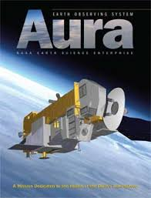
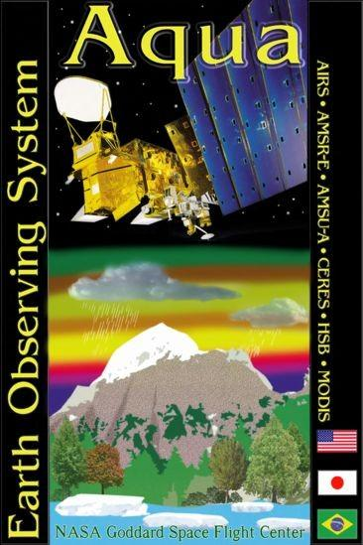
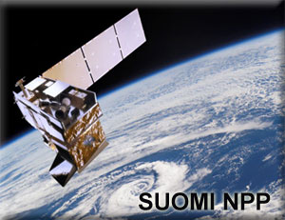
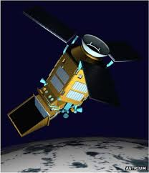
Profiles of Tropospheric O₃, CO, and CH₄ Retrieved from Multiple Satellite Instruments
Dejian Fu¹, K.W. Bowman¹, J.R. Worden¹, K. Miyazaki², S.S. Kulawik^{1,3}, H.M. Worden⁴, N.J. Livesey¹, M. Luo¹, S. Yu¹, V.H. Payne¹, J.L. Neu.¹, P. Veefkind⁵, I. Aben⁶, J. Landgraf⁶, L.E. Flynn⁷, H. Yong⁷, X. Xiong⁷, L.L. Strow⁸, with thanks to TES, AIRS, OMI, CrIS, OMPS, TROPOMI teams
⁰¹ NASA Jet Propulsion Laboratory, California Institute of Technology, USA
⁰² Japan Agency for Marine-Earth Science and Technology, Japan
⁰³ NASA Ames Research Center, USA
⁰⁴ National Center for Atmospheric Research, USA
⁰⁵ Royal Netherlands Meteorological Institute, The Netherlands
⁰⁶ Netherlands Institute for Space Research, The Netherlands
⁰⁷ NOAA Center for Satellite Applications and Research, USA
⁰⁸ University of Maryland Baltimore County, USA
Copyright 2016, California Institute of Technology. Government sponsorship acknowledged.
SuomiNPP
Sentinel-5P

Slide 2
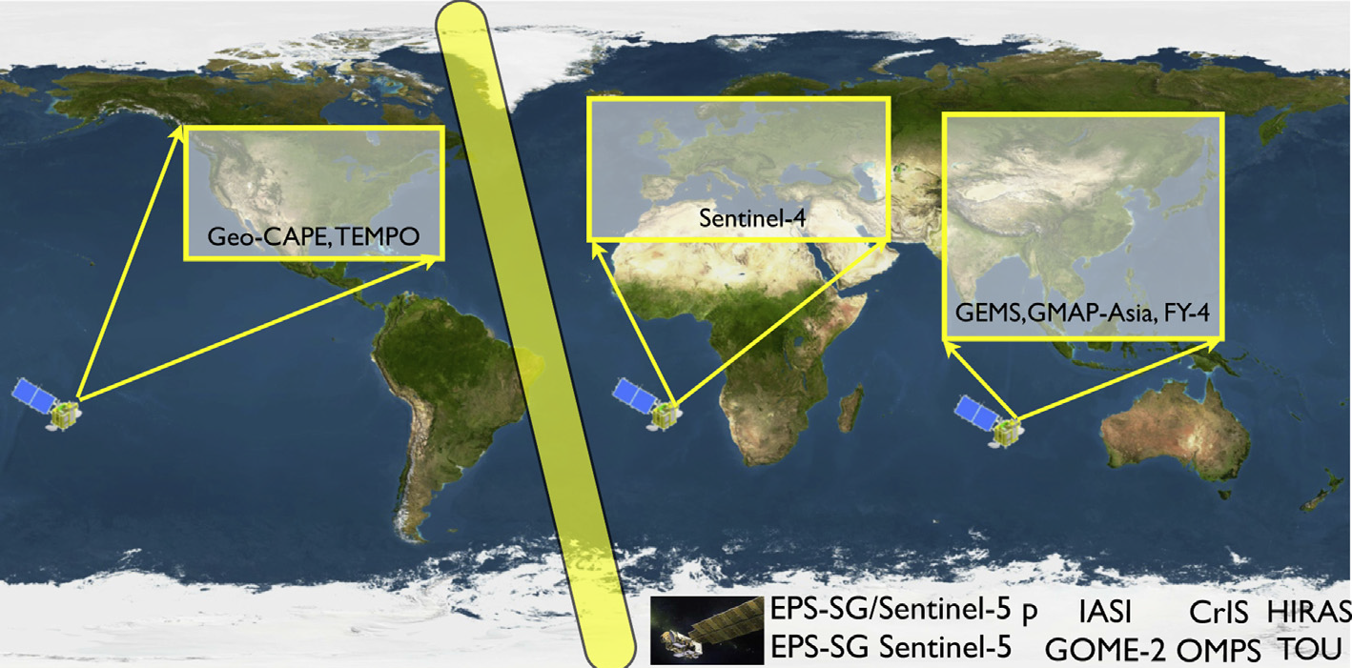
A new Atmospheric Composition Constellation to Observe Global and Regional Pollution and Greenhouse Gases
  The rapid change in global emissions and their impact of air quality and climate requires a new observing system of GEO and LEO sounders to quantify global sources of local pollution and inferring surface carbon fluxes [Bowman, 2013; Fu et al., 2016].
    LEO A-Train AIRS/OMI and SNPP CrIS/OMPS can support this constellation by distinguishing lower and upper tropospheric O₃ signals.
    LEO sounders will be a crucial link between GEO sounders over America, Europe and Asia as well as the sole satellite observations in the SH.
    LEO joint CrIS/TROPOMI measurements can provide the high resolution CO/CH₄ profile data [Fu et al., 2016].
Adapted from
Bowman, Atm. Env., 2013
A-Train, Suomi NPP
MetOp, Sentinel-5P

Slide 3
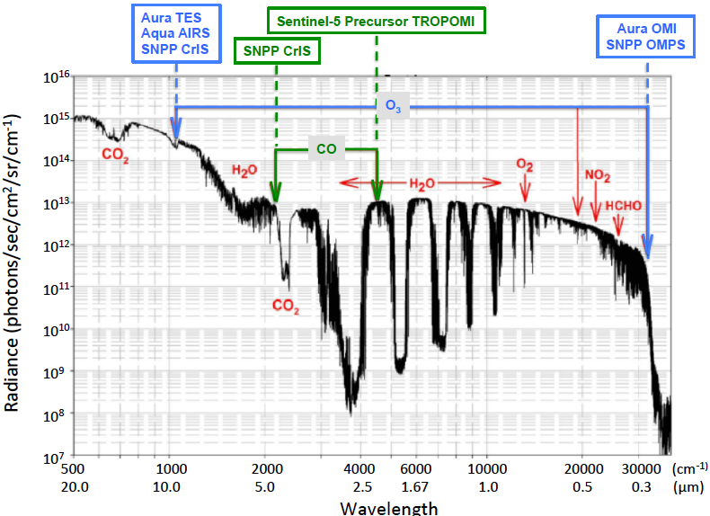
Spectral Regions Used in Joint Retrievals
CH₄
O₃
Aqua/Aura
Joint AIRS/OMI
NPP-JPSS
Joint CrIS/OMPS
CO and CH₄
MOPTT, Joint TES/GOSAT
NPP-JPSS/S5P
Joint CrIS/TROPOMI
Measurements from TIR (LW) are sensitive to the free-tropospheric trace gases.
Measurements from UV-Vis-NIR (SW) are sensitive to the column abundances of trace gases.
Joint LW/SW measurements can distinguish upper troposphere from lower troposphere.

Slide 4
JPL MUSES Retrieval Algorithm
  Multi-Spectra, Multi-Species, Multi-Sensors (MUSES)
  Builds off of heritage from the Aura Tropospheric Emission Spectrometer (TES) optimal estimation (OE) algorithm to combine a priori and satellite data [Worden et al., 2007; Fu et al., 2013; Fu et al., 2016]
    Key characteristics
    Use common a priori Xa and Sa
    Instrument specific precision Sε_{LW}, Sε_{SW}
    Forward model (F) and Jacobians (K) for LW and SW sensors
      Clouds, surface property
      Instrument response function
Notes:
In order to estimate the atmospheric state vector including ozone and CO concentration, we use this optimal estimation formula.

Slide 5
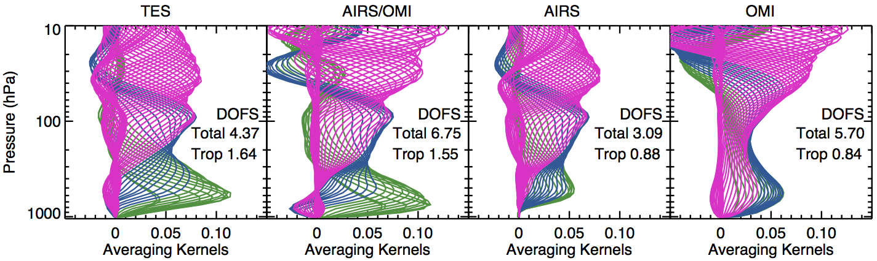
Sample Averaging Kernels and Estimated Uncertainty
MUSES provides observation operator (H) needed for data assimilation
H(x) = x_{a} + A(x_{model} - x_{a})
Averaging kernel matrix (A) is the sensitivity of the retrieved state to the true state.
The trace of averaging kernel matrix is the degree of freedom for signals (DOFS).

Slide 6
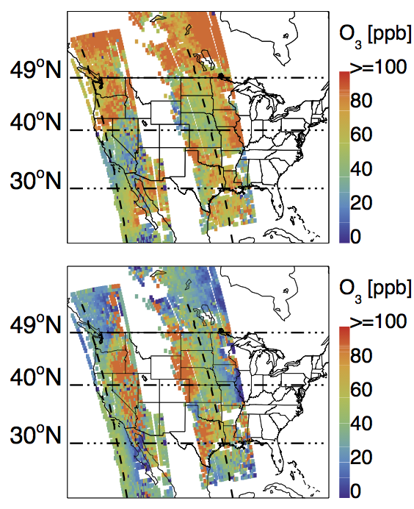
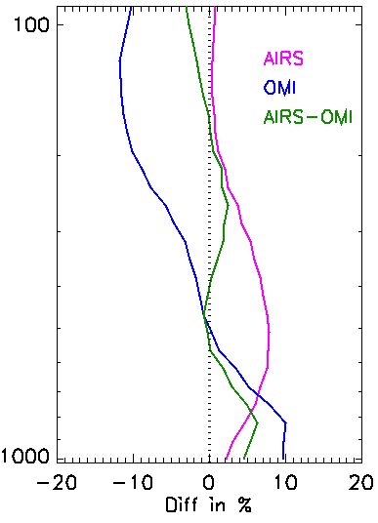
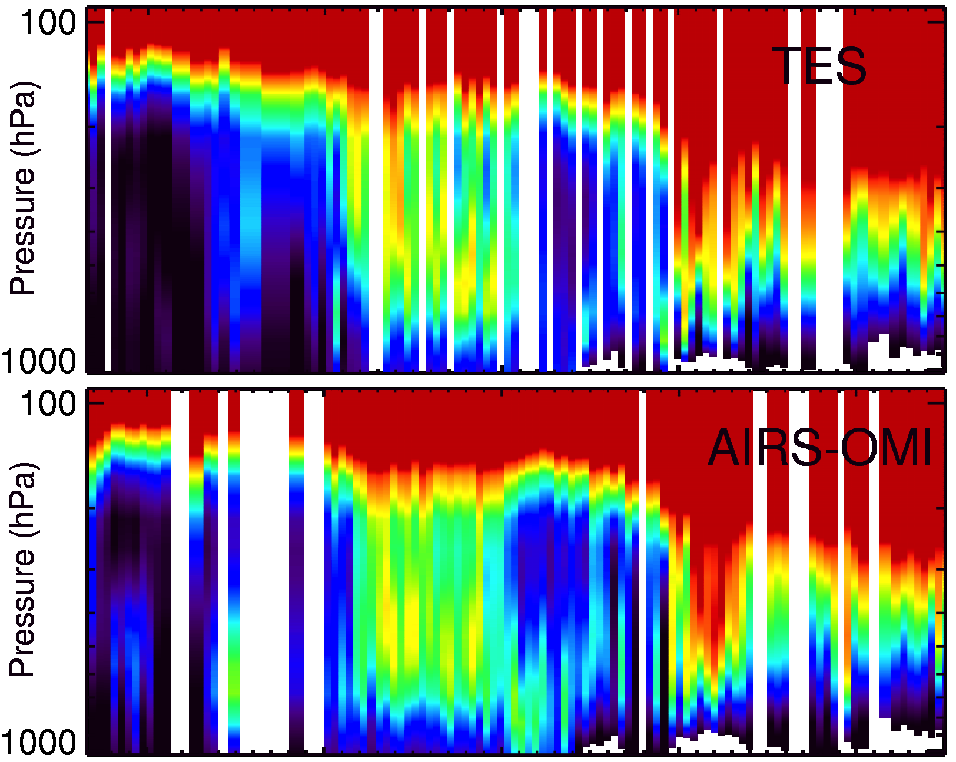
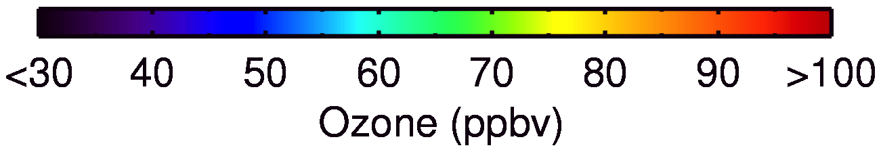
Joint AIRS/OMI and TES observations on August 23, 2006 during TexAQS Aircraft Flight Campaign
TES O₃, AIRS/OMI O₃, AIRS CO and cloud retrievals on August 23, 2006 during TexAQS aircraft flight campaign have been processed using common MUSES algorithm.
Joint AIRS/OMI ozone retrievals
    Differ from the a priori profiles
    Show best agreement to TES, in comparisons to each instrument alone
Joint AIRS/OMI O₃
Difference to TES
Transect over Western USA
300 hPa
680 hPa
100
100
1000
100
1000
Pressure (hPa)
Pressure (hPa)
200
300
400
500
10 20 30 40 50
Latitude(°)
600
700
1000
-20
-10
0
10
20
Diff (%)

Slide 7
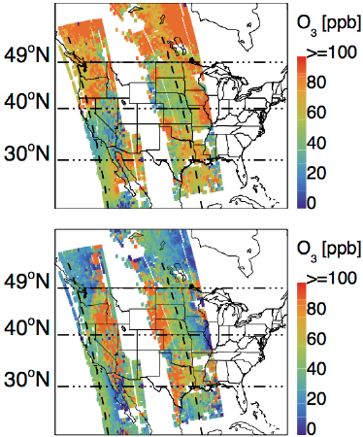
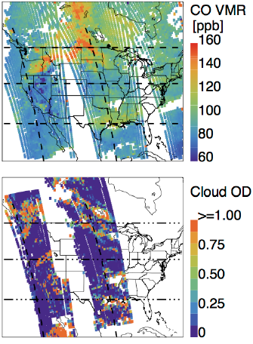
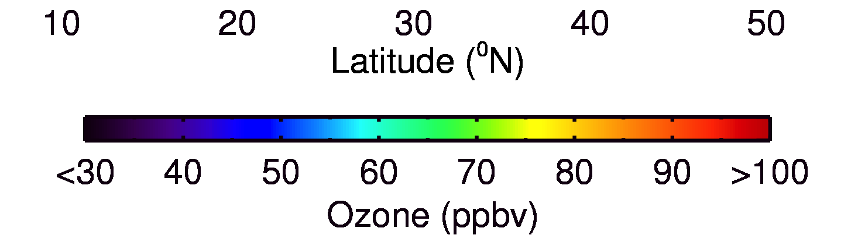
Impact of Biomass Burning on Ozone Distribution on August 23, 2006 during TexAQS Aircraft Flight Campaign
Collocated TES & Joint AIRS/OMI O₃ Measurements over Western USA
Joint AIRS/OMI O₃
AIRS CO and Cloud
300 hPa
500 hPa
680 hPa
  The enhanced ozone at 680 hPa is collocating to the enhanced CO due to the fire emissions.
  Joint AIRS/OMI retrievals distinguish the amount of O₃ between lower and upper trop, similar to TES, with broader spatial coverage, which helps in distinguishing between stratospheric influences and biomass burning.
  MUSES has been extended to additional species (NH₃, CH₃OH, HCOOH, CH₄, PAN) using measurements from multiple space sensors (TES, AIRS, CrIS, OMI, OMPS, TROPOMI).

Slide 8
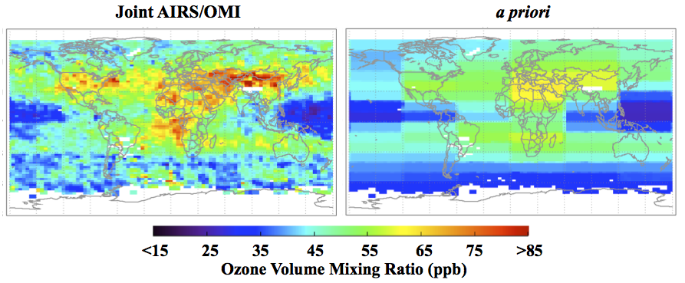
Monthly O₃ Global Maps
– towards Providing Decade Long Global Ozone Profiles
The JPL MUSES has been implemented and applied to joint AIRS/OMI ozone retrievals over global scale. We are processing June to August 2006 data.
Characteristics (e.g., August 2006)
  Both TES and Joint AIRS/OMI show similar spatial patterns, e.g., capturing the enhanced ozone over the continental outflow and biomass burning active regions
  Differ from a priori

Slide 9
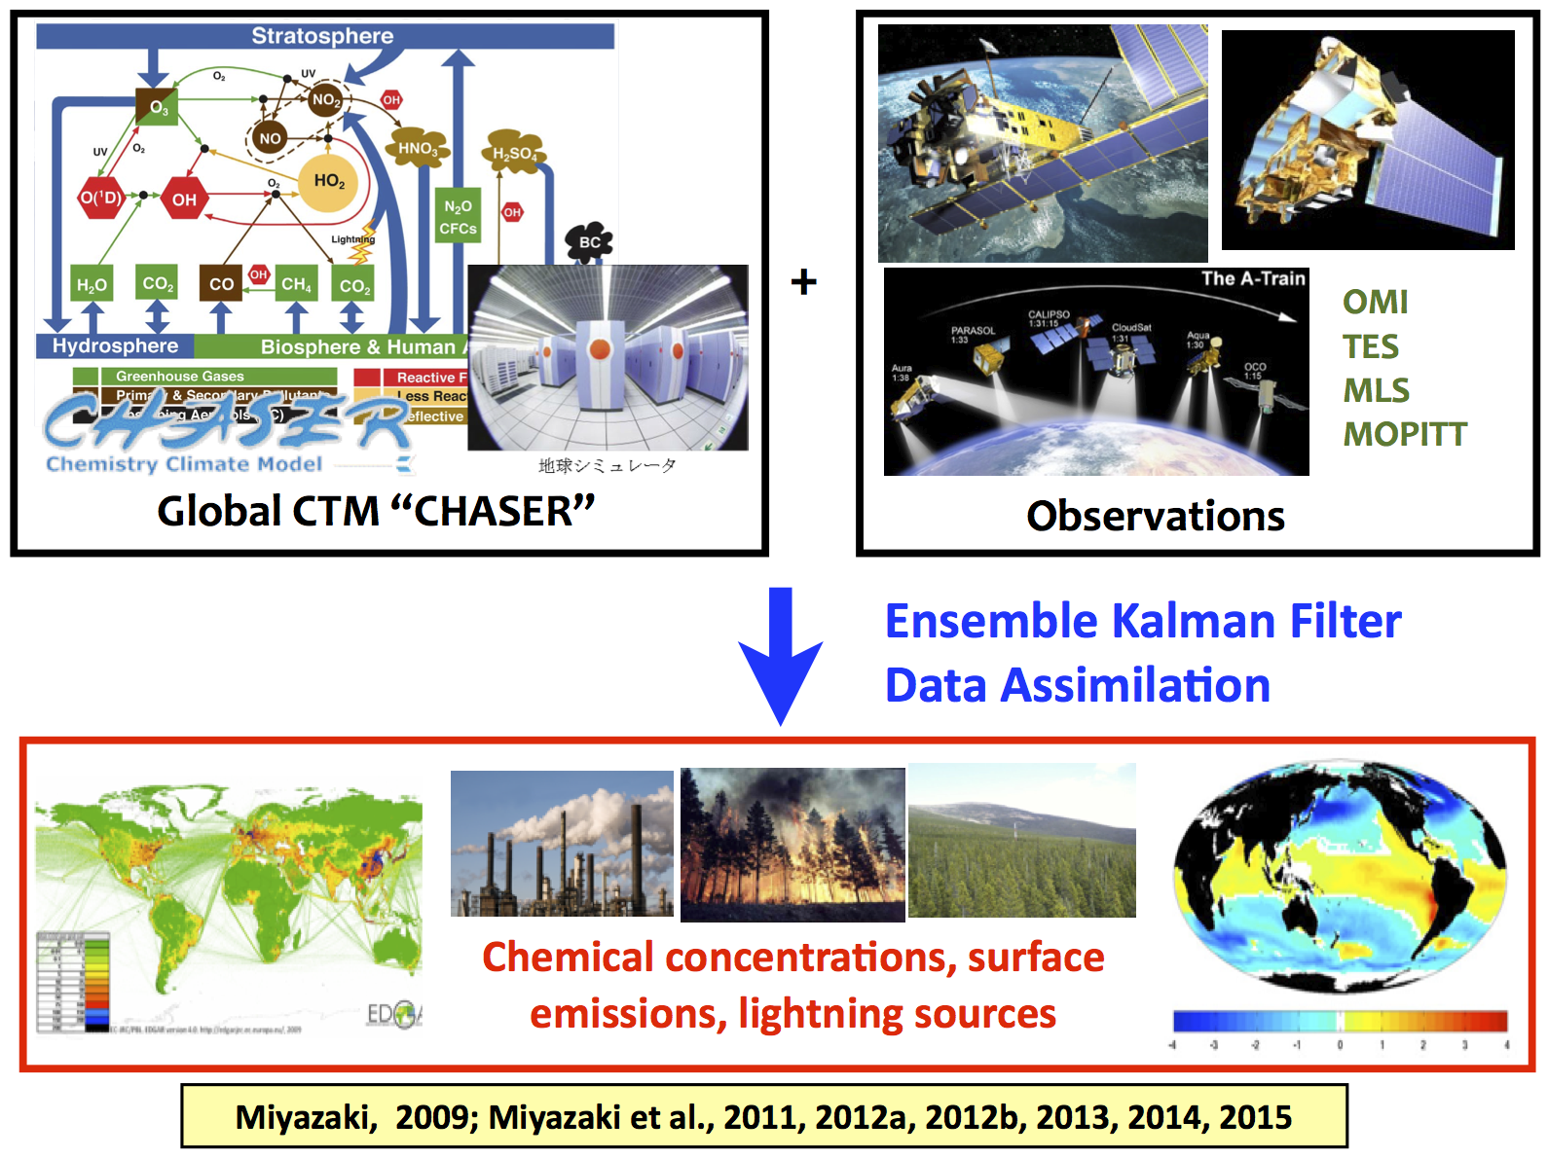
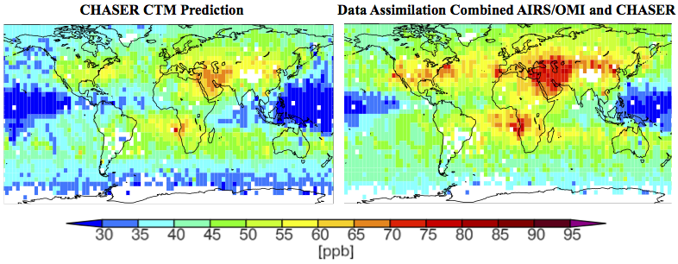
Data Assimilation System of the NASA A-Train Observations
Dr. Kazuyuki Miyazaki, implemented the CHASER data assimilation system.
MUSES algorithm delivered joint AIRS/OMI ozone and observation operator that enable data assimilation, e.g., the CHASER-DA.
Assimilations of AIRS/OMI ozone leads to enhanced concentration over middle east and south Africa.
Consistent to the previous study of the summertime buildup of tropospheric ozone abundances over the Middle East [Liu et al. 2009]

Slide 10
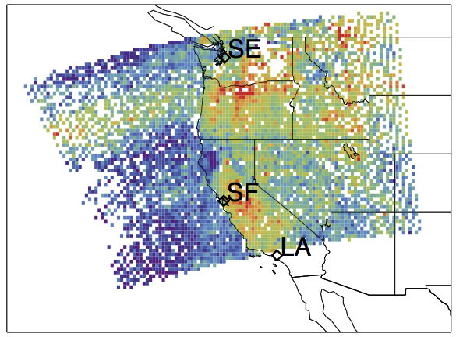
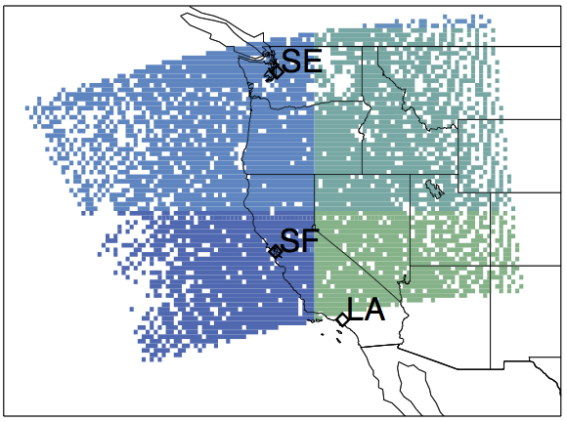

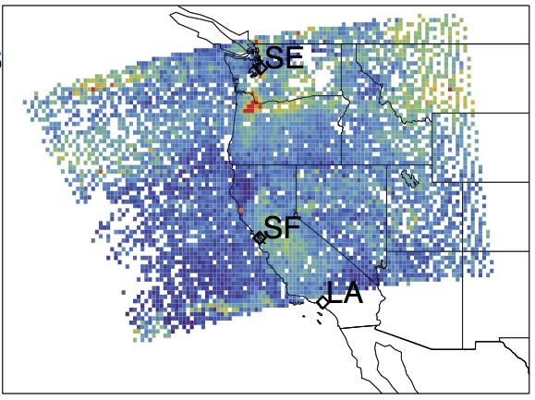

Retrievals Using MUSES Algorithm and SNPP Measurements in Support of the coming NOAA FIREX Intensive Campaign
Retrieved
a priori
O₃ VMR
500 hPa
Error
O₃
VMR
CrIS O₃ retrievals using MUSES
August 19, 2015
Single footprint (14 x 14 km² at Nadir)
Full spectral resolution
Provides observation operator (H) needed for data assimilation
Cloud OD <= 1.0

Slide 11
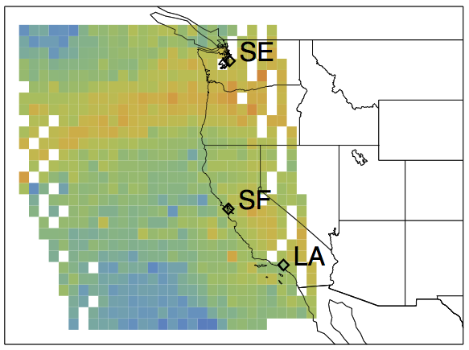
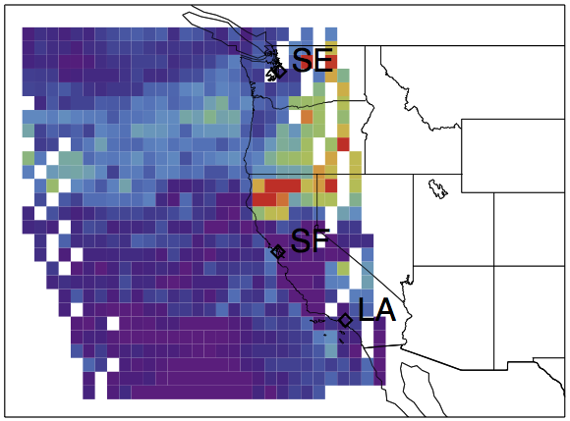


Observations from AIRS, CrIS and MODIS on Aug 19, 2015
CrIS O₃ [MUSES]
AIRS O₃ [v6]
O₃ VMR
AIRS CO [v6]
CO
VMR
MODIS Fire Map

Slide 12
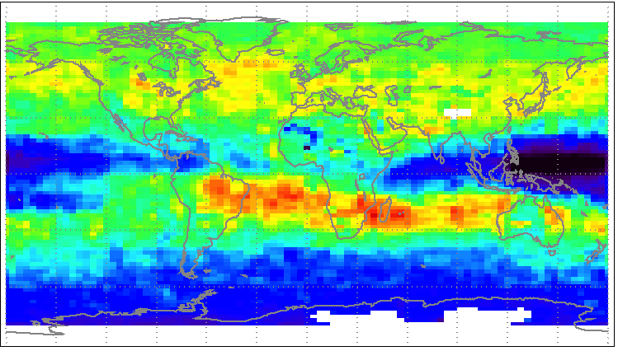
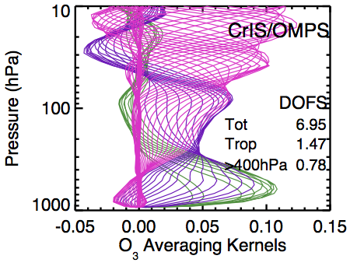
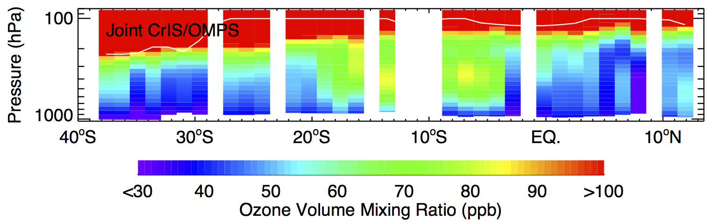
Extension to Joint CrIS/OMPS O₃ Retrievals
Monthly mean TES O₃ @ 681 hPa
  MUSES has been applied to joint CrIS/OMPS ozone retrievals over Africa on October 21, 2013.
  The elevated ozone concentrations between 2 - 20°S are associated with biomass burning.
  Joint CrIS/OMPS O₃ and CrIS CO retrievals using MUSES will support the NOAA FIREX flight campaign (Fire Influence on Regional and global Environments Experiment) – an intensive study of the impacts of western North America fires on climate and air quality.

Slide 13
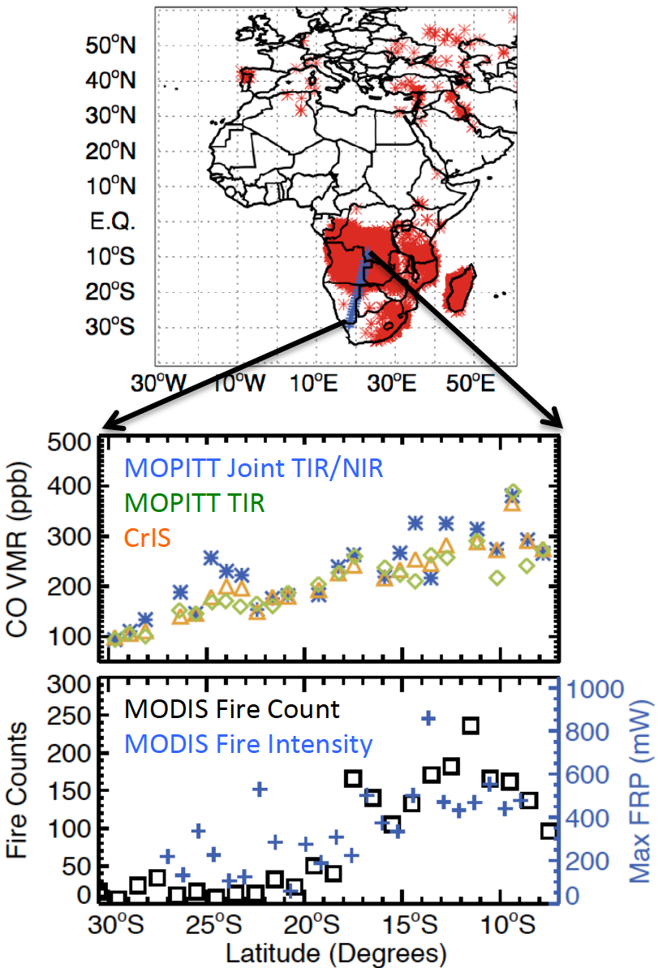
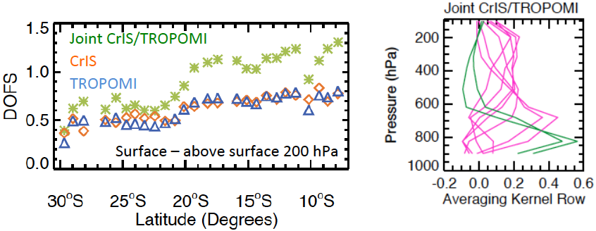
CrIS and MOPITT CO during Biomass Burning on August 27-28, 2013
Motivation: MOPITT’s unique thermal IR/near IR multispectral CO measurements, which are able to separate near-surface from the free troposphere, have no planned follow-on.
We applied the MUSES algorithm to the retrieval of CO VMR profiles from the NOAA/NASA CrIS Measurements. An analysis showed that combining CrIS TIR with the Sentinel 5p TROPOMI NIR data would have comparable to vertical sensitivity of MOPITT but with daily coverage (Fu et al., 2016).
MOPITT and CrIS
Real CrIS single footprint, full spectral resolution measurements
MUSES algorithm was used in
Joint CrIS/TROPOMI
Synthetic retrievals with realistic conditions
MUSES algorithm

Slide 14
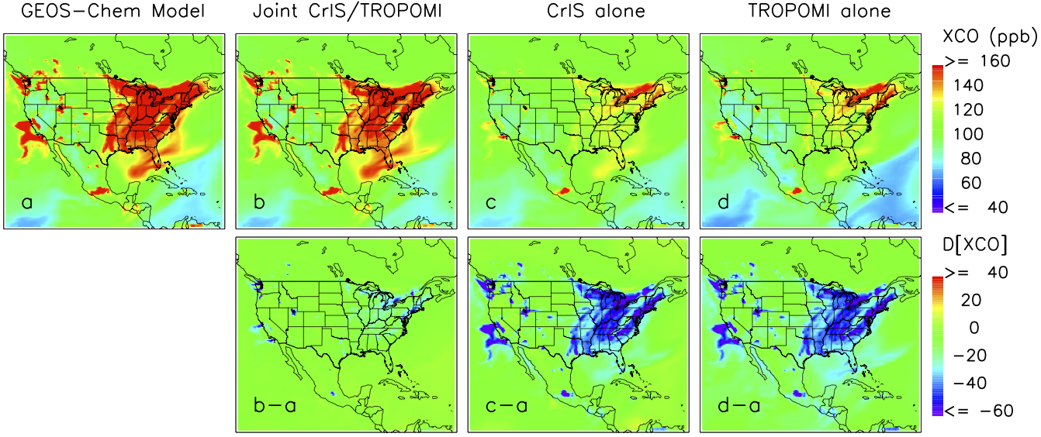
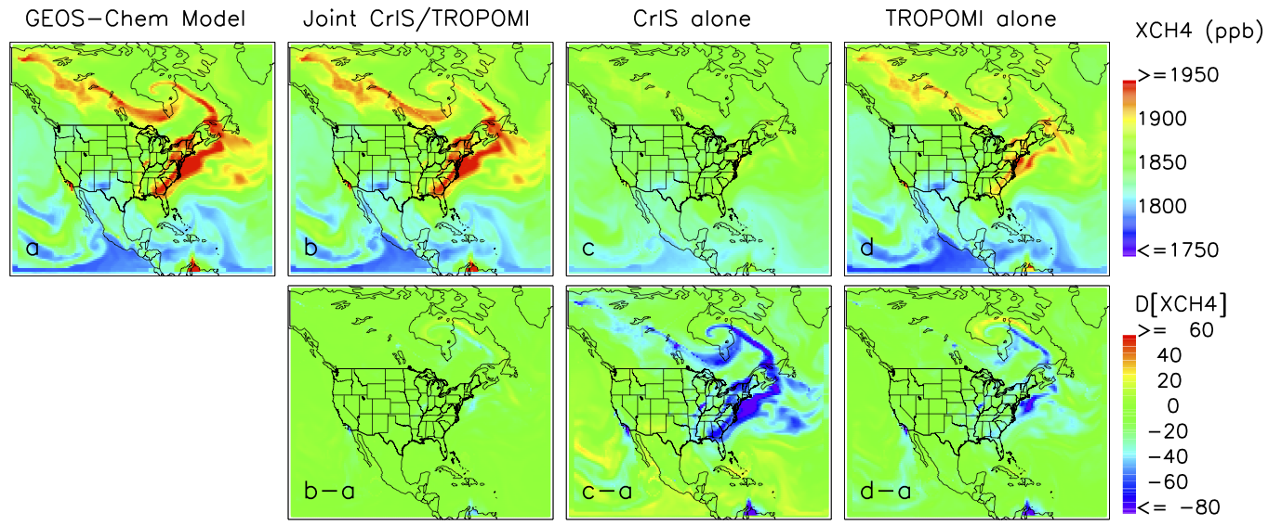
High Resolution CO/CH₄ Near Surface Data Through Combining CrIS/TROPOMI Measurements
XCO: Near surface partial column averaged VMR [surface to ~750 hPa]
Extend and improve the MOPITT joint TIR/NIR CO data [Fu et al., AMT, 2016]
XCH₄: Near surface partial column averaged VMR [surface to ~750 hPa]
Extend and Improve the joint TES/GOSAT CH₄ data [Worden et al., AMT, 2015]
True Joint C/T CrIS TROPOMI
True Joint C/T CrIS TROPOMI

Slide 15
Summary
  MUSES retrieval algorithm can combine radiances measured from LW and SW sensors including TES, AIRS, CrIS, OMI, OMPS, TROPOMI.
    Joint AIRS/OMI and CrIS/OMPS retrieved O₃ profiles can distinguish the abundances in the upper troposphere from the lower troposphere, and show better agreement to the well-validated TES data products.
    Joint CrIS/TROPOMI
      retrieved CO profiles show similar vertical resolution as MOPITT TIR/NIR, but with a factor of two finer footprint size and daily global coverage.
      retrieved CH₄ profiles would provide similar vertical resolution as joint TES/GOSAT, but with a factor of ~100 times daily spatial coverage.
  The observation operators of joint AIRS/OMI data products enable data assimilation, e.g., “CHASER-DA”, demonstrating the significant impacts on ozone distributions.
  The multiple spectral observations enable the continuation of key EOS observations including TES and MOPITT which do not have follow on missions.
  These critical observations will form the pillar of the LEO and GEO air quality constellations [Bowman, 2013; Fu et al., 2016].
Thank you for attention. Questions?

Slide 16
Backup

Slide 17

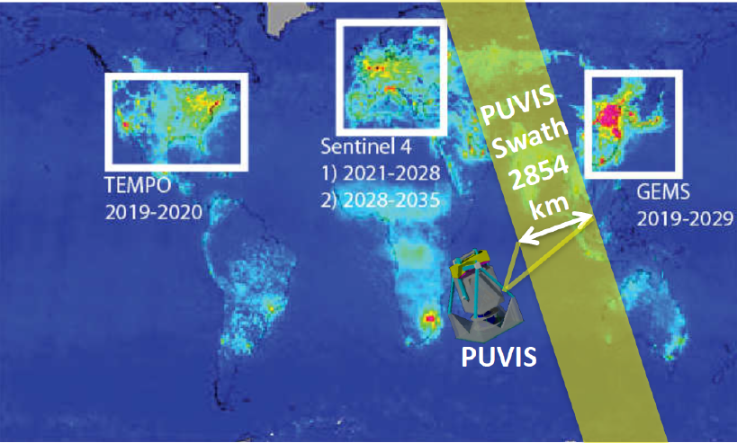
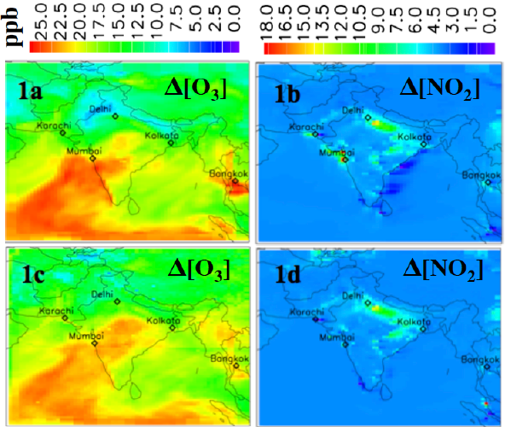

IIP-2016 Concept: A Polarization UV-Vis Imaging Spectrometer (PUVIS) for the Composition in the Lower Most Troposphere
PI: Dejian Fu, JPL
Description and Objectives:
The proposed effort will advance the state of art in the imaging spectropolarimetric technology thus enabling new Earth measurement capabilities of atmospheric composition in the Lower Most Troposphere (0-2 km) with meeting the accuracy/precision/resolution requirements specified by the 2017 NASA Decadal Survey science community [Neu J.L. et al., 2016; Pickering K. et al., 2016] and the 2015 NASA workshop on Outstanding Questions in Atmospheric Composition named “Air Quality in the Developing World”.
PUVIS not only enables new Earth science measurements, its design substantially reduces the size, mass, power, volume, and cost of the instrumentation needed to accomplish key air quality and climate science objects identified by science community.
Air-PUVIS: to fit readily on a NASA aircraft for demonstrating the technology and advancing TRL. When flying on ER-2 (cruise altitude: ~20 km a.b.s.l.), the spatial resolution would be 100×100 m² with a swath width of 31 km.
Satellite-PUVIS: to provide unique high spatial resolution (4×4 km²) and high sensitivity measurements of LMT O₃ and NO₂, and a set of trace gases (HCHO, SO₂, BrO, C₂H₂O₂, Aerosol & Cloud properties), with a swath width of 2,854 km when onboard a 12 U platform in a LEO orbit (altitude ~ 824 km a.b.s.l.).
1a and 1b: Model Difference
1c and 1d: Difference in Simulated Retrieval
Figure 1: (Upper Panel) Unprecedented global LMT O₃ and NO₂ measurements of PUVIS, covering key regions not observed by the slated future GEO missions. (1a-d) Estimated performance of PUVIS measurements in capturing the changes of LMT O₃ and NO₂ between polluted and clean days over India: True differences of O₃ (1a) and NO₂ (1b); Simulated PUVIS measurements of O₃ (1c) and NO₂ (1d).
August/17

Slide 18
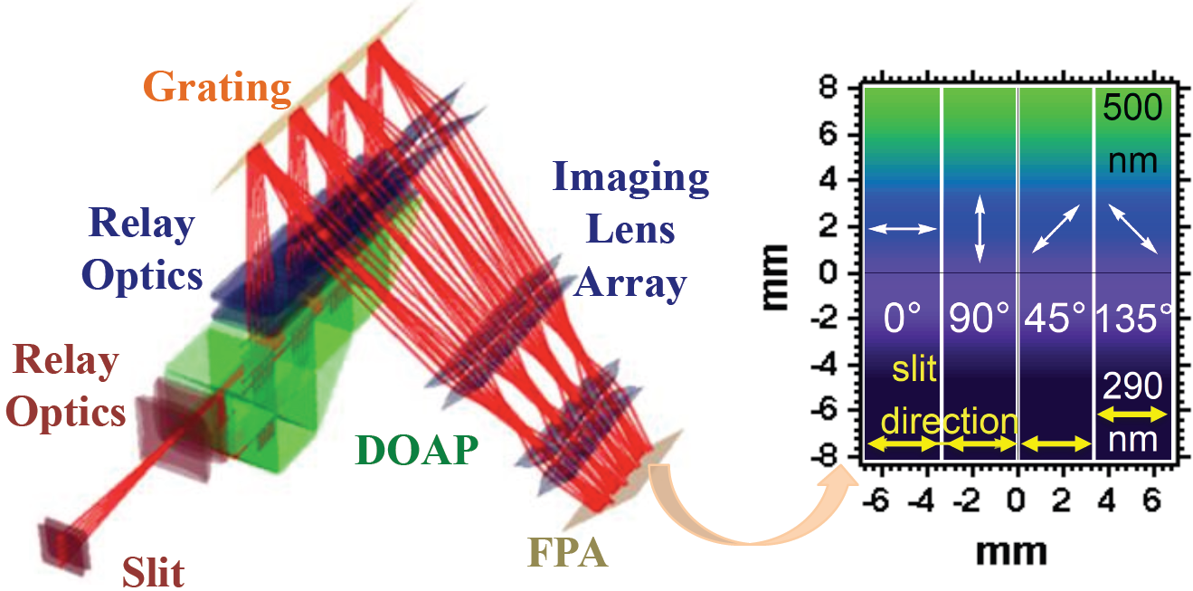
IIP-2016 Concept: A Polarization UV-Vis Imaging Spectrometer (PUVIS) for the Composition in the Lower Most Troposphere
PI: Dejian Fu, JPL
Description and Objectives:
The proposed effort will advance the state of art in the imaging spectropolarimetric technology thus enabling new Earth measurement capabilities of near surface (0-2 km) atmospheric composition, as specified by the 2017 NASA Decadal Survey science community.
Advance the innovative imaging spectropolarimetric technology (TRL in/out: 3/5)
Advance the high quantum efficiency, low noise UV-Vis Focal Plane Assembly (FPA) technology (TRL in/out: 3/5)
Advance the TRL of a Air-PUVIS instrument package (TRL in/out: 3/4)
(Left) Optics design from Polaris-M polarization ray trace program
(Right) Layout of spatial and spectropolarimetric image on the FPA.
Approach:
Key Milestones
Capitalize on UofA’s and JPL’s unique strengths in optical/coating design for accurate polarization measurements and UV-Vis sensitive, low-noise FPAs
Design/build/calibrate a precision/accuracy (≤0.5%) resilient imaging spectropolarimeter
Build/characterize a UV-Vis sensitive (QE≥50%; 290-500nm), low-noise, high-read-out rate FPA by modifying a commercial 2-D sCOMS detector
Validate end-to-end high-accuracy polarimetry and radiometry in the laboratory, followed by field tests
Optics and coatings design review 06/17
Detector tests, meeting requirements 04/18
Spectropolarimeter integrated 04/18
Spectropolarimeter calibrated 11/18
FPA software design review 12/18
FPA tests, meeting requirements 04/19
PUVIS system integrated 06/19
End-to-end spectropolarimetric calibration 09/19
PUVIS field tests 10/19
Deliver final report to NASA IIP program office 12/19
TRL_{in} = 3
TRL_{out} = 5 (Spectropolarimeter, UV-Vis FPA)
  4 (PUVIS System)
CoIs: Russell Chipman, University of Arizona
Shouleh Nikzad, Stanley Sander; and Shanshan Yu, JPL
August/17

Slide 19
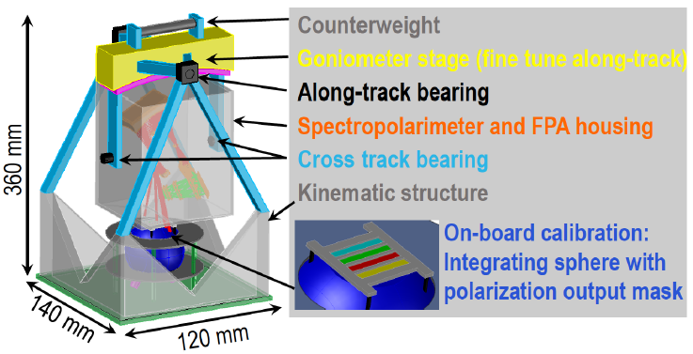
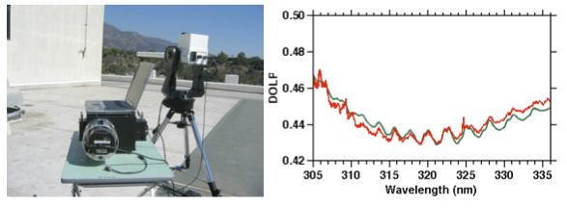
The JPL ground-based UV-Vis Spectropolarimeter, an innovative remote sensing instrument, can rapidly deliver accurate and high vertical resolution profiles for O₃ and its precursors. This capability could greatly contribute to the validation programs of satellite missions, and the ground-based network of air quality and atmospheric composition.
IIP-2016 Concept: A Polarization UV-Vis Imaging Spectrometer (PUVIS) for the Composition in the Lower Most Troposphere
PI: Dejian Fu, JPL
Operational Concept
We propose building an aircraft-size (6U, shown in Figure 3) PUVIS instrument package (FOV 76°, single FPA), which will readily fly on an aircraft for demonstrating the operational readiness in the coming NASA programs in December 2019.
For future space mission, PUVIS could provide imaging spectropolarimetric measurements with a wide swath (FOV 120°, through combining two sets of optics and the FPAs) from a 12U platform in a LEO orbit.
Figure 3. 3-D view of Air-PUVIS.
Measurement
Simulation
Figure 4. (Left) A heritage ground-based high resolution UV-Vis spectropolarimeter that was built with support from the JPL internal Research and Technology Development program. (Right) Measured (red) and simulated (green curve) degree of linear polarization of O₃ from the rooftop of a JPL building.
August/17

Slide 20
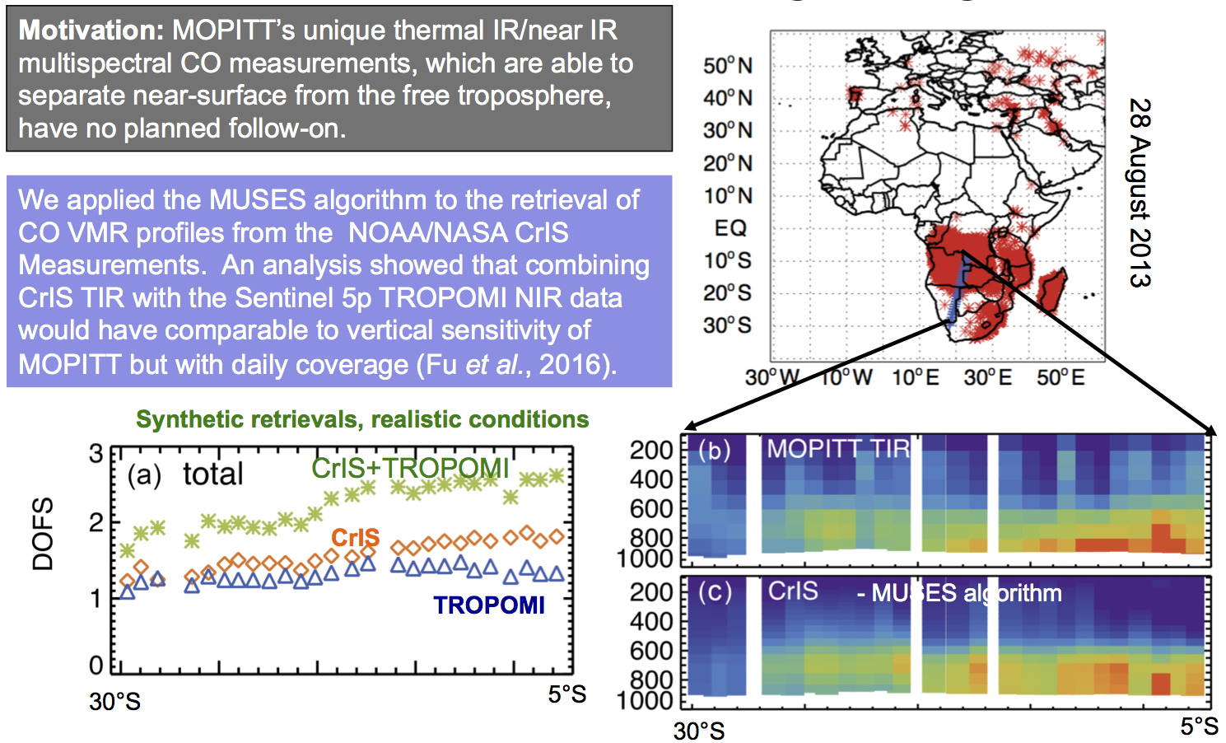
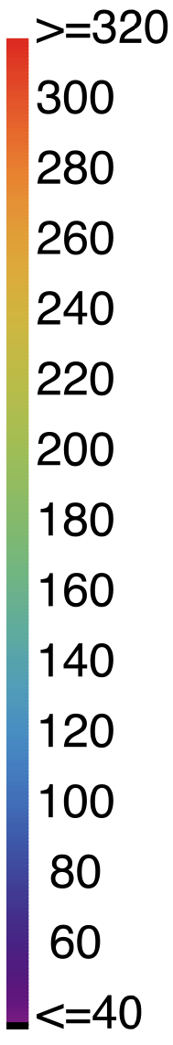

CrIS and MOPITT CO during Biomass Burning on August 27-28, 2013

Slide 21
Applied TES algorithm to IASI Data
Oetjen H., Payne V.H., et al., ACP, 2016: A joint data record of tropospheric ozone from Aura-TES and MetOp-IASI

