Slide 1
NUCAPS EDR Product Performance: Ozone and Carbon Trace Gases
Nicholas R. Nalli^{1,2}, Q. Liu², C. Tan^{1,2}, A. Gambacorta³, C. D. Barnet³, X. Xiong^{1,2}, F. Iturbide-Sanchez^{1,2}, M. Wilson^{1,2}, J. W. Smith^{3,4}, et al.
¹IMSG, Rockville, Maryland, USA
²NOAA/NESDIS/STAR, College Park, Maryland, USA
³STC, Columbia, Maryland, USA
⁴National Research Council, Washington, DC, USA
2016 NASA Sounder Science Team
Greenbelt, Maryland, USA
September 2016

Slide 2
Acknowledgments
The NOAA Joint Polar Satellite System (JPSS-STAR) Office (M. D. Goldberg, L. Zhou, et al.) and the NOAA/STAR Satellite Meteorology and Climatology Division (F. Weng and I. Csiszar).
SNPP Sounder Trace Gas EDR Validation Dataset collection
Ozone
NOAA AEROSE: V. R. Morris, E. Joseph, M. Oyola (HU/NCAS); D. Wolfe (NOAA/ESRL)
AEROSE works in collaboration with the NOAA PIRATA Northeast Extension (PNE) project (R. Lumpkin, G. Foltz and C. Schmid), and is supported by the NOAA Educational Partnership Program (EPP) grant NA17AE1625, NOAA grant NA17AE1623, JPSS and STAR
CalWater/ACAPEX: R. Spackman (STC); R. Leung (PNNL); C. Fairall, J. Intrieri (NOAA); N. Hickmon, M. Ritsche, A. Haruta, and the ARM Mobile Facility 2 (AMF2)
World Ozone and Ultraviolet Radiation Data Centre (WOUDC) data contributors (DWD-GRUAN, & INPE, & KNMI, & NASA-WFF, & SMNA. http://www.woudc.org
SHADOZ: Southern Hemisphere ADditional Ozonesondes (A. Thompson et al.)
Carbon Trace Gases
NASA Sounder Science Team: E. Olsen (for his expertise and assistance with the AIRS v6 EDR products), and T. Pagano, E. Fetzer (NASA/JPL)
Total Carbon Column Observing Network (TCCON) (D. Wunch et al.) data were obtained from the TCCON Data Archive, hosted by the Carbon Dioxide Information Analysis Center (CDIAC), tccon.onrl.gov
STAR soundings team (past and present): A.K. Sharma, T. King, W. W. Wolf (STAR)

Slide 3
Outline
JPSS Sounder Trace Gas EDR Cal/Val Overview
JPSS Level 1 Requirements
Validation Hierarchy recap
NUCAPS Algorithm
Offline v1.5 (operational emulation, CrIS nominal res)
Offline v1.8.x (CrIS full-res)
NUCAPS IR Ozone Profile EDR Product Evaluation
v1.5 (operational emulation)
Global Focus Day
Ozonesonde ensemble
v1.8.1 (CrIS full-res)
Global Focus Day
NUCAPS Trace Gas EDR Product Evaluation (Preliminary)
Truth Datasets and Methodology
AIRS Version 6
TCCON
NUCAPS (v1.5 and v1.8.3) versus AIRS v6
Carbon Monoxide (CO)
Methane (CH₄)
Carbon Dioxide (CO₂)
NUCAPS and AIRS versus TCCON
Summary and Future Work

Slide 4
JPSS Sounder Trace Gas EDR Cal/Val Overview
NUCAPS EDR Product Performance: Ozone and Carbon Trace Gases

Slide 5
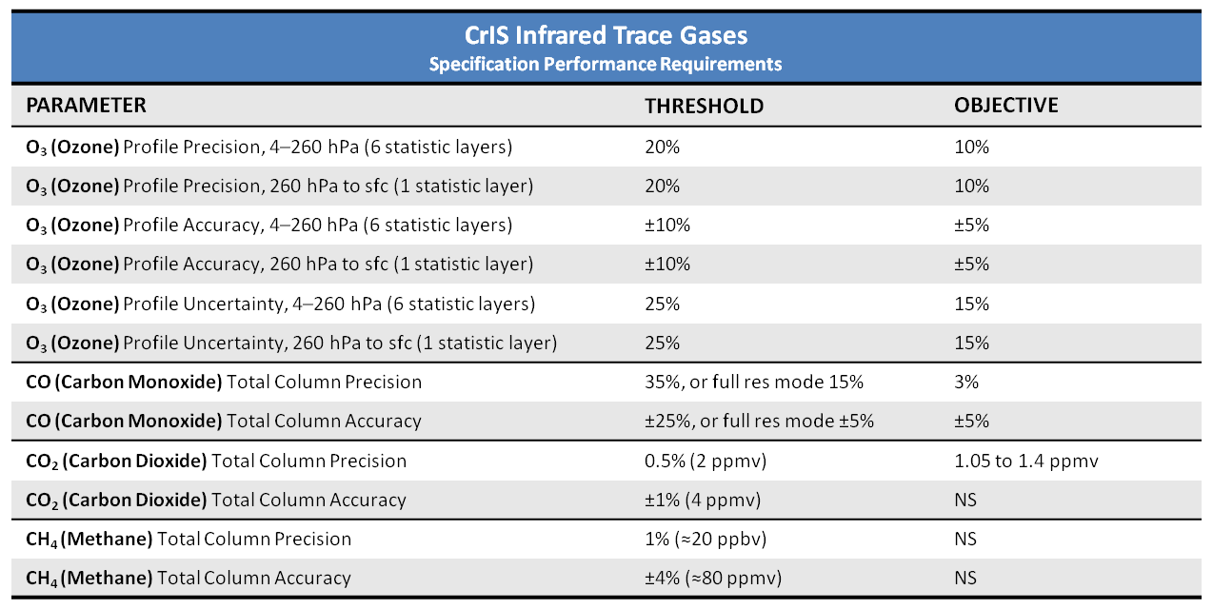
JPSS Specification Performance Requirements CrIS Trace Gas EDR Uncertainty (O₃, CO, CO₂, CH₄)
Source:
(L1RD, 2014, pp. 45-49)

Slide 6
Validation Methodology Hierarchy (e.g., Nalli et al., JGR Special Section, 2013)
Numerical Model (e.g., ECMWF, NCEP/GFS) Global Comparisons
Large, truly global samples acquired from Focus Days
Useful for sanity checks, bias tuning and regression
Limitation: Not independent truth data
Satellite Sounder EDR (e.g., AIRS, ATOVS, COSMIC) Intercomparisons
Global samples acquired from Focus Days (e.g., AIRS)
Consistency checks; merits of different retrieval algorithms
Limitation: Similar error characteristics; must take rigorous account of averaging kernels of both systems (e.g., Rodgers and Connor, 2003)
Conventional RAOB Matchup Assessments
WMO/GTS operational sondes launched ~2/day for NWP
Representation of global zones, long-term monitoring
Large samples after a couple months (e.g., Divakarla et al., 2006; Reale et al. 2012)
Limitations:
Skewed distribution toward NH-continents
Mismatch errors, potentially systematic at individual sites
Non-uniform, less-accurate and poorly characterized radiosondes
RAOBs assimilated , by definition, into numerical models
Dedicated/Reference RAOB Matchup Assessments
Dedicated for the purpose of satellite validation
Known measurement uncertainty and optimal accuracy
Minimal mismatch errors
Atmospheric state “best estimates” or “merged soundings”
Reference sondes: CFH, GRUAN corrected RS92/RS41
Traceable measurement
Uncertainty estimates
Limitation: Small sample sizes and limited geographic coverage
E.g., ARM sites (e.g., Tobin et al., 2006), AEROSE, CalWater/ACAPEX , BCCSO, PMRF
Intensive Field Campaign Dissections
Include dedicated RAOBs, some not assimilated into NWP models
Include ancillary datasets (e.g., ozonesondes, lidar, M-AERI, MWR, sunphotometer, etc.)
Ideally include funded aircraft campaign using IR sounder (e.g., NAST-I, S-HIS)
Detailed performance specification; state specification; SDR cal/val; case studies
E.g., SNAP, SNPP-1,-2, AEROSE, CalWater/ACAPEX, JAIVEX, WAVES, AWEX-G, EAQUATE
Notes:
SNAP – Suomi-NPP Aircraft validation Program (2015)

Slide 7
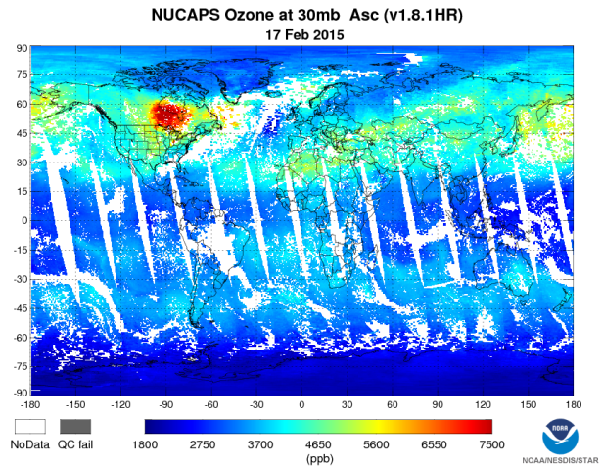
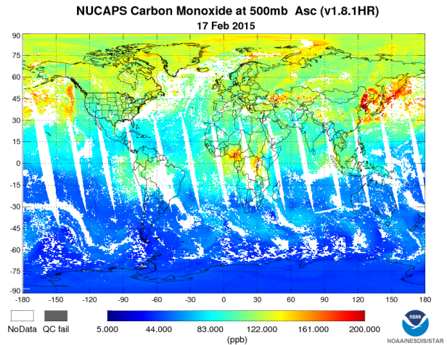
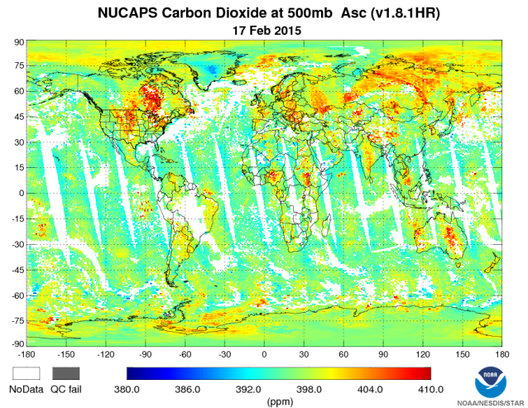
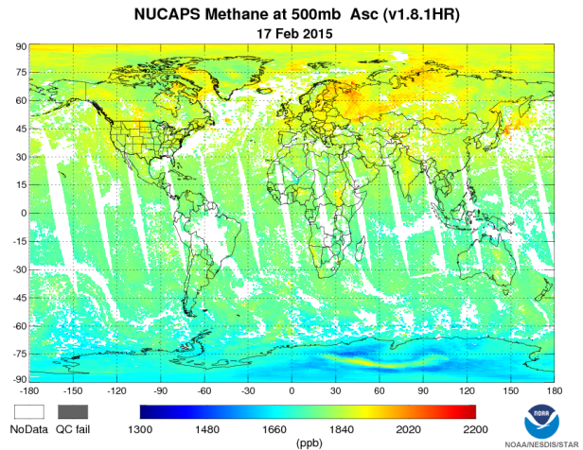
NOAA Unique Combined Atmospheric Processing System (NUCAPS) Algorithm (1/2)
Operational algorithm
Unified Sounder Science Team (AIRS/IASI/CrIS) retrieval algorithm (Susskind, Barnet and Blaisdell, IEEE 2003; Gambacorta et al., 2014)
Global non-precipitating conditions
Atmospheric Vertical Temperature , Moisture Profiles (AVTP, AVMP)
Trace gas profiles (O₃, CO, CO₂, CH₄)
Validated Maturity for AVTP/AVMP, Sep 2014
Users
Weather Forecast Offices (AWIPS)
Nowcasting / severe weather
Alaska (cold core)
NOAA/CPC (OLR)
NOAA/ARL (IR ozone, trace gases)
TOAST (IR ozone)
Basic and applied science research (e.g., Pagano et al., 2014)
Via NOAA Data Centers (e.g., CLASS)
Atmospheric chemistry research
Universities, peer-reviewed pubs
NUCAPS IR O₃
NUCAPS CO
NUCAPS CO₂
NUCAPS CH₄

Slide 8
NOAA Unique Combined Atmospheric Processing System (NUCAPS) Algorithm (2/2)
NUCAPS Offline Code Versioning
Version 1.5
Offline emulation of current operational algorithm
Runs on nominal CrIS spectral resolution data
Version 1.8.1
Offline experimental algorithm (used in ozone results)
Runs on CrIS full spectral resolution data
Uses conventional regression algorithm for the IR/MW first guess (as opposed to MW retrieval as in v1.7 full-res)
Other upgrades
Updated IR RTA bias correction coefficients (based on the best combination resulted after testing the use of several atmospheric states and trace gaseous profiles)
IR emissivity threshold decreased from 1.05 to 1.0 in the temp_cris.nl namelist.
Replaced the Taylor expansion to the Exponential formula in fasttau_co2.F
As in v1.6: Updated MW bias correction; updated MW RTA model error coefficients; removal of MW channel 16
Version 1.8.3
Offline experimental algorithm (used in carbon trace gas results)
Retrieval step changed from “RODCO2” (Rodgers) to “CO2”
Optimized channels for CO₂, CO and CH₄ (damping is also changed)
Optimized CH₄ first guess

Slide 9
IR OZONE Profile EDR
NUCAPS EDR Product Performance: Ozone and Carbon Trace Gases

Slide 10
IR Ozone Profile EDR Validation (1/8) In Situ Truth Datasets
Collocated ozonesondes for O₃ (ozone) profile EDR
Dedicated Ozonesondes
NOAA AEROSE (Nalli et al. 2011)
CalWater/ACAPEX 2015
Sites of Opportunity
SHADOZ (Thompson et al. 2007)
Costa Rica
Hanoi
Irene
Java
Natal
Paramaribo
Reunion
American Samoa
WOUDC
STN043
STN053
STN107
STN101
Notes:
SHADOZ - Southern Hemisphere Additional Ozonesondes MOZAIC - Measurement of Ozone from Airbus in-Service Aircraft WOUDC - World Ozone and Ultraviolet Radiation Data Centre

Slide 11
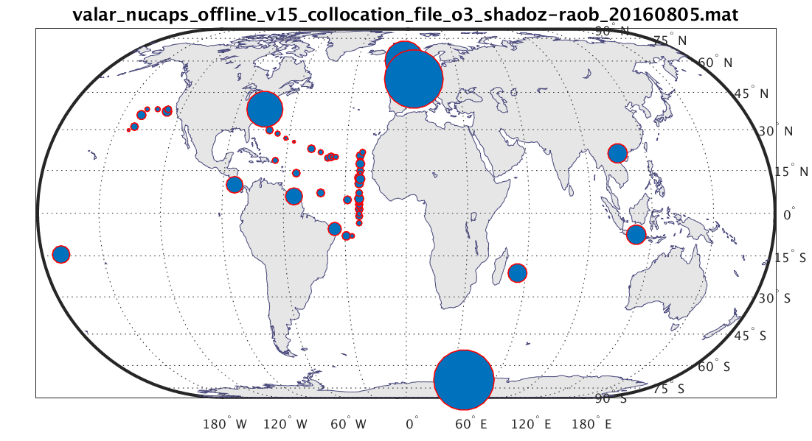
IR Ozone Profile EDR Validation (2/8) VALAR Ozonesonde-FOR Collocation Sample (n = 6024)
Geographic Histogram (Equal Area)
FOR Collocation Criteria: δx ≤ 125 km, −240 < δt < +120 min

Slide 12
IR Ozone Profile EDR Validation (3/8) NUCAPS Offline (v1.5) versus Global Ozonesondes
Retrieval and A Priori First Guess
IR+MW Yield = 62.2%

Slide 13
IR Ozone Profile EDR Validation (4/8) NUCAPS Offline (v1.5) versus Global Ozonesondes
Retrieval and ECMWF
IR+MW Yield = 62.2%

Slide 14
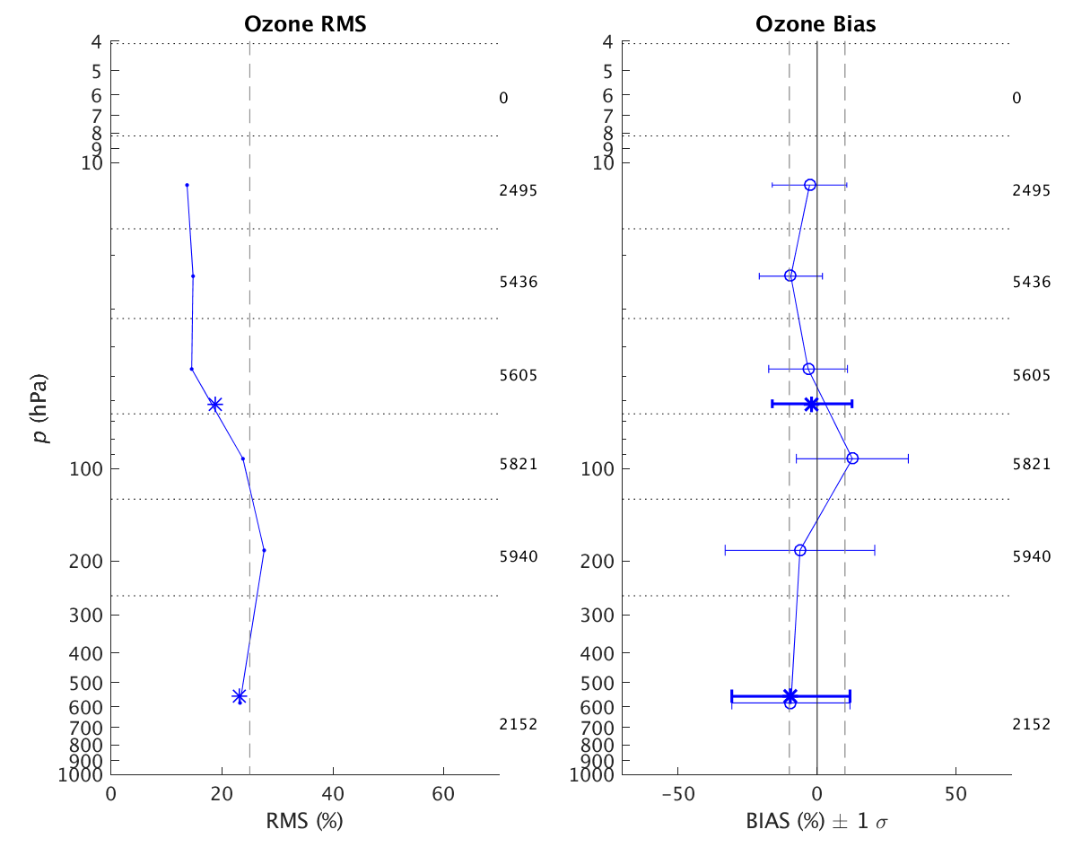
IR Ozone Profile EDR Validation (5/8) NUCAPS Offline (v1.5) versus Global Ozonesondes
* Broad-Layer Statistics
(Per JPSS Level 1 Requirements)
IR+MW Yield = 62.2%

Slide 15
IR Ozone Profile EDR Validation (6/8) NUCAPS Offline (v1.5) versus Global Focus Day 17-Feb-2015
O₃ Versus ECMWF
IR+MW
First Guess
NUCAPS v1.5
Yield = 63.4%

Slide 16
IR Ozone Profile EDR Validation (7/8) NUCAPS Offline (v1.8.1) versus Global Focus Day 17-Feb-2015
O₃ Versus ECMWF
IR+MW
First Guess
NUCAPS v1.8.1
Yield = 70.1%

Slide 17
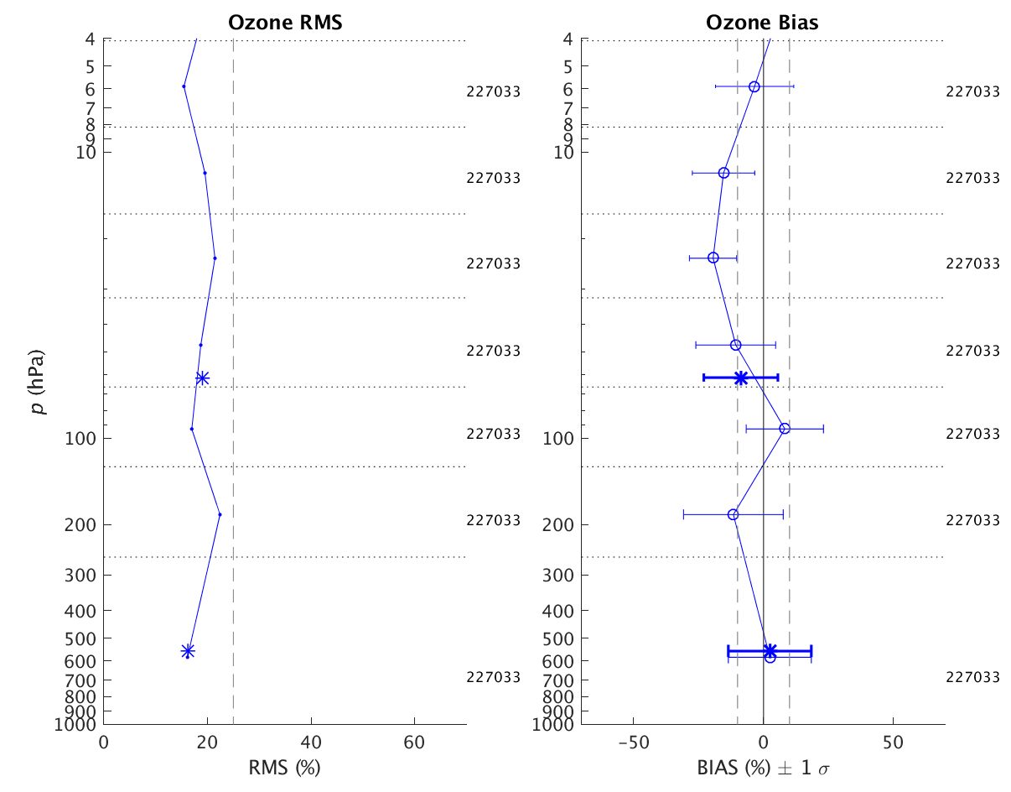
IR Ozone Profile EDR Validation (8/8) NUCAPS Offline (v1.8.1) versus Global Focus Day 17-Feb-2015
* Broad-Layer Statistics
(Per JPSS Level 1 Requirements)
NUCAPS v1.8.1
Yield = 70.1%

Slide 18
Carbon Trace Gases
NUCAPS EDR Product Performance: Ozone and Carbon Trace Gases

Slide 19
Basic Methodology for Trace Gases (1/2)
Truth Datasets
AIRS v6 standard trace gas EDRs (Cal/Val Method #2)
Obtained for the global Focus Day 17 February 2015
Total column integrated CO and CH₄
Offline v6 runs for CO₂ were made available to us courtesy of Ed Olsen (JPL AIRS Science Team)
Provides global assessment
Total Carbon Column Observing Network (TCCON) (Wunch et al. 2011)
Global network of ground-based FTS that accurately measure total column abundances of CO₂, CO, CH₄, N₂O trace gases
Provides independent “spot checks” for verifying NUCAPS and AIRS at the TCCON station locations

Slide 20
Basic Methodology for Trace Gases (2/2)
NUCAPS and AIRS for 17 February 2015 Focus Day are divided into ascending (ASC) and descending (DES) orbits
Linear interpolations of FOR (lat/lon) are performed to create one-to-one correspondence of collocation data points
AIRS CO, CH₄ interpolated to NUCAPS
NUCAPS CO₂ interpolated to more sparse AIRS
NUCAPS and AIRS are space-interpolated to TCCON stations
Quality assurance (QA)
NUCAPS IR+MW quality flag
AIRS trace gas quality flags
For additional QA on NUCAPS retrievals, we also impose thresholds on retrieval degrees-of-freedom (DoF)
CO₂ = 0.8
CO, CH₄ = 0.4
For NUCAPS CO, CH₄, profile EDRs on 100 RTA layers are integrated to obtain total column abundances (molecules/cm2) (e.g., Nalli et al. 2013)
For NUCAPS CO₂, stats are performed simply for atmospheric column averages (in PPMV)
TCCON CO, CH₄ (in dry mole fractions, ppm) are converted to total column abundance Σ_{i} (molecules/cm²) using the following formula
where x_{i} is the TCCON-measured dry mole fraction for species i, and Σ_{w} is the H₂O column abundance (provided by NUCAPS retrieval).

Slide 21
Carbon monoxide
NUCAPS EDR Product Performance: Ozone and Carbon Trace Gases

Slide 22
Total Column Carbon Monoxide (CO) EDR (1/2) 17 Feb 2015 Focus Day, NUCAPS v1.5 and AIRS v6 Accepted Cases
Preliminary
AIRS v6
NUCAPS v1.5
NUCAPS v1.5
QA Yield = 62.7%

Slide 23
Total Column Carbon Monoxide (CO) EDR (2/2) 17 Feb 2015 Focus Day, NUCAPS v1.8.3 and AIRS v6 Accepted Cases
Preliminary
AIRS v6
NUCAPS v1.8.3
NUCAPS v1.8.3 QA Yield = 67.7%

Slide 24
NUCAPS v1.5 CO − AIRS v6 CO 17 Feb 2015 Focus Day, Accepted Cases
Preliminary
NUCAPS v1.5 (Nominal CrIS Resolution)

Slide 25
NUCAPS v1.8.3 CO − AIRS v6 CO 17 Feb 2015 Focus Day, Accepted Cases
Preliminary
NUCAPS v1.8.3 (Full CrIS Resolution)

Slide 26
Methane
NUCAPS EDR Product Performance: Ozone and Carbon Trace Gases

Slide 27
Total Column Methane (CH₄) EDR (1/2) 17 Feb 2015 Focus Day, NUCAPS v1.5 and AIRS v6 Accepted Cases
Preliminary
AIRS v6
NUCAPS v1.5
NUCAPS v1.5
QA Yield = 62.7%

Slide 28
Total Column Methane (CH₄) EDR (2/2) 17 Feb 2015 Focus Day, NUCAPS v1.8.3 and AIRS v6 Accepted Cases
Preliminary
AIRS v6
NUCAPS v1.8.3
NUCAPS v1.8.3 QA Yield = 67.7%

Slide 29
NUCAPS v1.5 CH₄ − AIRS v6 CH₄ 17 Feb 2015 Focus Day, Accepted Cases
Preliminary
NUCAPS v1.5 (Nominal CrIS Resolution)

Slide 30
NUCAPS v1.8.3 CH₄ − AIRS v6 CH₄ 17 Feb 2015 Focus Day, Accepted Cases
Preliminary
NUCAPS v1.8.3 (Full CrIS Resolution)

Slide 31
Carbon Dioxide
NUCAPS EDR Product Performance: Ozone and Carbon Trace Gases

Slide 32
Mean Column Carbon Dioxide (CO₂) EDR (1/2) 17 Feb 2015 Focus Day, NUCAPS v1.5 and AIRS v6 Accepted Cases
Preliminary
AIRS v6
NUCAPS v1.5
NUCAPS v1.5
QA Yield = 29.5%

Slide 33
Mean Column Carbon Dioxide (CO₂) EDR (1/2) 17 Feb 2015 Focus Day, NUCAPS v1.8.3 and AIRS v6 Accepted Cases
Preliminary
AIRS v6
NUCAPS v1.8.3
NUCAPS v1.8.3
QA Yield = 39.4%

Slide 34
NUCAPS v1.5 CO₂ − AIRS v6 CO₂ 17 Feb 2015 Focus Day, NUCAPS and AIRS Accepted Cases
Preliminary
NUCAPS v1.5 (Nominal CrIS Resolution)

Slide 35
NUCAPS v1.8.3 CO₂ − AIRS v6 CO₂ 17 Feb 2015 Focus Day, NUCAPS and AIRS Accepted Cases
Preliminary
NUCAPS v1.8.3 (Full CrIS Resolution)

Slide 36
NUCAPS v1.8.3 & AIRS versus TCCON: Histograms (QA cases, n = 1230)

Slide 37
NUCAPS & AIRS versus TCCON: Summary Stats (QA cases, n = 1230)
 | v1.5 CrIS Nom Res |  |  | v1.8.3 CrIS Full Res |  |  | v6 AIRS
Trace Gas EDR | BIAS (%) | STD (%) | RMS (%) | BIAS (%) | STD (%) | RMS (%) | BIAS (%) | STD (%) | RMS (%)
CO | +5.7 (±25.0) | 24.5 (35.0) | 25.2 | −1.7 (±5.0) | 9.2 (15.0) | 9.3 | −1.5 | 7.4 | 7.6
CO₂ | 0.7 (±1.0) | 1.0 (0.5) | 1.2 | −0.1 (±1.0) | 0.8 (0.5) | 0.8 | −0.6 | 1.2 | 1.4
CH₄ | −8.1 (±1.0) | 1.7 (0.5) | 8.3 | −5.7 (±1.0) | 1.7 (0.5) | 6.0 | −4.1 | 1.7 | 4.4

Slide 38
O₃, CO, CH₄, CO₂ Trace Gas Summary
The operational NUCAPS IR ozone (O₃) profile EDR products meet JPSS Level 1 requirements and have reached “Validated Maturity”
Offline v1.5 (operational emulation, nominal CrIS resolution) meets requirements, based upon coarse/broad layer statistical analyses versus
Collocated global ozonesondes, including dedicated ozonesondes (Validation Hierarchy Method #4)
Global Focus Day (17 February 2015) ECMWF output (Validation Hierarchy Method #1)
Offline v1.8.1 (full CrIS resolution) also meets Level 1 requirements based upon coarse/broad layer statistical analyses versus global Focus Day ECMWF
Statistics are comparable to the ozonesonde-validated NUCAPS v1.5
Preliminary validation of NUCAPS carbon trace gas EDRs was based upon truth datasets:
Collocated AIRS v6 (satellite EDR Intercomparisons, Validation Method #2)
AIRS flown on Aqua is in the same orbit as SNPP and is thus ideal for collocations with SNPP
Global coverage
TCCON ground-based uplooking FTS measurements
Spot checks of both NUCAPS and AIRS
NUCAPS v1.8.3 CO, CH₄, and CO₂ versus AIRS and TCCON are reasonably close to JPSS Level 1 requirements
Future Work
Further optimization of NUCAPS full-resolution algorithm: Implement full-res RTA delivered by UMBC
Apply additional techniques for QA (e.g., χ², applying AKs, etc.)
Use TCCON H₂O (provided by D. Wunch for subsample of stations) to verify conversion scheme using NUCAPS H₂O
Perform additional “spot-checks” of AIRS and NUCAPS EDRs using additional in situ datasets of opportunity
Utilize a larger data sample (e.g., multiple focus days)

Slide 39
Thank you! Questions?
NUCAPS EDR Product Performance: Ozone and Carbon Trace Gases

