Slide 1
Common Formats and Consistent Products from Sounders Part 1: Technical Issues
Evan M. Manning
Jet Propulsion Laboratory, California Institute of Technology,
4800 Oak Grove Dr., Pasadena, CA 91109

Slide 2
Goal
Our new format for SounderCDF should be:
Easy to use
Interoperable with future products
Standard conformant:
CF
ACDD
Flexible – other instruments, products are “the same but different”

Slide 3
Standards
CF:
Climate and Forecast Metadata
COARDS heritage
Stated goals include:
Locate data in space–time and as a function of other independent variables, to facilitate processing and graphics
Identify data sufficiently to enable users of data from different sources to decide what is comparable, and to distinguish variables in archives
Conventions for dimensions, units, and variable and file attributes
Users will need to consult an interface specification document much less
ACDD:
Attribute Conventions for Dataset Discovery
Mostly file-level or collection-level metadata emphasizing letting users find our data set

Slide 4
Sample tool -- Panoply
Panoply is a cross-platform geo-aware tool from NASA GISS

Slide 5
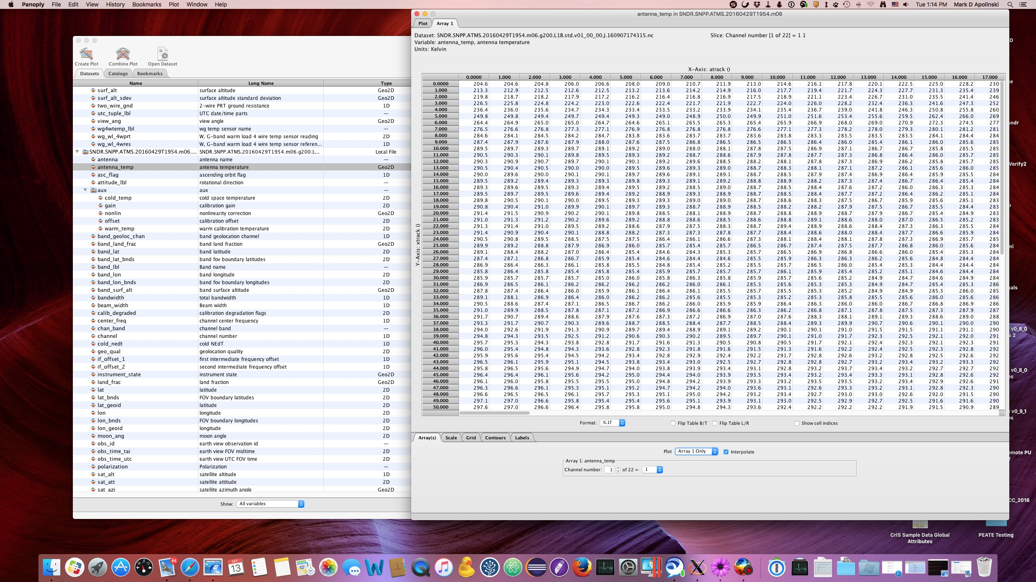
Sample tool -- Panoply
Image: Mark Apolinski

Slide 6
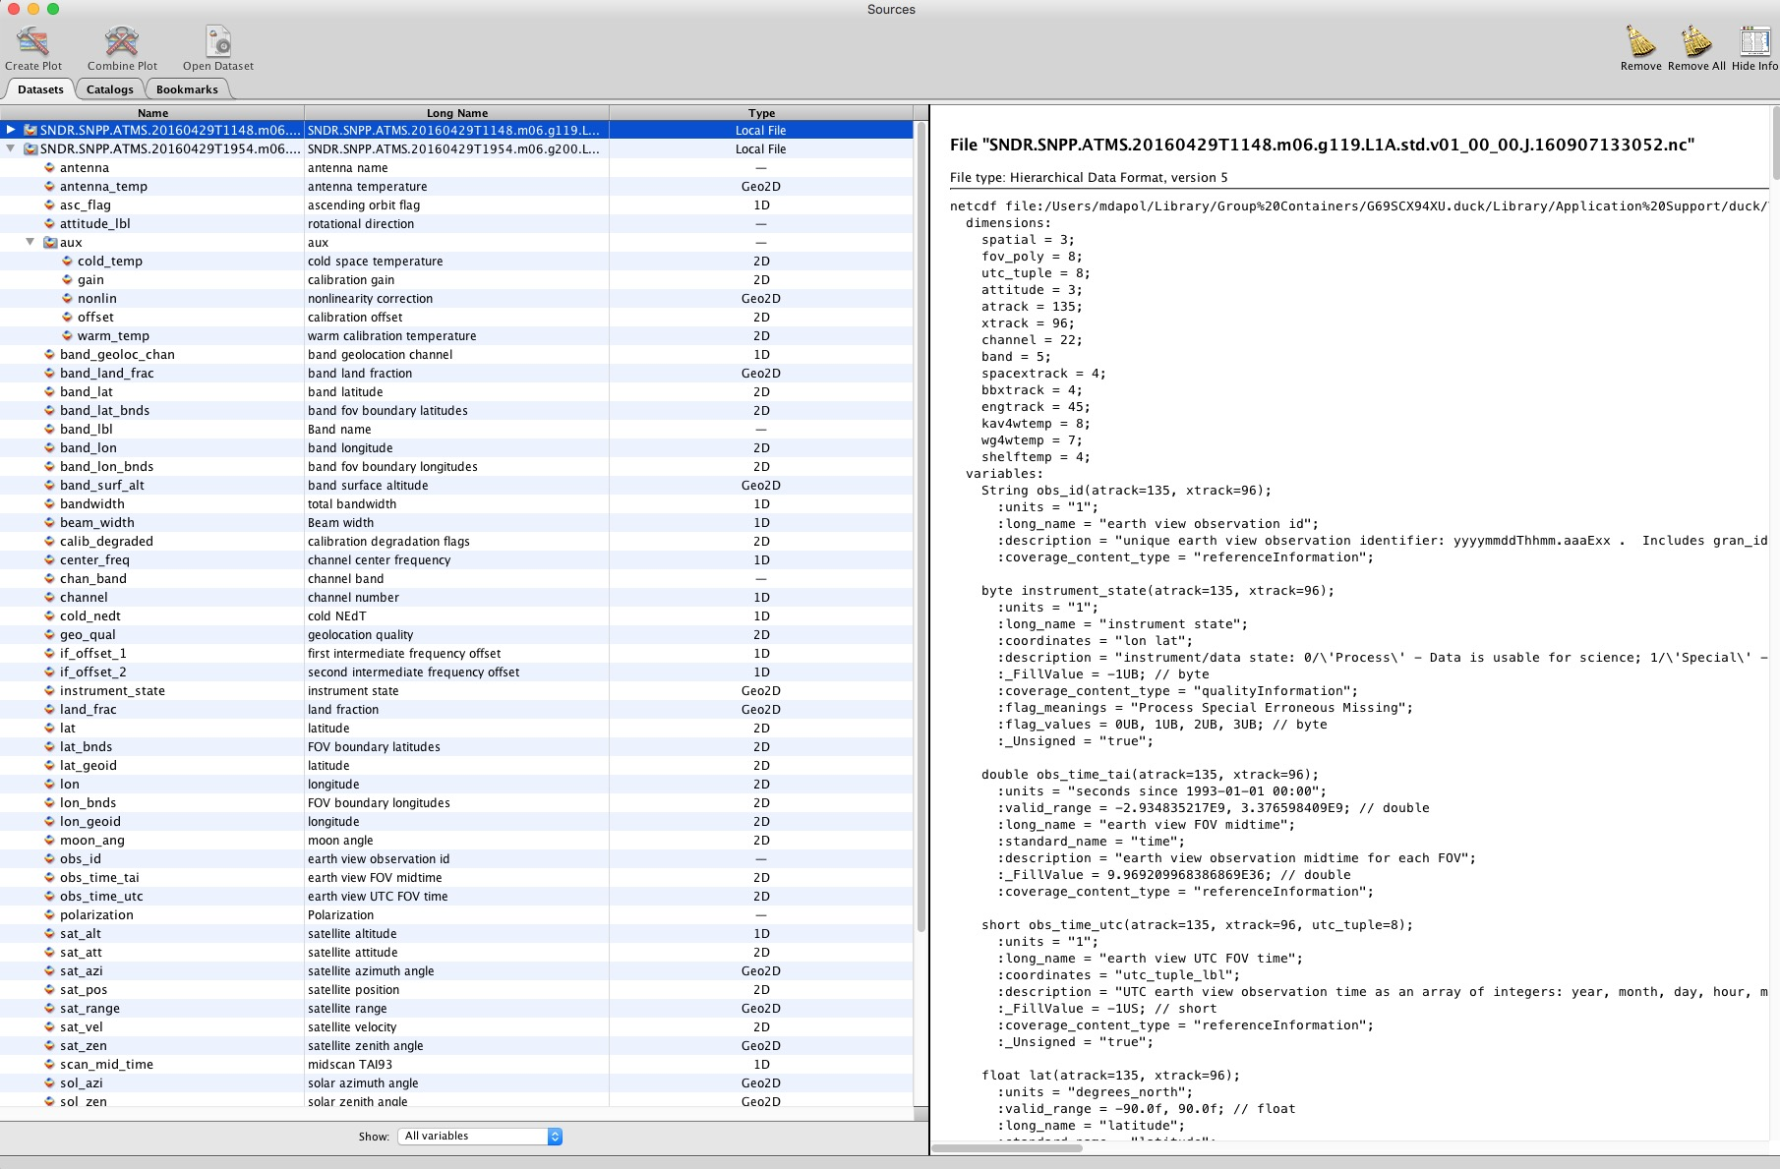
Sample tool -- Panoply
Image: Mark Apolinski

Slide 7
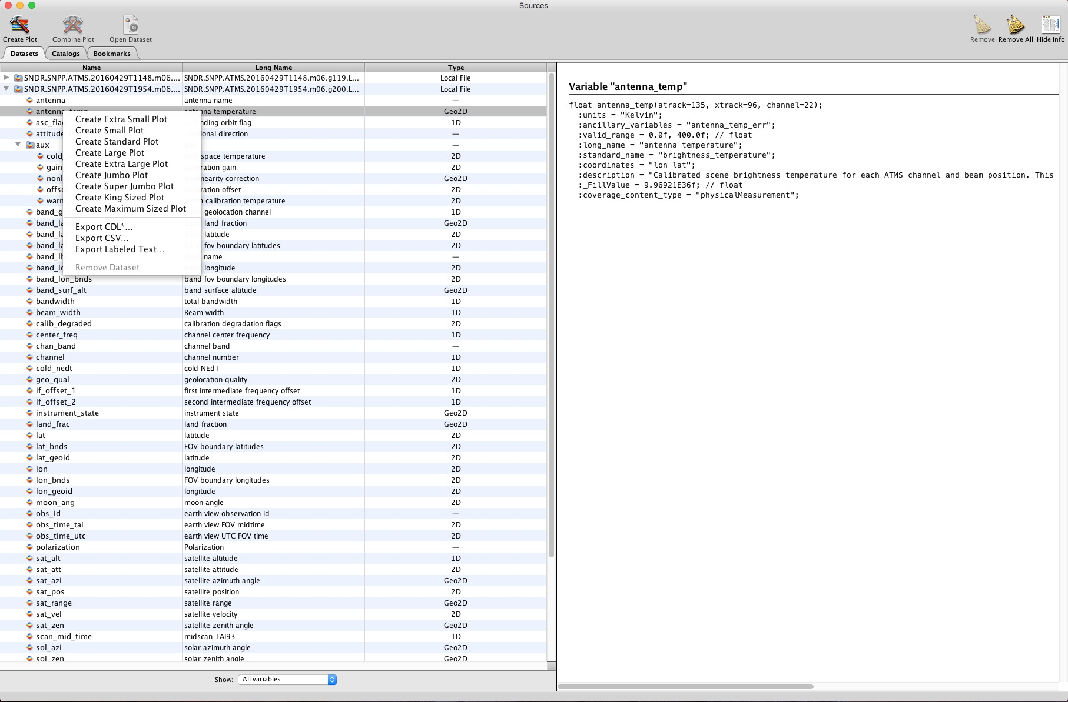
Sample tool -- Panoply
Image: Mark Apolinski

Slide 8
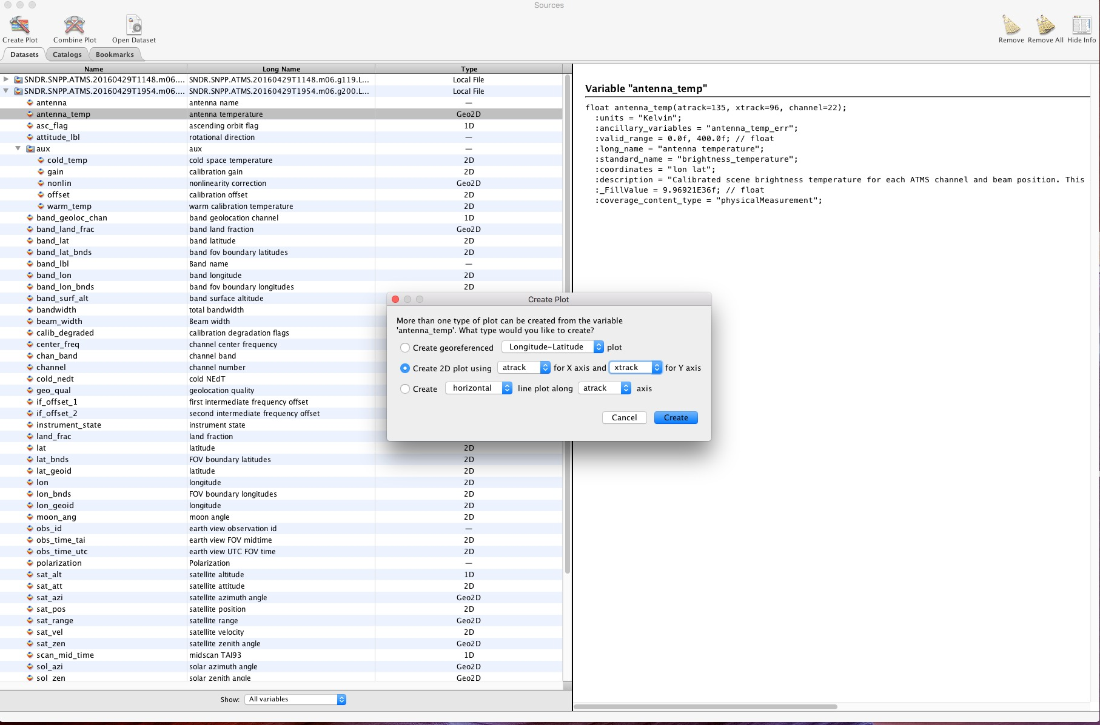
Sample tool -- Panoply
Image: Mark Apolinski

Slide 9
Sample tool -- Panoply
Image: Mark Apolinski

Slide 10
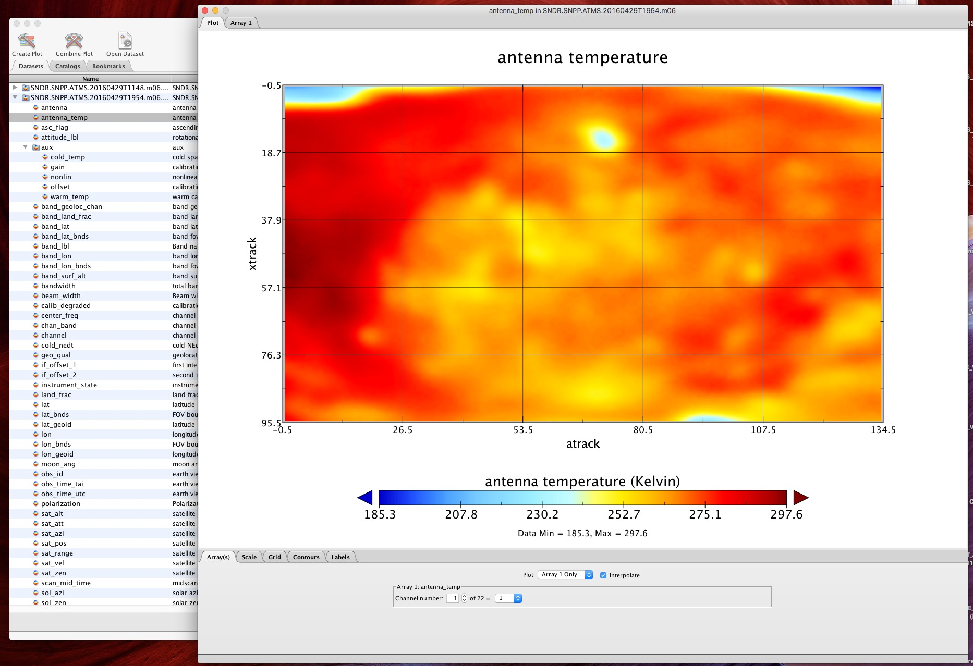
Sample tool -- Panoply
Image: Mark Apolinski

Slide 11
Basic Format
netCDF4
Built on HDF5 – but users should not use the HDF5 library directly
Compared to classic netCDF adds:
Strings
Groups
compound types (structures)
etc.
We minimize use of these new features:
Strings are used but not arrays of strings
Groups are used but sparingly – most parameters are in the root group for most granule products
Compound types are not used.

Slide 12
Granule structure
Like AIRS, SounderCDF Level-1 and Level-2 granule files are six minutes in duration – 45 8-second cycles
But unlike AIRS these granules are closely aligned with UTC time, the first one starting within 8 seconds of midnight.
File names have both start time to the nearest minute and granule number:
SNDR.SNPP.ATMS.20120228T2354.m06.g240.L1B.std.v01_00_00.J.160908005508.nc
The structure is swath-like with primary cross-scan and along-scan dimensions: atrack, xtrack
Plus fov for CrIS

Slide 13
Group structure
netCDF4 allows a hierarchical structure – “groups”
This allows useful partitioning of data
But too much use of the group structure imposes a burden on users, so we keep it simple
Granule Level-1 and Level-2 files will have all of the most commonly used variables in the root group:
Data
Geolocation
QC
Casual users can ignore the group feature entirely
It will be easy to order data with any additional groups stripped out
An “aux” group holds extra information not of interest to most users
L1B CrIS aux includes imaginary components, OPD, fold points, laser wavelength
L1B ATMS aux includes calibration coefficients and hot & cold calibration temperatures
L2 aux varies by algorithm
L2 aux for GSFC algorithm includes first guess, MW-only, QC predictors
L2 also has a “col_den” group with column density profiles

Slide 14
Group Structure for subset files
Subset file types include SNO, Match-Ups, calibration subset
Subset files add a layer of group structure at the top, so there are groups for L1B ATMS vs L1B CrIS vs L2 CrIMSS and new groups with info on the selection process and per-granule info
Example: SNO of Aqua AMSU-A with ATMS:
/l1b_amsua – obs from L1B AMSU-A
/l1b_atms – obs from L1B ATMS
/select – info about the match: distance, dtime, …
/l1b_amsua_ingran – AMSU-A attributes as 240-element arrays: ingran_gran_id, ingran_file_name, ingran_day_night_flag, …
/l1b_atms_ingran

Slide 15
Key dimensions
atrack
Along-track horizontal dimension: 45 or 135
xtrack
Cross-track horizontal dimension: 30 or 96
fov
FOV dimension within FOR: 9
channel
ATMS channel dimension: 22
band
ATMS band dimension for geolocation (1.1, 2.2, 5.2 degree FOVs): 3
chan_lw, chan_mw, chan_sw
CrIS channel dimension
wnum_lw etc. have frequencies in wavenumber
lev_100
100 pressure levels
Coordinate variable lev_100 has the pressures
lay_100
100 pressure layers
Coordinate variable lay_100 has the mid-layer pressures
Boundary variable lay_100_bnds has the layer boundaries

Slide 16
Attributes
SounderCDF files contain many attributes.
Global attributes are like metadata giving info at the file level or higher
Many are required or recommended by CF or ACDD
ACDD attributes generally describe the data set to a new user: instrument, platform, publisher, …
Variable attributes provide information about each variable
long_name
description
standard_name
units
coverage_content_type
valid_range
Coordinates
bounds
_FillValue
ancillary_variables
cell_methods
flag_values, flag_masks, flag_meanings

Slide 17
Variable names
Each variable has several “names”:
The actual name of the variable
We have complete freedom
We go with easy-to-type, short but not cryptic, underscores, no caps:
lat, land_frac, antenna_temp, rad_lw, air_temp
“standard_name”
CF maintains a table. Not all variables have standard names. New names can be added after discussion.
Names are precise:
latitude, land_area_fraction, antenna_temperature, toa_outgoing_radiance_per_unit_wavenumber, air_temperature
“long_name”
Freeform, suitable for use as an axis label by automatic plotting tools
Long for a name but short for a description:
“latitude”, “land fraction”, “antenna temperature”, “longwave real spectral radiance”, “air temperature profile”
“description”
A full description, excluding things like units covered in other attributes
Similar to what you might find in a format specification, but right there in the file:
“latitude of FOV center”
“land fraction over the FOV”
“Calibrated scene brightness temperature for each ATMS channel and beam position. This output is the Rayleigh equivalent temperature and not the Planck blackbody equivalent temperature”
“longwave real spectral radiance”
“air temperature profile on 100 levels”

Slide 18
Variable attribute example: longitude
float lon(atrack, xtrack);
string lon:units = "degrees_east";
float lon:valid_range = -180.0, 180.0;
string lon:long_name = "longitude";
string lon:standard_name = "longitude";
string lon:description = "longitude of FOV center";
float lon:_FillValue = 9.9692099683868690e+36f;
string lon:coverage_content_type = "referenceInformation";
string lon:bounds = "lon_bnds";

Slide 19
Gran_id, Obs_id
Each observation (granule, FOR, and FOV) has a unique identifier over the entire mission.
These will be kept alongside the data in subsets like SNO, match-ups, calibration subset
They should be used when sample granules, spectra, or profiles are included in papers or presentations
gran_id: yyyymmddThhmm – 20160914T1124
obs_id:
ATMS: yyyymmddThhmm.aaaExx -- 20160914T1124.135E96
CrIS FOR, FOR-oriented L2: yyyymmddThhmm.aaExx -- 20160914T1124.45E30
CrIS FOV, FOV-oriented L2: yyyymmddThhmm.aaExx.f -- 20160914T1124.45E30.9

Slide 20
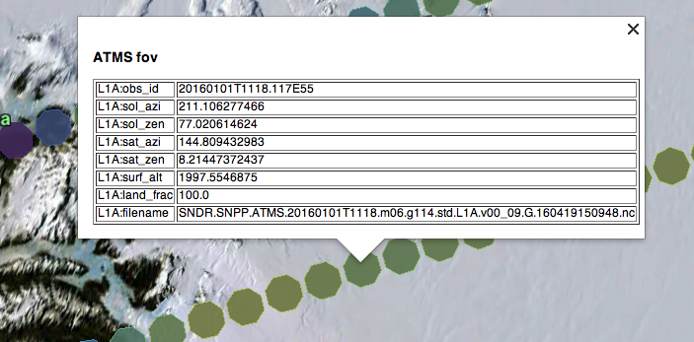
FOV boundaries
One key feature of CF is boundaries.
For each ATMS and CrIS FOV we are able to provide a bounding polygon – currently 8 points.
This will greatly simplify the task of users who want to plot data on a map.
This image shows
Elevation data displayed
in Google Earth using
ATMS FOV polygons
Tool: Jia Zong

Slide 21
SounderCDF in the wild
We have sample data sets of Level-1B for CrIS and ATMS
At JPL now, public soon.
Feedback is still welcome
Level-2 is still under development
Eventually AIRS and hopefully other instruments should adopt this format

