Slide 1
Operational IASI L2 products and services at EUMETSAT
an overview of the latest developments
T. August, T. Hultberg, M. Crapeau, D. Klaes, R. Munro, EUMETSAT
D. Hurtmans, L. Clarisse, P. Coheur, ULB
C: Clerbaux, M. George, LATMOS

Slide 2
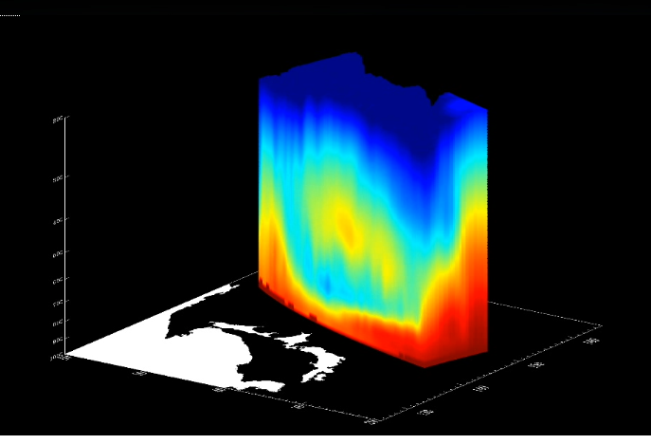
Outline
IASI L2 v6, 2 years in operations (v6.0 9/30/14)
Algorithms updates (v6.2 released 6/2/16)
Sounding and surface products performance
Atmospheric composition products
Applications and services

Slide 3
1. IASI L2 v6 High-level processor overview
L1
Statistical retrieval
Cloud detection
Optimal estimation
Atm. comp.
L2
IASI
PWLR³
All-sky
OEM
AMSU
T, q, T_{s}
O₃
MHS
On every pixel
AVHRR
T, q, T_{s}
O₃
land emiss.
Cloud fraction, top height,
phase
Dust index
O₃
CO
CH₄
SO₂
HNO₃
(CO_{2,} N₂O)
NWP

Slide 4
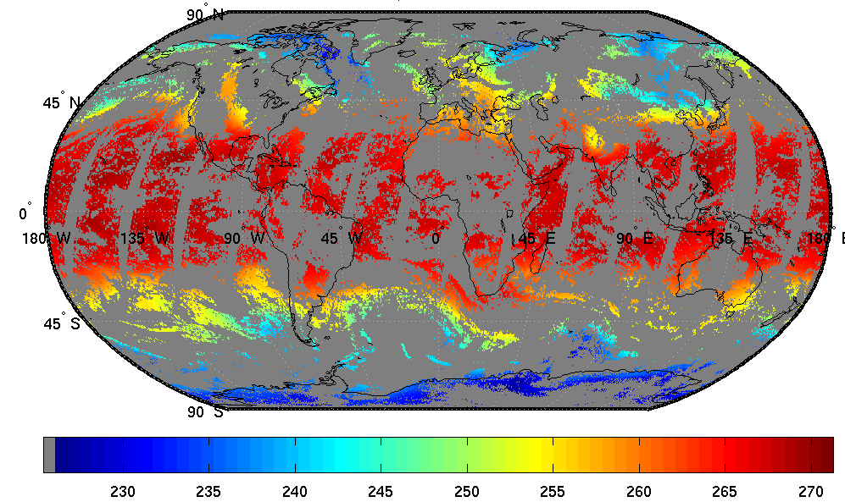
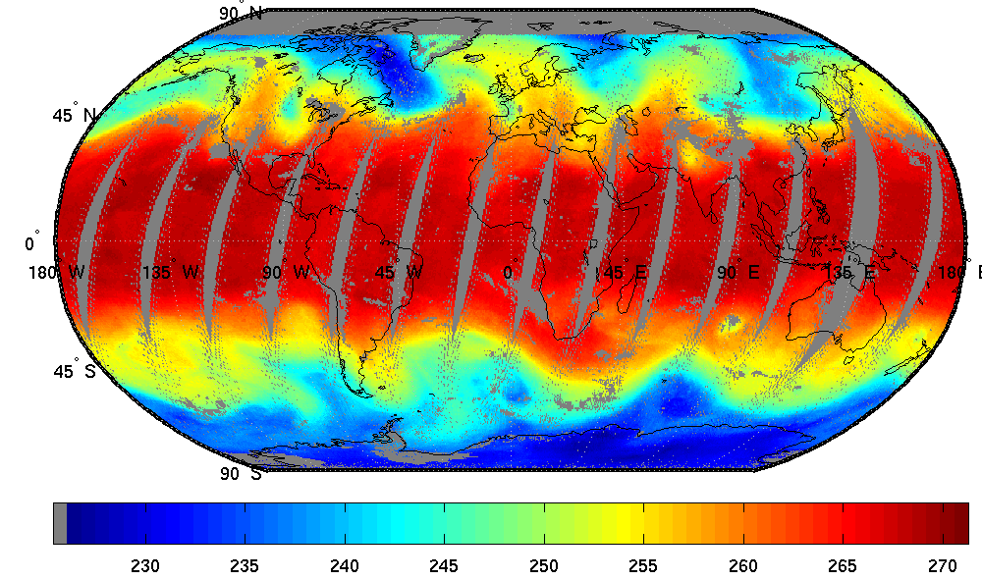
1. IASI L2 v6 Typical useful yield
All-sky PWLR³
26 October 2015
T@500 hPa
Daytime
Clear-sky OEM

Slide 5
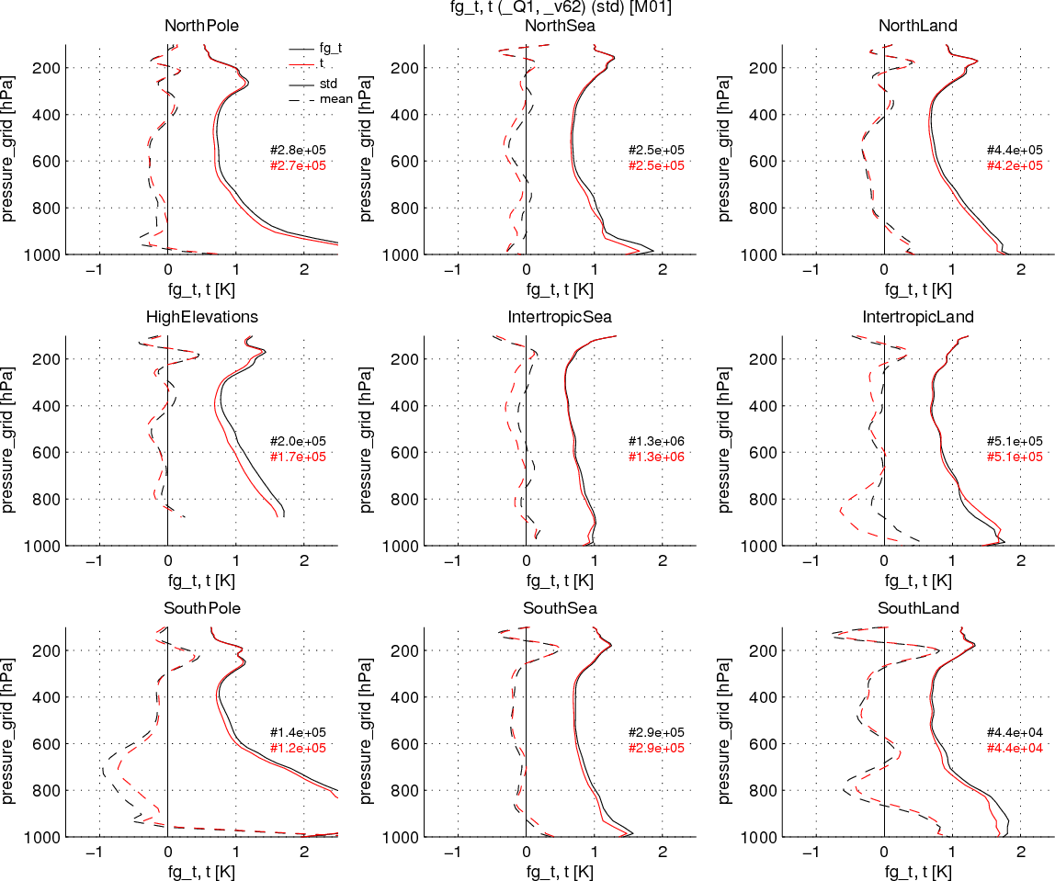
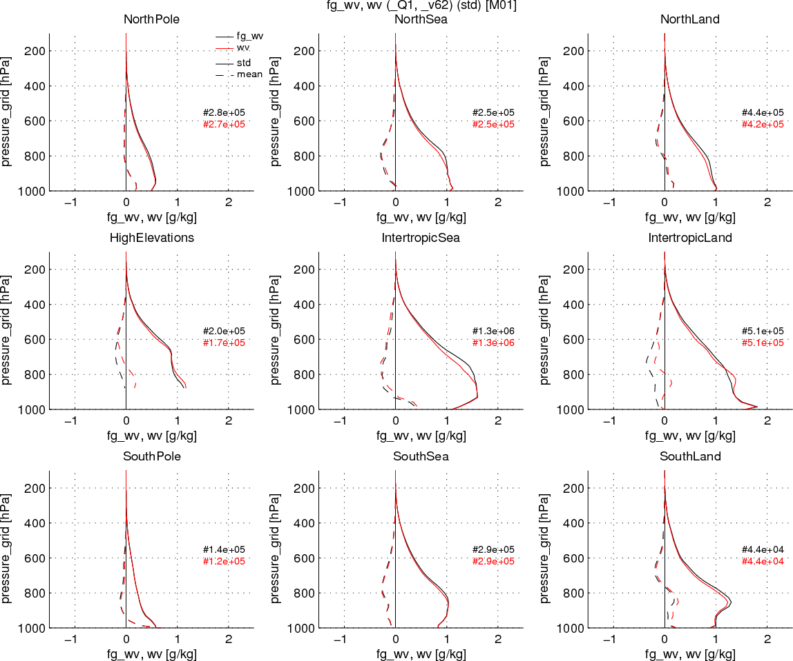
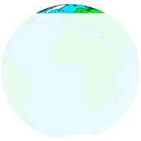
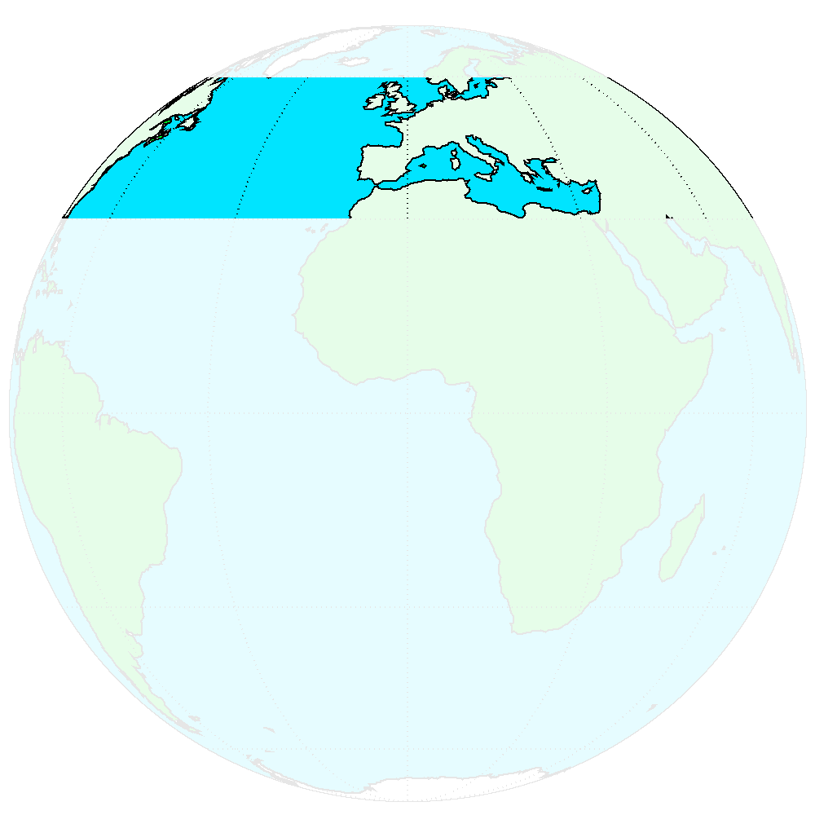
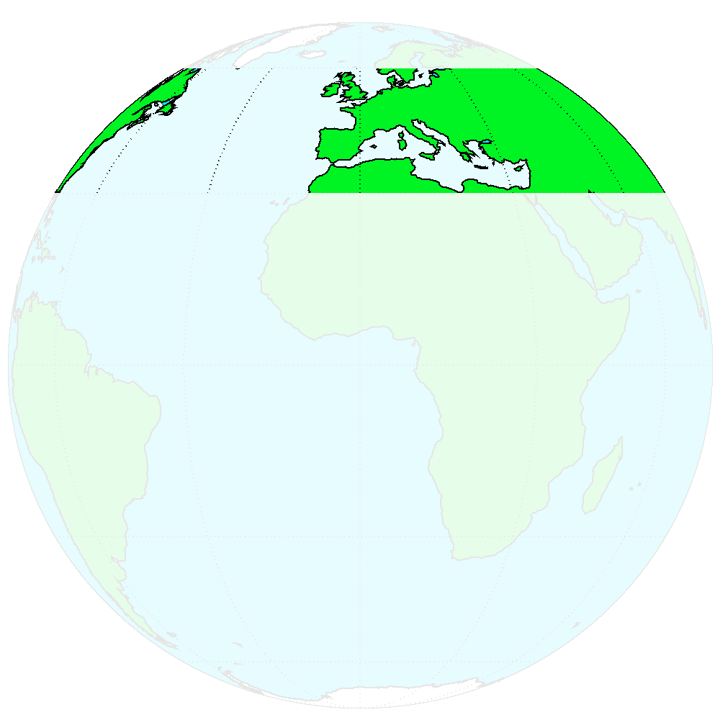
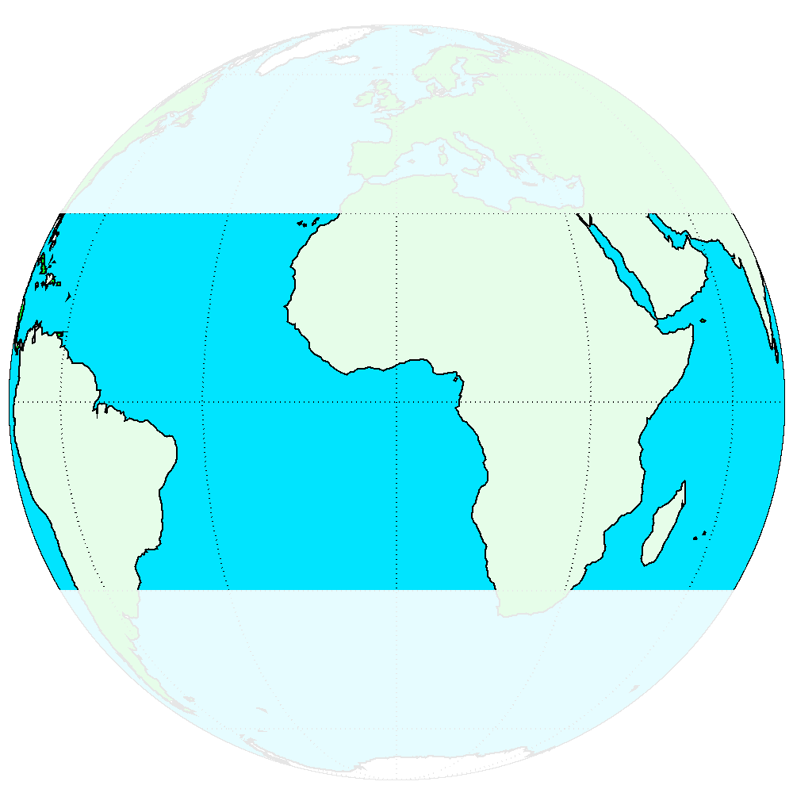
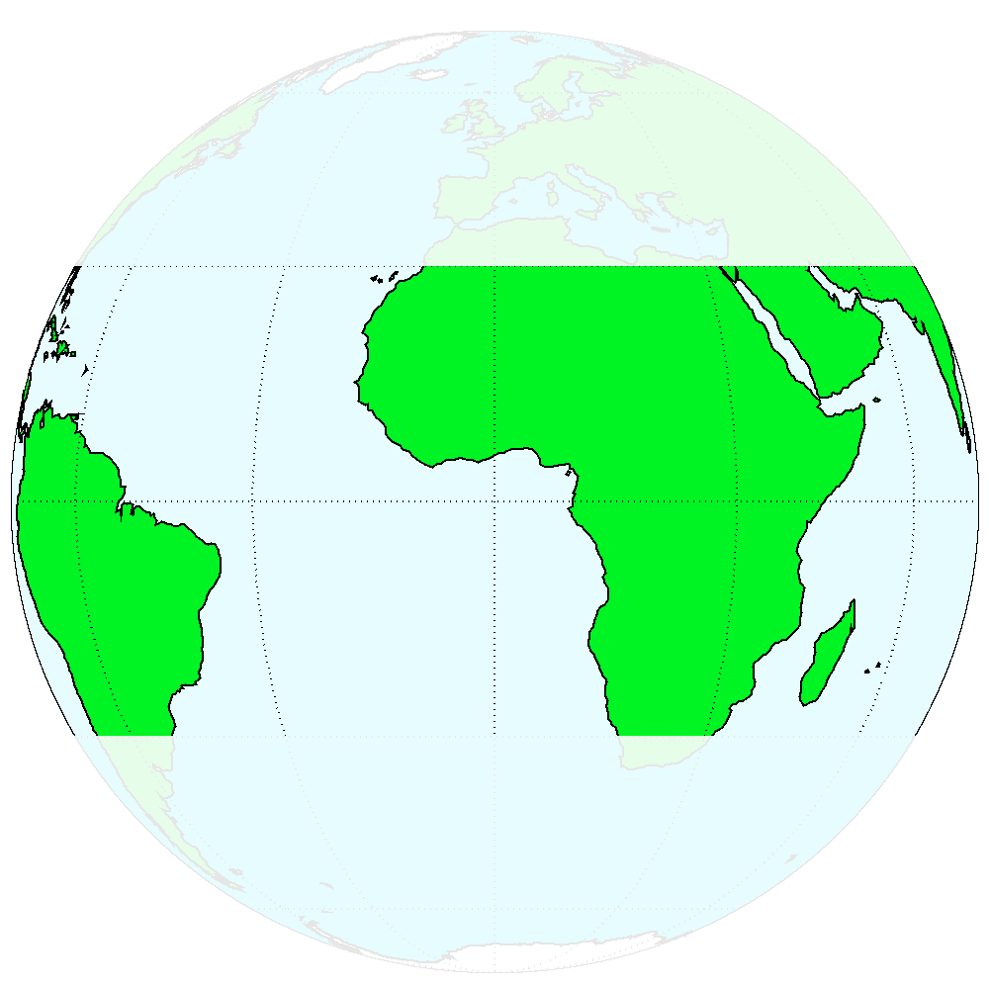
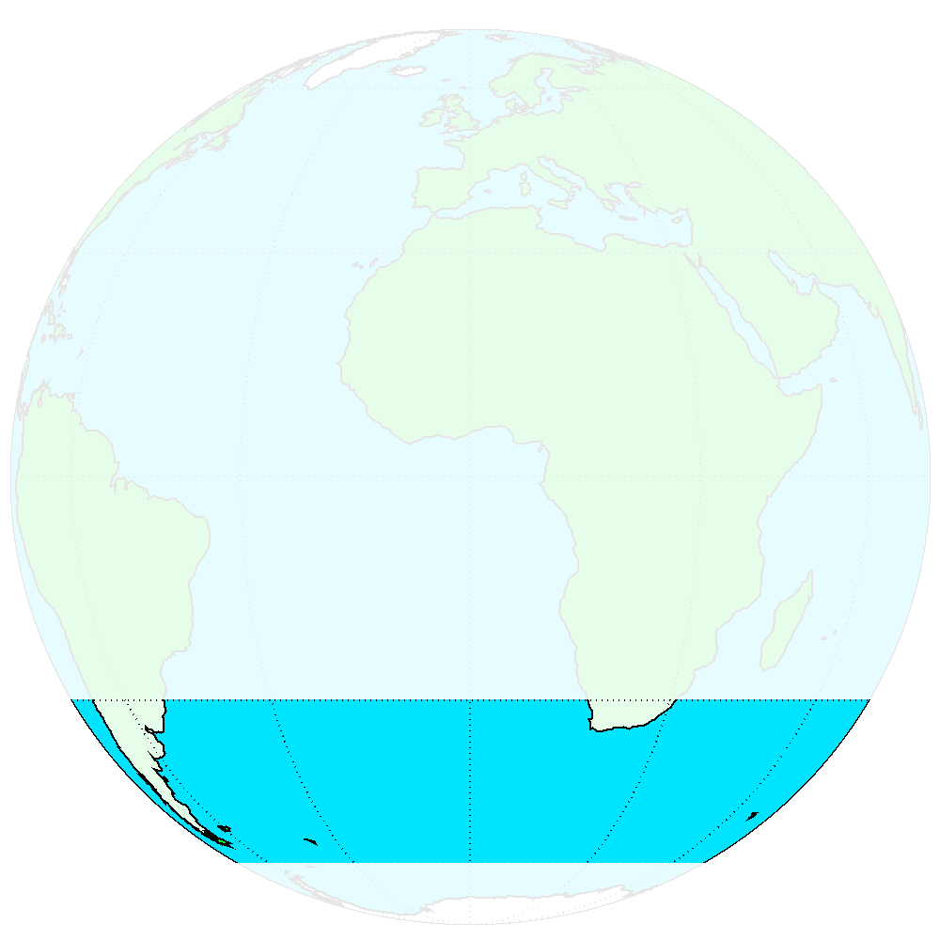
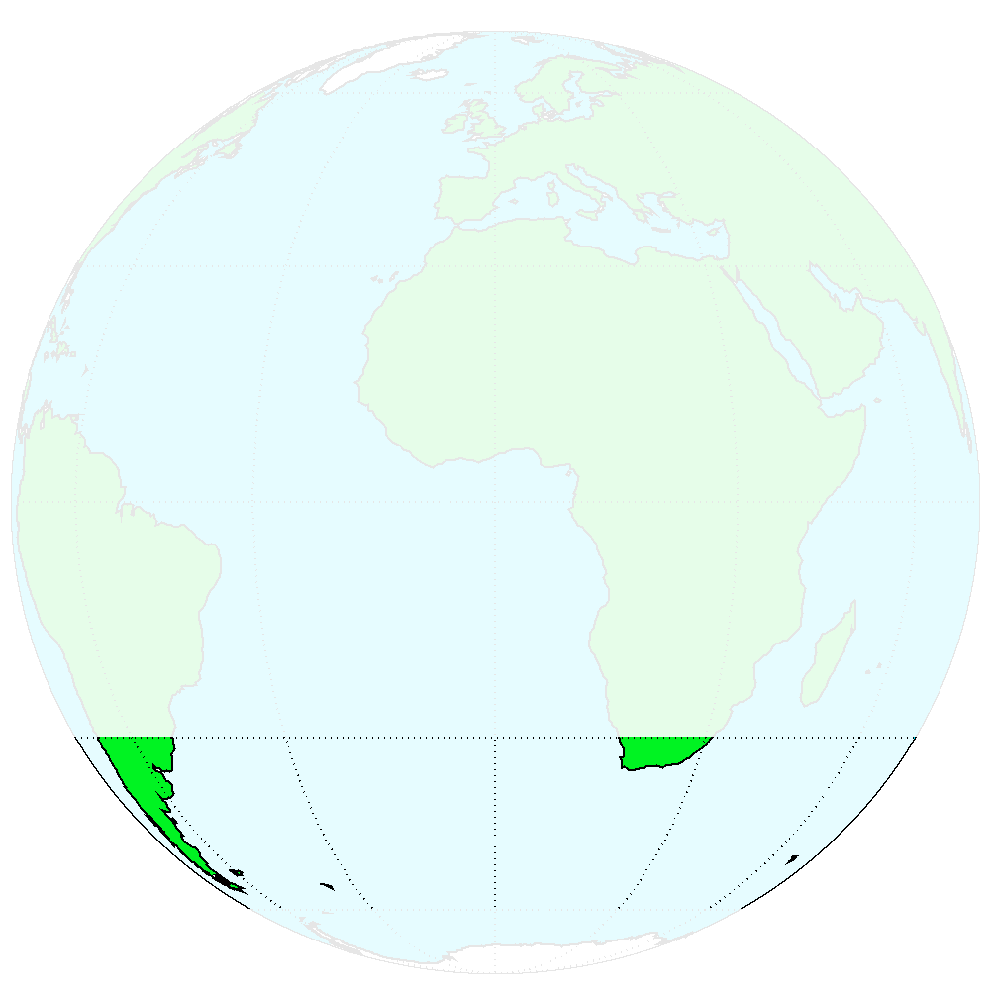
1. IASI L2 v6.2 performances Assessment with NWP
L2 temperature
vs ECMWF analyses
L2 humidity
vs ECMWF analyses
PWLR³
OEM

Slide 6
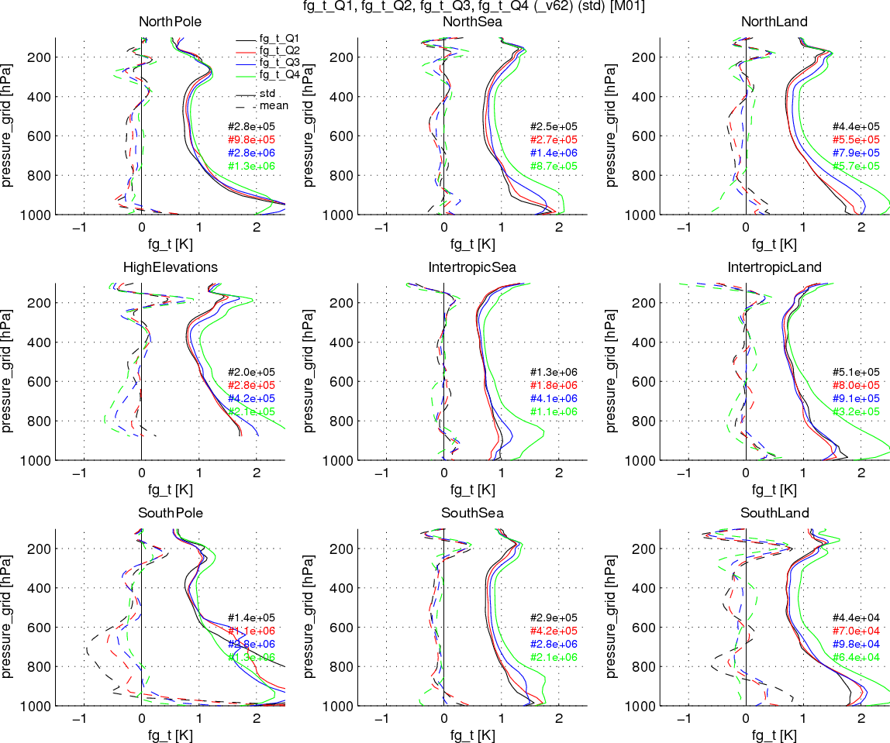
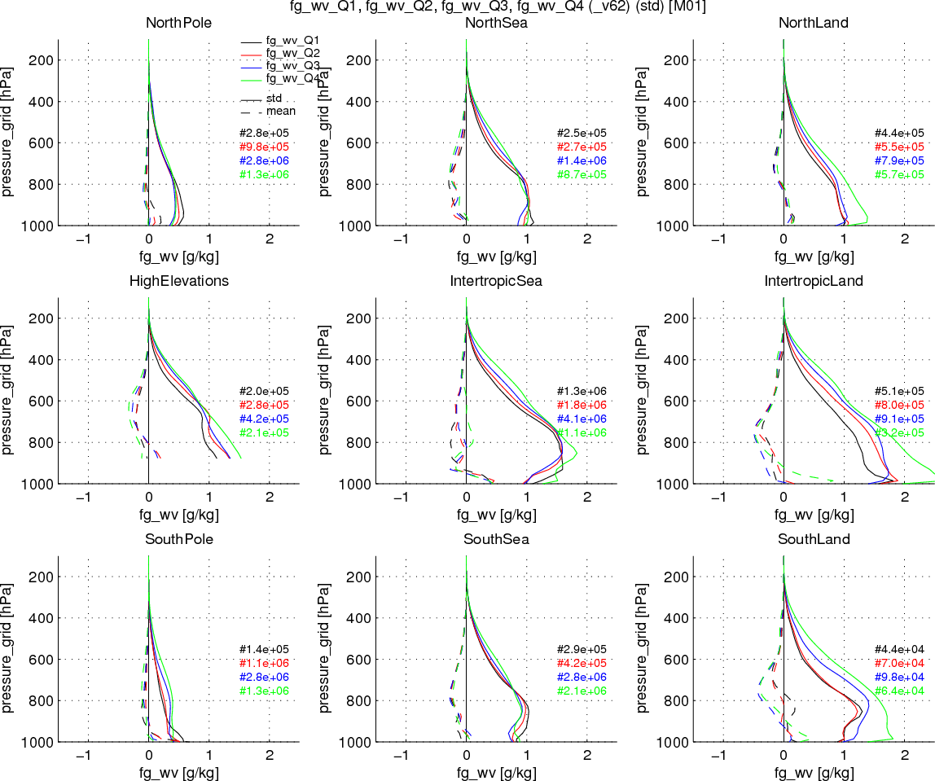
1. IASI L2 v6.2 performances Assessment with NWP
L2 temperature
vs ECMWF analyses
L2 humidity
vs ECMWF analyses
Clear-sky
Likely clear
Partly cloudy
Fully cloudy
Notes:
The nearly all-sky first-guess products PWLR³ are relatively robust against cloud contamination

Slide 7
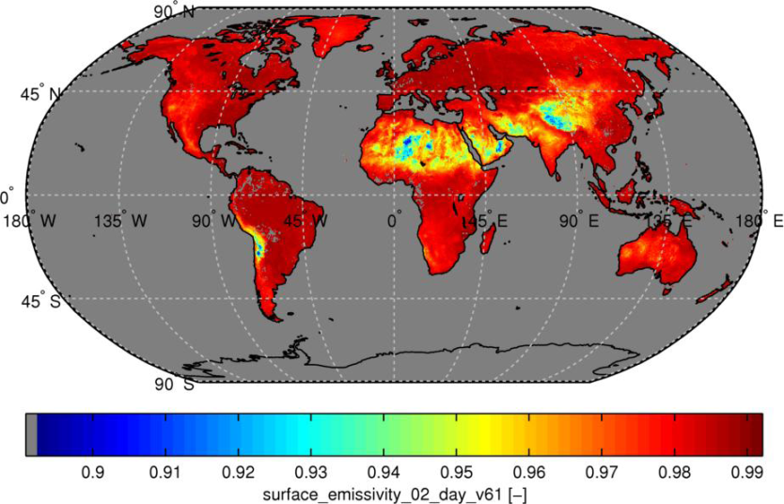
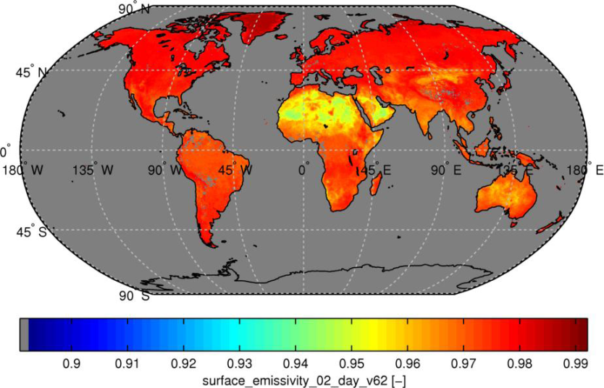
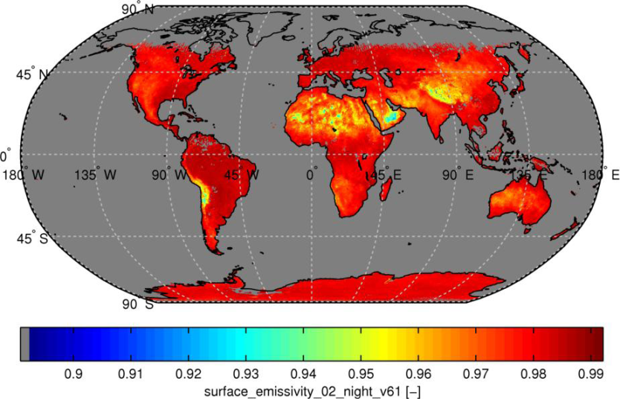
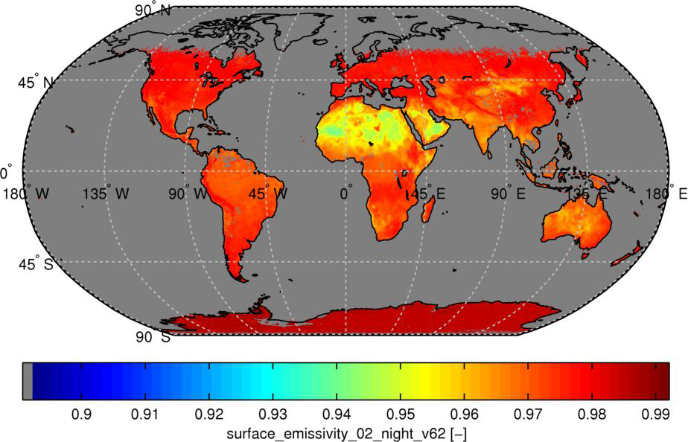
1.IASI L2 v6.2::PWLR³ A new surface emissivity product
The PWLR³ enables the retrieval of surface emissivity over continental surfaces, which exhibit more realistic diurnal variations and fits better IASI (radiance) observations.
Day
Day
v6.1
v6.2
Night
Night
Retrieved emissivity @900cm⁻¹ :: 12-24 May 2016

Slide 8
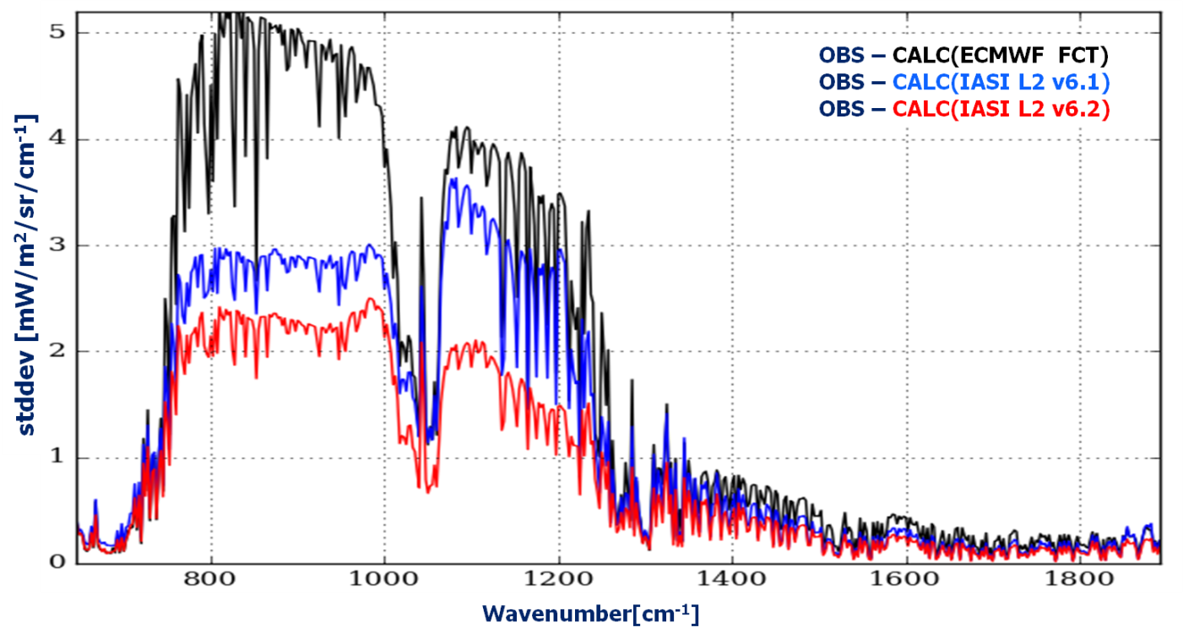
1. IASI L2 v6.2 performances Residual assessment
Land surfaces within [60°S;60°N] latitudes
16/05/2016
OBS - CALC(ECMWF FCT + static ems atlas)
OBS - CALC(IASI L2 v6.1 T,q,O₃,Ts,ems)
OBS - CALC(IASI L2 v6.2 T,q,O₃,Ts,ems)

Slide 9
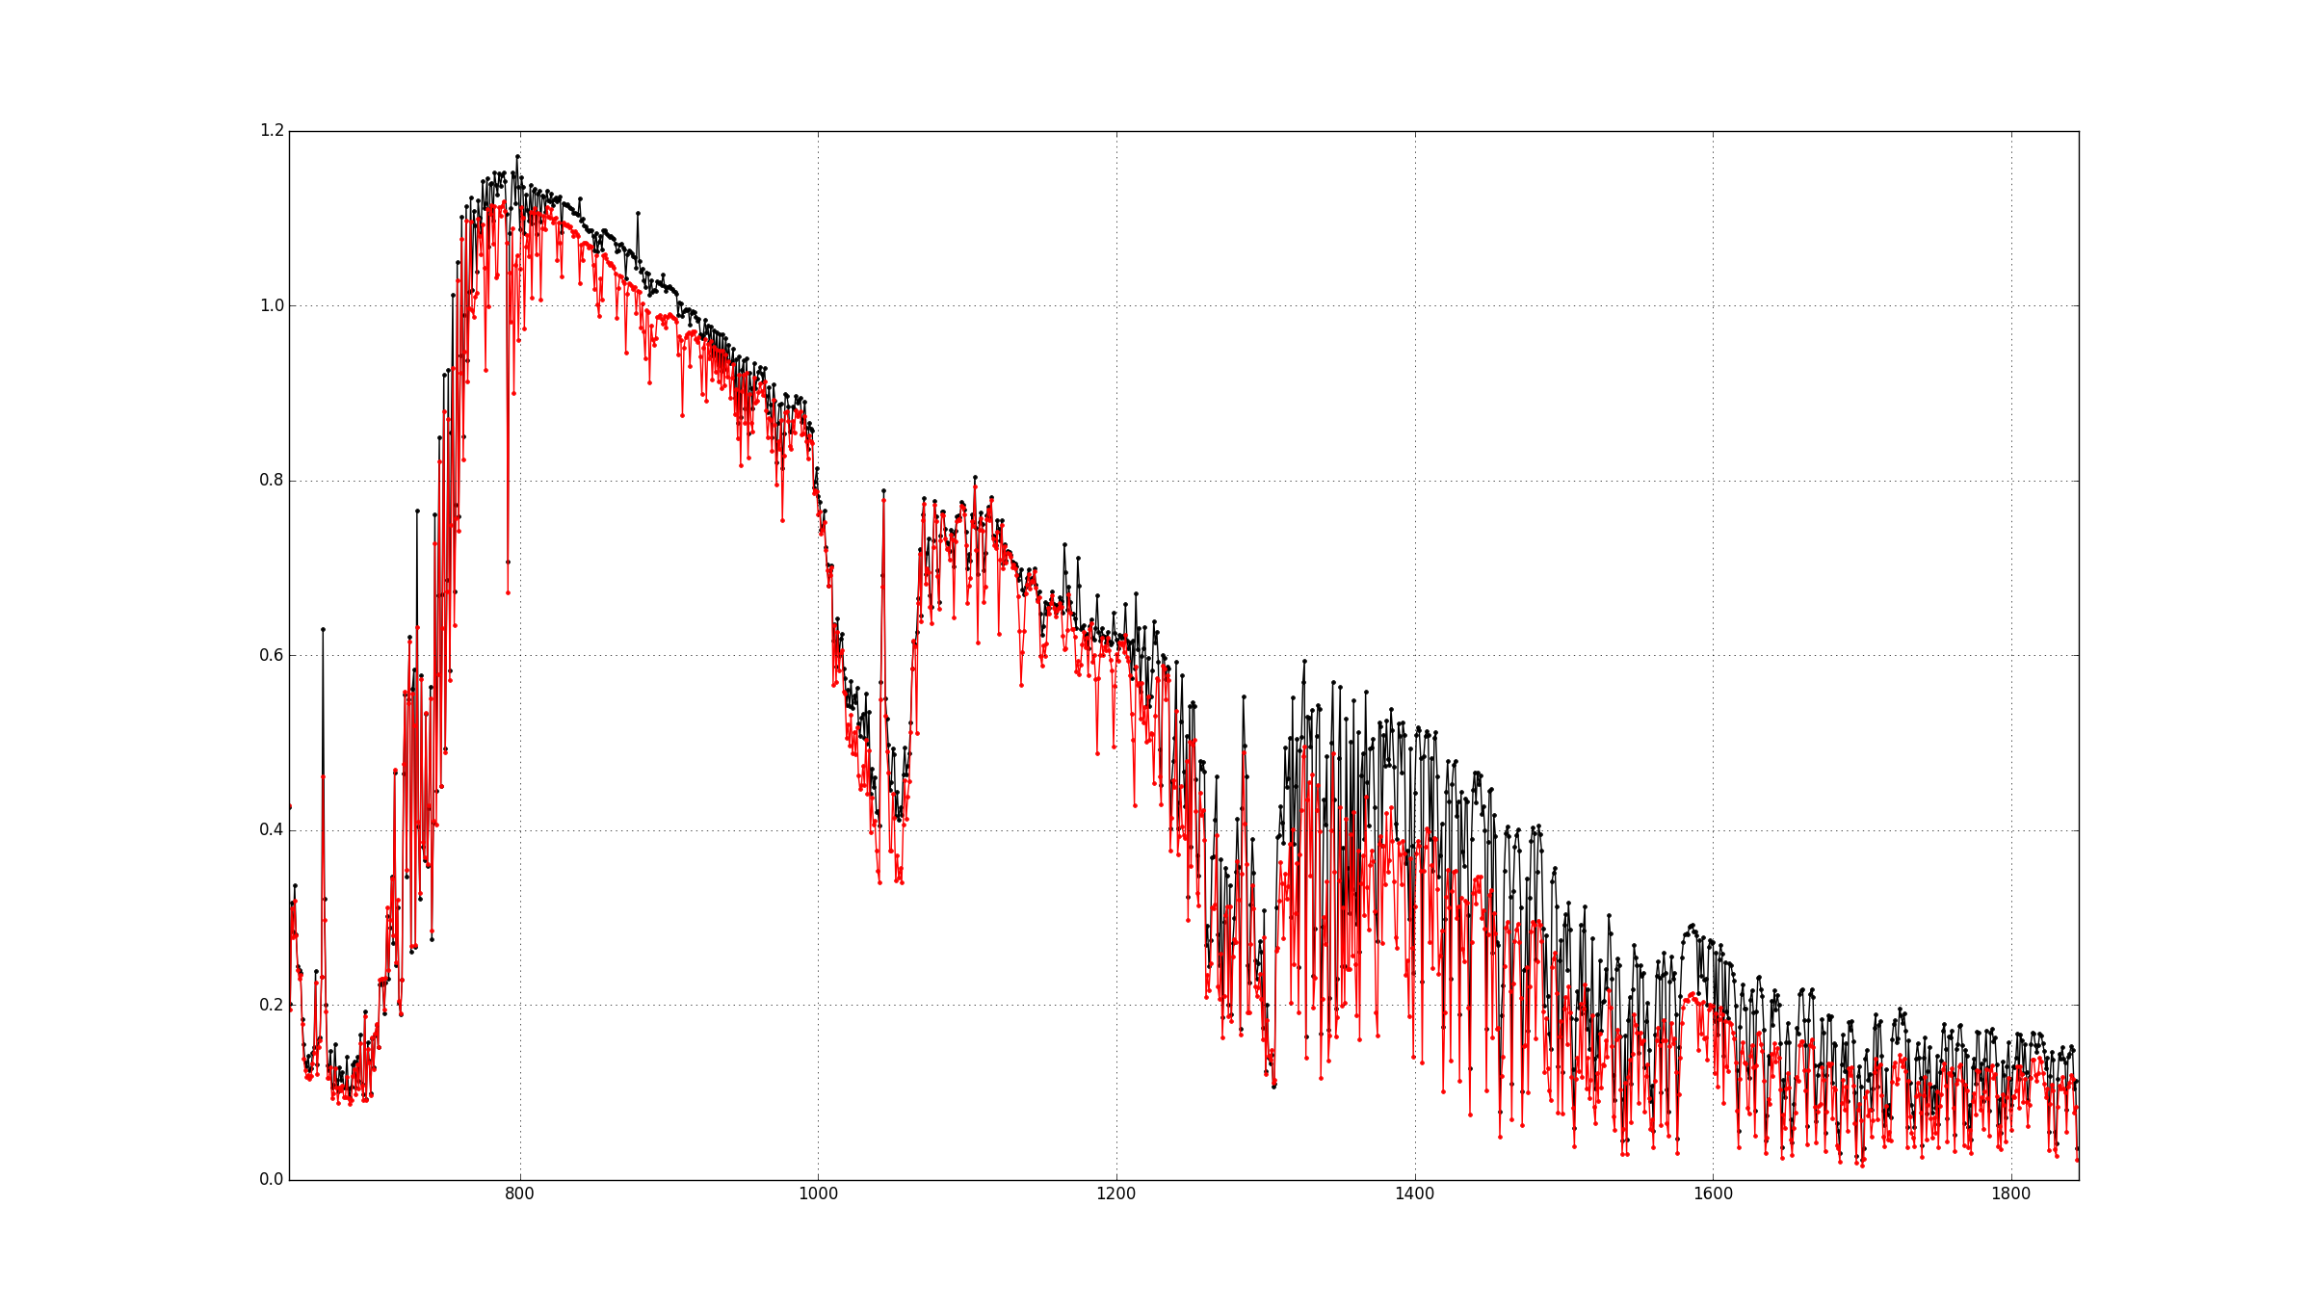
1. IASI L2 v6.2 performances Residual assessment
13/01/2014 :: clear-sky maritime situations
OBS – CALC(ECMWF ANA)
OBS – CALC(PWLR³)
1.0
Stddev [mW/m²/sr1cm^{-!}]
Surface
Better fit with PWLR³ in all spectral regionsns
Surface
Ozone
Temperature
Water-vapour
0
800
1000
1200
cm⁻¹
1400
1600
1800

Slide 10
1. IASI L2 v6.2 Accurate retrievals over land
LST :: IASI (OEM) vs SEVIRI
IASI L2 humidity (OEM) vs ECMWF analyses
v6.1
v6.2
v6.1
v6.2
bias
stddev
The quality of land emissivity is key for accurate WV sounding

Slide 11
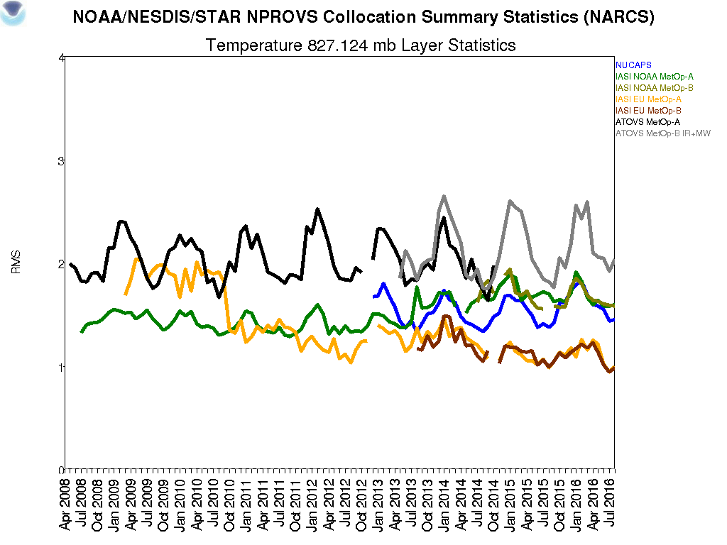
1.IASI L2 v6 performances Monitoring with in situ data
www.star.nesdis.noaa.gov/smcd/opdb/nprovs/NPROVS_trends.php#crumb
EUMETSAT L2
IASI+MW
Metop-A
Metop-B
T @ 830 hPa, Sea
1K rms
v4
v5
v6
2009
2013
2015
2010
2012
2014
2011
2016
Credits: B. Sun, T. Reale (NOAA)

Slide 12
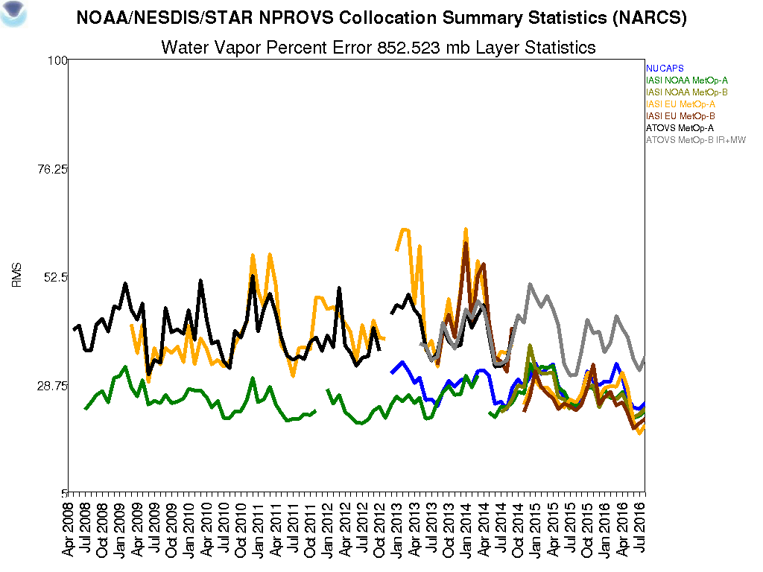
1.IASI L2 v6 performances Monitoring with in situ data
www.star.nesdis.noaa.gov/smcd/opdb/nprovs/NPROVS_trends.php#crumb
EUMETSAT L2
IASI+MW
Metop-A
Metop-B
H₂O @ 850 hPa, Sea
v4
v5
v6
2009
2013
2015
2010
2012
2014
2011
2016
Credits: B. Sun, T. Reale (NOAA)

Slide 13
1.IASI L2 v6 performances Monitoring with in situ data
T@940 hPa Ocean :: IASI L2 vs radiosondes :: credits T. Reale & B. Sun, NOAA
stddev
PWLR⁽³⁾
OEM
v6.1
v6.2
bias
May 2016
June 2016
stddev
WV@800 hPa :: IASI L2 vs radiosondes :: maritime (NPROVS)
v6.1
v6.2
bias
OEM
PWLR⁽³⁾
May 2016
June 2016

Slide 14
1. IASI L2 v6.2 Keypoints highlights
v6.2 introduces PWLR³
Statistical retrieval of T, q, Ts, emissivity…
As accurate and precise as OEM
Ultra fast (1 day in 8’ on a normal PC)
Quality indicators for users convenience
Forecast-free
v6.2 brings OEM retrievals over bare land at same quality level as over oceans.
➔ full details in “IASI L2 v6 Validation Report” EUM/TSS/REP/14/776443, 290pp
and “IASI L2 v6.2 Validation Report” EUM/RSP/REP/16/857500, 73pp
PWLR³ can generate full uncertainty estimates and characterisation of vertical sensitivity (averaging kernels) → see Tim Hultberg’s talk on Thursday

Slide 15
Outline
IASI L2 v6, 2 years in operations (v6.0 9/30/14)
Algorithms updates (v6.2 released 6/2/16)
Sounding and surface products performances
Atmospheric composition products
Applications and services

Slide 16
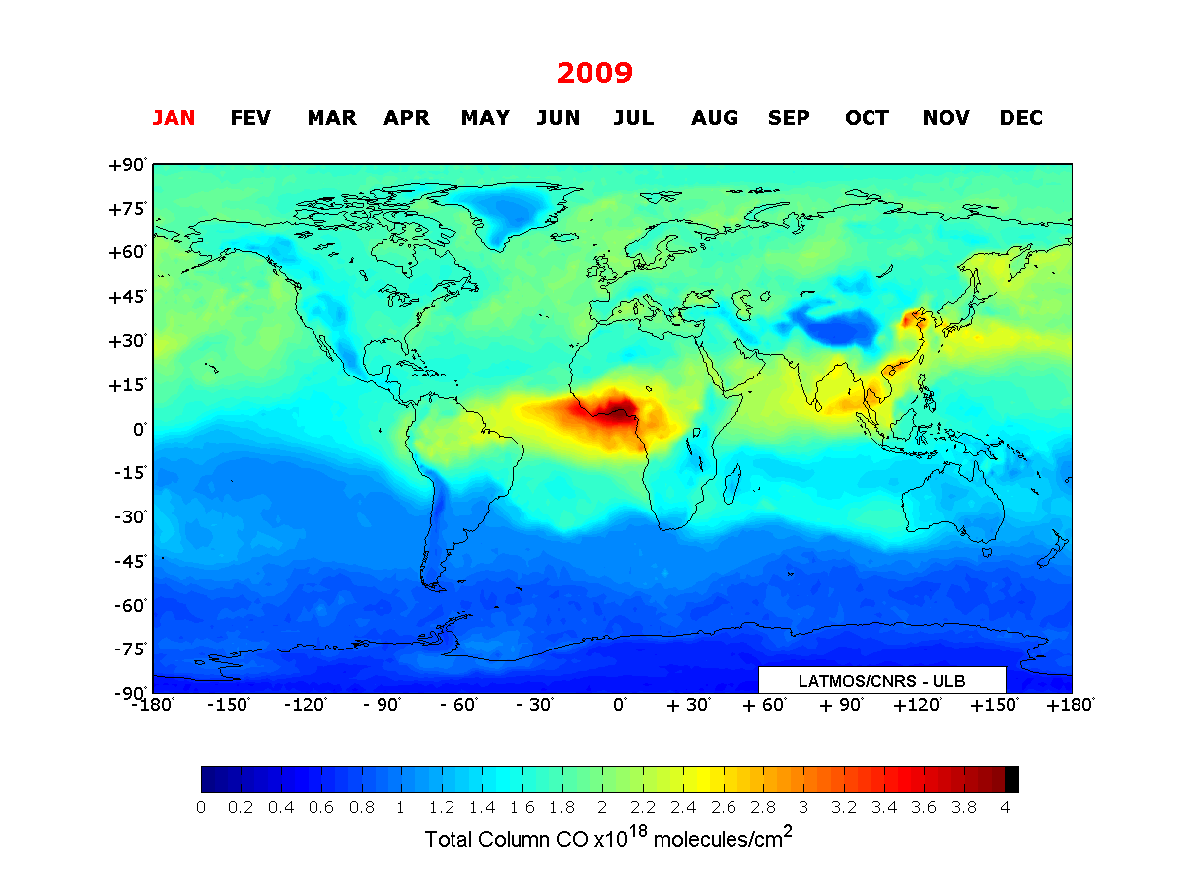
2. Atmospheric composition CO and future plans
The IASI L2 v6 includes the CO products (profiles and averaging kernels) from the FORLI (Fast Optimal Retrievals on Layers for IASI, Hurtmans et al., JQSRT 2012) developped at ULB (Brussels) and LATMOS (Paris).
Next evolutions will include :
SO₂ columns (BRESCIA, ULB)
Aerosol/Dust index (Clarrise et al. ACP 2013)
O₃ profiles + AK (FORLI)
HNO₃ profiles + AK (FORLI)
CH4 column from LMD
Credits: ULB/LATMOS
Coheur, Clerbaux et al.
Clerbaux et al., ACP 2008, 2009
Turquety et al., ACP 2009
Pommier et al., ACP 2010
Kerzenmacher et al. AMT 2012
George et al. AMT 2015 ➔ IASI & MOPITT

Slide 17
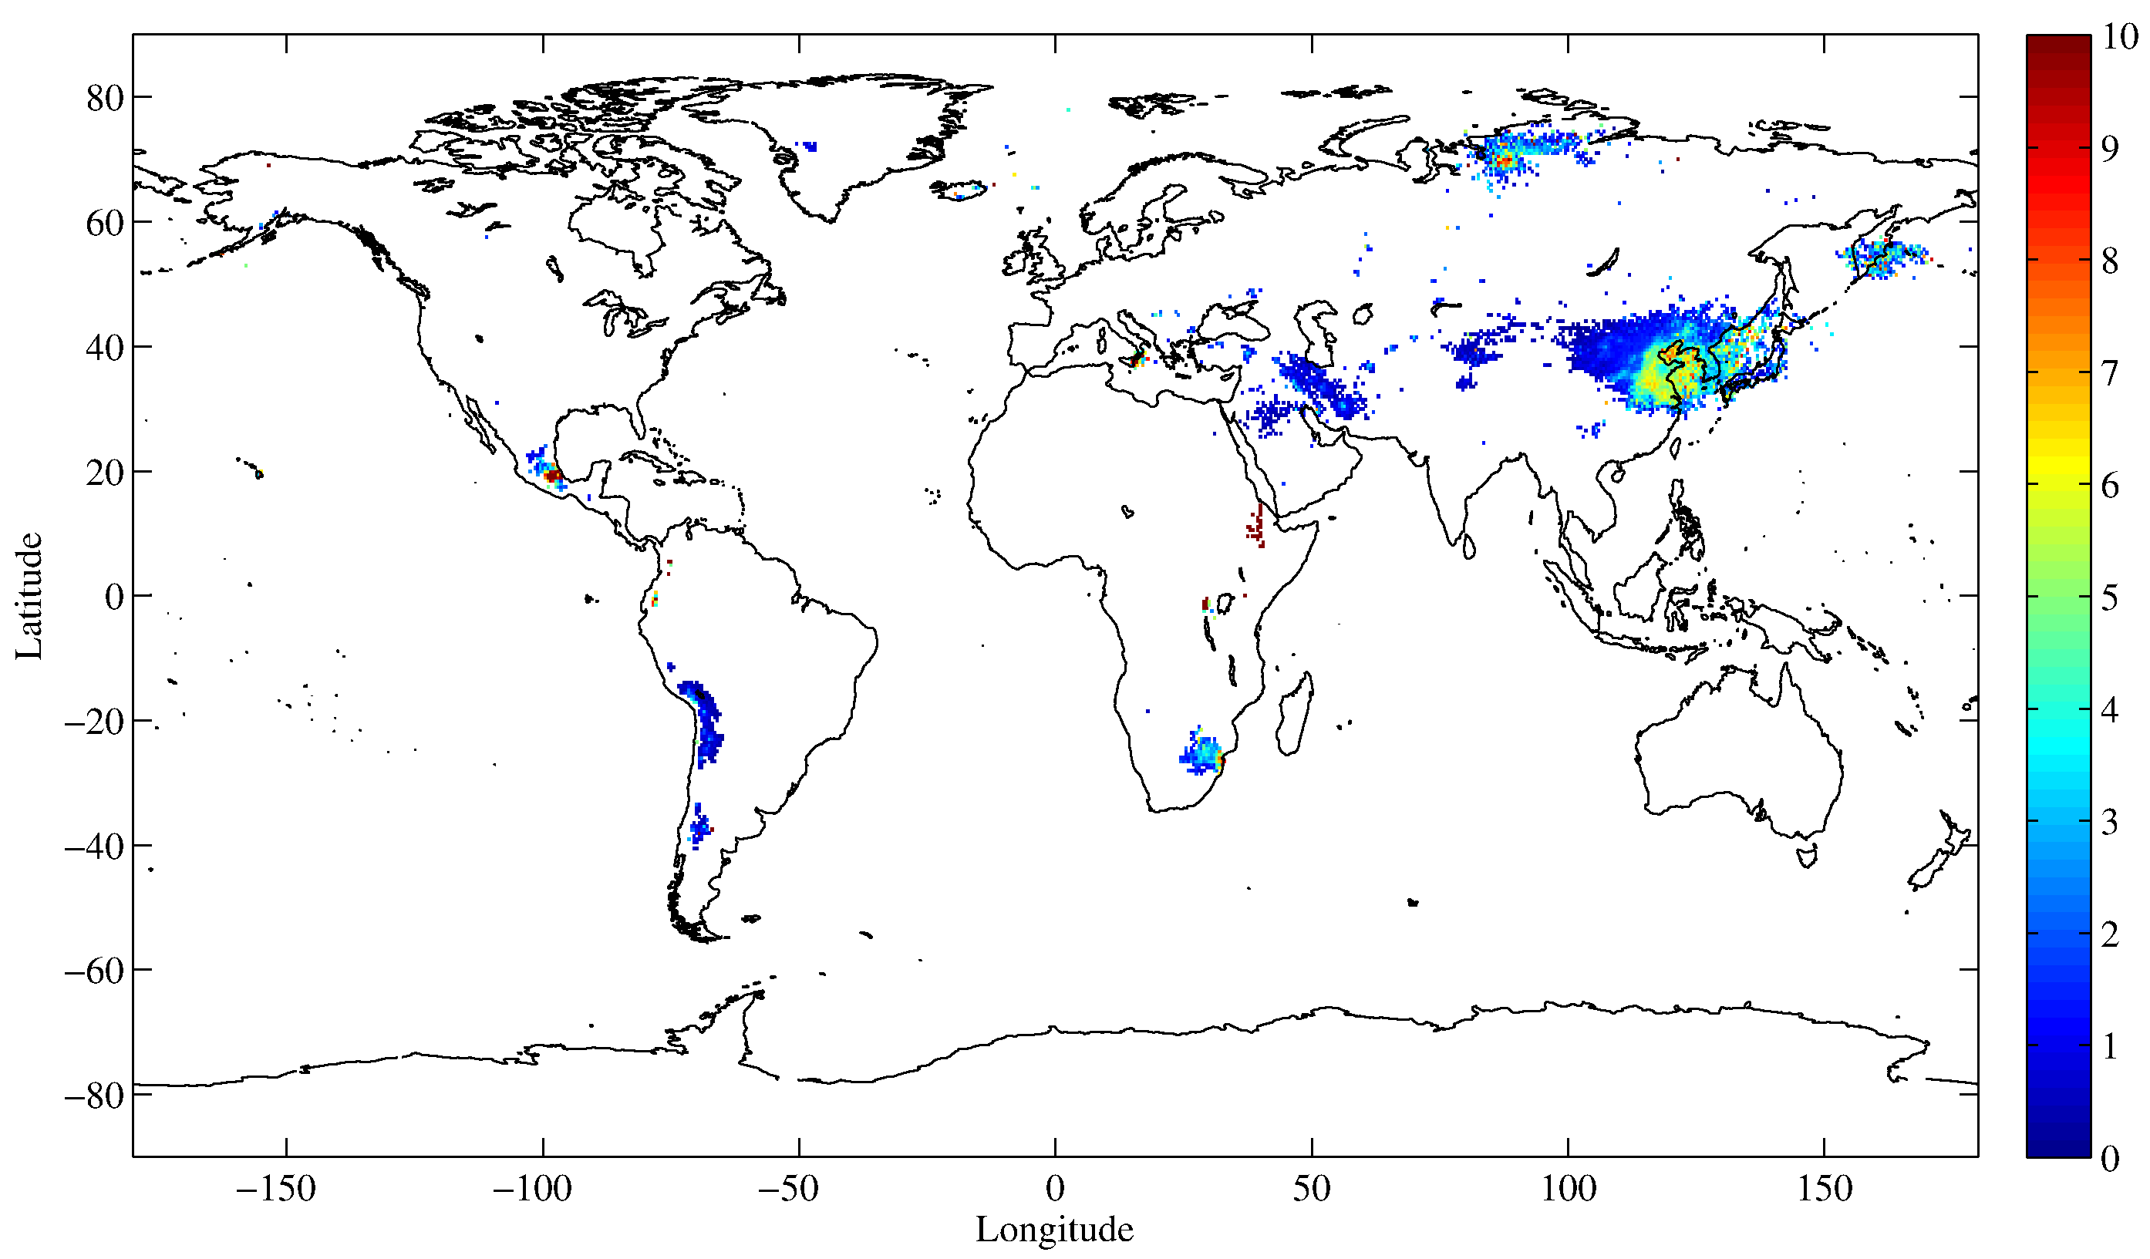
2. Atmospheric composition SO₂ monitoring
2008-2014 AM
SO₂ (DU)
Volcanoes
Anthropogenic
Clarisse et al., ACP 2008, 2013, 2014, AMT 2012
Bauduin et al., doi:10.5194/amt-9-721-2016

Slide 18
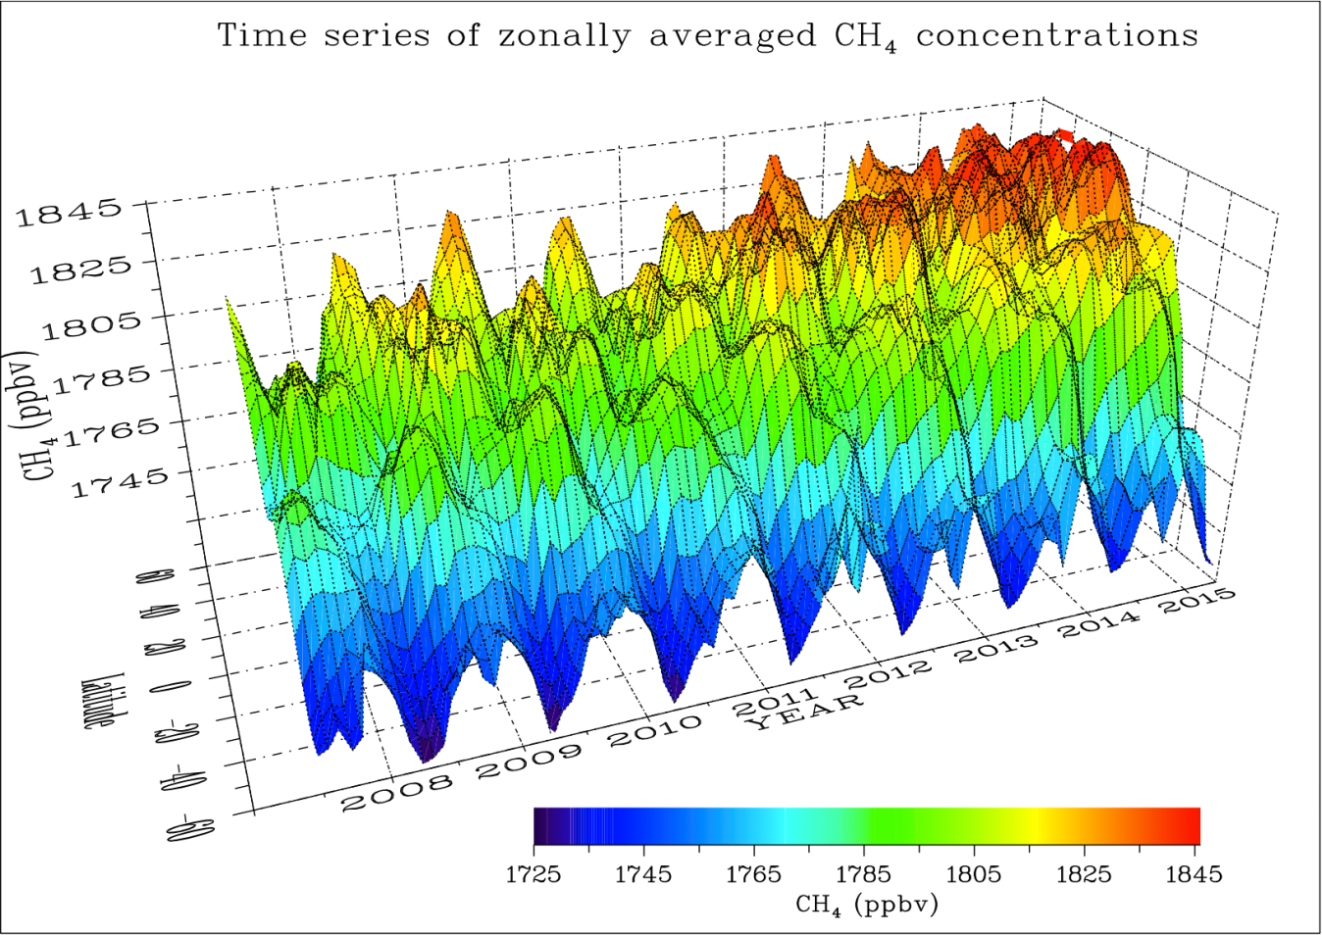
2. Atmospheric composition Methane from LMD
CH₄ (ppb)
Latitude
Year
Crevoisier et al., doi:10.5194/acp-9-6337-2009
Crevoisier et al., doi:10.5194/acp-13-4279-2013

Slide 19
Outline
IASI L2 v6, 2 years in operations (v6.0 9/30/14)
Algorithms updates (v6.2 released 6/2/16)
Sounding and surface products performances
Atmospheric composition products
Applications and services

Slide 20
3. New utilisations of IASI L2 3D Humidity fields
29/09/2013 ~00UTC
The PWLR³ enables accurate “all-sky” retrievals of 3D WV fields, nominally exploiting MW and IR.

Slide 21
3. New utilisations of IASI L2 Deriving AMVs?
September 2013
H₂0 retrieved at 500hPa
The derivation of atmopsheric motion vectors profiles from the water-vapour 3D information is being studied, also taking advantage of the dual coverage with Metop-A and Metop-B.
Composite of
Metop-A and Metop-B products

Slide 22
3. 3D winds from IASI level 2 Methodology
Data sources:
Operational IASI sounding L2 products (EUMETSAT)
Metop-A and Metop-B to maximize overlaps
Parameters:
Humidity (water vapor mixing ratio) fields at standard pressure levels, Polar stereographic interpolation
Method:
3D optical flow
Humidity at 500 hPa for successive overpasses
Metop-B t₀
Metop-A t₁
Metop-B t₂
Metop-A t₃
Extracted from O. Hautecoeur & R. Borde, Wind Workshop June 2016

Slide 23
3. 3D winds from IASI level 2 Preliminary results
Wind fields at 700 hPa derived from IASI
Forecast wind field
Case study 21 March 2013
Extracted from O. Hautecoeur & R. Borde, Wind Workshop June 2016

Slide 24
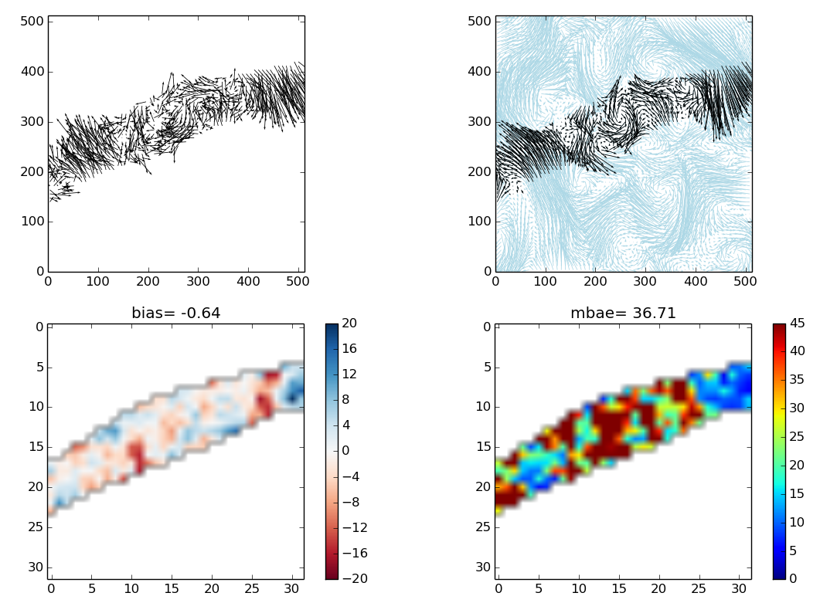
3. 3D winds from IASI level 2 Preliminary results
Wind fields at 500 hPa derived from IASI
Forecast wind field
Case study 21 March 2013
Extracted from O. Hautecoeur & R. Borde, Wind Workshop June 2016

Slide 25
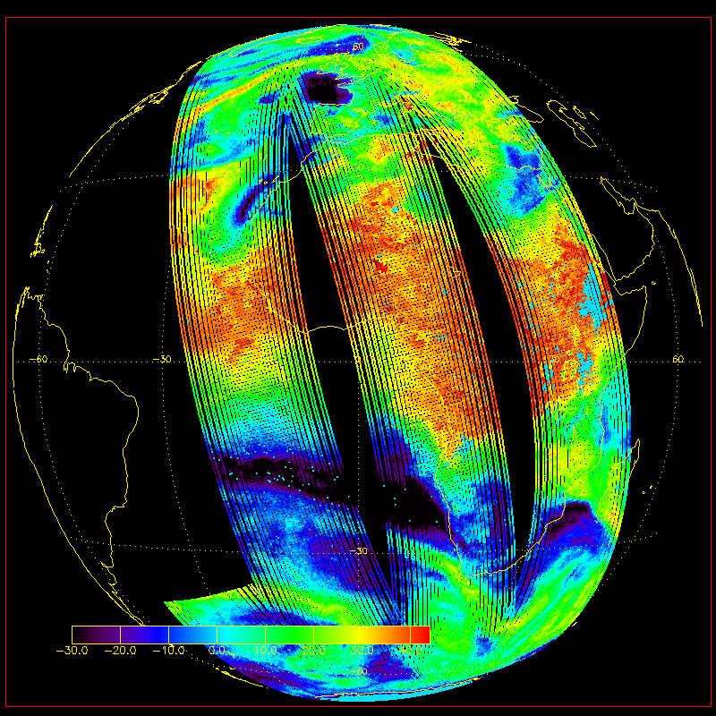
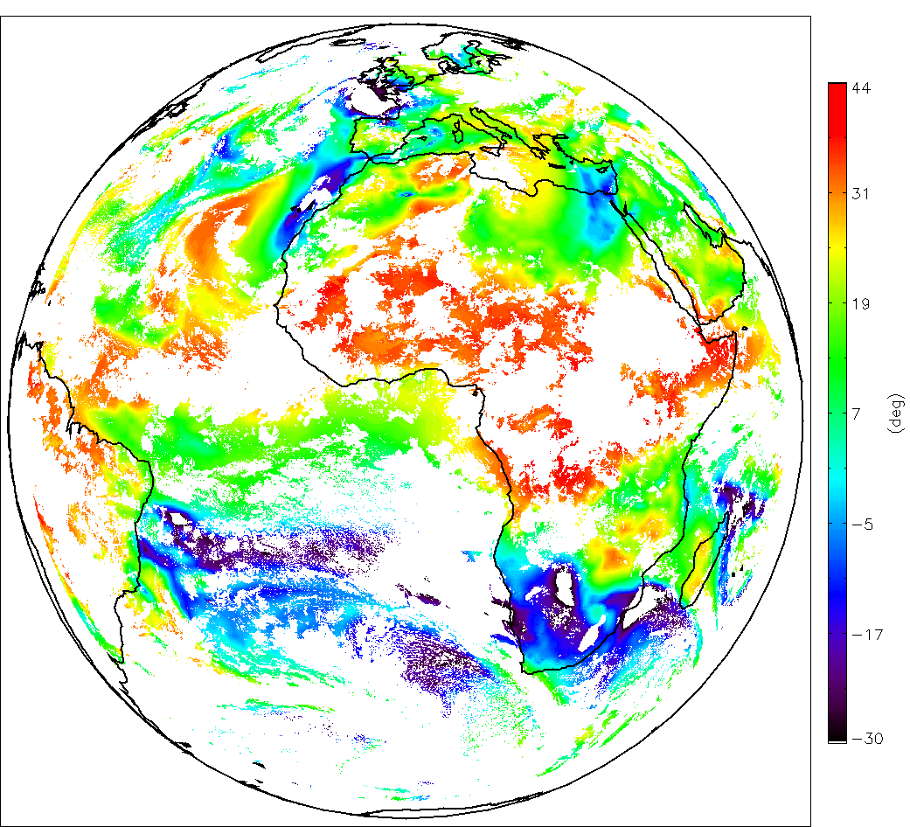
3. New utilisations of IASI L2 Tracking instabilities
MSG
Geo Instability Index
+
IASI v6
IASI L2 v6 is consistent with the GII and complementary as it provides information in the cloudy areas and at high latitudes.
Results: M. Koenig (EUMETSAT)

Slide 26
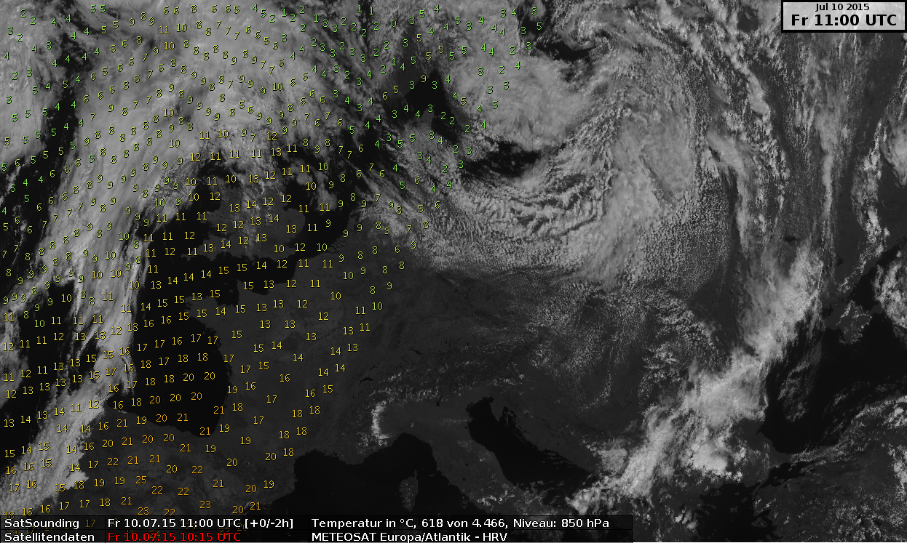
2. New utilisation Monitoring at DWD in NinJo
Credits: Katja Hungershöfer (DWD)

Slide 27
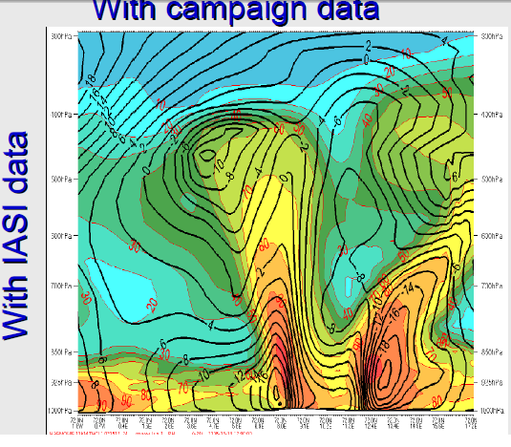
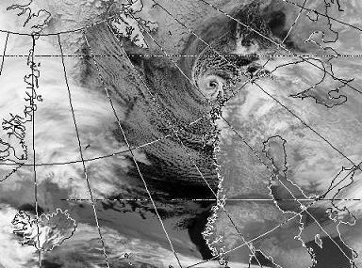
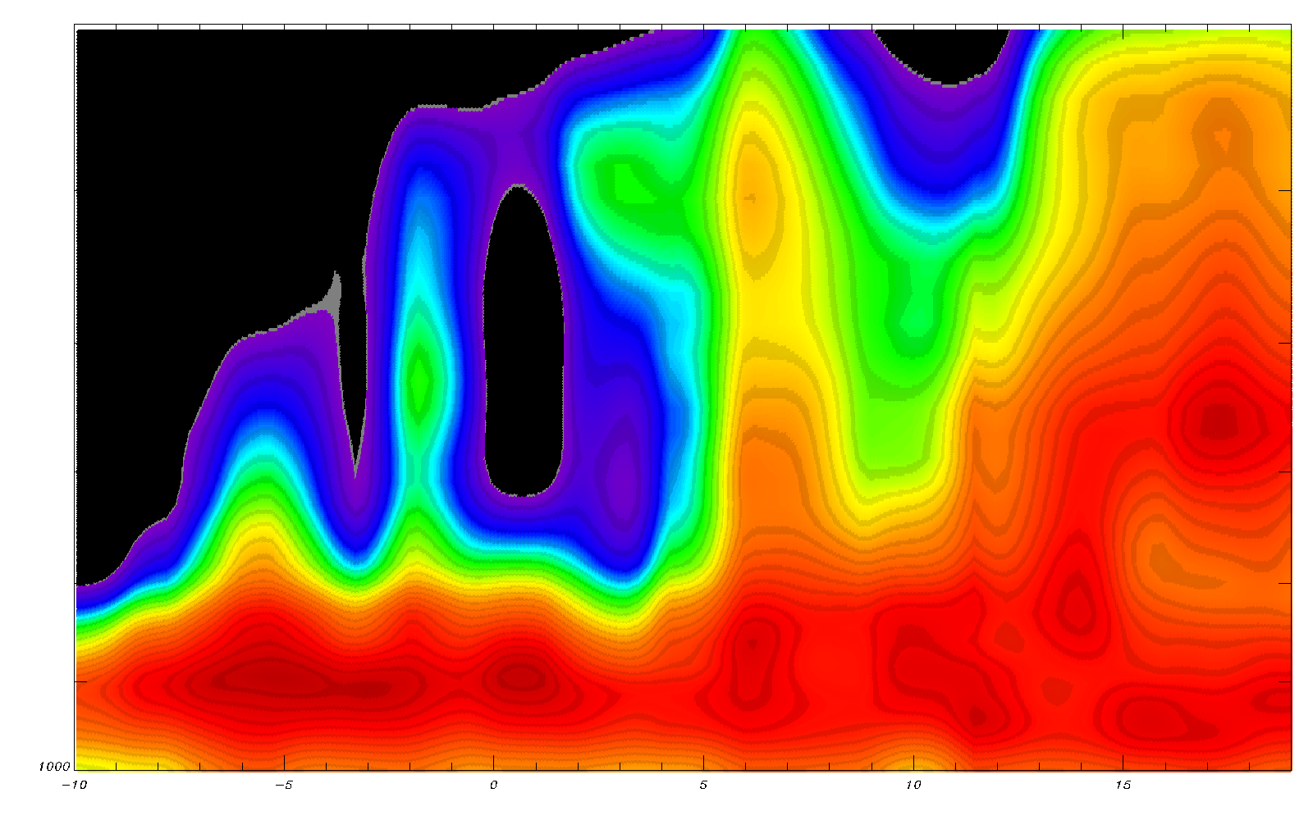
3. New utilisations of IASI L2 Tracking Polar lows?
IASI L2 v6.2 (PWLR³)
for the same transect
on the 72°N parallel
(1h difference)
Results R. Randriamampianina (MetNo)

Slide 28
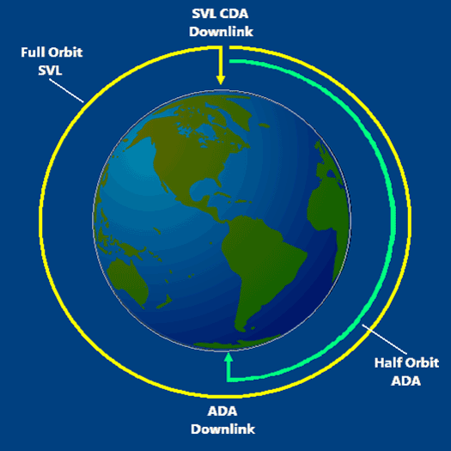
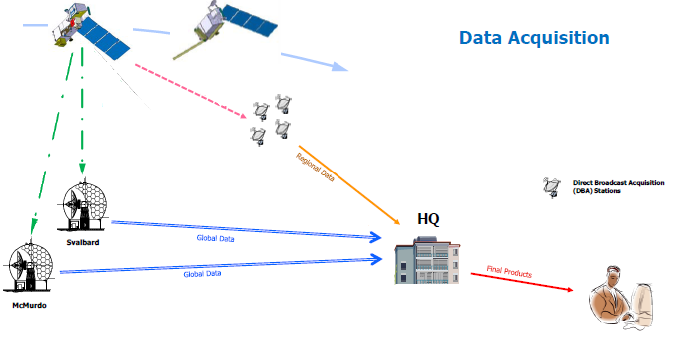
3. EARS-IASI L2, a new regional service
Opening
EARS-IASI L2 service
Regional: requirement < 30’
Trial disemination to start October 2016
Global: NRT < 2h
GTS
EUMETCast

Slide 29
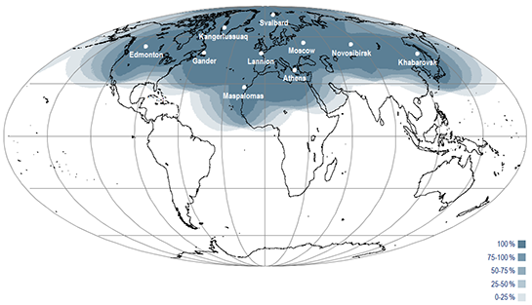
The current EARS-IASI coverage
www.eumetsat.int/website/home/Data/RegionalDataServiceEARS/EARSIASI/index.html

Slide 30
Conclusion
IASI L2 v6.2 operational since 2 June 2016, includes PWLR³
unprecendented sounding at IASI footprint resolution
all-sky statistical retrieval with uncertainties characterisation
as accurate and precise as OEM, robust to clouds
ultra fast (1 Day in 8 mn) compatible with NWC requirements
Forecast-free
Atmospheric composition
CO profiles + averaging kernels released with v6.2
SO₂, aerosol/dust, HNO₃ , CH₄ coming soon
Outlook, potential for new applications
3D winds ➔ study further operationalisation
IASI-L2 regional service (<30’ latency) to open by October
Study further with Users the use of these new and enhanced products in support to short- and mid-range forecasts

Slide 31
Thank you for your attention !
thomas.august@eumetsat.int

Slide 32
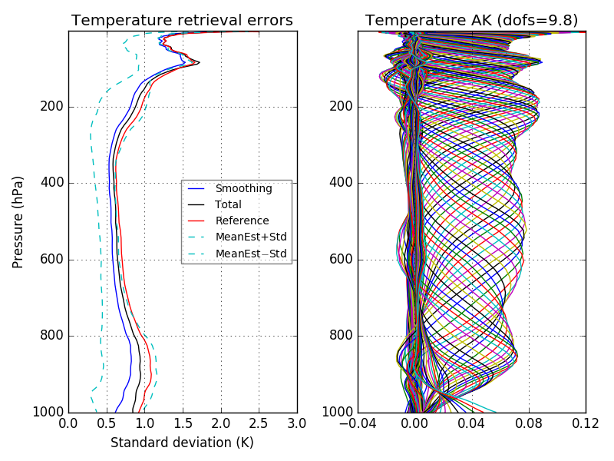
PWLR AK :: Class 0 Temperature (clear) 137 levels

Slide 33
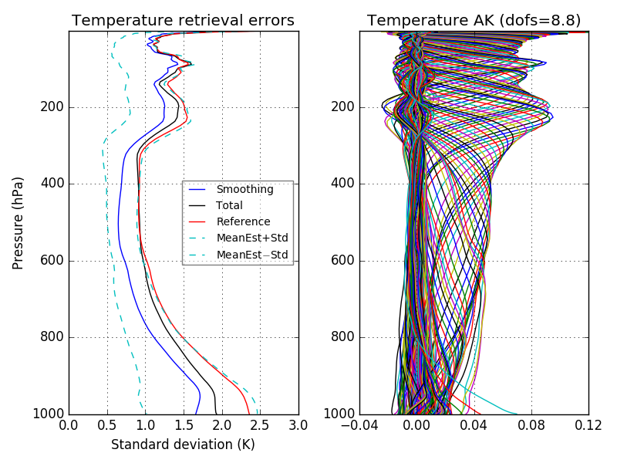
PWLR AK :: Class 1 Temperature (cloudy) 137 levels

Slide 34
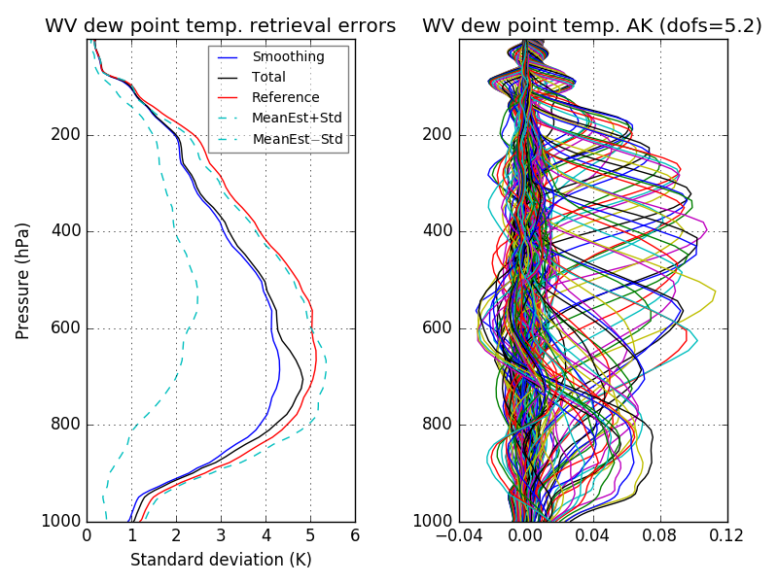
PWLR AK :: Class 0 Water-Vapour (clear) 137 levels

Slide 35
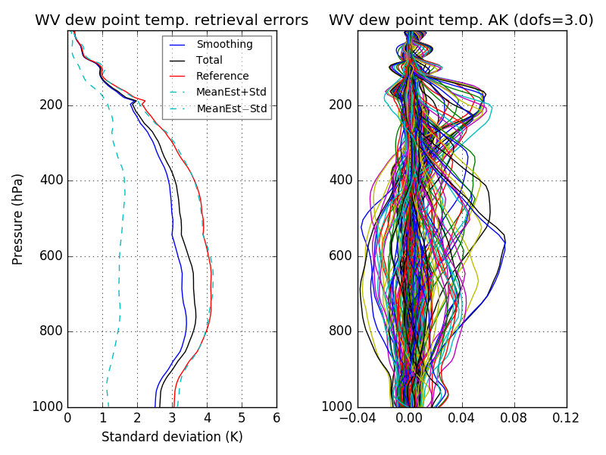
PWLR AK :: Class 1 Water-Vapour (cloudy) 137 levels

