Slide 1





Space-based observations of tropospheric ethane map emissions from fossil fuel extraction
Jared F. Brewer¹, Dylan B. Millet¹, Vivienne H. Payne², Susan Kulawick^{2,3}, Corinne Vigouroux⁴, Karen E. Cady-Pereira⁵, Rick Pernak⁵, Kelley C. Wells¹, Minqiang Zhou⁶
¹ University of Minnesota
²NASA Jet Propulsion Laboratory (JPL)
³Bay Area Environmental Research Institute (BAER)
⁴Royal Belgian Institute for Space Aeronomy (BIRA-IASB)
⁵AER
⁶Institute of Atmospheric Physics, Chinese Academy of Sciences

Slide 2
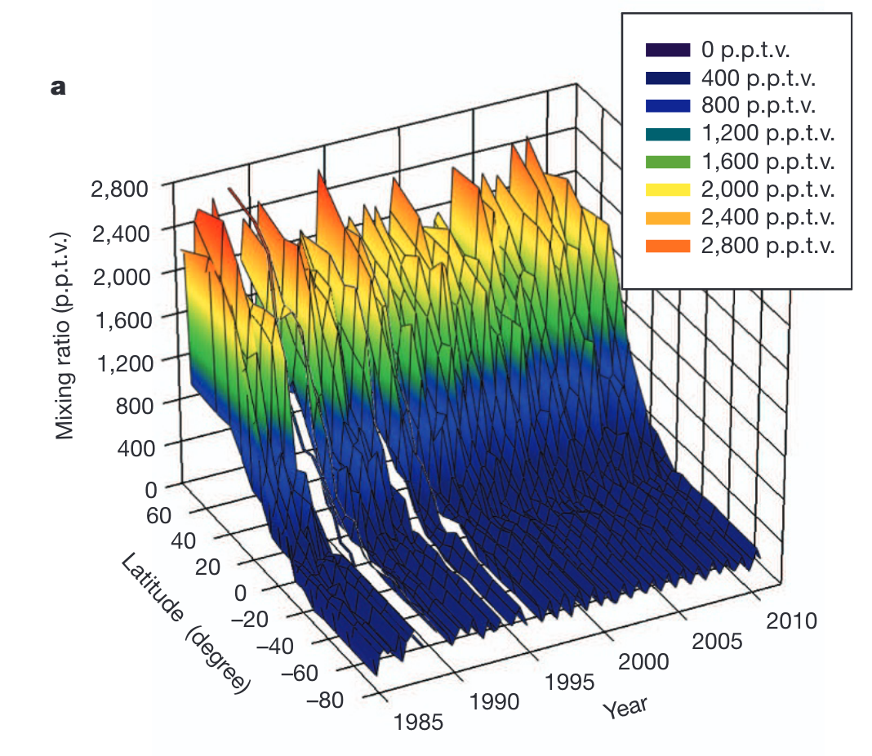
Ethane is the most abundant NMHC in the background atmosphere, with a 2-month atmospheric lifetime, and consequent impacts on O₃, PAN, and OH.
Fossil fuels are the largest source (7-13 Tg yr⁻¹)
  Biomass burning and biofuels are together ~2-8 Tg yr⁻¹
  Natural sources are uncertain but potentially as high as 2-6 Tg yr⁻¹
Bottom-up studies of ethane consistently underestimate emissions when compared with top-down studies
Used on regional scales to partition fossil vs non-fossil emissions but there’s not enough data to do that globally
Simpson et al., 2012
Tzompa-Sosa et al., 2017
Tribby et al., 2022
Adedji et al., 2022
Dalsøren et al., 2018

Slide 3
We use the Cross-track Infrared Sounder (CrIS) to create a space-based retrieval of tropospheric ethane.
Cross-track Infrared Sounder (CrIS):
10/2011 (Suomi-NPP), 11/2017 (JPSS-1/NOAA-20), 11/2022 (JPSS-2)
Near-global coverage twice/day (8.7 million spectra/day)
Afternoon (~1330 LT SNPP) overpass
Low noise
The Ethane Jacobian
Peak Absorption in the LWIR:
815-840 cm⁻¹

Slide 4
Ethane has a broad but weak absorption, so our retrieval is built upon the Hyperspectral Range Index.
Measured spectrum
Mean background spectrum (measured)
The Hyperspectral Range Index (HRI):
a dimensionless index that quantifies the strength of the spectral signature of a target gas in an observed spectrum y.
Spectral Jacobian (modeled)
Background spectral covariance (measured)
The HRI uses a broader active spectral range: enhanced sensitivity, less impact from interferences
(e.g., NH₃ and VOCs from IASI, Whitburn et al., 2016; Franco et al., 2018; 2019; 2020)
Franco et al., 2018
Wells et al., 2022
Walker et al., 2011

Slide 5
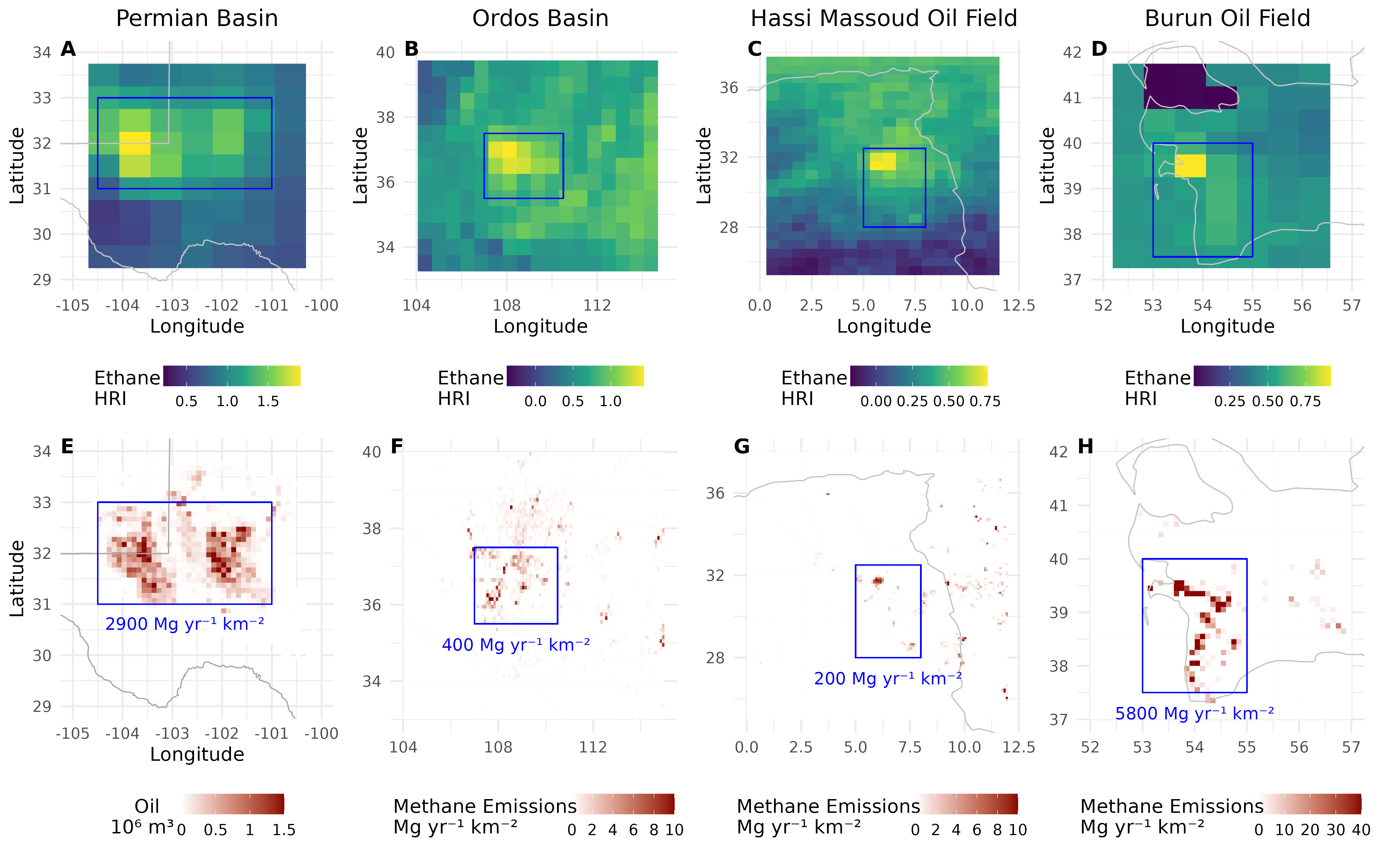
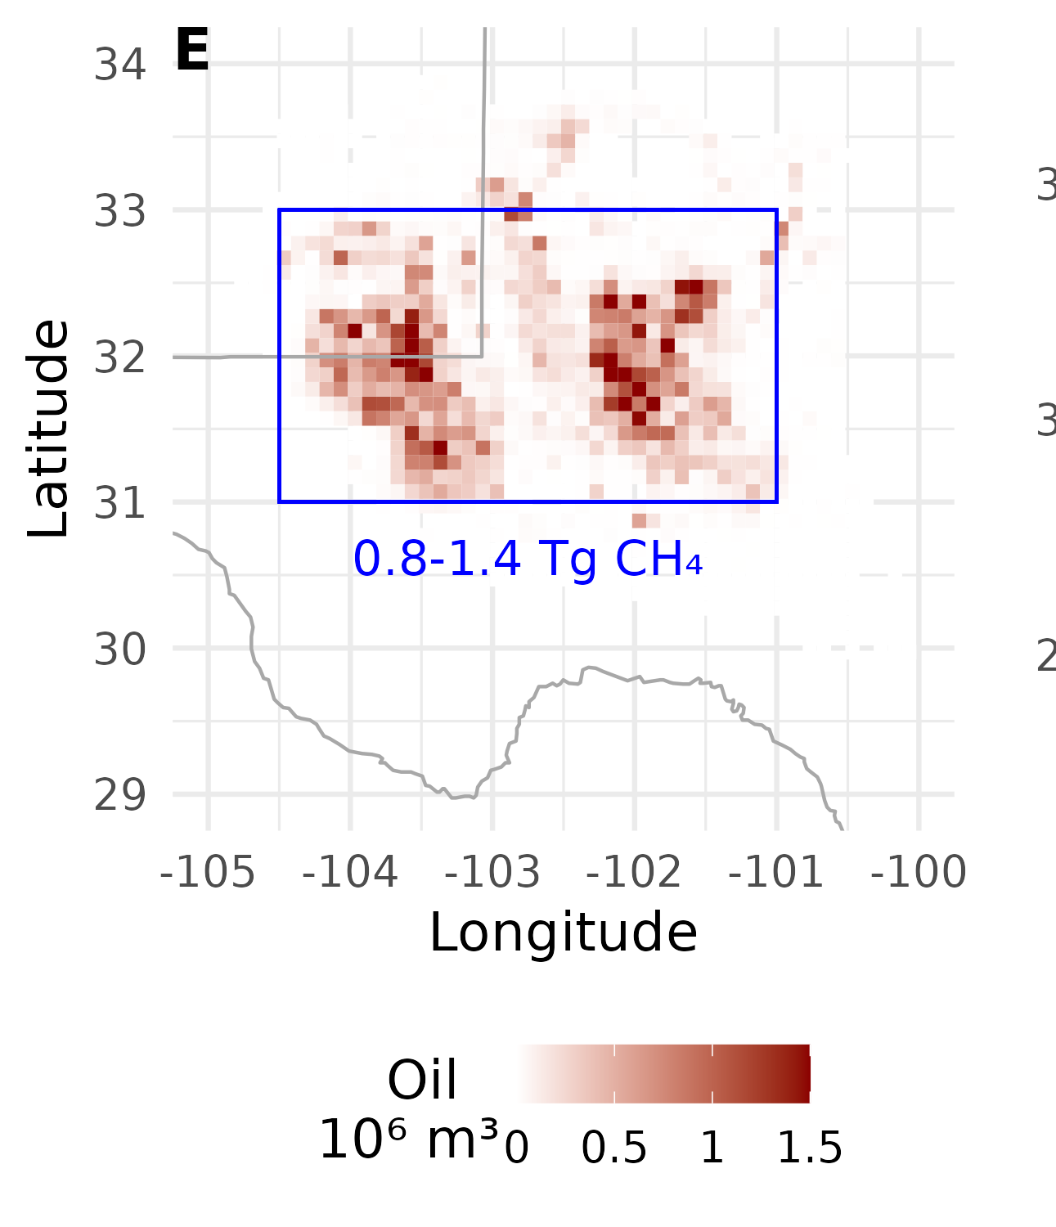
The ethane HRI is well-correlated with known patterns of fossil-fuel extraction: the long-term HRI over the Permian shows the Delaware and Midland basins.
Scarpelli et al., 2022
Zhang et al., 2020

Slide 6

HRI is dimensionless, so we need some way to relate an HRI to a column amount. Machine Learning works!
GEOS-Chem
Model “truth”
Start with a model of the atmosphere to be our ‘truth’.
Sample it the way CrIS would see it.

Slide 7


We use a radiative transfer model to answer the question ‘given this atmosphere, what radiance spectrum would the satellite see?’
LBL Radiative Transfer Model
GEOS-Chem
Model “truth”
What HRI would CrIS see, given the model data?

Slide 8
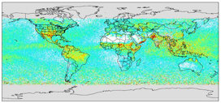

With this dataset of radiances based on a known atmosphere, we will train a neural network to convert between the two.
LBL Radiative Transfer Model
GEOS-Chem
Machine
Learning
Model “truth”
What HRI would CrIS see, given the model data?
Train the algorithm on the relationship.
HRI
P₉₀
Thermal contrast
H₂O vapor column
Surface pressure
Satellite view angle

Slide 9
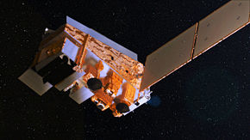

We then take this trained neural network and use it to turn the HRIs derived from real CrIS observations into a column ethane value.
LBL Radiative Transfer Model
GEOS-Chem
Machine
Learning
Model “truth”
What HRI would CrIS see, given the model data?
Train the algorithm on the relationship, use it to interpret real CrIS HRIs.
HRI
P₉₀
Thermal contrast
H₂O vapor column
Surface pressure
Satellite view angle

Slide 10
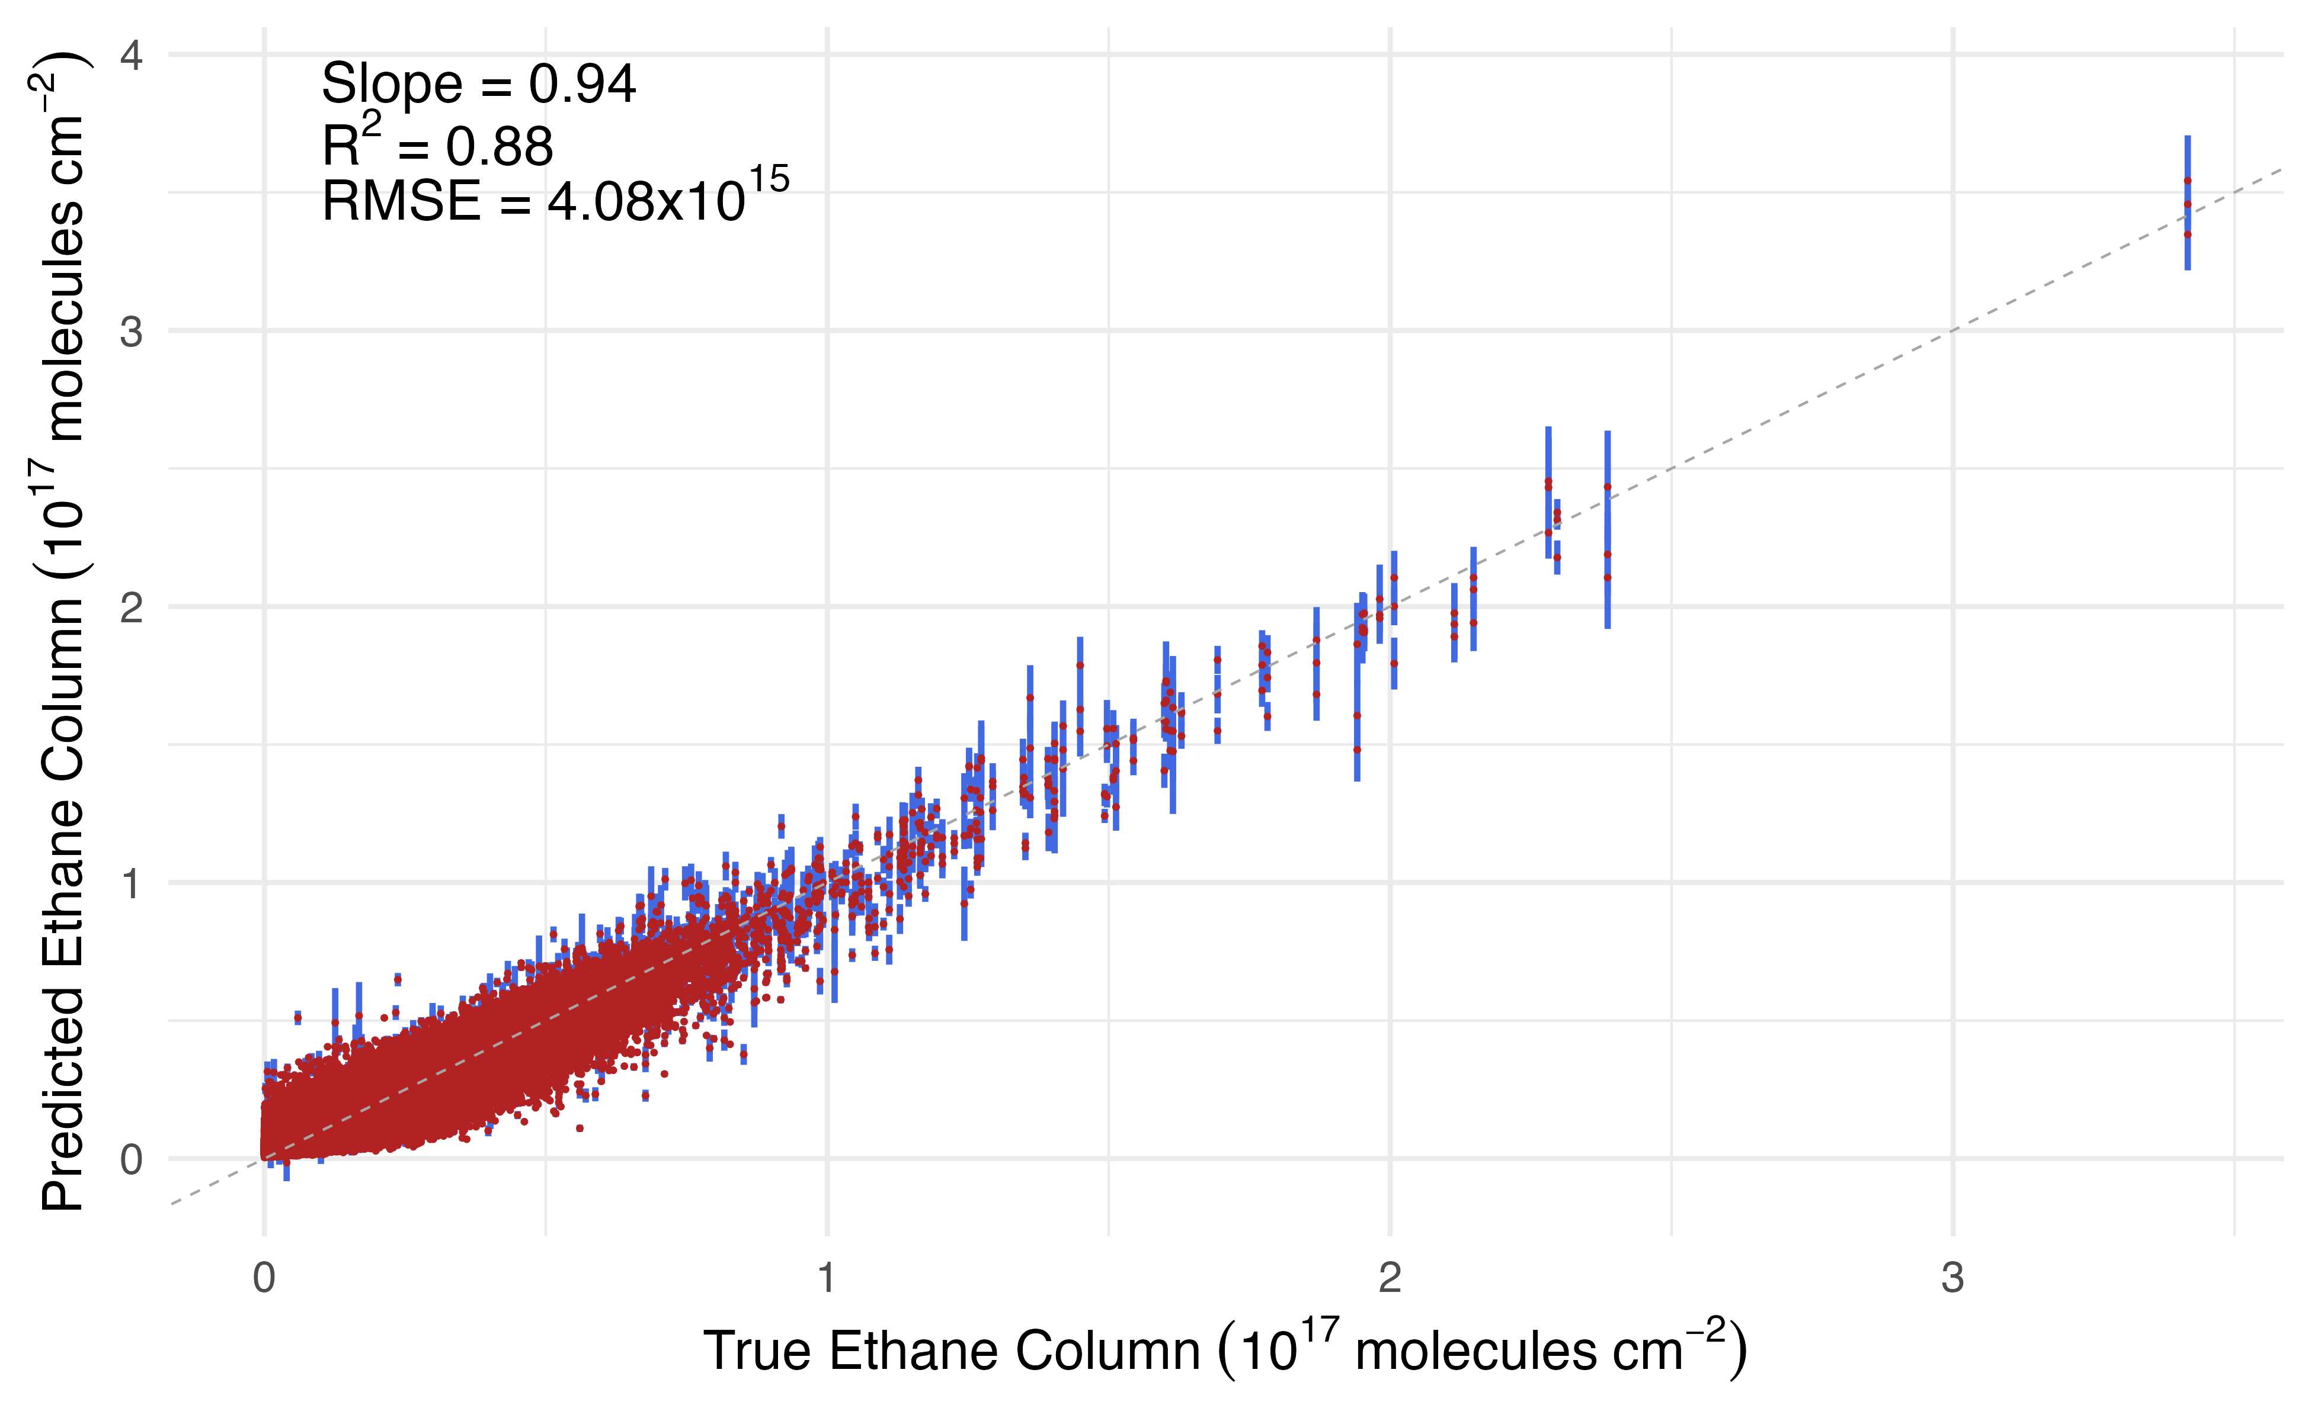
With 10 predictors, our algorithm performs very well in the testing set, reproducing 88% of the ethane column variance.
Most important predictors:
The ethane HRI
The vertical distribution of ethane
Surface and atmospheric temperatures

Slide 11
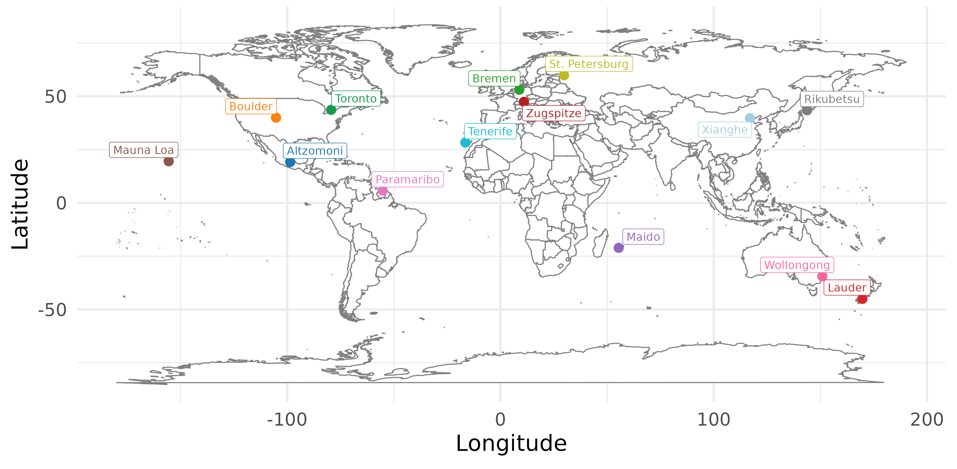
We evaluate the ethane retrieval using surface observations from the Network for the Detection of Atmospheric Composition Change (NDACC).
NDACC: ground-based solar Fourier Transform Infrared (FTIR) measurements in the near-IR
<6% systemic error
<3% random error
Good agreement with surface observations
Franco et al., 2015
Rinsland et al., 1994
Notes:
Reasons why NDACC could be different from the ground:
Different forward model
Not necessarily the same spectroscopy
Vivienne thinks the water vapor input could be different too
Things that a lot of people are looking at have a lot of efforts to compare thermal vs near IR and there’s not a ton being done on ethane

Slide 12
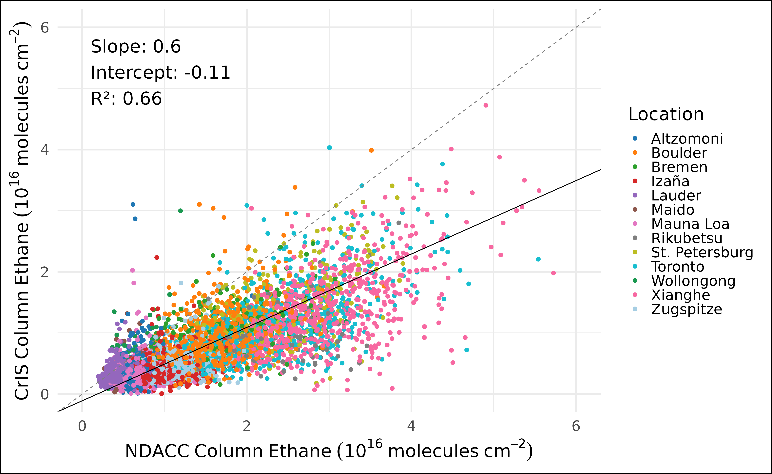
CrIS ethane columns are well correlated with the NDACC observations but biased low a factor of two.
Relaxing the ±2 hours requirement has no effect.
Comparing only to the specific pixel of the NDACC site increases slope to 0.75 with higher noise.
We are uncertain why this underestimate exists.
± 0.01
± 0.1

Slide 13
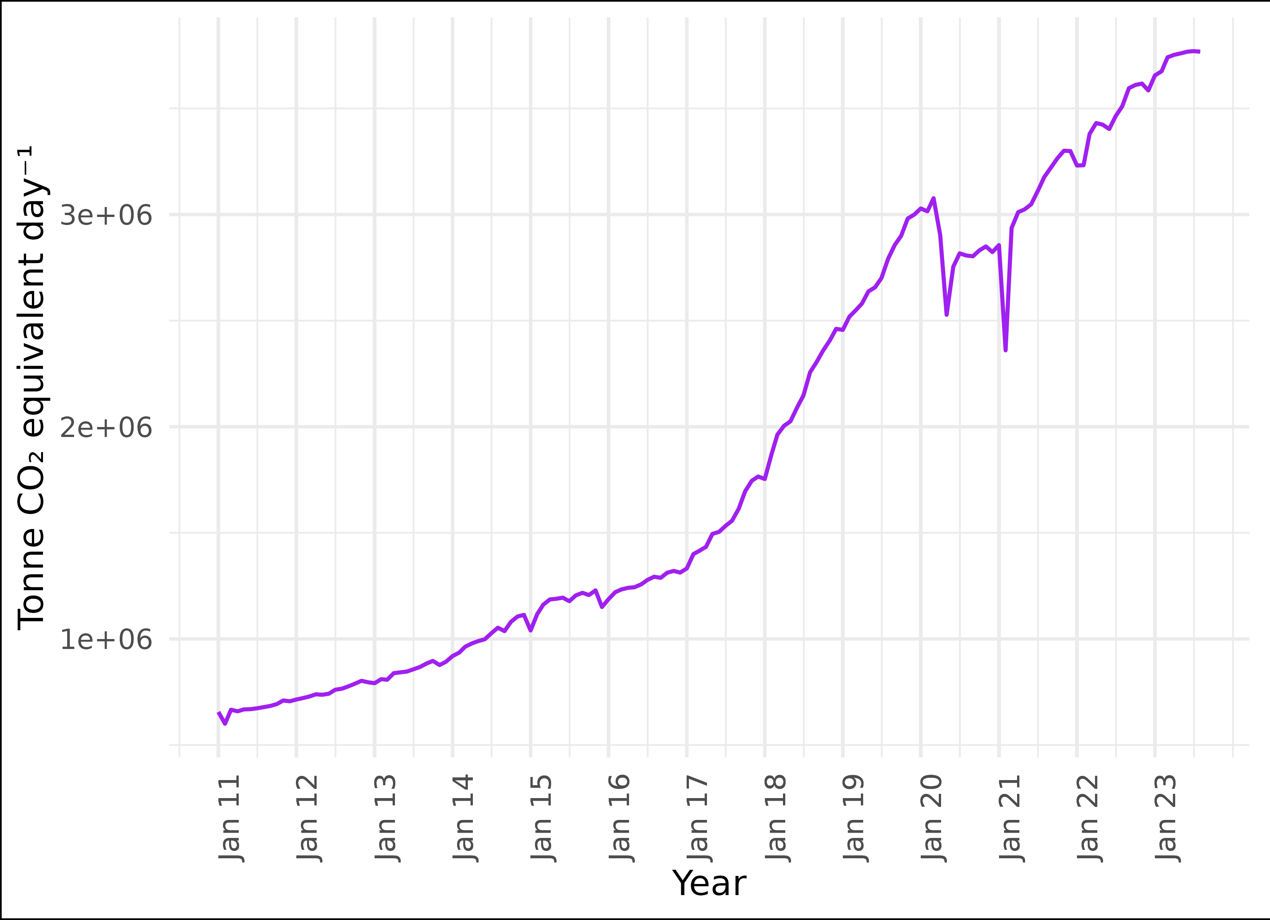
Our first analysis of this data is aimed at the location with the highest global ethane HRI: the Permian basin (TX/NM).
Most productive oil-producing basin in the US and one of the largest in the world.
Fossil fuel production over this region has increased immensely since 2016
Barkley et al., 2021
Zhang et al., 2020
US EIA 2023

Slide 14
How much would we have to scale up GEOS-Chem emissions to make the GEOS-Chem ethane column (𝜴_{GC}) match our CrIS ethane columns (𝜴_{CrIS})?
GEOS-Chem 2019 Simulation
GEOS-Chem version 14.1
MERRA-2 Meteorology
0.5° x 0.625° resolution
Ethane emissions from Tzompa-Sosa et al. (2017)
  Scaled version of the 2011 NEI

Slide 15
How much would we have to scale up GEOS-Chem emissions to make the GEOS-Chem ethane column (𝜴_{GC}) match our CrIS ethane columns (𝜴_{CrIS})?
Apply Permian Emissions Multiplier (PEM) scaling factor to ethane emissions in the Delaware and Midland basins
GEOS-Chem 2019 Simulation
GEOS-Chem version 14.1
MERRA-2 Meteorology
0.5° x 0.625° resolution
Ethane emissions from Tzompa-Sosa et al. (2017)
  Scaled version of the 2011 NEI
PEM = 1
PEM = 2
…
PEM = 5
…
PEM = 11

Slide 16
How much would we have to scale up GEOS-Chem emissions to make the GEOS-Chem ethane column (𝜴_{GC}) match our CrIS ethane columns (𝜴_{CrIS})?
Apply Permian Emissions Multiplier (PEM) scaling factor to ethane emissions in the Delaware and Midland basins
GEOS-Chem 2019 Simulation
GEOS-Chem version 14.1
MERRA-2 Meteorology
0.5° x 0.625° resolution
Ethane emissions from Tzompa-Sosa et al. (2017)
  Scaled version of the 2011 NEI
PEM = 1
Observed 𝜴_{CrIS}
PEM = 2
…
Calculate 𝜴_{GC}
PEM = 5
…
PEM = 11

Slide 17
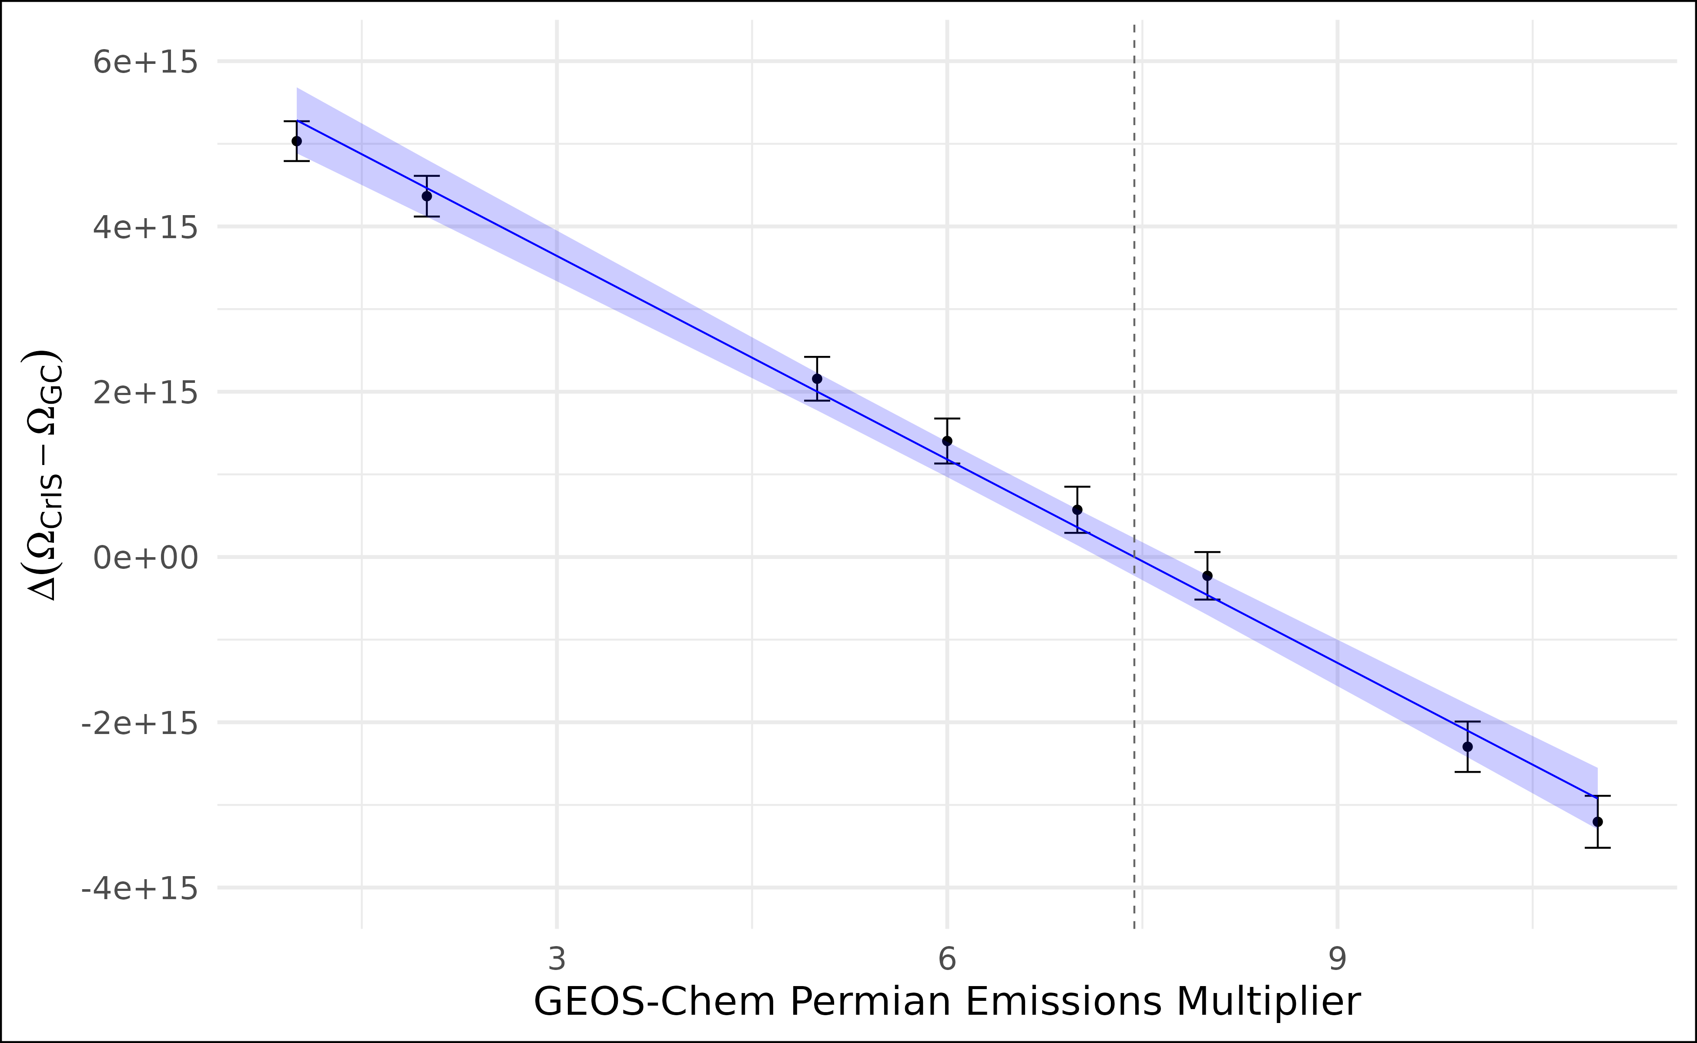
This is what the average difference between 𝜴_{CrIS} and 𝜴_{GC} looks like over the Permian for 2019, suggesting GEOS-Chem underestimates by 7.4x on average.
Scaling Factor = 1 – a priori
Scaling Factor = 7.4 – a posteriori

Slide 18
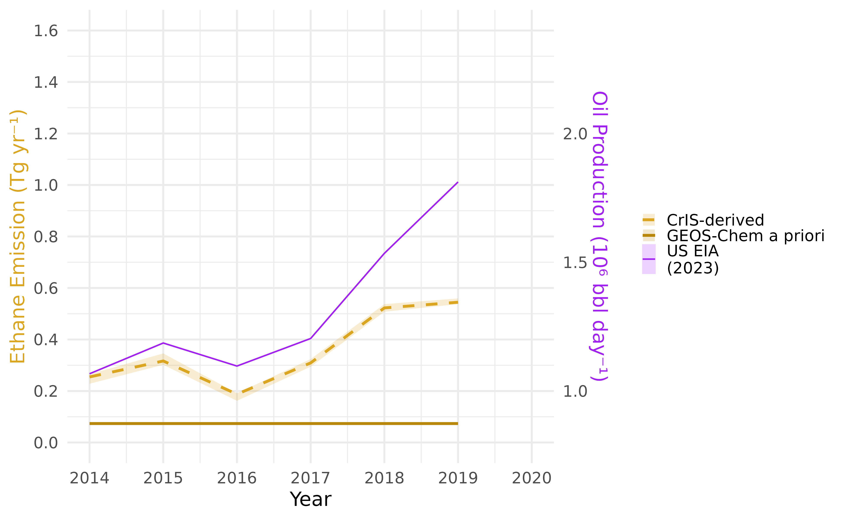
Extending this technique shows an ethane emissions that is higher than our prior and correlated with fossil fuel production in the Permian.

Slide 19
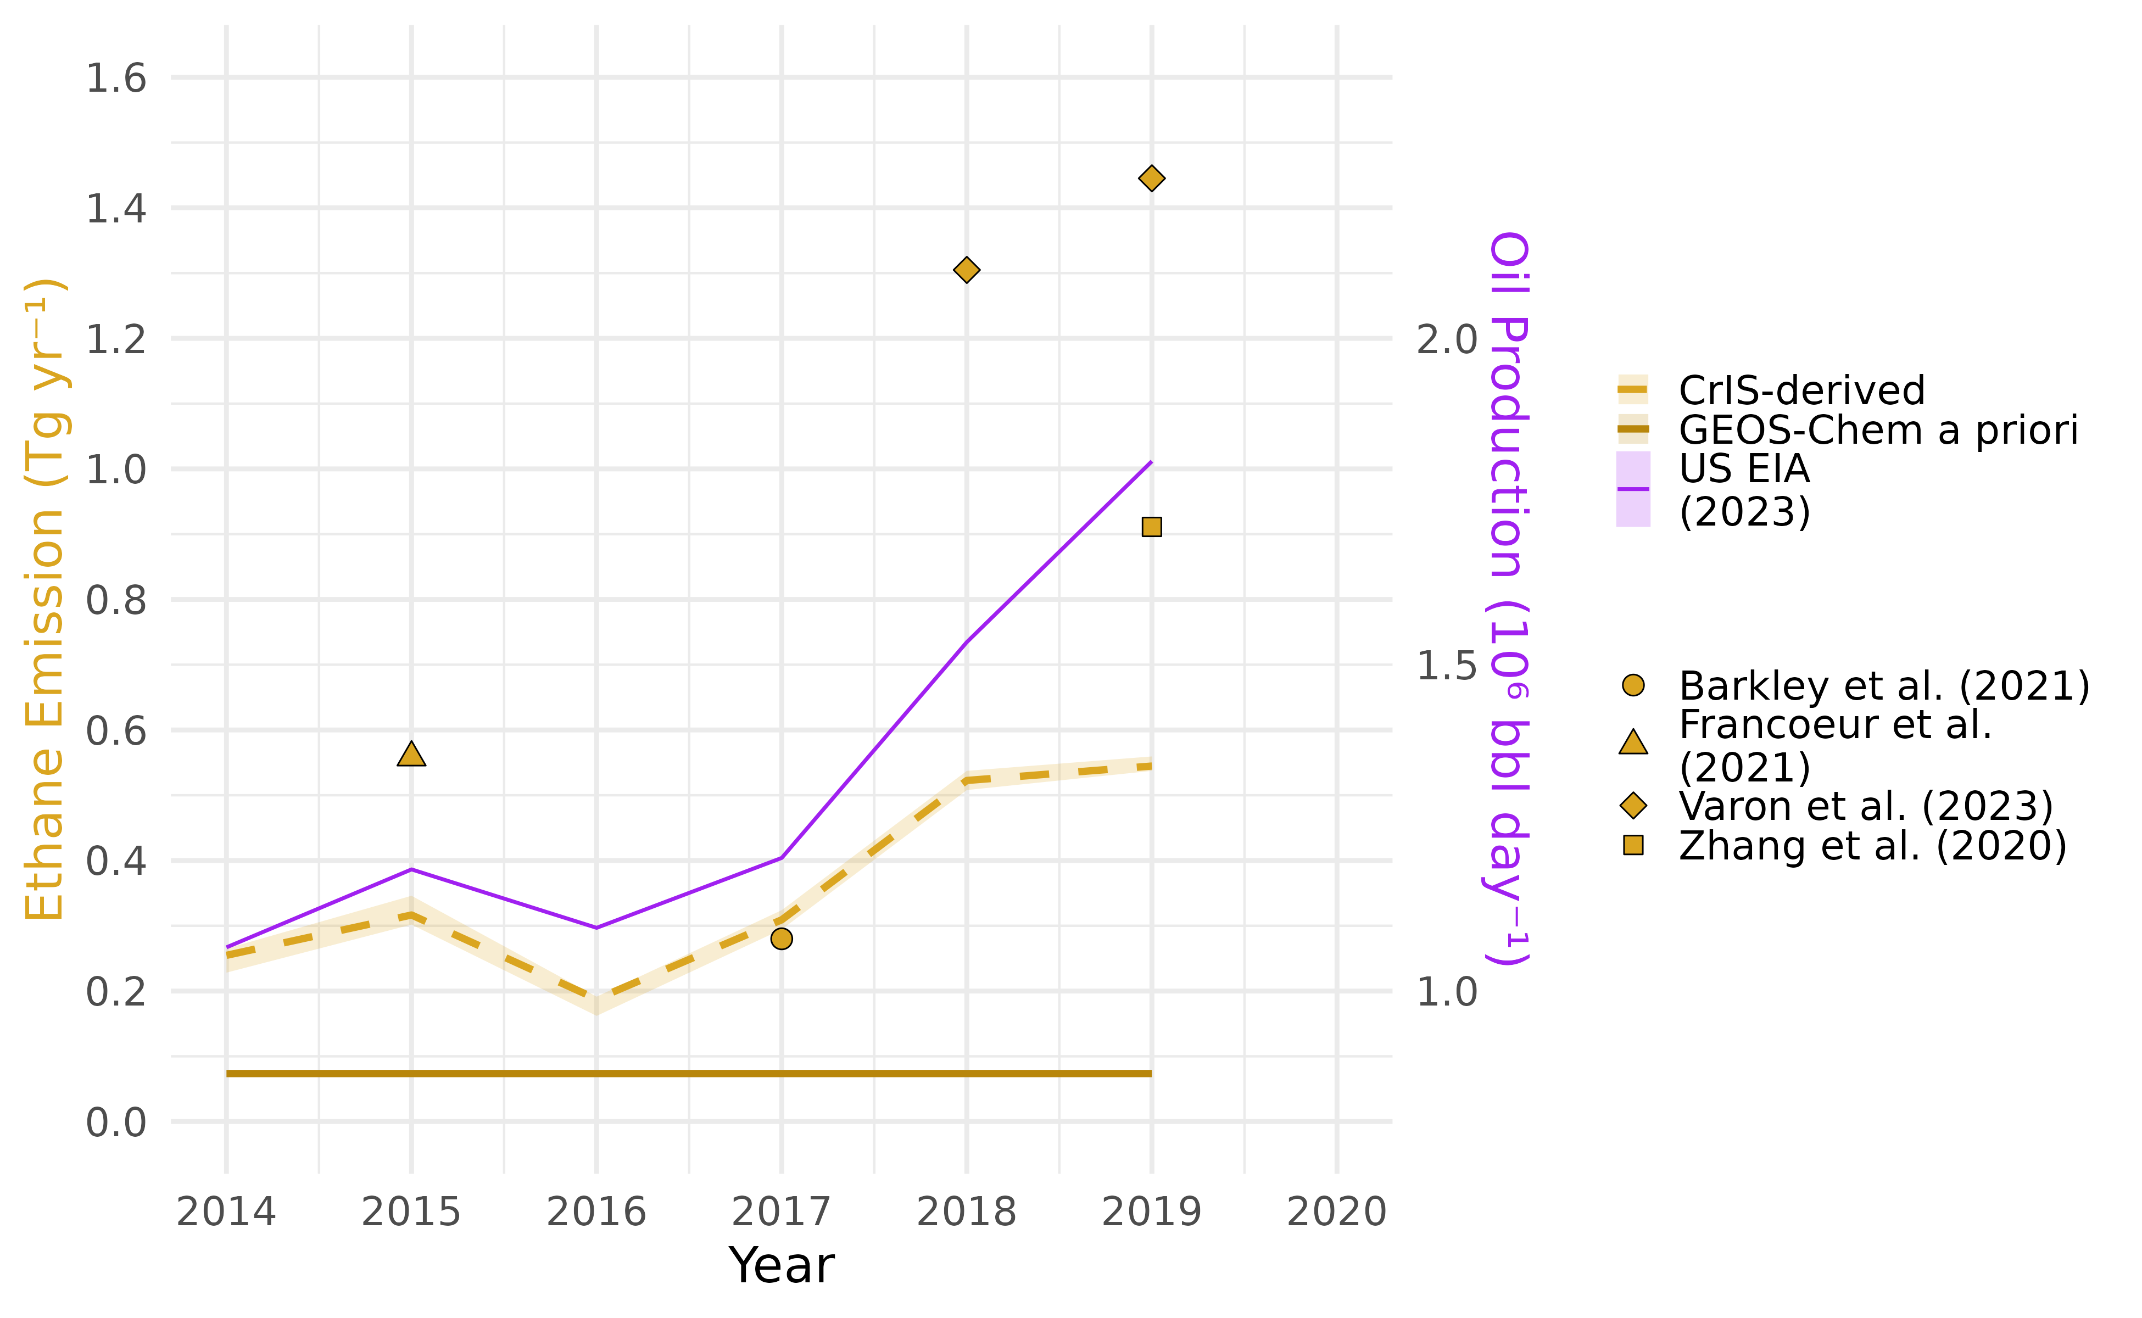
Our retrieval is still low compared with most available observations of ethane and methane, assuming an 18% Ethane:Methane emissions ratio.
The Barkley et al. (2021) inversion is based upon ACT-America observations

Slide 20
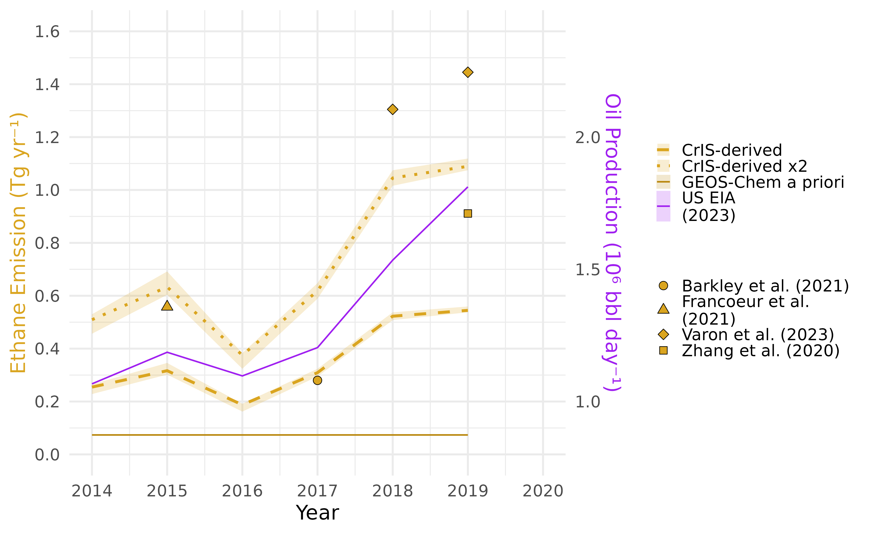
If we a apply a factor of 2 scalar, as our NDACC results suggested we should, we get a time series that much more closely fits these observations.

Slide 21
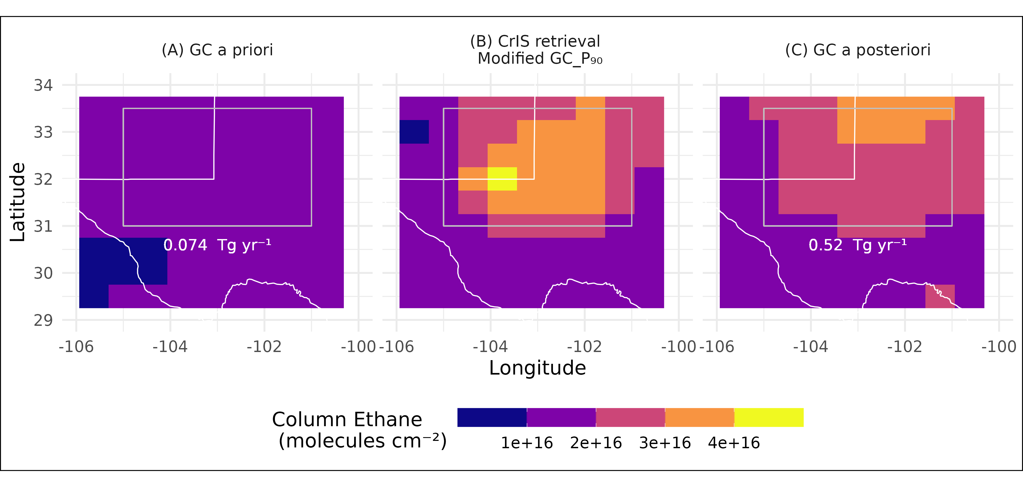
The scaled emissions minimize the difference between 𝜴_{CrIS} and 𝜴_{GC} on average, but they are spatially misaligned because the spatial pattern of GC emissions are wrong.
2019
Remember, our retrieval is biased low by up to a factor of 2 relative to NDACC observations.
Barkley et al., 2021
Tzompa-Sosa et al., 2017
Tribby et al., 2022
Notes:
Michael was unclear where the a posteriori value came from and how it impacted the P90. Define a prior and a posteriori simulations here

Slide 22
Our immediate next steps involve using better tools to tackle the question of ‘how much ethane do our observations suggest is being emitted’.
Use the CHEEREIO GEOS-Chem LETKF framework to derive new maps of ethane emissions
Investigate the underestimate in our CrIS ethane column
Think about averaging kernels for this kind of ML-based retrieval

Slide 23
Questions?
Keep an eye out for our pub – we just submitted our response to reviewers and hope to have this out before too long.
Data used in this presentation were obtained from Brian Vasel, Dr. Nicholas Jones, Dr. Clare Paton-Walsh, Dr. David Griffith, Dr. V. Duflot, Dr. Justus Notholt, Richard Querel, Dr. Michel Grutter de la Mora, Radjkoemar Nanda, Dr. T. Nagahama, Dr. Emilio Cuevas Aguiló, Dr. Kimberly Strong, Dr. Ralf Sussmann, and Dr. Maria Makarova as part of the Network for the Detection of Atmospheric Composition Change (NDACC) and are available through the NDACC website (www.ndacc.org).

Slide 24
Our immediate next steps involve using better tools to tackle the question of ‘how much ethane do our observations suggest is being emitted’.
Add a second layer of auxiliary training to the ML framework to account for the factor-of-two underestimate
Broaden the comparison with NDACC observations to include TCCON sites where ethane observations are available
  Especially where aircraft observations can also be compared
Investigate trends in ethane over time
Think about averaging kernels for this kind of ML-based retrieval

Slide 25
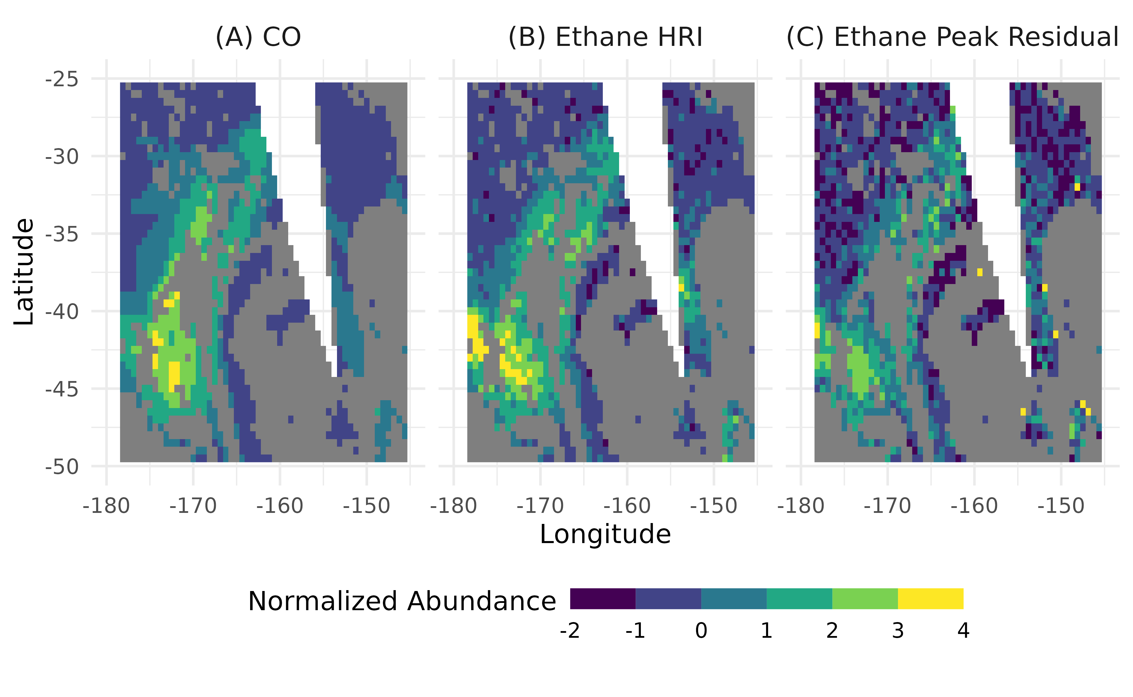
This is a wildfire plume from the January 2020 Australian wildfires, observed over the southern Pacific and defined using CrIS CO values.
Data is cloud-screened using the difference between brightness temperature and skin temperature at 900 cm⁻¹
Notes:
How is the NA calculated here?

Slide 26
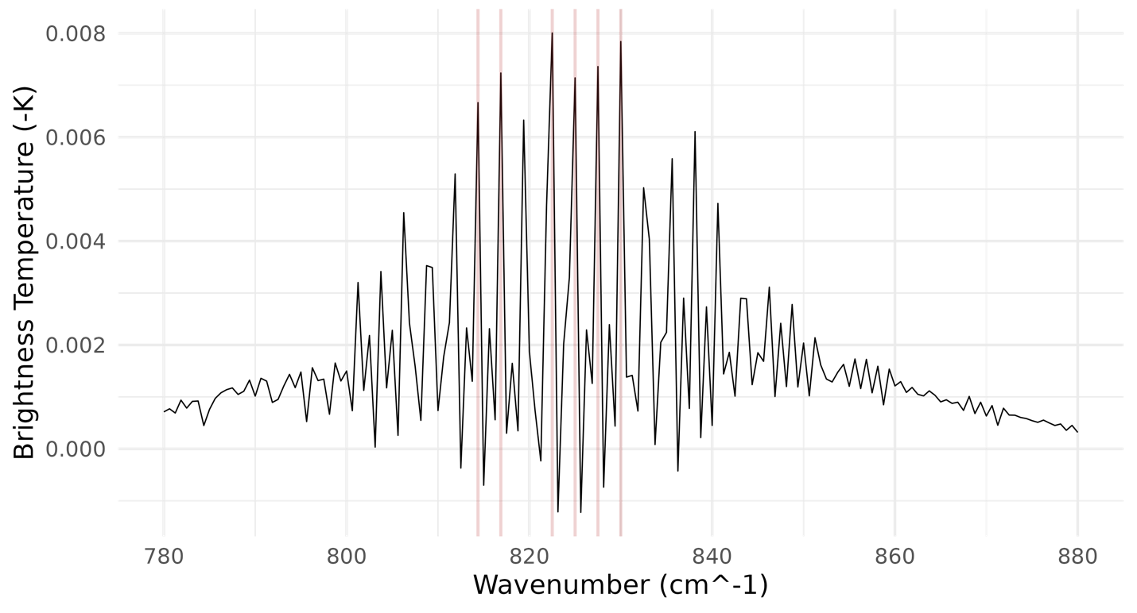
In this isolated plume, we can the peak-offpeak residual difference at the eight highest ethane absorption peaks to find an ethane signal from CrIS.
I used the mean difference between the peak and its left and right shoulders for each of the 8 wavenumbers with the highest ethane absorption.
Notes:
How is the NA calculated here?

Slide 27
The ethane HRI gives a much less noisy and more coherent signal, with clear correlation with the CrIS CO.
Notes:
How is the NA calculated here?

Slide 28
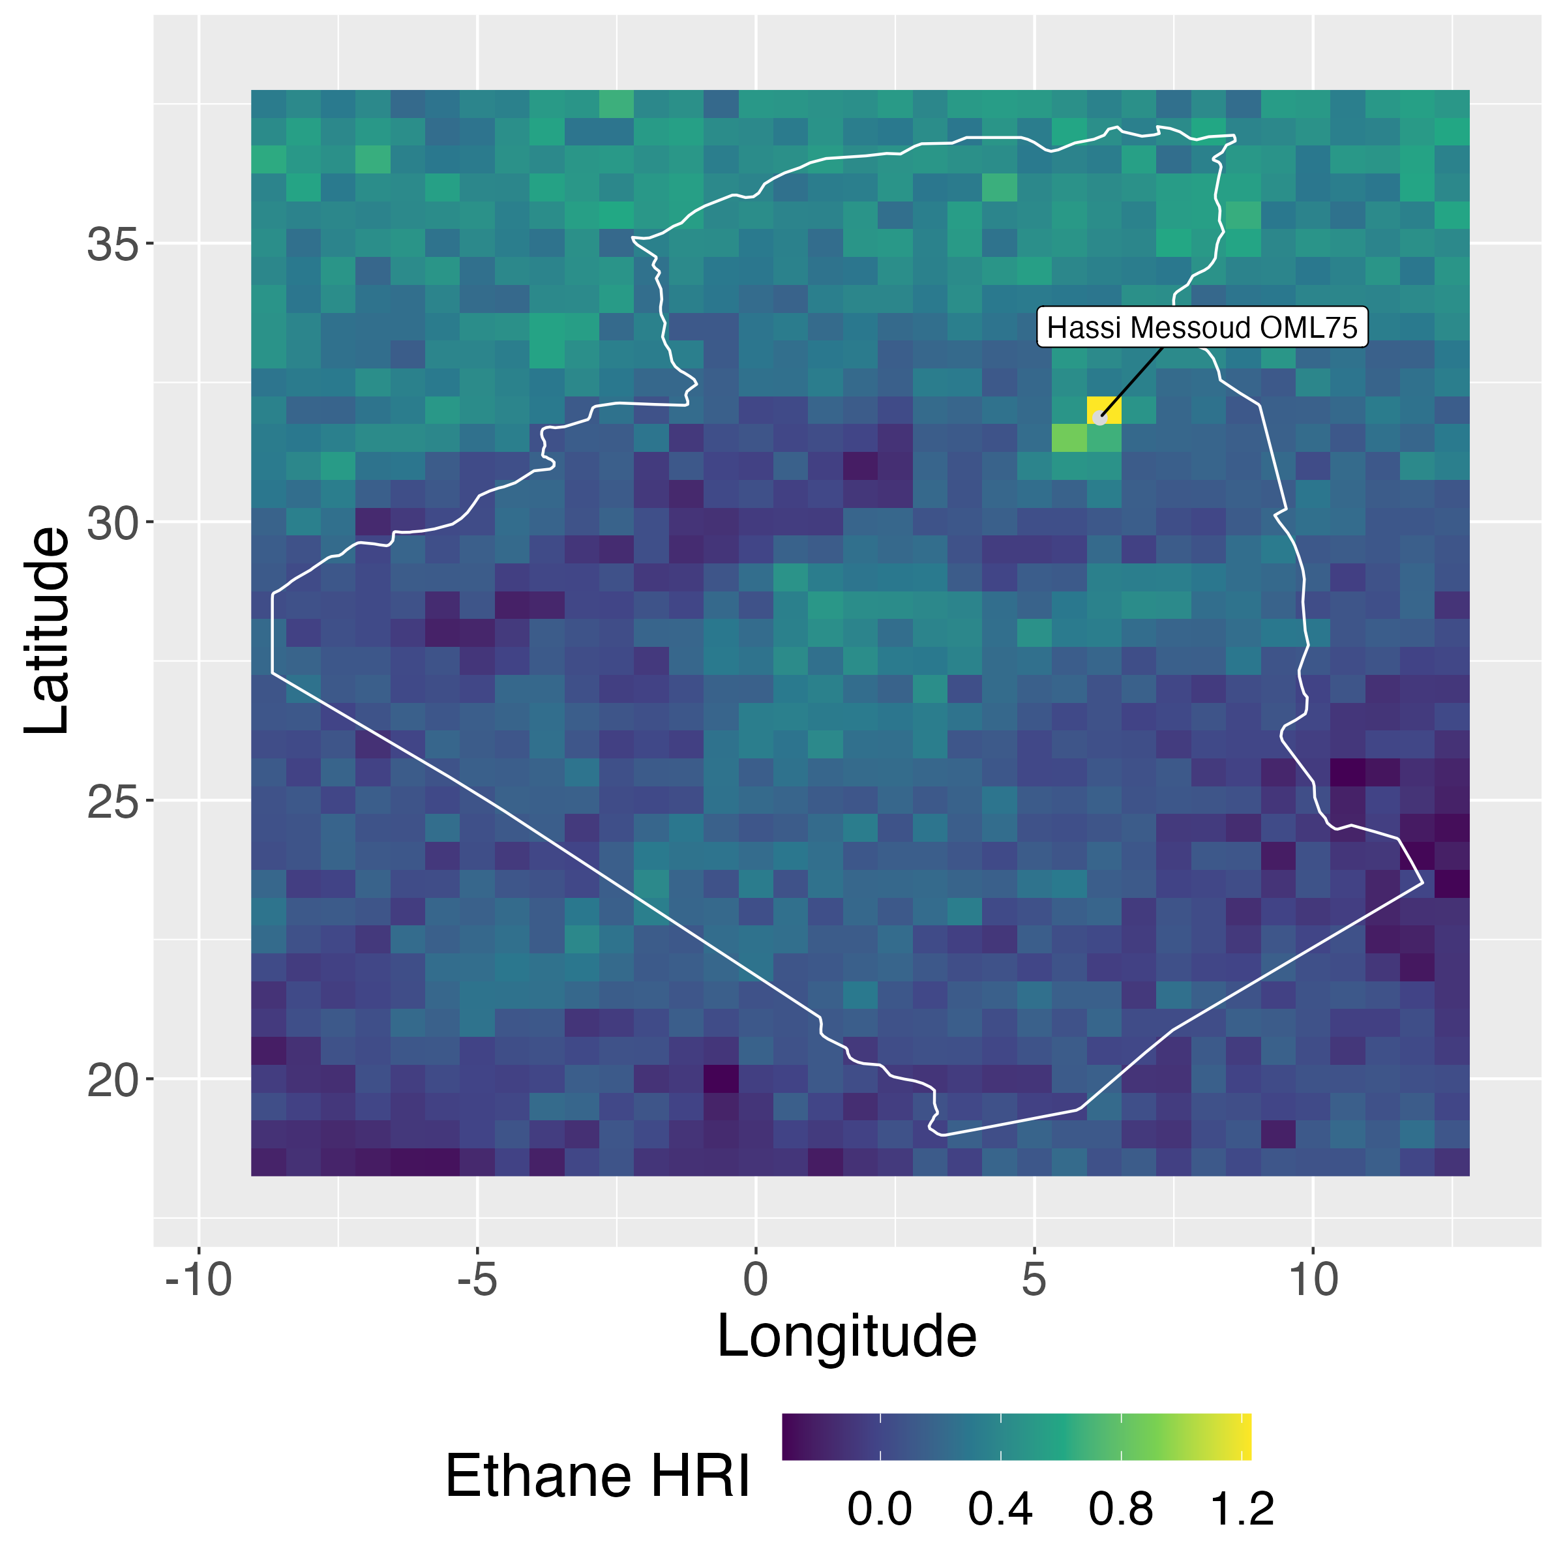
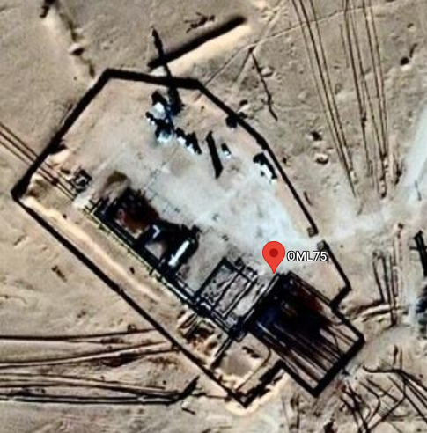
This is Hassi Messaoud OML75, which leaked an average of 30 tons methane per hour continuously between 1/3/20-2/8/20.
Scarpelli et al. (2022)
Pandey et al. (2023)
Varon et al. (2021)
Notes:
Sudhanshu thinks that we are seeing the ethane signal more prominently over oil production because they are ready to capture it in ethane

Slide 29
We train 10 instances of a feed-forward ANN using 10 different predictors.
Ethane HRI
P₉₀ (measure of vertical distribution of the ethane column)
View Angle
Surface Pressure
Column Water Vapor
Skin Temperature
Surface Air Temperature
860 hPa Temperature
630 hPa Temperature
230 hPa Temperature

Slide 30
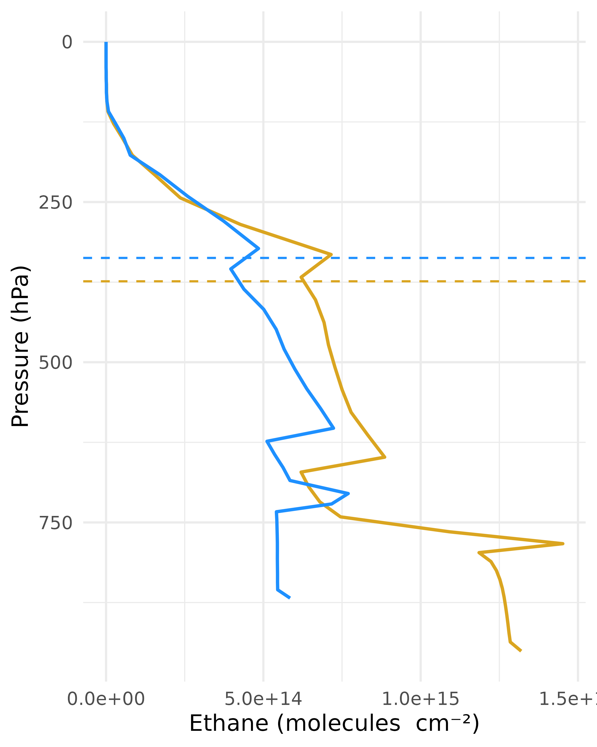
The HRI is calculated in the thermal-IR and is thus sensitive to the vertical distribution of ethane within a given column, which we represent using P₉₀.
P₉₀: the pressure level above 90% of column ethane.
A large amount of ethane in the lower troposphere and a relatively smaller amount of ethane higher in the column can give similar HRI values.
P₉₀ Provides a basis for comparison with models/observations
P₉₀
P₉₀
Notes:
Introduce the idea that thermal-IR is sensitive to vertical distribution
Need to explicitly represent this to be able to compare with a model
This is a metric for where in the vertical column this is located

Slide 31
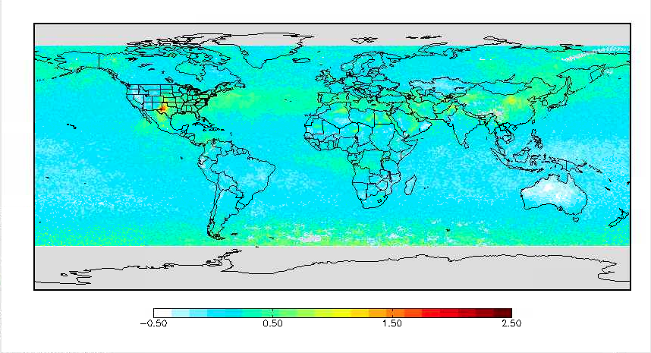
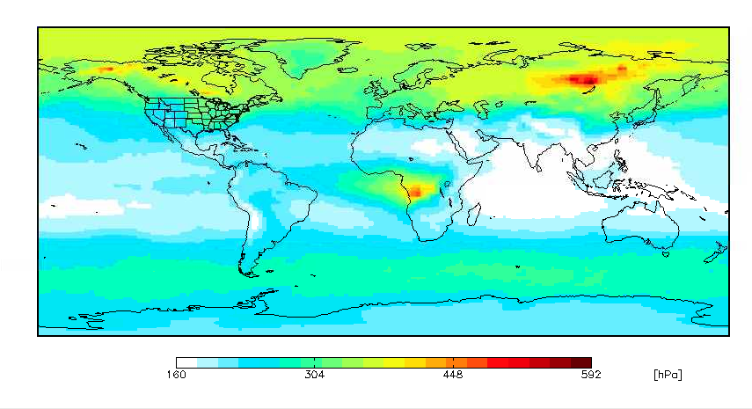
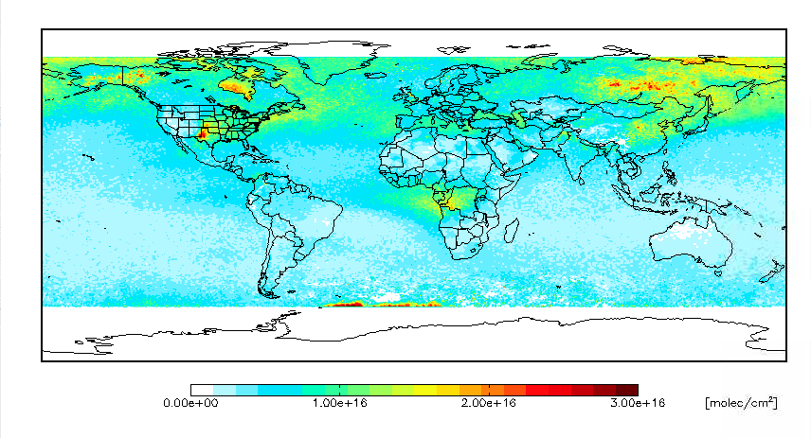
Ethane HRI
GEOS-Chem P₉₀ for July 2020
ANN-retrieved ethane column
July 2020

Slide 32
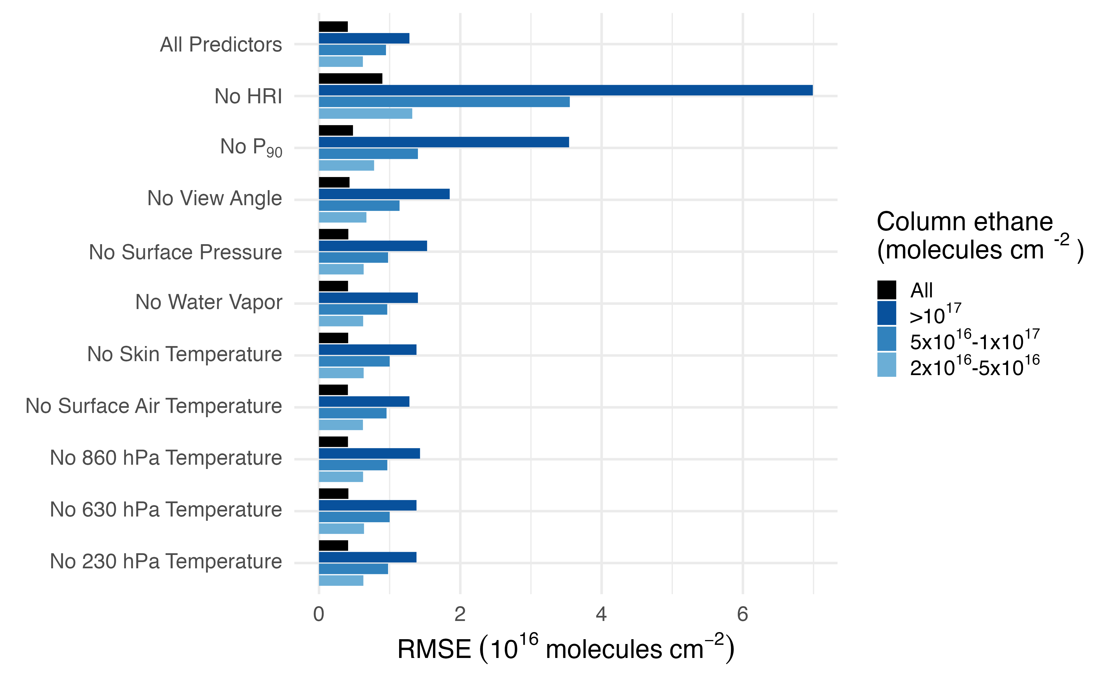
Relative prediction error decreases as column values increase, from ~50% at 1x10¹⁶ molecules cm⁻² to 10% at 5x10¹⁶ molecules cm⁻².

Slide 33
The ethane HRI is the most important predictor (which is good), and the vertical distribution of ethane (P₉₀) is the second most important.

Slide 34
Temperature also matters, but the effect is spread between five different predictors!
We do need all these
temperatures!
They tell the ANN info about vertical structure in the atmosphere.
Notes:
Don’t mention isoprene
Do we feed latitude and longitude as inputs to the ML? If so, shouldn’t that be counted as a feature?

Slide 35
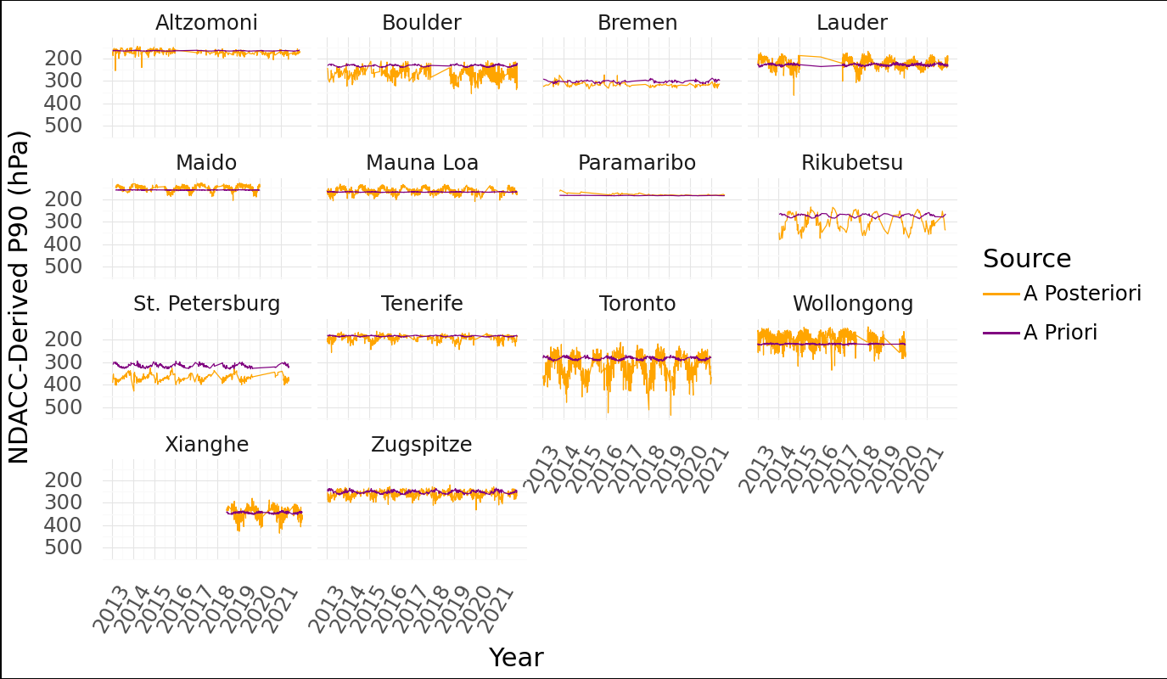
We compare each NDACC site to a 3x3 matrix of CrIS pixels (0.5° x 0.625° resolution) centered on the site and taken within ±2 hours of the overpass.
P₉₀ values are taken from the NDACC FTIR observations
Notes:
Josh Laughner thinks we are implicitly using an averaging kernel of 1 here - effectively treating the NDACC column as truth
TCCON in Oklahoma can measure ethane around 3000 cm-1. They do a scaling retrieval and assume the shape of the profile is right and then just multiply to fit
How could you remove the different assumptions about verticality from our comparison
Would there be a way to use the embedded assumptions to understand how our vertical assumptions differ from NDACC
Could do finite differencing with the LBLRTM to see how sensitive the radiances are to changes in the profile structure
If you change the profile at a given level, how does that change the HRI?
Is it easy go find the derivitive of how the column changes with HRI

Slide 36
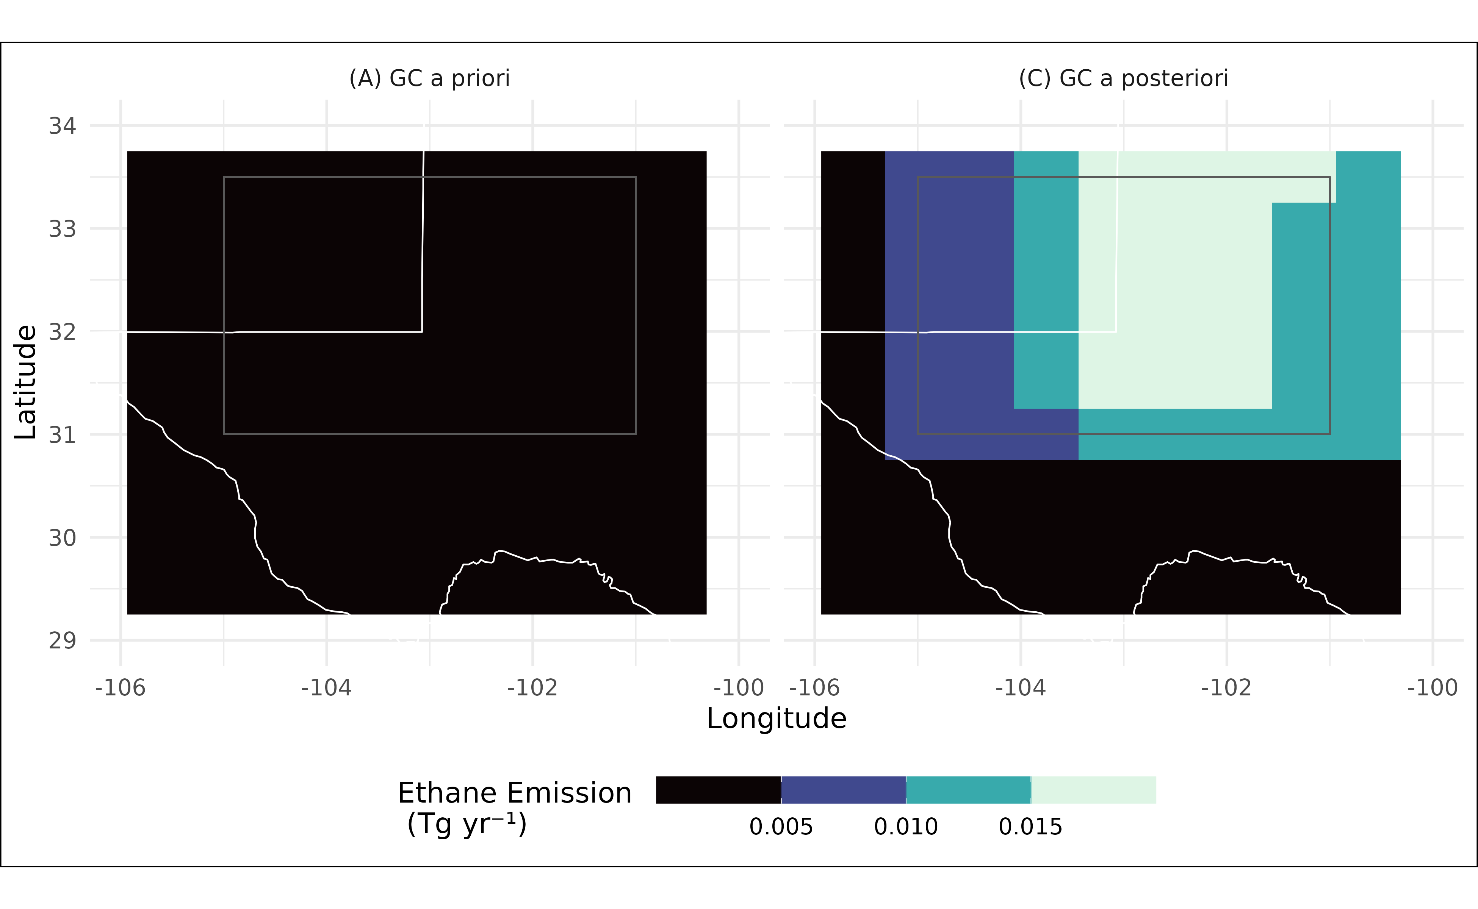
A big part of the problem is that the ethane emission fields in GEOS-Chem are incomplete – the Delaware and Midland hotspots are missing.

Slide 37
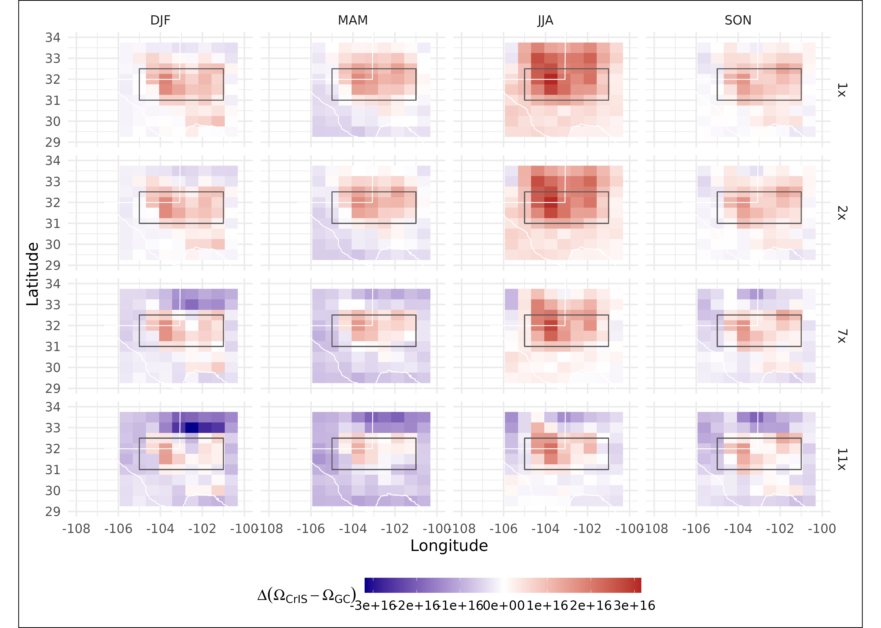
Differences between CrIS observations and GEOS-Chem vary in both space and time: the largest model underestimates occur in summer.
Scaling up Permian ethane emissions leads to model overestimates outside the region of highest ethane HRI.
Notes:
Vivienne is worried about sensitivity for the seasonality:
We get better HRI sensitivity over especially rocky surfaces
Vertical distribution is a potentially significant uncertainty, and summertime would mean ethane gets transported up and shows up better
If we see a strong seasonal cycle, is there some way to differentiate between a sensitivity related issue vs the shutoff

Slide 38
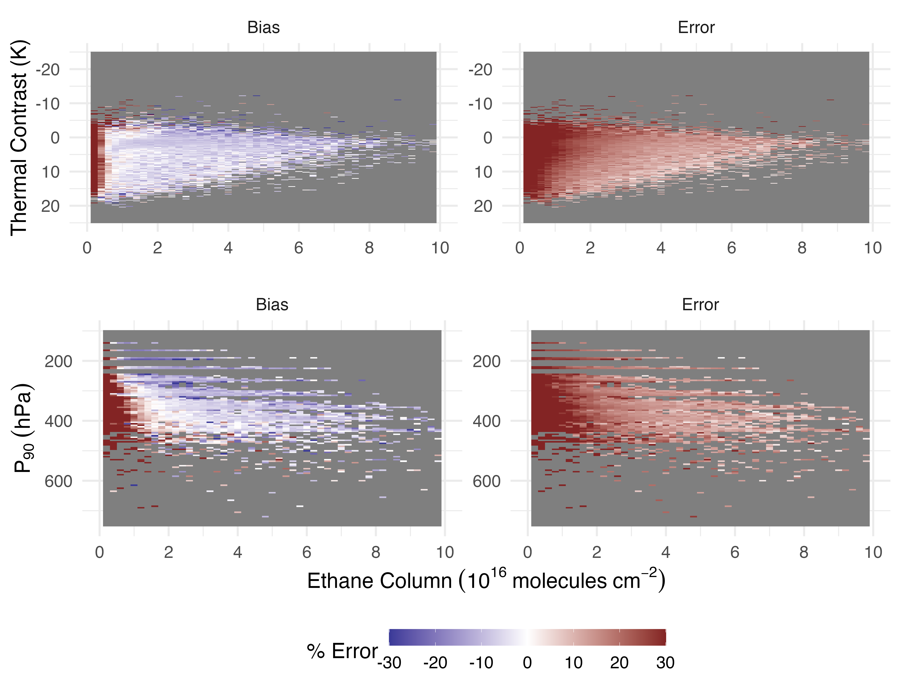
Our retrieval is biased low when compared to the training set, with stronger low biases at low thermal contrast and higher-altitude P90 values.
Error is inversely correlated with column ethane

Slide 39
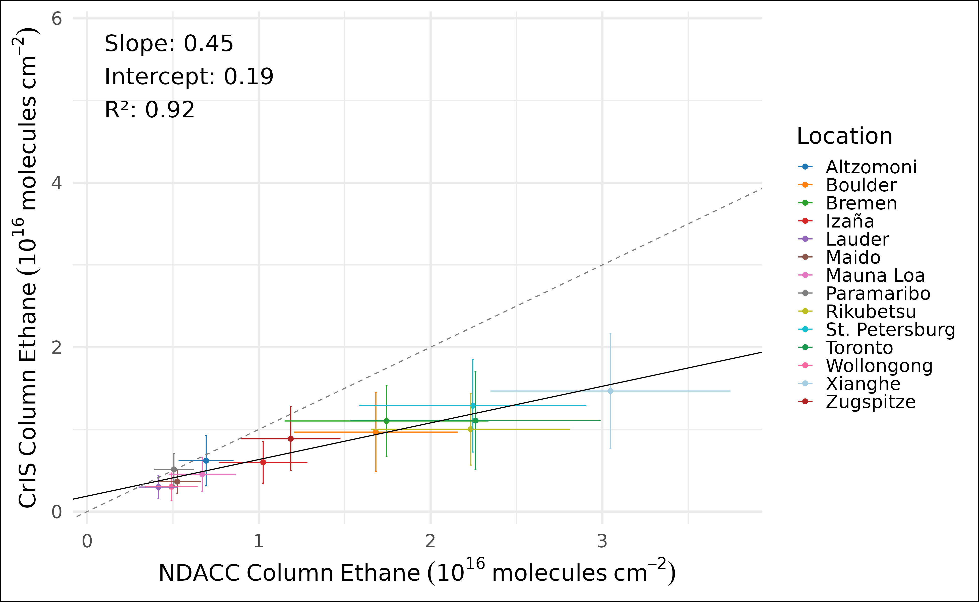
Averaging the comparisons at each NDACC location shows the consistency of the factor-of-two underestimate.

