Slide 1
NASA Sounder Discipline call
14th February 2024

Slide 2
Topics for today
Terra/Aqua/Aura Continuity (D. Considine)
ROSES
F.8 call in ROSES 2023, “Supplements for Open Source Science”
ROSES 2024 solicitation
Planetary Boundary Layer
Product Releases
SiFSAP
JPSS-2 CrIS L1B
SNPP/JPSS-1/JPSS-2 status (J. Gleason)

Slide 3
Terra/Aqua/Aura Data Continuity

Slide 4
ROSES 2023: F.8 Supplements for Open Source Science
https://nspires.nasaprs.com/external/viewrepositorydocument/cmdocumentid=918324/solicitationId=%7B2B66037B-0507-568E-5D64-2A3B61DF0195%7D/viewSolicitationDocument=1/F.8_%20SOSS_Amend57.pdf
Add an open science component to an existing ”parent” award
Making results more accessible, inclusive and usable
Contributing back to open science communities used by award
Requests for Amazon Web Services credits to support activities from award
Image: https://www.earthdata.nasa.gov/technology/open-science

Slide 5
NASA Open Source Science
https://science.nasa.gov/researchers/open-science/
“NASA is making a long-term commitment to building an inclusive science community over the next decade. Open-source science is a commitment to the open sharing of software, data, and knowledge (algorithms, papers, documents, ancillary information) as early as possible in the scientific process.”
NASA Open Science Certification
Open Science 101 course released

Slide 6
ROSES 2024

Slide 7
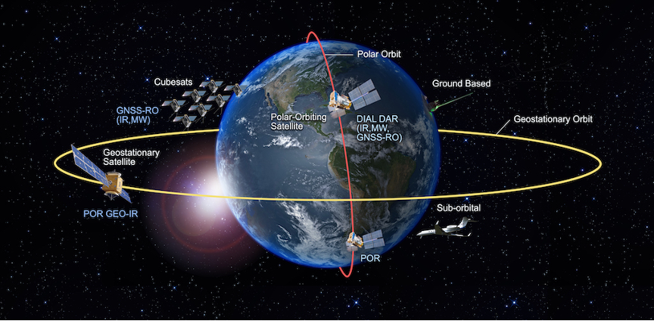
Planetary Boundary Layer

Slide 8
Product releases

Slide 9
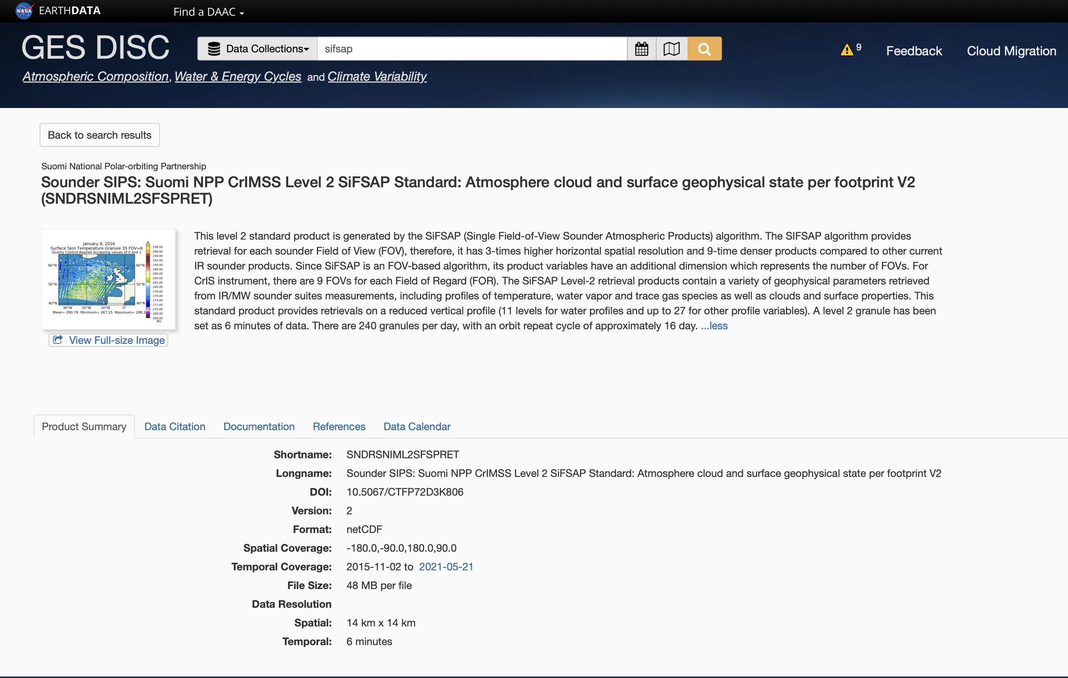

Slide 10
From JPSS-1 to JPSS-2 products
Dependencies and scheduling?

Slide 11
SNPP/JPSS-1/JPSS-2 status

