Slide 1
Feasibility and Applications of Retrieving Oil and Gas Ethane Emissions from Space
Colby Francoeur¹⁻³, Brian McDonald¹, Jian He^{1,2}, Colin Harkins^{1,2}, Daven Henze³
NOAA Chemical Sciences Laboratory, Boulder, CO USA
Cooperative Institute for Research in Environmental Sciences, University of Colorado, Boulder, CO USA
Department of Mechanical Engineering, University of Colorado, Boulder, CO USA
NASA Sounder Discipline telecon
^{May 15th, 2024}

Slide 2
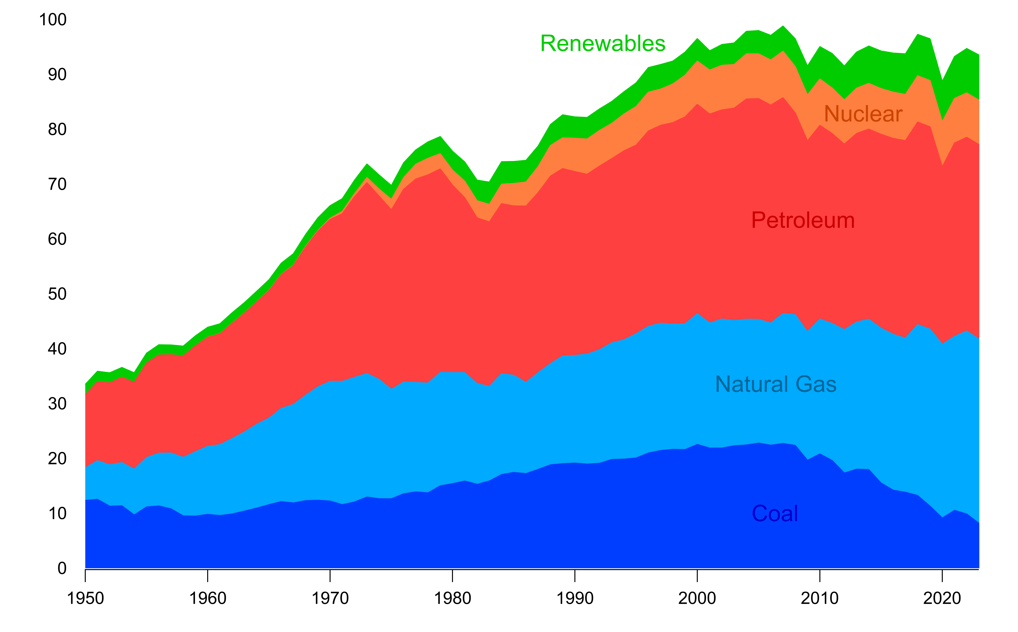
Petroleum and Natural Gas Growing Source of US Energy Mix
US Primary Energy Consumption (1950-2023)
Quadrillion BTUs
Domestic energy production
~95% of US consumption
Projected to increase,
then decrease by 2050
(little change)
Projected to grow
~30% by 2050
US Energy Information Administration (Monthly Energy Review, 2024)

Slide 3
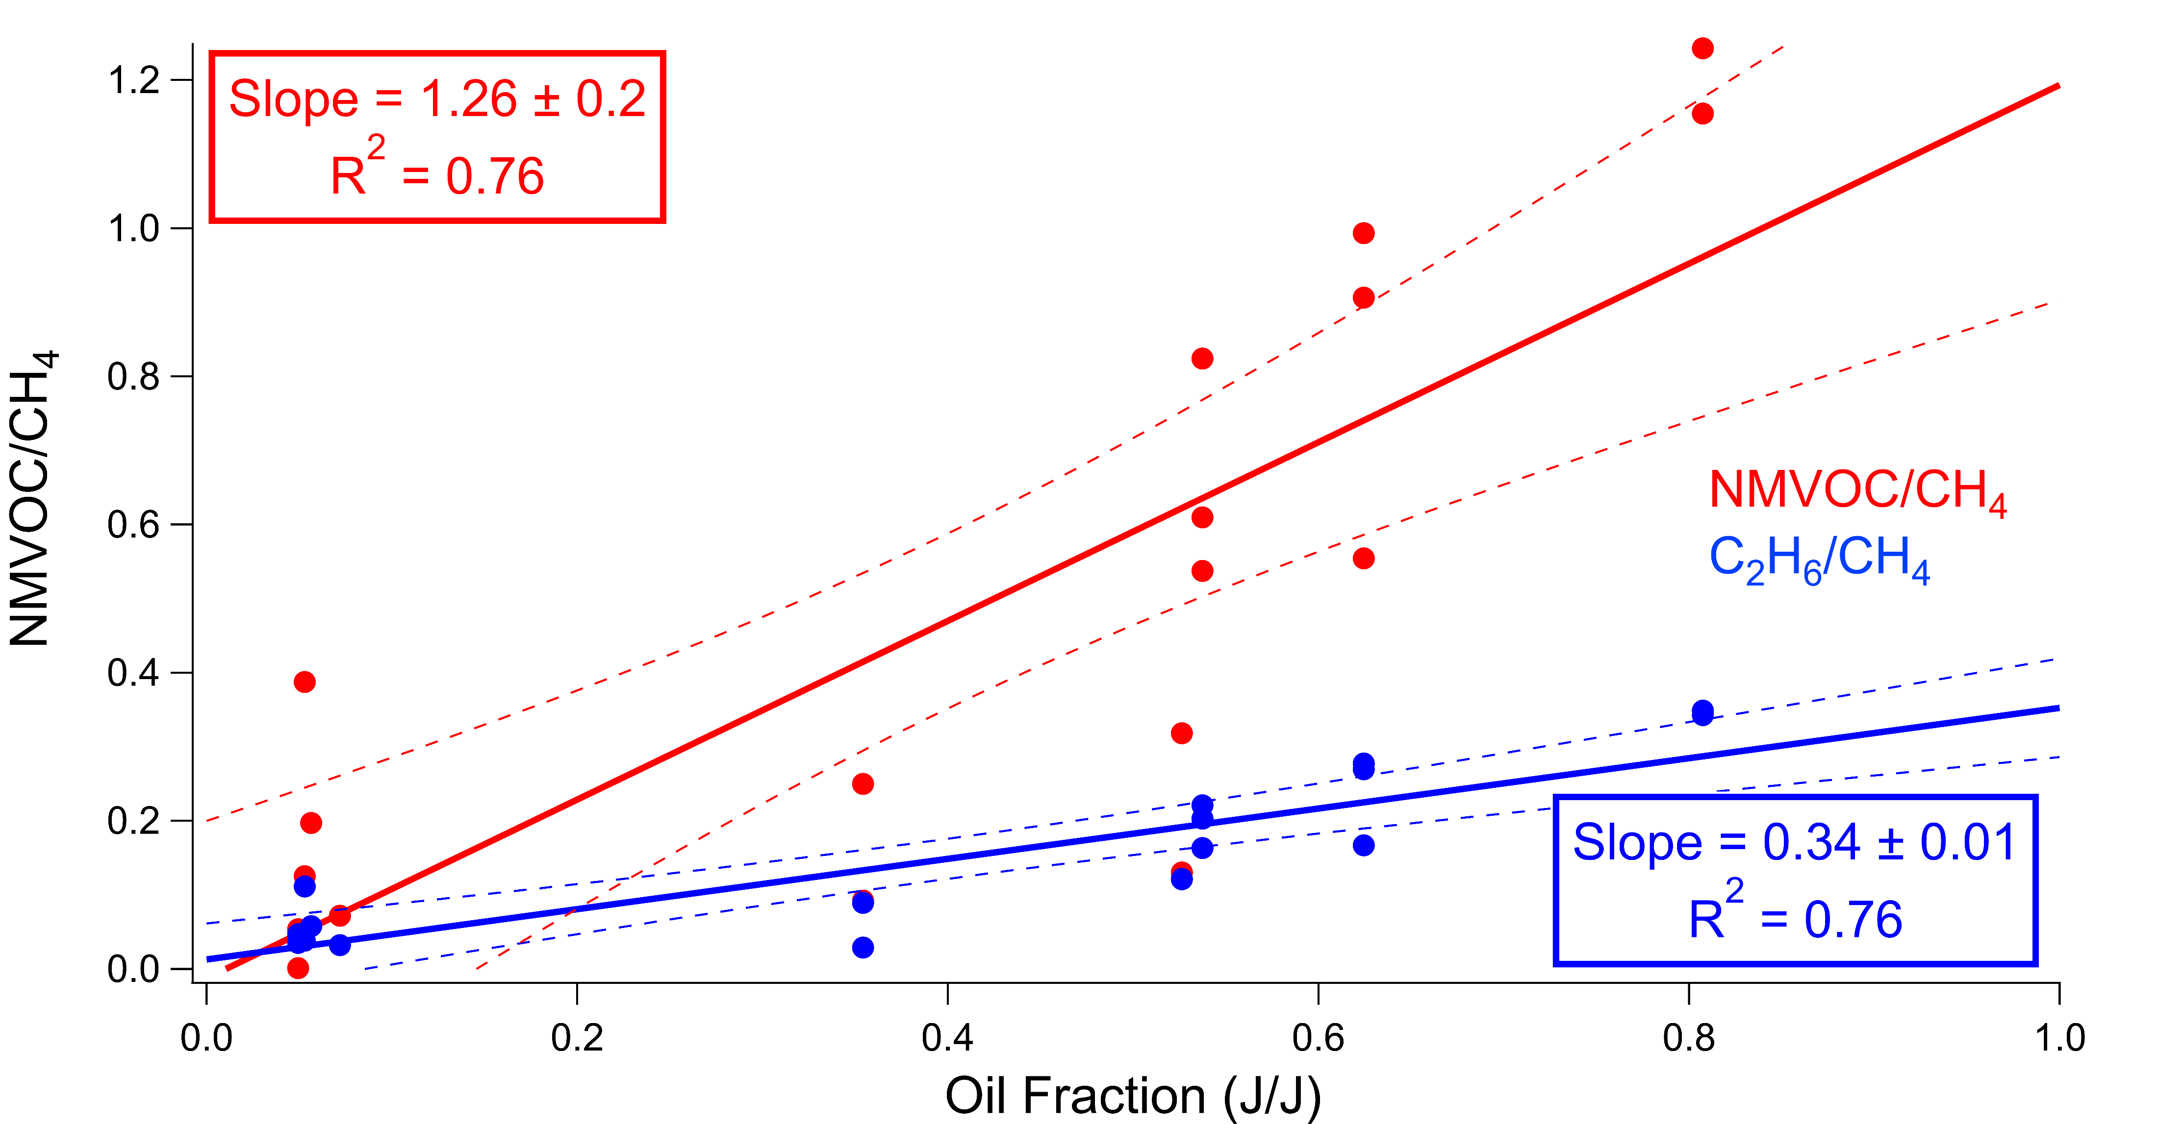
VOC Correlation
Francoeur et al. (Environ. Sci. Technol., 2021)

Slide 4
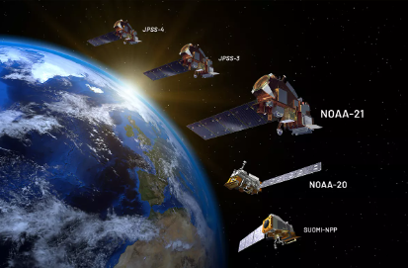
Research Objectives
Demonstrate ability to retrieve O&G C₂H₆ from Cross-track Infrared Sounder (CrIS)
Evaluate in conjunction with 2015 O&G field campaign
Compare CrIS trends with expected production and emission intensity trends
CrIS constructed to measure atmospheric temperature, pressure and moisture profiles, but also relevant for key atmospheric composition species
Onboard NOAA-20 since 2017 and Suomi-NPP since 2011

Slide 5
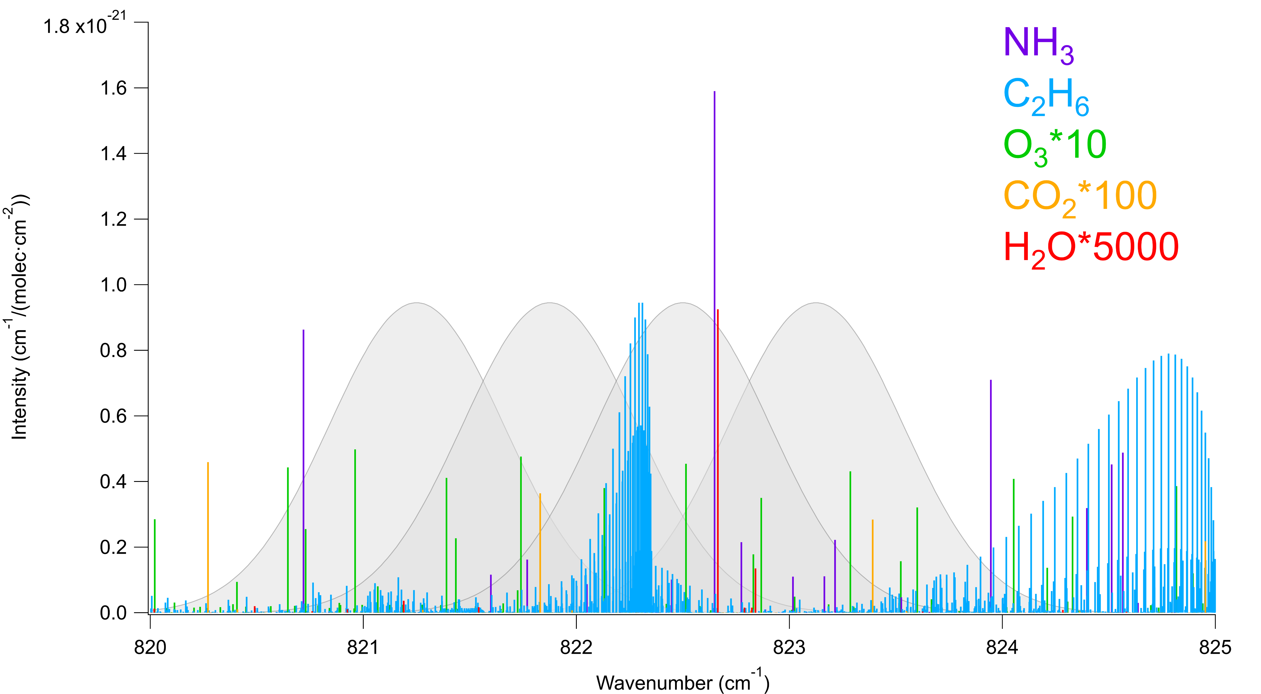
HITRAN absorptions between 821 and 824 cm⁻¹
Gordon et al. (2022)

Slide 6
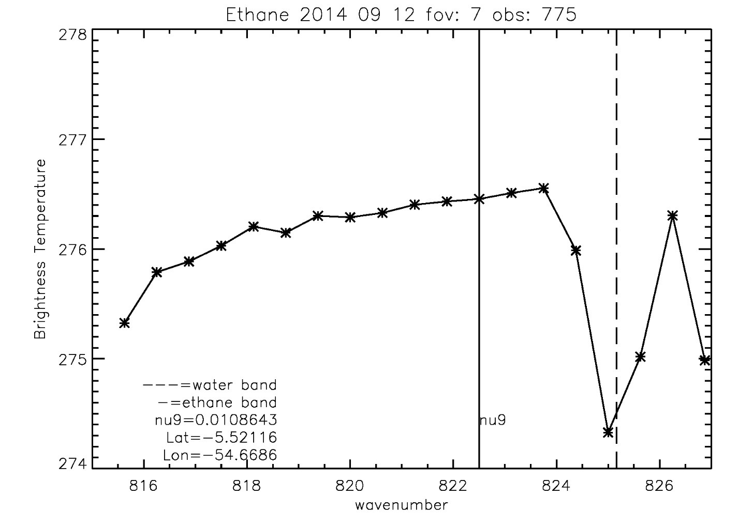
CrIS Ethane Brightness Temperature Difference (ΔBT)
ΔBT=0.5*(BT_{821.25} +BT_{823.125} - BT_{821.875} - BT_{822.5})
Higher ΔBT→ more absorption
Eliminate errors due to clouds, surface temperature, emissivity etc.
Notes:
Strength – removes a lot of systematic errors
Weakness- relying on only a few weak signals

Slide 7
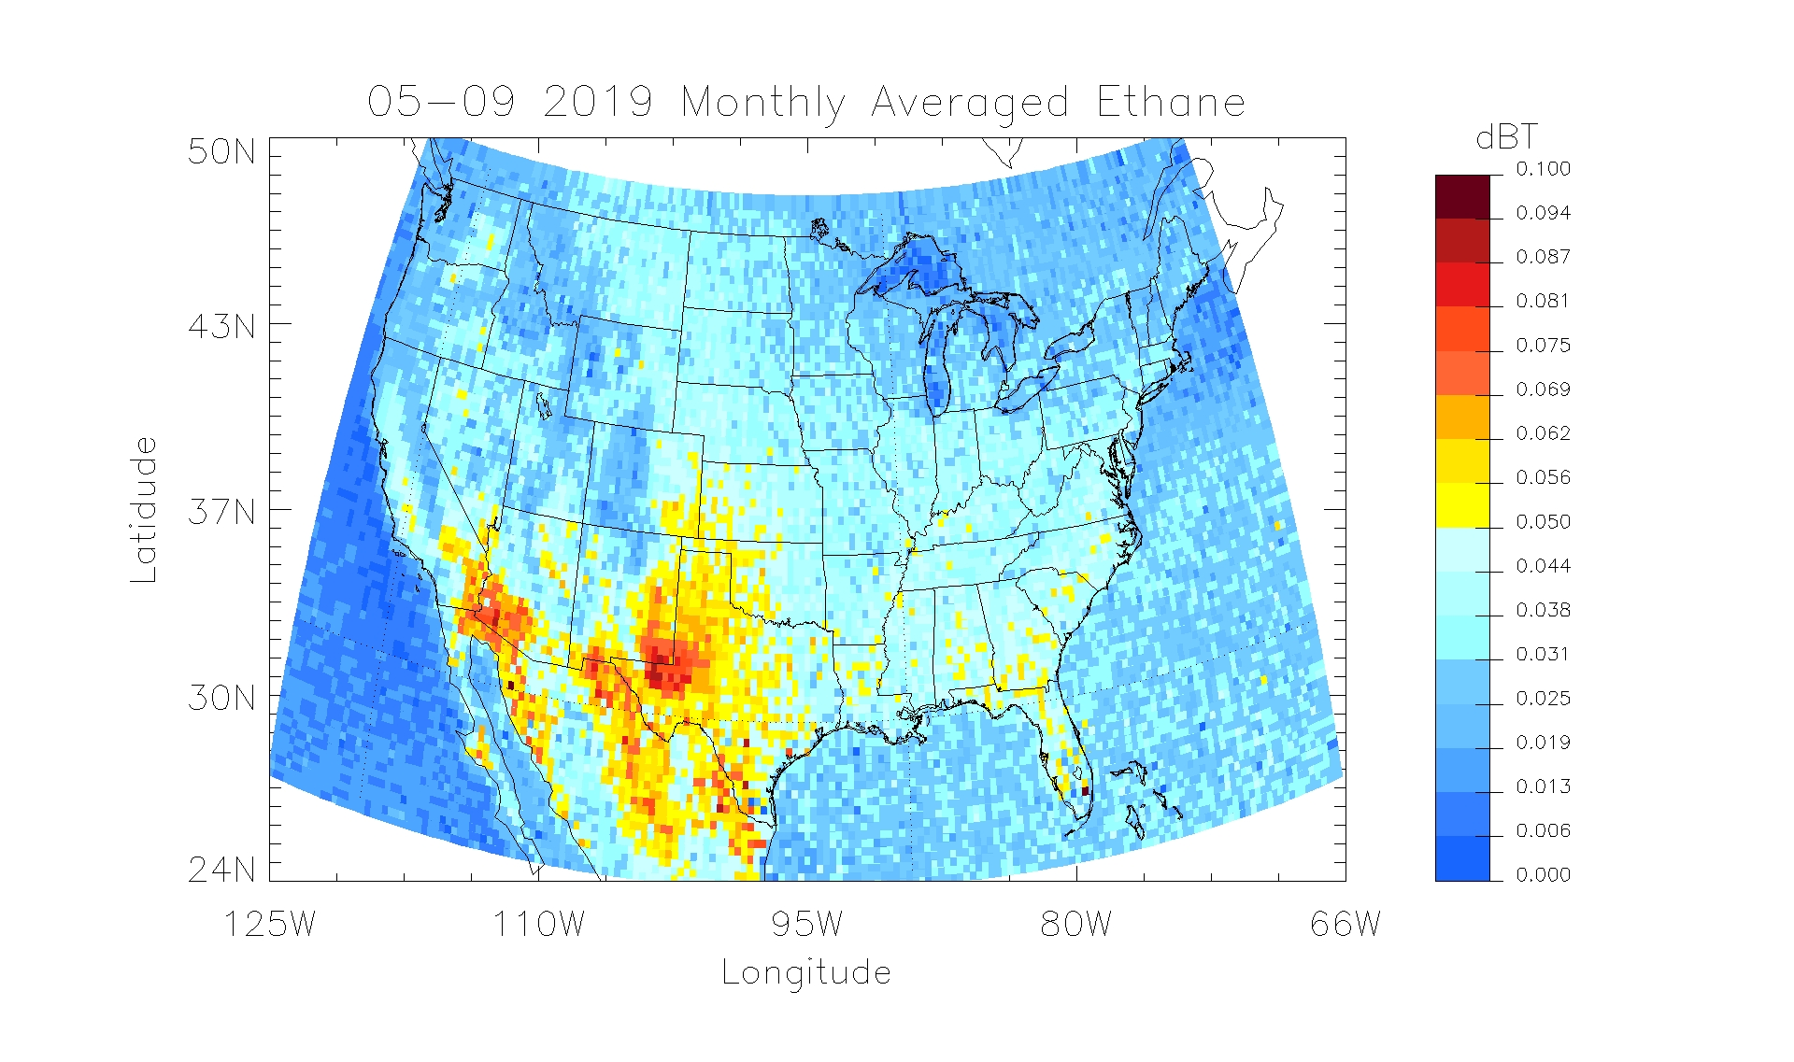
Plotted Brightness Temperature Difference
NASA Community Long-term Infrared Microwave Coupled Atmospheric Product System (CLIMCAPS) radiances corrected for clouds
Monarrez et al. (CLIMCAPS User Guide, 2021)

Slide 8
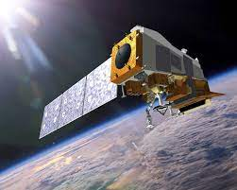
VLIDORT Modeling
Satellite Radiance
Modeled ΔBT without C₂H₆
CLIMCAPS retrieved Variables:
T(p), q(p), CO₂(p),CH₄(p) Reflectance
Solar and Satellite Angles
Simulated Radiance
Vector Linearized Discrete Ordinate
Radiative Transfer (VLIDORT)

Slide 9
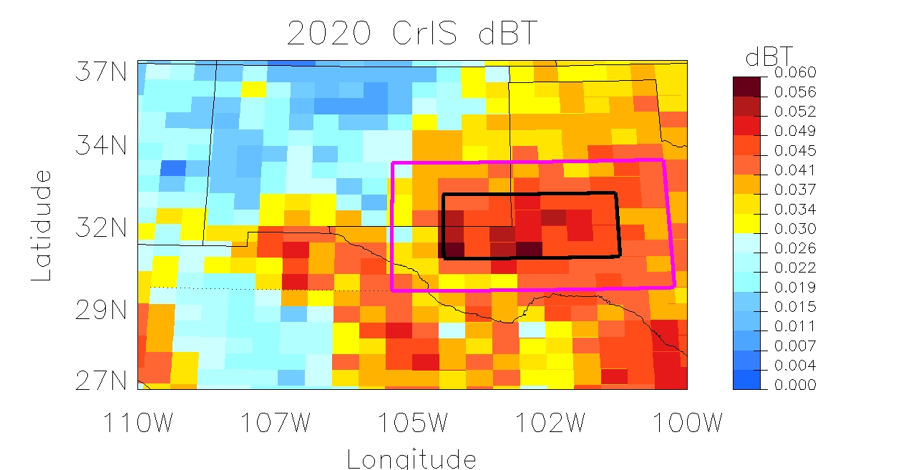
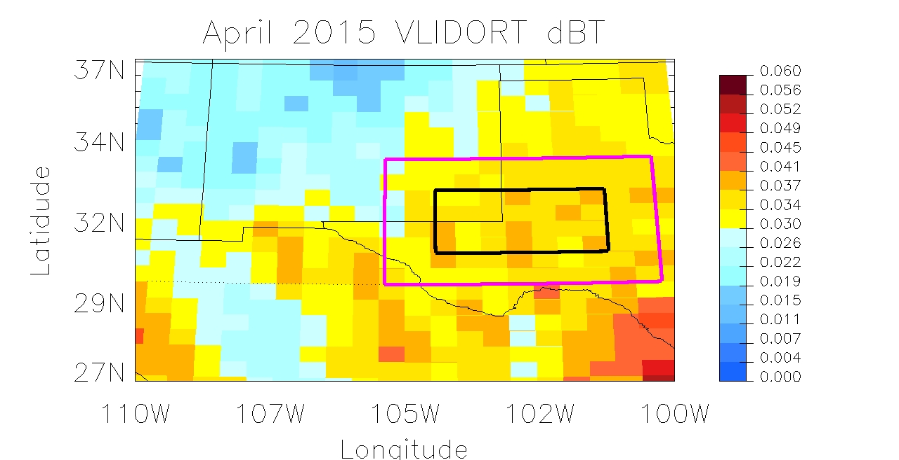
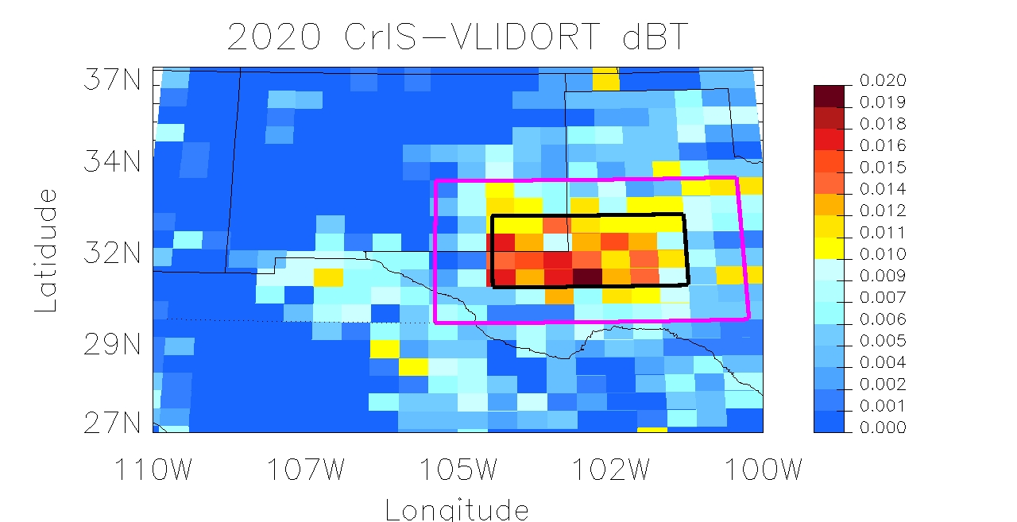
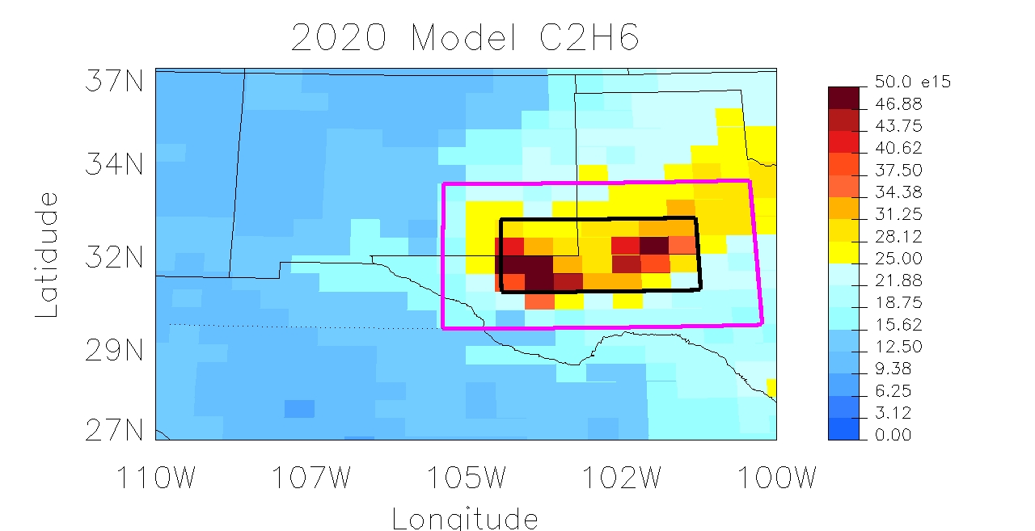
Removing Interferences from Observations
OBS ΔBT_{total}
Model ΔBT_{non-ethane}
20%
4.8%
OBS-Model ΔBT_{ethane}
Molec/cm²
WRF-Chem Column
100%
60.8%

Slide 10
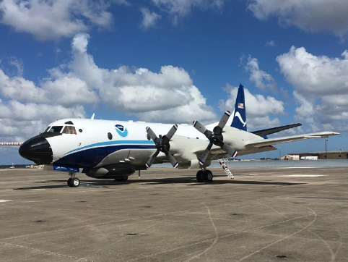
WRF-Chem modeling during SONGNEX
Simulated in WRF-CHEM (12 km x 12 km)
March 28th-April 26th 2015

Slide 11
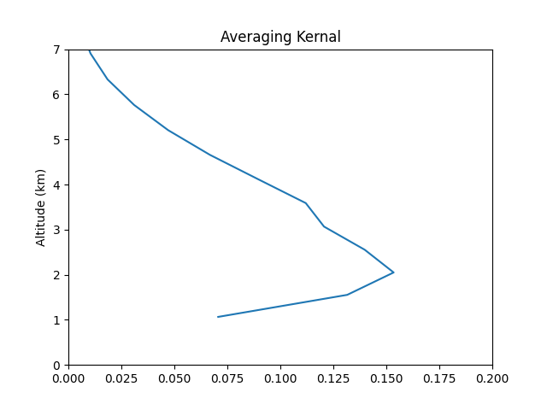
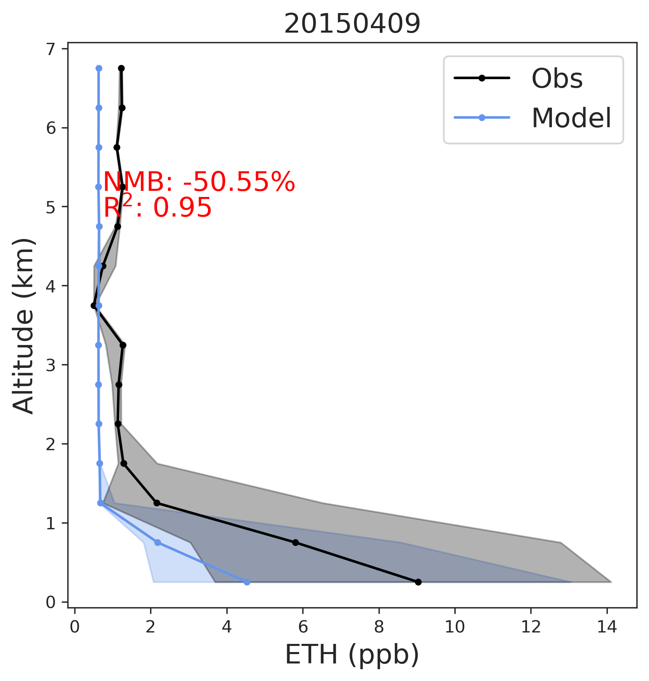
Ethane Profile
Averaging Kernel

Slide 12
Choosing which AK to apply
L
M
H

Slide 13
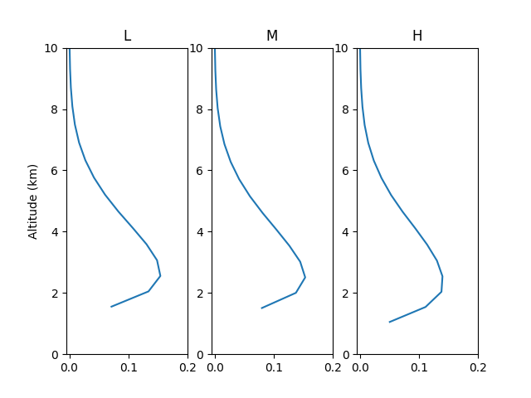
Choosing which AK to apply

Slide 14
Next Steps and Impact
Compute averaging kernel and apply to model
Computationally expensive
Determine skill of instrument
Improved ΔBT could be used to get the trends of C₂H₆ over OG fields
2012-Present, as well as guaranteed for 10+ years
C₂H₆ is important as a tracer and ozone precursor
Improving understanding of C₂H₆ trend helps assess other OG emissions

Slide 15
Questions?
Contact: Colby.Francoeur@noaa.gov

