Slide 1
The Joint Single Footprint Retrieval Algorithm (JoSFRA) Bill Irion
Jet Propulsion Laboratory
California Institute of Technology
with thanks to so many colleagues for its funding, development, testing, documenting, and production.
©️ 2024 California Institute of Technology. Government sponsorship acknowledged.

Slide 2
JoSFRA
Joint Single-Footprint Retrieval Algorithm
MODIS cloud on AIRS footprint
(Cld emissivity used day/night for optical depth.)
Optimal-Estimation Solver
(TES Heritage)
SARTA forward model
Delta-4-Stream cloud abs. calc.
Platnick et al., 2003
Averaging: Wang et al., 2016
Strow et al., 2003
Ou et al., 2013
NCEP forecast
a priori
(temporally and spatially interpolated)
T_{atm}/H₂O profiles
to cloud-top (if thick)
or surface (if thin)
Cloud-top temperature
Effective cloud OD & size
13.5 km footprint (at nadir) provides detail often washed out in cloud-cleared results (45 km), esp. for H₂O.
If retrieval ok
QC = 1
QC = 0
AIRS L1b spectra & metadata

Slide 3
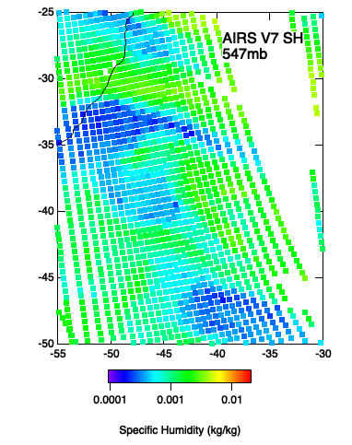
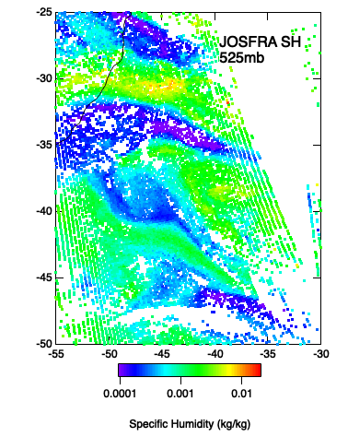
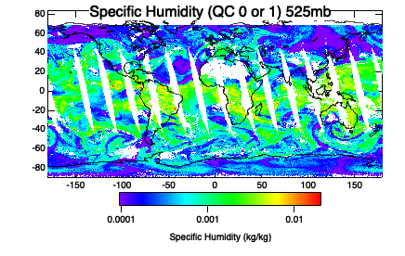
Note different pressure layers!
From late-stage test retrieval
Daytime, Jan 13, 2011

Slide 4
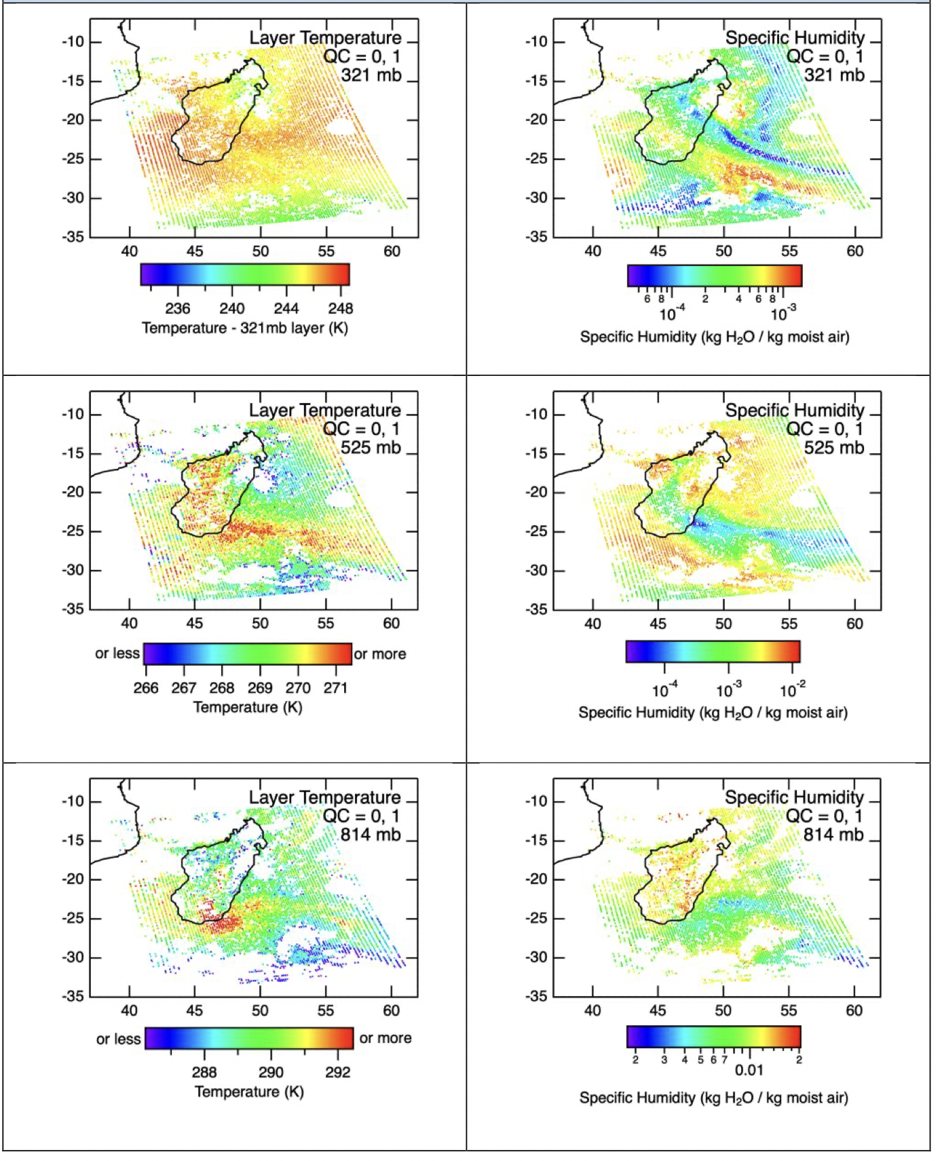
Retrievals on 13.5 km footprint
(Compared to 45 km with AIRS V7)
Temperature
Water Vapor
Surface Temperature
Cloud-top Temperature
Cloud Optical Depth
Cloud Effective Radius Ozone and Carbon Dioxide
(not recommended for further study) Optical estimation-type error estimation and DOFS for individual species. (Averaging kernels calculated but not routinely output.)
(Graphics from User’s Guide)

Slide 5
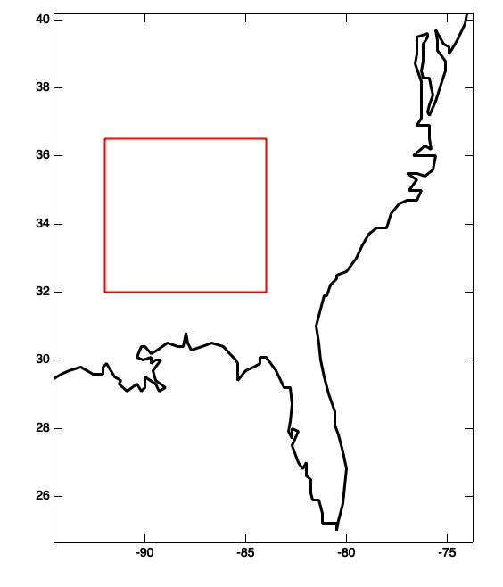
Initial retrievals now available at GES DISC
Global coverage: Jan 13-17, July 13-17, 2011
Dedicated sonde coincidences, 2002-2007
NSA, SGP, TWP, field campaigns
MAGIC campaign region (Pacific between CA and HI)
June 2012 through Sept. 2013
• Southeast United States
May – August, 2009 – 2019

Slide 6
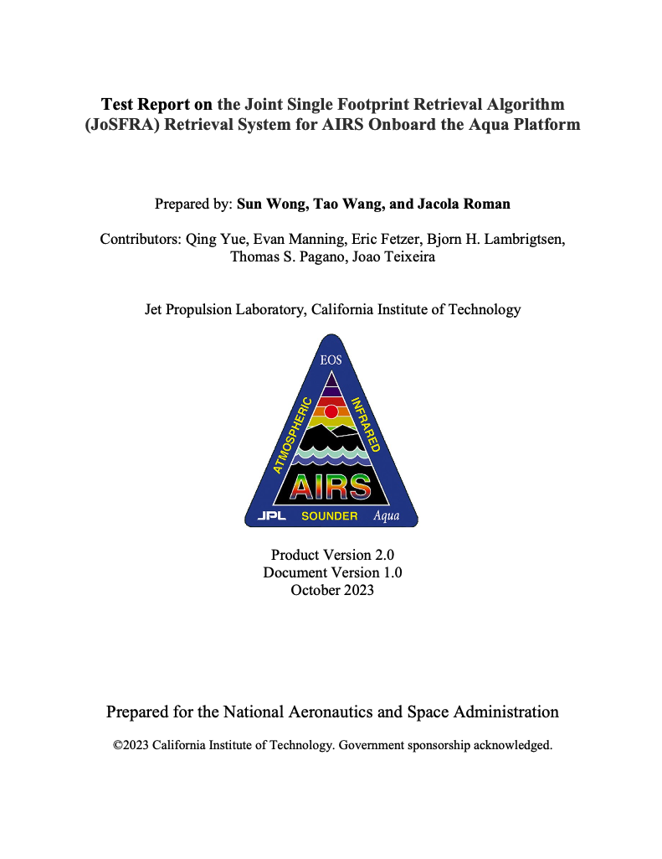
User’s Guide, Test Report, and ATBD available
Comparisons of JoSFRA retrievals to AIRS V7 and ERA5
Comparisons to IGRA sondes
Calculations of skill under different pressures and latitudes Things to watch out for …
- biases and RMSE’s and where they can be
- ocean surface temperature biases anti-correlated with deviations from cloud-top temperature or cloud OD from prior

Slide 7
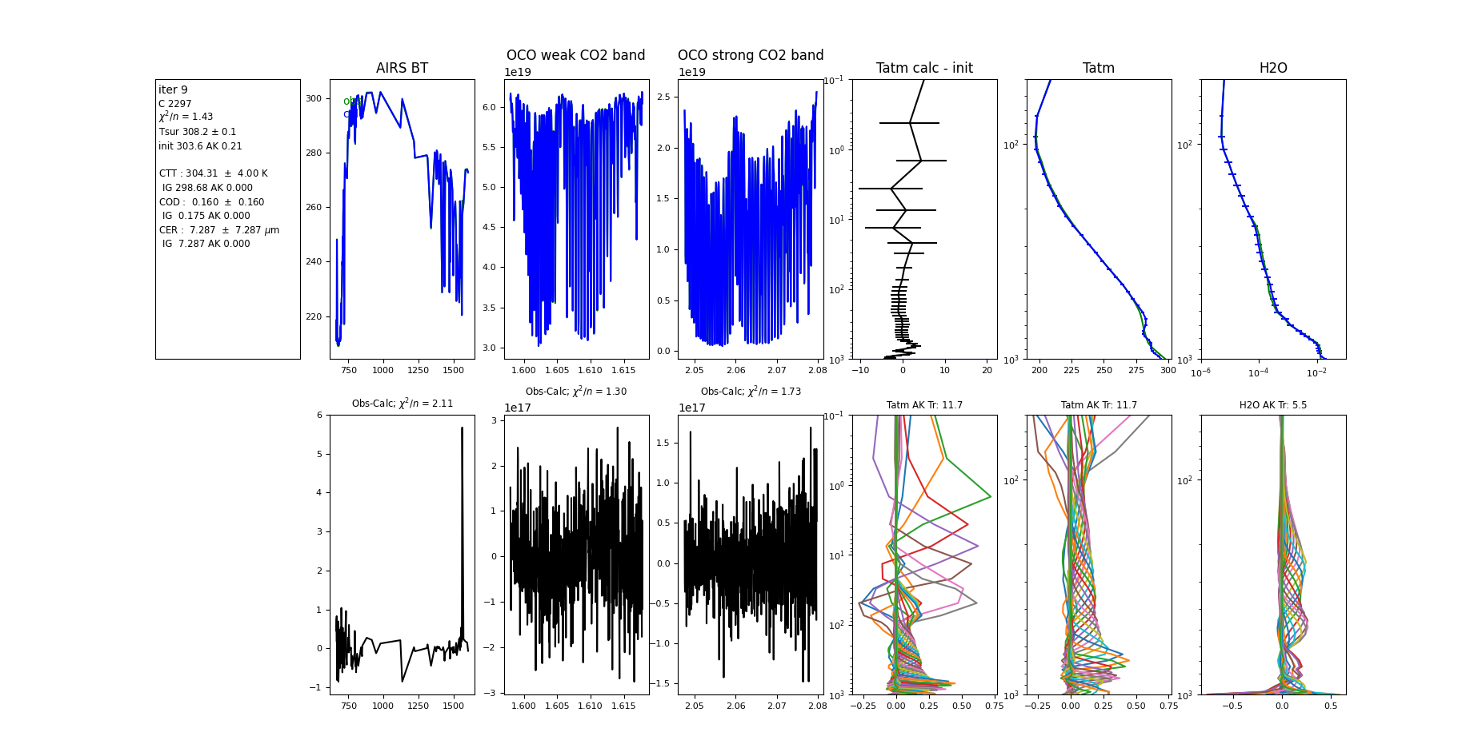
Moving forward with JoSFRA … Combining AIRS and OCO2 for PBL retrieval
Emission
in TIR
Absorption
in NIR
AIRS+OCO2 retrieval of
Tatm and H2O

Slide 8
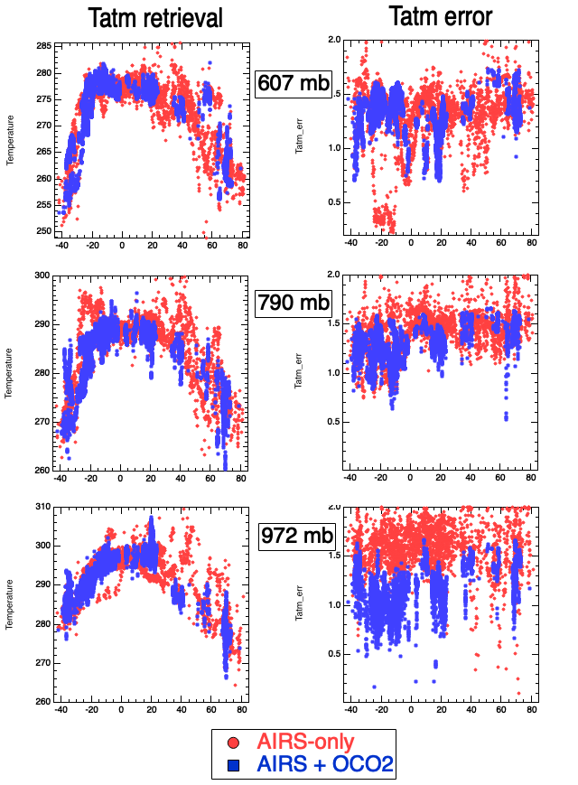
AIRS and OCO2 both on A-train OCO2 footprint (~1.5 km, ~ 8 minute difference) located within AIRS footprint (~13.5 km) NCEP a priori for Tatm and H2O Same a priori covariances
AIRS forward model: SARTA
OCO2 forward model: REFRACTOR Cloud-retrieval different for AIRS and OCO2, otherwise same state vector. Combine the Jacobians, and minimize cost function under JoSFRA L-M solver (Moré) Optimal estimation error analyses VERY preliminary results (not all data processed for AIRS-OCO2)
Latitude
Latitude
July 11, 2017

Slide 9
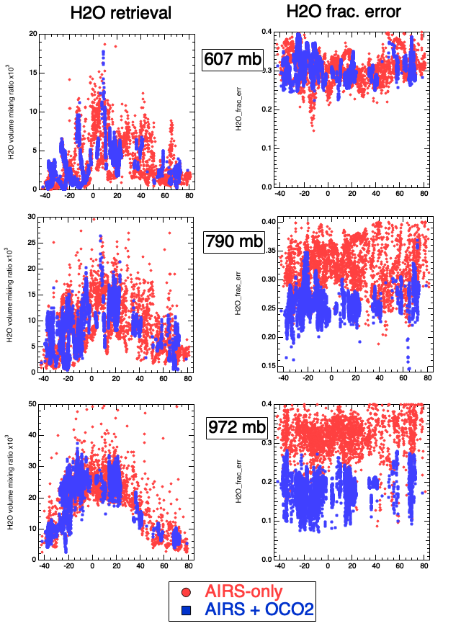
AIRS and OCO2 both on A-train OCO2 footprint (~1.5 km, ~ 8 minute difference) located within AIRS footprint (~13.5 km) NCEP a priori for Tatm and H2O Same a priori covariances
AIRS forward model: SARTA
OCO2 forward model: REFRACTOR Cloud-retrieval different for AIRS and OCO2, otherwise same state vector. Combine the Jacobians, and minimize cost function under JoSFRA L-M solver (Moré) Optimal estimation error analyses VERY preliminary results (not all data processed for AIRS-OCO2)
Latitude
Latitude
July 11, 2017

Slide 10
Thank you!

