Slide 1
Recently published article overview:
Erica McGrath-Spangler, Manisha Ganeshan, Oreste Reale,
Niama Boukachaba, Will McCarty and Ron Gelaro: 2021.
"Sensitivity of low tropospheric Arctic temperatures to assimilation of AIRS cloud‐cleared radiances: Impact on mid‐latitude waves."
Quarterly Journal of the Royal Meteorological Society, 147 (741):4032-4047 [10.1002/qj.4166]
Presented by Oreste Reale

Slide 2
Focus on the Arctic Region
Most of the previous work by this team was centered on Observing System Experiments (OSEs) also known as “impact studies”, with the goal of assimilating AIRS and CrIS data in regions affected by clouds to improve tropical cyclone (TC) analysis and forecast
In the same set of Observing System Experiments used to investigate TCs occurred during the 2014 Atlantic Season (whose results were published in 2018), it was found that a strong impact consequent to the assimilation of cloud-cleared radiances was noted on the Arctic Region.
The Arctic ocean and adjacent regions are affected in summer and fall by broken low-level stratus clouds. Assimilation of clear-sky radiances only (as done in the operational setting) can some time be afflicted large data voids which are associated with substantial drops in forecast skill over the entire northern hemisphere
The paper shows that assimilation of AIRS cloud-cleared radiances (CCRs) improves the coverage, changing the thermal structure of the lower and mid-troposphere over the Arctic region, which leads to improved weather forecasts in these situations.

Slide 3
Observing System Experiment to compare the impact of assimilating cloud-cleared radiances (CLD3) against the Control (RAD) which uses clear-sky radiances as in the operational setting
Experiments start on 01 September 2014 and end on 10 November 2014,
with daily 7-day forecasts, initialized at 0000 UTC.
All data used operationally are assimilated in both. RAD and CLD3 differ only because of the different assimilation of AIRS. RAD uses clear-sky radiances, thinned on a 145km x145km box, CLD3 uses cloud-cleared radiances thinned on a 300km x 300km box.

Slide 4
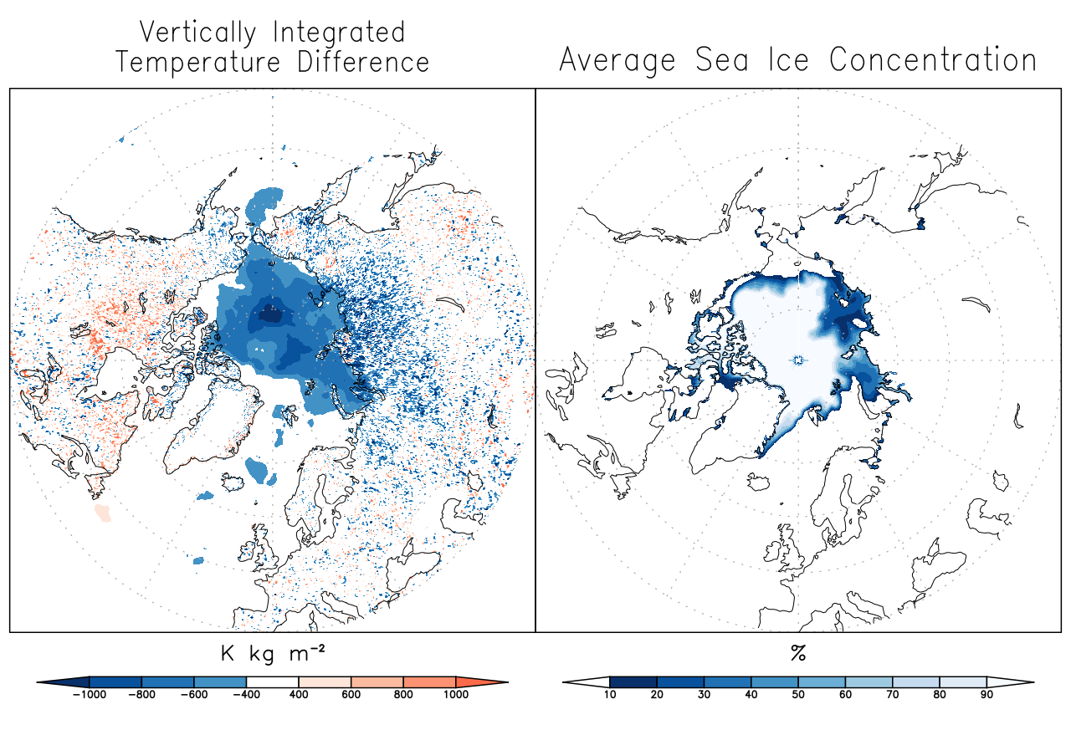
CLD3 minus RAD vertically integrated temperature difference in the analyses (from the surface to 800 hPa) and sea ice concentration (Peng et al., 2013; Meier et al., 2017) temporally averaged from 0000 UTC 21 September to 1800 UTC 31 October 2014
Assimilation of cloud-cleared radiances makes the low-mid troposphere slightly cooler over the Arctic region, roughly in correspondence to sea ice.

Slide 5
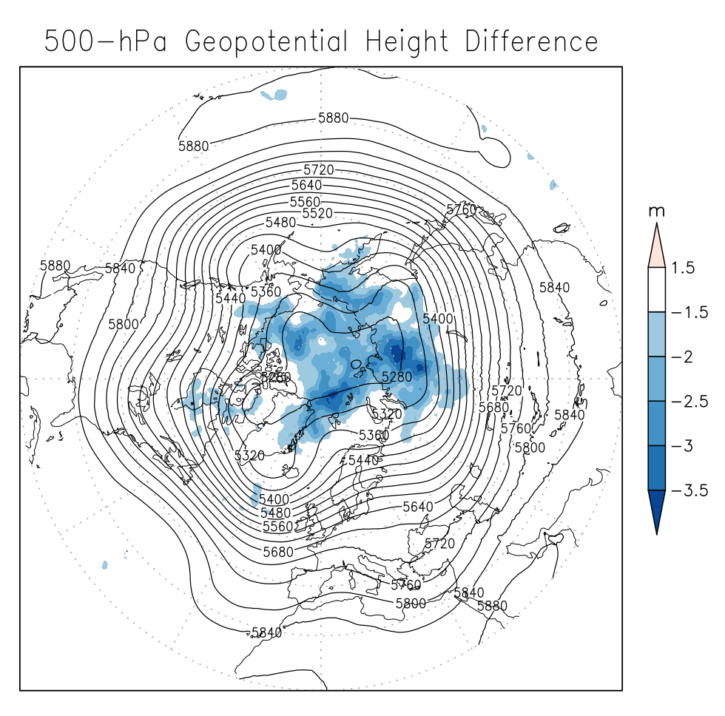
500 hPa geopotential height difference for CLD3 minus RAD (shading) and RAD 500 hPa geopotential height (contours) temporally averaged in the analyses from 0000 UTC 21 September 2014 to 1800 UTC 31 October 2014
The cooling consequent to the assimilation of cloud-cleared radiances causes a drop in mid-tropospheric geopotential height due to hydrostatic adjustment

Slide 6
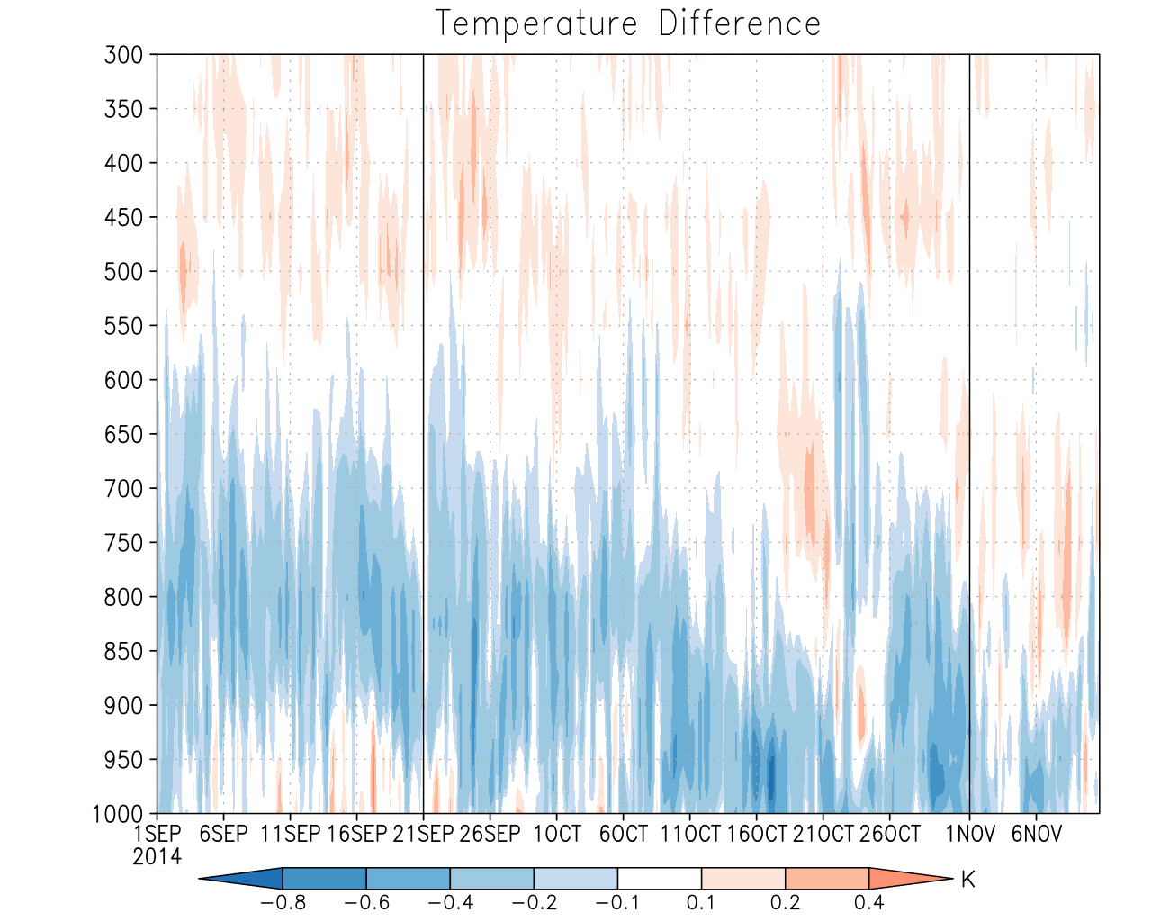
Time–height cross-section of temperature difference for CLD3 minus RAD analyses, averaged from 70°N poleward. The black vertical lines denote the forecast period used to assess the skill (first part of Sep discarded for spinup)
The cooling consequent to the assimilation of AIRS CCRs slopes downward with the progress of time from 800 hPa in early September to 900 hPa in early November

Slide 7
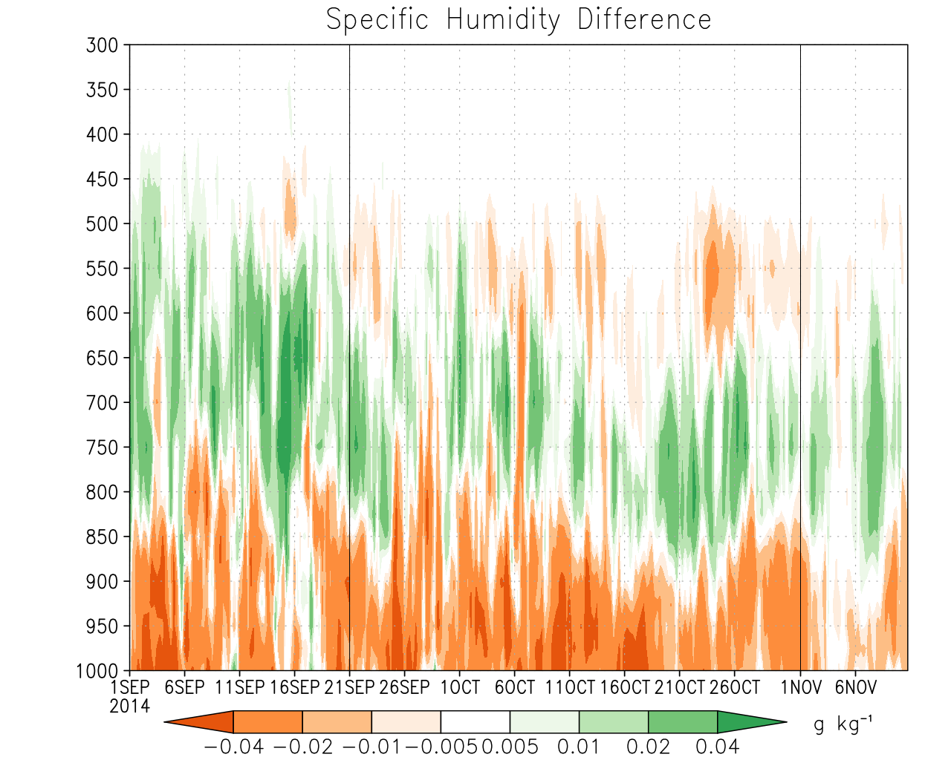
Time–height cross-section of specific humidity difference for CLD3 minus RAD analyses, averaged from 70°N poleward.
The increase in relative humidity between 800hPa and 600 hPa suggests an increased probability of low-level stratus clouds in the CLD3 experiment (compared to RAD), indicating that the cooling in the previous slide occurs below the cloud layer.

Slide 8
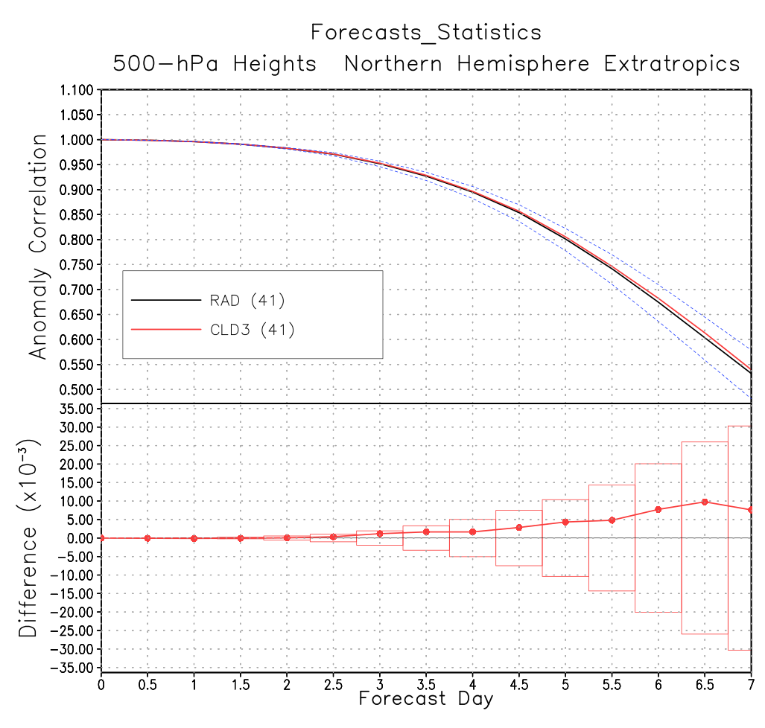
Northern Hemisphere Extratropics (20°–80°N) 500 hPa geopotential height anomaly correlation for AIRS cloud-cleared experiment (CLD3) compared to AIRS clear-sky experiment (RAD), computed for the forecasts initialized from 21 September to 31 October 2014 (41 7-day forecasts). Forecast skill as a function of forecast time and CLD3 minus RAD forecast skill difference. The horizontal bars represent statistical significance
Assimilation of CCRs positively impacts the skill for the entire period, but without reaching significance

Slide 9
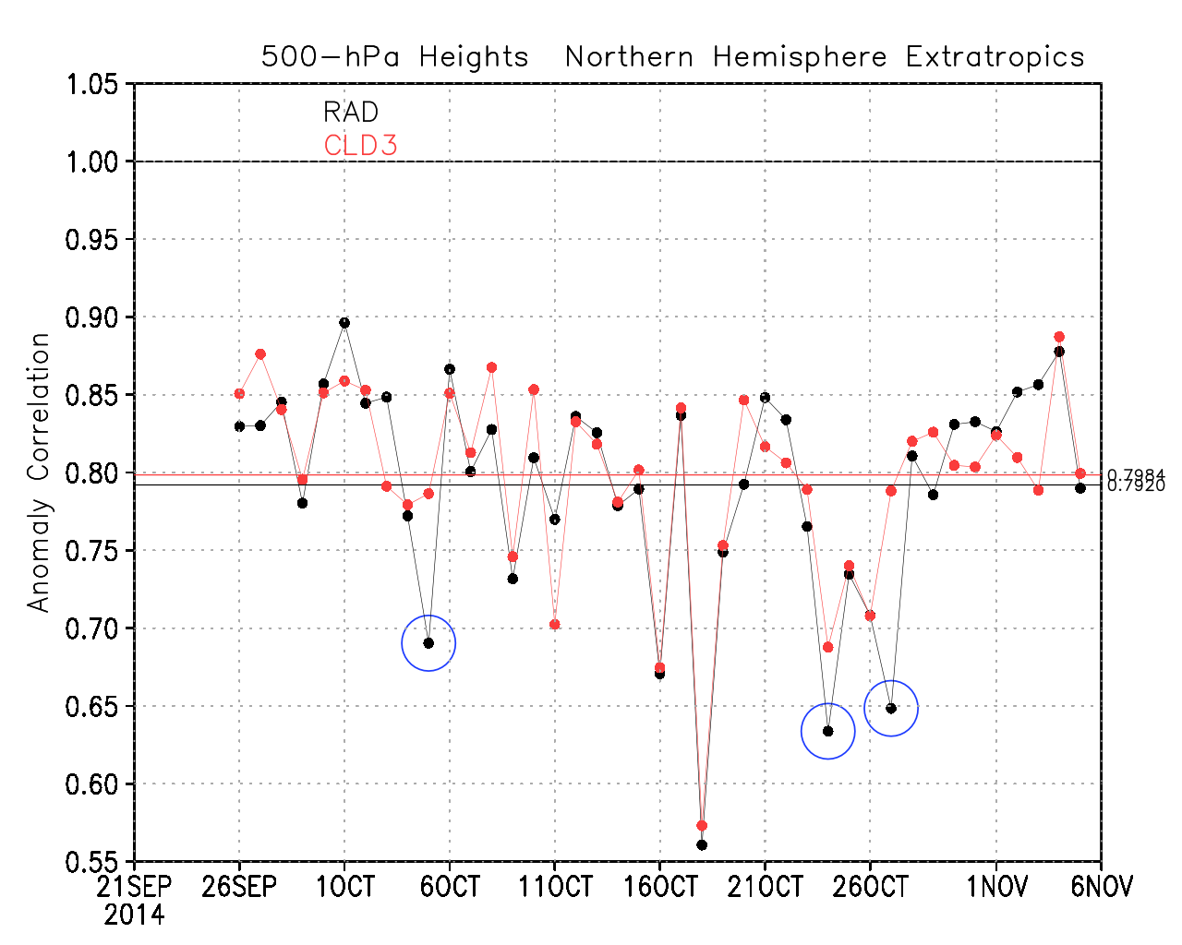
500 hPa geopotential height anomaly correlation for day 5 in the Northern Hemisphere Extratropics for RAD and CLD3 time series. Each dot is valid at the given date and is the value for a 5-day forecast, initialized at 0000 UTC 5 days prior. The horizontal lines indicate perfect anomaly correlation of 1.00 and the average anomaly correlation coefficient for each experiment. Blue circles indicate dates for which the RAD experiment suffered a drastic drop in skill which did not occur in the CLD3 experiment
However, there are isolated drops in skill (busted forecasts in RAD) that are the source of the improved skill in CLD3.

Slide 10
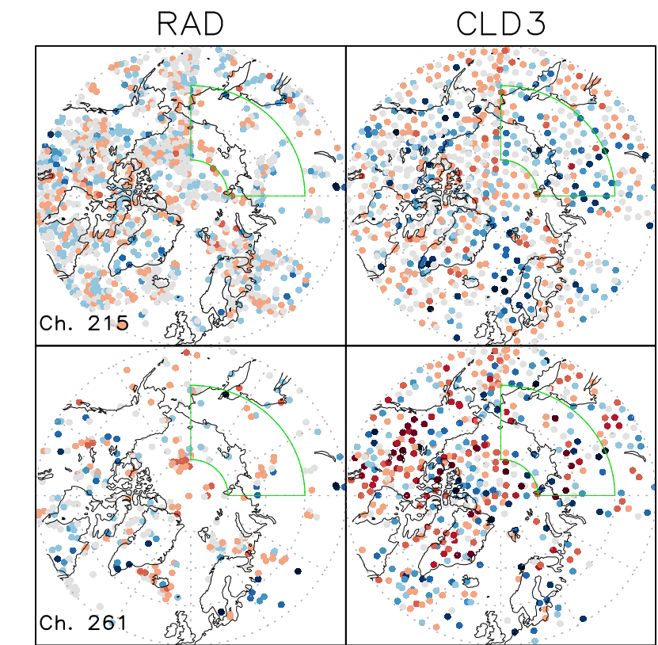
Comparison of (RAD) clear-sky and (CLD3) cloud-cleared AIRS coverage over the Arctic for the 12 hr assimilation window of 0900 to 2100 UTC 21 October 2014, the assimilation time relevant to the generation of the 0000 UTC 22 October forecast. Circles indicate locations of assimilated radiances: O–F brightness temperatures (K) for channels 215 (wavenumber 711 𝑐𝑚⁻¹) and 261 (wavenumber 724.52 𝑐𝑚⁻¹), corresponding to approximately 487 hPa and 891 hPa pressure levels respectively. The area outlined in green highlights a region that is well-sampled in in the CLD3 experiment but is comparatively data void in the RAD experiment.
Difference in coverage at two different levels between the RAD and CLD3 analyses. The green box is where we focus our attention (error growth will be large).

Slide 11
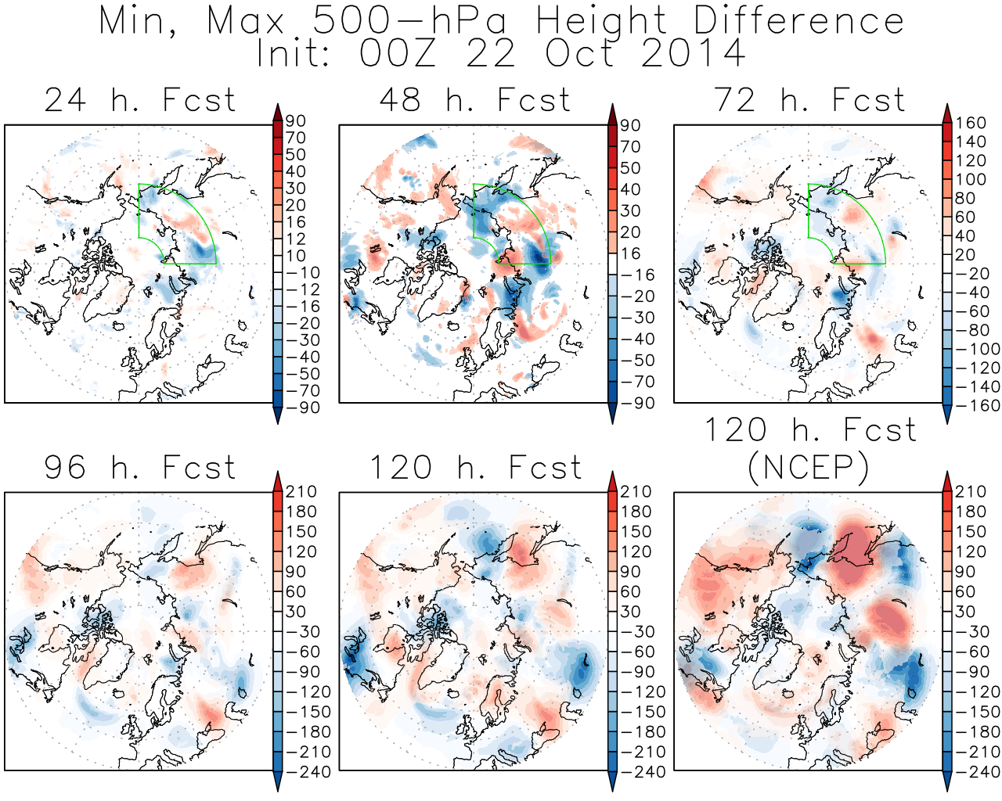
The spatiotemporal evolution of the minimum (blue shading) and maximum (red shading) 500 hPa geopotential height differences (m) through the 24, 48, 72, 96, and 120 hr for forecasts initialized at 0000 UTC 22 October 2014. The scale needs to change after 72 h and 96h.
Error growth is very large in the selected region in the 24 hours, and rapidly propagates throughout the entire hemisphere. Similar results in the other 2 cases selected.

Slide 12
Conclusions
Assimilation of cloud-cleared radiances affects the representation of the thermal structure of the low and mid-troposphere in the Arctic producing a slight cooling which is caused by improved representation of broken low-level stratus clouds.
Situations in which stratus cloud cover is extended cause temporary loss of AIRS coverage for operational systems which use only clear-sky radiances, which translates in forecast skill drop. The drop does not occur if cloud-cleared radiances are assimilated.
The different low- and mid-tropospheric thermal structure between the control and the experiment assimilating CCRs affects the 500 hPa geopotential height and the geopotential gradients which are the root of rapidly growing baroclinic disturbances
The Arctic region is very sensitive to initialization in a global forecasting framework

Slide 13
Acknowledgments
Work supported by NASA Grant 80NSSC18K0927
Thanks to Dr. Tsengdar Lee (NASA HQ) for support and for allocations on NASA High-End Computing resources.
Thanks to Dr. Chris Barnet for his role in the development of cloud-cleared radiance algorithms and valuable advice.
All simulations were performed at the NASA Center for Climate Studies (NCCS) in Greenbelt, Maryland.
Thanks to Joel Susskind and his former team, particularly John Blaisdell, Lena Iredell, Lou Kouvaris for previous collaborative efforts.
AIRS data obtained from the Goddard Earth Sciences (GES) Data and Information Services Center (DISC)

