Slide 1
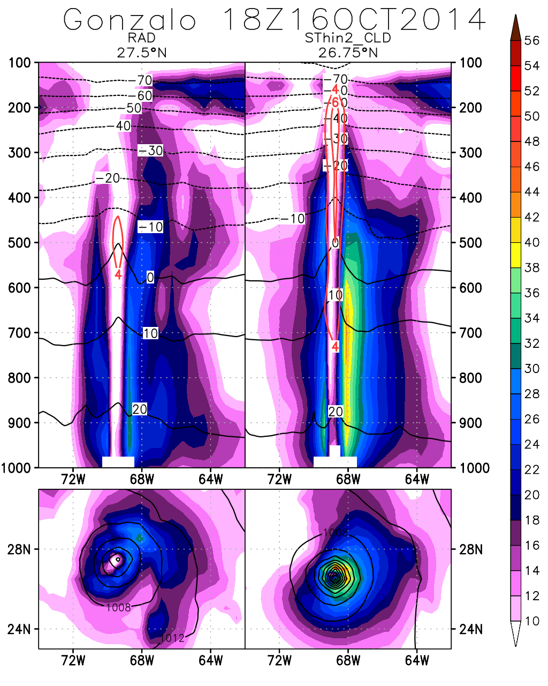
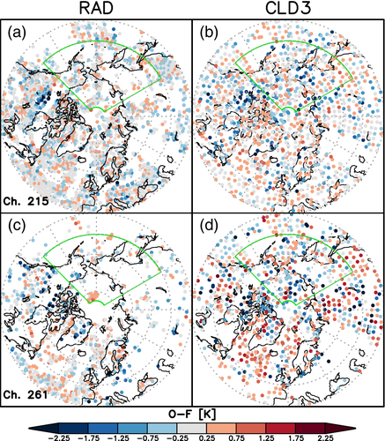
Previous Work/Background
Past work performed under predecessor Grant 80NSSC18K0927 (PI: Oreste Reale) demonstrated that the operational use of AIRS clear-sky radiances was suboptimal. Assimilation of cloud-cleared radiances improves the representation of tropical cyclones (Reale et al. 2018) and the representation of the low-tropospheric thermal structure of the Arctic (McGrath-Spangler et al. 2021) which led to improved midlatitude forecasts. In addition, the team ported and customized the AIRS cloud-clearing algorithm on NCCS improving latency
Improvement on the representation of Hurricane Gonzalo (Reale et al.2018) consequent to assimilation of adaptively thinned cloud-cleared radiances
Reale, O., E. McGrath-Spangler, W. McCarty, D. Holdaway, R, Gelaro, 2018: Impact of adaptively thinned AIRS cloud-cleared radiances on tropical cyclone representation in a global data assimilation and forecast system. Weather and Forecasting, 33, 908-931. [10.1175/waf-d-17-0175.1]
McGrath-Spangler, E., M. Ganeshan, O. Reale, O.,N. Boukachaba, W. McCarty, R. Gelaro, 2021: "Sensitivity of low tropospheric Arctic temperatures to assimilation of AIRS cloud‐cleared radiances: Impact on mid‐latitude waves." Quarterly Journal of the Royal Meteorological Society, 147 (741):4032-4047 [10.1002/qj.4166]
Improved coverage from cloud-cleared compared to clear-sky radiances over the Arctic (McGrath-Spangler et al. 2021) reduces forecast error growth

Slide 2
New selected proposal: USING AIRS AND CRIS RADIANCES IN AREAS AFFECTED BY CLOUDS TO BETTER UNDERSTAND PROCESSES AFFECTING TROPICAL CYCLONE STRUCTURE IN A GLOBAL DATA ASSIMILATION AND FORECASTING FRAMEWORK.
PI: Oreste Reale^{1,2}, Co:Is Erica McGrath-Spangler^{2,3}, Manisha Ganeshan^{2,3}, Niama Boukachaba^{2,3}, Yanqiu Zhu², Ata Akbari Asanjan⁴
¹SSAI, ²NASA GSFC, ³MSU, ⁴USRA
Planned work
Applying same modifications to the CrIS cloud clearing algorithm (parallelize it, remove dependencies, customized selection of channels)
Explore new techniques for thinning to reduce the horizontal error correlation (TC-shaped domains for adaptive thinning)
Set the foundation for an all-sky IR assimilation

