Slide 1
EOS Aqua
Extended Mission
Status at NASA/NOAA Sounder Discipline Working Group Meeting February 16, 2022
Bill Guit
Aqua Mission Director – Code 584/428
Mission Validation and Operations Branch
Earth Science Mission Operations (ESMO) Project
Goddard Space Flight Center (GSFC)
National Aeronautics and Space Administration (NASA)
William.J.Guit@nasa.gov
240-308-9051

Slide 2
Topics
Mission Summary
Spacecraft Subsystem Summaries
Propellant Usage
Orbit Predictions
End-of-Mission Plan
Extended Mission Timeline
Orbital Lifetime Estimate
Questions

Slide 3
EOS Aqua Mission Summary
05/04/2002: Launch (6-Year Design Life)
12/02/2008: End of Prime Mission Review
12/08/2015: End of AMSR-E Operations
11/17/2016: A-Train PS Teleconference
Maintain tight Mean Local Time (MLT)
10/02/2018: Aqua Decommissioning Review
03/06/2020: Senior Review Proposal #7
Reliability Estimates thru end of CY 2026
Consumables through early CY 2022
Proposed After the A-Train Extended Mission
07/08/2020: NASA Earth Science Senior Review Subcommittee Panel Presentation
10/20/2020: Received HQ Guidance
Continue as baselined through at least FY23
03/24/2021: Updated Aqua Phase F Plan
05/04/2021: Aqua 19-Year Anniversary
02/01/2022: ESMO Annual Review #15

Slide 4
Aqua Spacecraft Subsystems
All subsystems configured to primary hardware
Command & Data Handling (CDH) – Nominal
Solid State Recorder (SSR) holds ~2 orbits of data)
SSR Ops Error Anomaly (12/2/2007) – fully recovered 1/28/2009
8/16/2020: A Formatter Multiplexer Unit (FMU)/SSR anomaly – Fully Recovered on 9/2/2020
Communications (COMM) – Nominal
Electrical Power System (EPS) – Nominal (Numerous solar array string failures)
Array Regulator Electronics (ARE) power drops and current fluctuations have occurred since 2004
Most recent power drops: ARE-1A: 7/27/2021 (1 string), ARE-6C: 8/19/2021 (cracked cell)
Summary: Estimated that Aqua has lost up to 23 strings of solar cells out of a total of 132 strings, Aqua continues to have significant power margin out until September 2025
Battery Cell Anomaly (9/2/2005)
Solar Array (SA) Panel #8 Thermistor #6 Failure (8/3/2009)
Solar Array (SA) Offset (Reported 1RED 1/17/09, Corrected 6/29/2010)
Flight Software (FSW) – Nominal
Guidance, Navigation & Control (GN&C) – Nominal
Propulsion (PROP) – Nominal
Dual Thruster Module (DTM-2) Heater Anomaly (9/8/2007)
Thermal Control System (TCS) – Nominal

Slide 5
Propellant Usage

Slide 6
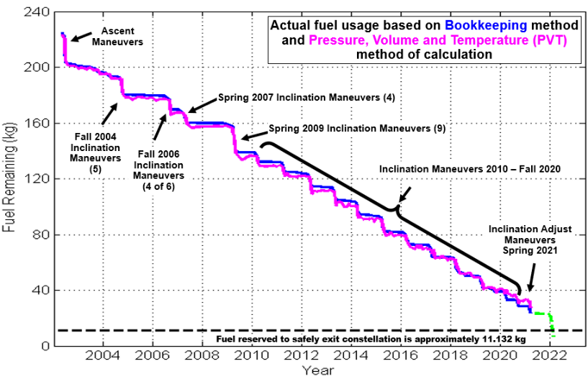
Fuel Usage: Actual & Predicted
November 2021

Slide 7
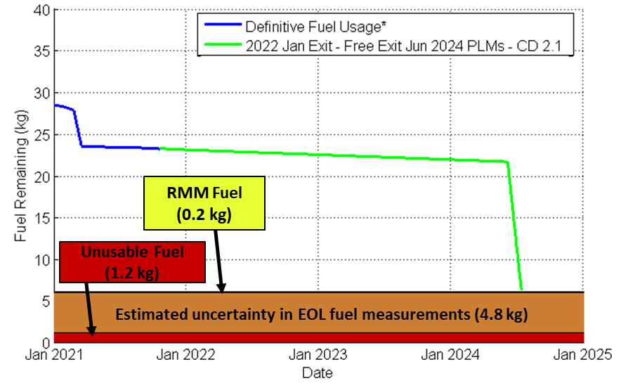
Fuel Usage: Predicted Available
November 2021
No Exit in 2022, Free-Drift, PLMs in June 2024

Slide 8
Orbital Predictions
Credit:FDS-Free-Exit-Analysis-Update-v6-9Nov21

Slide 9
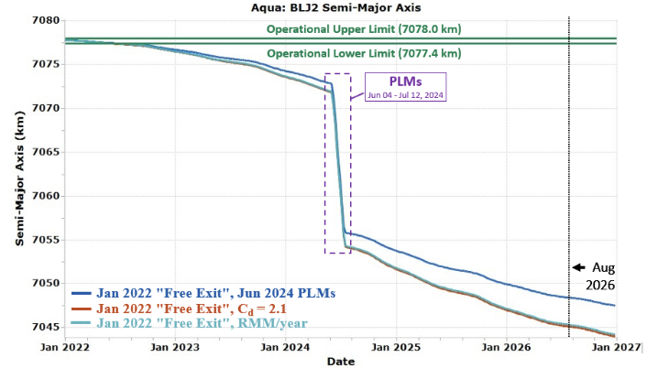
Semi Major Axis (SMA) Free-Drift, Drag-Down Constellation Exit Approach June-July 2024 PLMs
Free-Drift, Drag-Down
Cd = 2.1
January 2022 “Free Exit” with June 2024 PLMs, Cd 1.76
Lifetime analysis that models one RMM per year has marginally higher SMA.
Credit:FDS-Free-Exit-Analysis-Update-v6-9Nov21

Slide 10
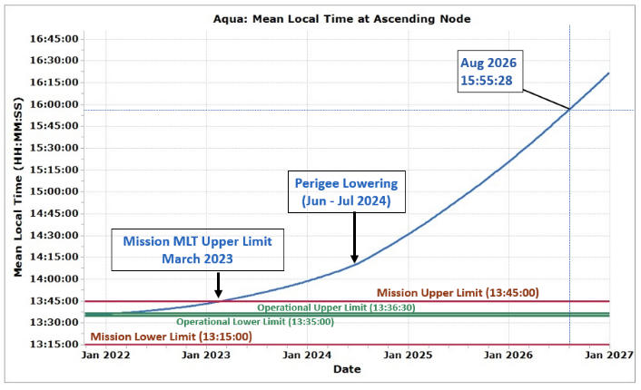
Mean Local Time (MLT) Free-Drift, Drag-Down Exit with Cd = 2.1 June-July 2024 PLMs
Performing orbit-lowering retrograde maneuvers causes the MLT rate to increase. By skipping CEMs and delaying PLMs to June 2024 we keep the MLT lower, which ultimately helps delay passivation to August 2026 in the "free-drift" case shown.
Passivation
August 2026
Credit:FDS-Free-Exit-Analysis-Update-v6-9Nov21

Slide 11
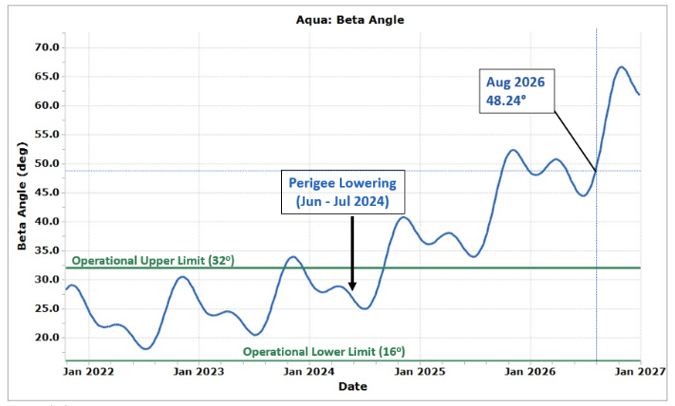
Solar Beta Angle Free-Drift, Drag-Down Exit with Cd = 2.1 June-July 2024 PLMs
Performing orbit-lowering retrograde maneuvers causes the beta angle rate to increase. By skipping CEMs and delaying PLMs to June 2024 we keep the beta angle lower, which ultimately helps delay passivation to August 2026 in the "free-drift" case shown.
Passivation
August 2026
Credit:FDS-Free-Exit-Analysis-Update-v6-9Nov21

Slide 12
Post Mission
Orbital Lifetime Estimate

Slide 13
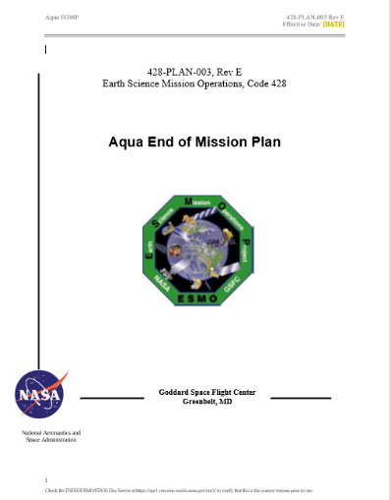
Aqua End of Mission Plan
Initial draft February 2009
“Interim” End of Mission Plan: May 2011
Approved by NASA HQ July 2011
End of Mission Plan (Rev A): February 2013
End of Mission Plan (Rev B): June 2015
Safely exit the A-Train Constellation (19 km Exit)
Passivate to the extent possible for uncontrolled reentry
Aqua has five (5) approved waivers for passivation
Pressurant Passivation
Large Object Collision Probability
Small Object Collision Probability
Orbital Lifetime (30-Year)
Re-entry Risk (Un-controlled)
Waivers approved in May 2013
End of Mission Plan (Rev C): August 2017
Includes ~4.4 km exit from A-Train in early 2022
End of Mission Plan (Rev D): December 2019
Latest Annual Lifetime Estimate (November 2019)
Retrograde maneuver slews on reaction wheels
Approved by NASA HQ OSMA on 10/28/2020
End of Mission Plan (Rev E): December 2021
Latest Annual Lifetime Estimate (November 2021)
Free-drift, Drag-Down A-Train Constellation Exit Approach
Final produced 60 days before End of Mission

Slide 14
– This version reflects the Aqua Over-Guide Budget Request –
Aqua After-the-A-Train
Extended Mission Timeline
Aqua 20-Years
Senior Review Proposal (SRP)
SRP
SRP
2020
2021
2022
2023
2024
2025
2026
2027
Q1
Q2
Q3
Q4
Q1
Q2
Q3
Q4
Q1
Q2
Q3
Q4
Q1
Q2
Q3
Q4
Q1
Q2
Q3
Q4
Q1
Q2
Q3
Q4
Q1
Q2
Q3
Q4
Q1
Q2
Q3
Q4
2017 SRP
FY18 – FY20
2017 SRP: FY21 – FY23
2020 SRP: FY21 – FY23
2020 SRP: FY24 – FY26
2023 SRP: FY24 – FY26
Operate WITHIN the A-Train
Operate slightly BELOW the A-Train
Free-drift, drag-down A-Train Exit
Operate ~20 km BELOW the A-Train operational orbit
4
IAMs
3
IAMs
4
IAMs
Power Concerns
August 2026 due to
Beta Angle Drift
Inclination Adjust Maneuvers
(IAMs)
Perigee
Lowering Maneuvers
(PLMs)
June/July 2024
Instruments OFF
Passivate
Spacecraft Disposal
KDP-F
5/17/2021
A-Train Exit
Review
DR
DRR
After the A-Train Extended Science Mission
Operate Instruments below A-Train operational orbit – Power Limited
TODAY
2/1/2022
DR – Decommissioning Review
KDP-F – HQ Key Decision Point to proceed with Phase F
DRR – Disposal Readiness Review

Slide 15
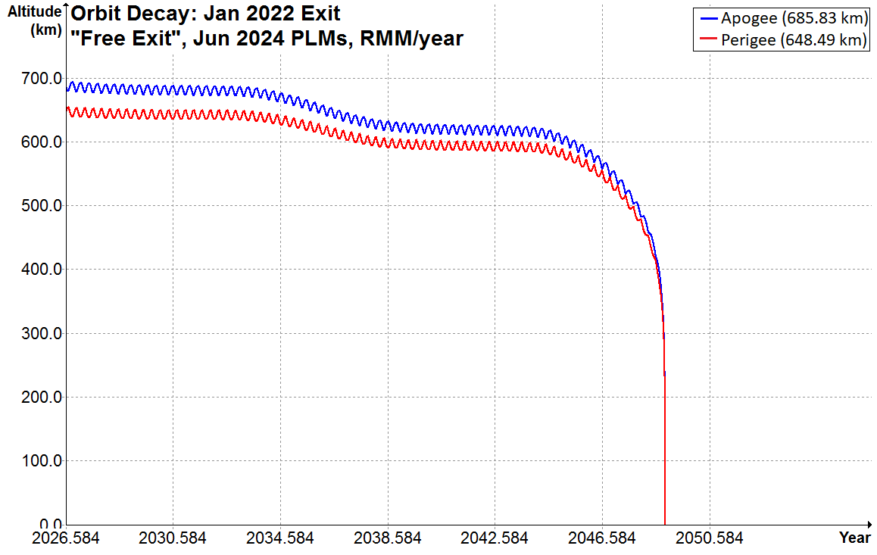
January 2022 Free-Drift Exit June 4th – July 12th, 2024, PLMs End of Science Mission: August 2026
Without 1 RMM/year
DAS predicts that Aqua will re-enter in November 2048.
22.3 years after passivation in August 2026.
In August 2026, during passivation and the end of the fuel life, we will perform fuel depletion burns with the fuel being held as uncertainty (4.8 kg) and any remaining fuel allocated for RMMs. This may provide additional perigee lowering to what is planned for the June 2024 PLMs.
Credit:FDS-Free-Exit-Analysis-Update-v6-9Nov21

Slide 16
Questions & Backup Slides

Slide 17
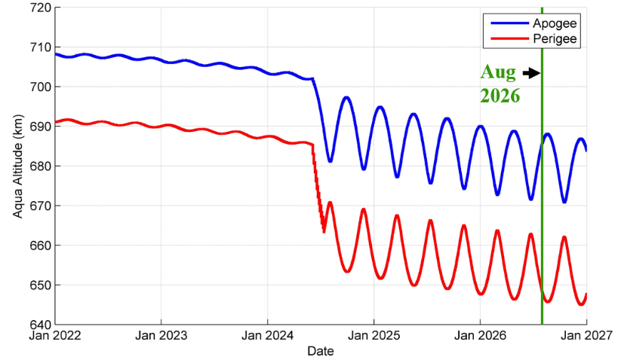
January 2022 Free-Drift Exit June 4th – July 12th, 2024 PLMs Passivate/Decommission August 2026
Schatten Solar Flux Model (SFM)
DAS
SFM
Jan 2022 "Free-Drift Exit"
Jun 2024 PLMs, C_{d} = 2.1
Credit:FDS-Free-Exit-Analysis-Update-v6-9Nov21

Slide 18
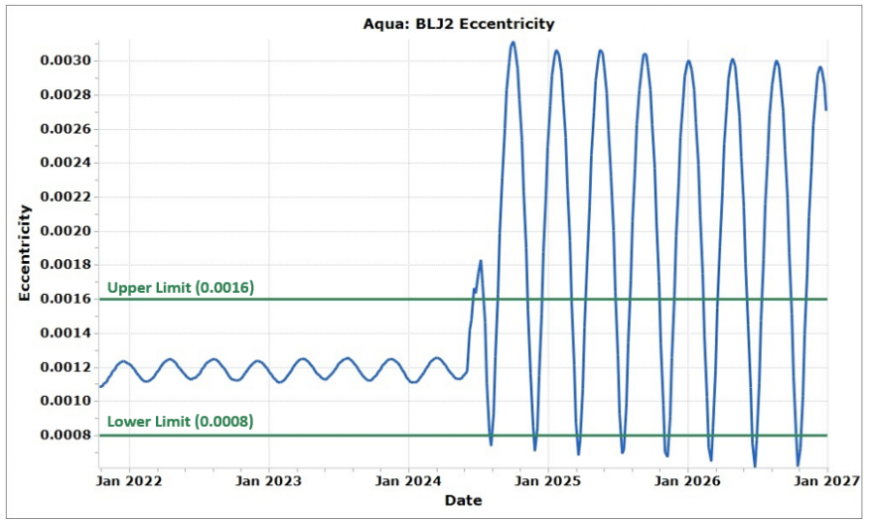
Eccentricity (ECC) Free-Drift, Drag-Down Exit with Cd = 2.1 June-July 2024 PLMs
Since PLMs are delayed until June 2024 in this case, Aqua’s orbit will remain frozen for the first ~2.5 years of the extended science mission. During the remainder of the extended mission Aqua’s orbit will be more elliptical, as indicated by the large ECC variations.
Credit:FDS-Free-Exit-Analysis-Update-v6-9Nov21

Slide 19
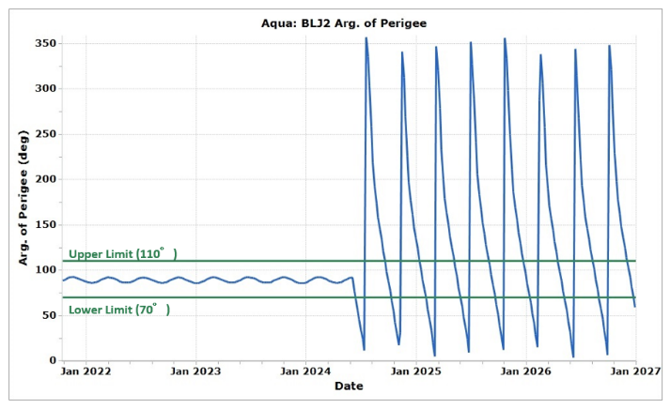
Argument of Perigee (AoP) Free-Drift, Drag-Down Exit with Cd = 2.1 June-July 2024 PLMs
Since PLMs are delayed until June 2024 in this case, Aqua’s orbit will remain frozen for the first ~2.5 years of the extended science mission. During the remainder of the extended mission, Aqua’s orbit will no longer be frozen, as indicated by the AoP drifting a complete 360-degrees.
Credit:FDS-Free-Exit-Analysis-Update-v6-9Nov21

Slide 20
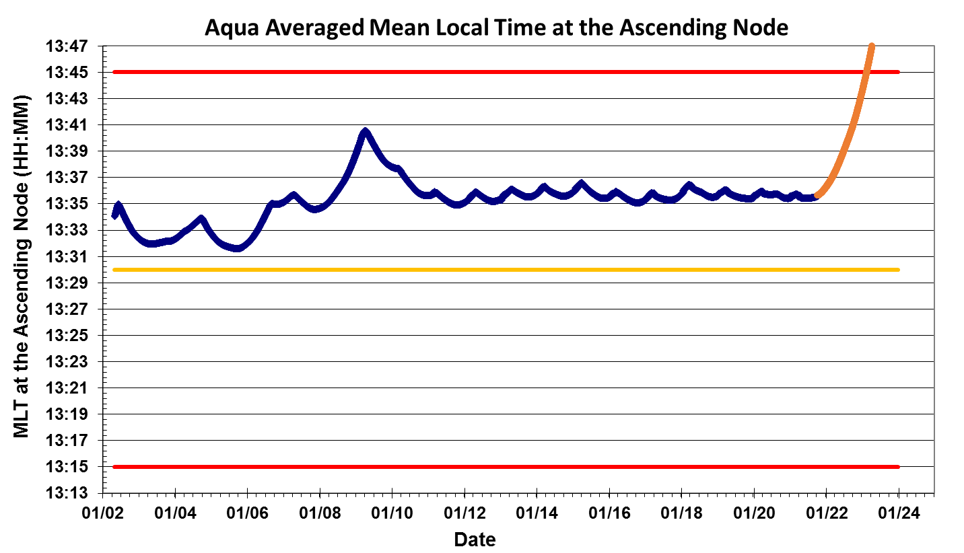
Aqua Definitive and Predictive MLT @ Ascending Node (Updated October 2021)
Mission Operations Range for Aqua MLT is 13:30 – 13:45
Predicted
data
The current target MLT range for Aqua is 13:35:45 +/- 45 sec
Definitive Data
MLT Mission Requirement 13:30 +/- 15 minutes

