Slide 1

AI Enhancement of the Planetary Boundary Layer in Retrievals from Microwave and Infrared Sounders
Adam B. Milstein (MIT-LL, milstein@ll.mit.edu ),
Joseph A. Santanello (NASA GSFC), William J. Blackwell (MIT-LL)
Thanks to NASA ESTO and ESD for Support
DISTRIBUTION STATEMENT A. Approved for public release. Distribution is unlimited.
This material is based upon work supported by the National Aeronautics and Space Administration under Air Force Contract No. FA8702-15-D-0001. Any opinions, findings, conclusions or recommendations expressed in this material are those of the author(s) and do not necessarily reflect the views of the National Aeronautics and Space Administration.
© 2023 Massachusetts Institute of Technology.
Delivered to the U.S. Government with Unlimited Rights, as defined in DFARS Part 252.227-7013 or 7014 (Feb 2014). Notwithstanding any copyright notice, U.S. Government rights in this work are defined by DFARS 252.227-7013 or DFARS 252.227-7014 as detailed above. Use of this work other than as specifically authorized by the U.S. Government may violate any copyrights that exist in this work.

Slide 2
Outline
Overview: Planetary Boundary Layer retrievals
Detail Enhancement with Deep Neural Network
Initial Results
Ongoing work: Toward Optimal Estimation with Deep Network Priors

Slide 3
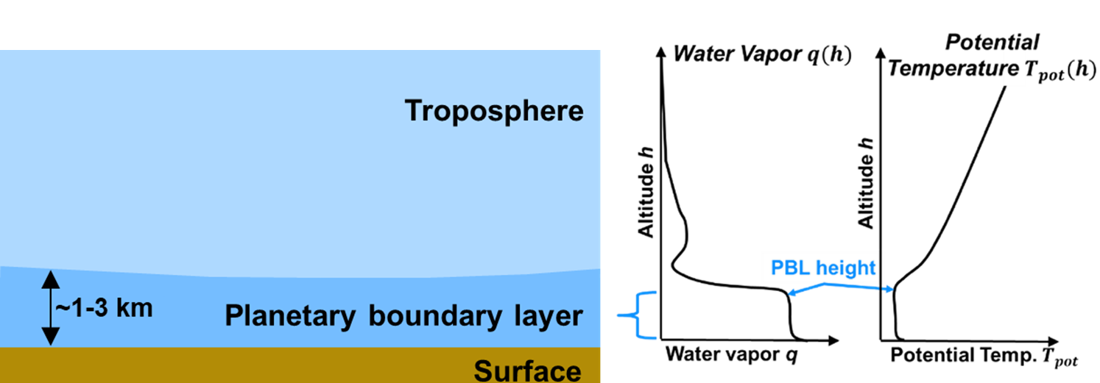
Planetary Boundary Layer (PBL)
Despite recent improvements in AIRS/AMSUv7 assisted by fine vertical structure from MIT-LL’s NN first guess, existing IR+microwave retrievals have difficulty resolving PBL features
This presentation: How can we use powerful, modern DNN tools to improve existing remote-sensing IR+microwave retrievals of T and q, especially in PBL?

Slide 4
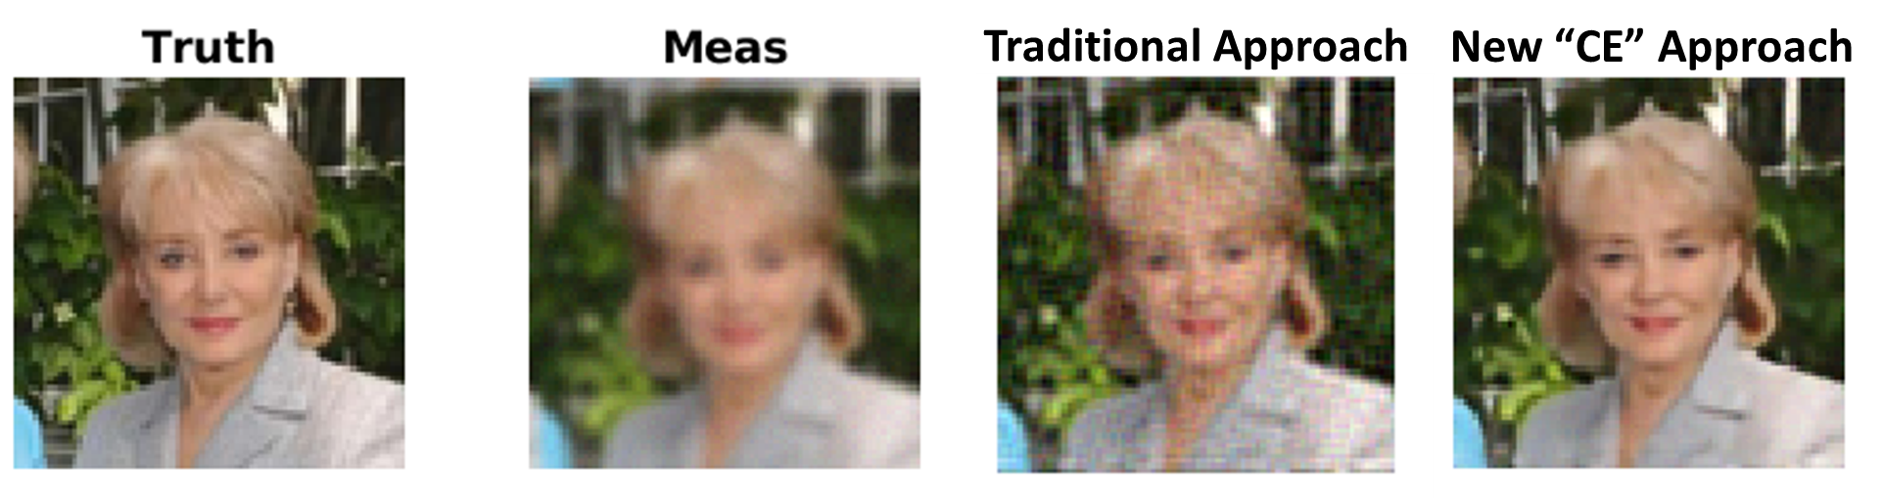
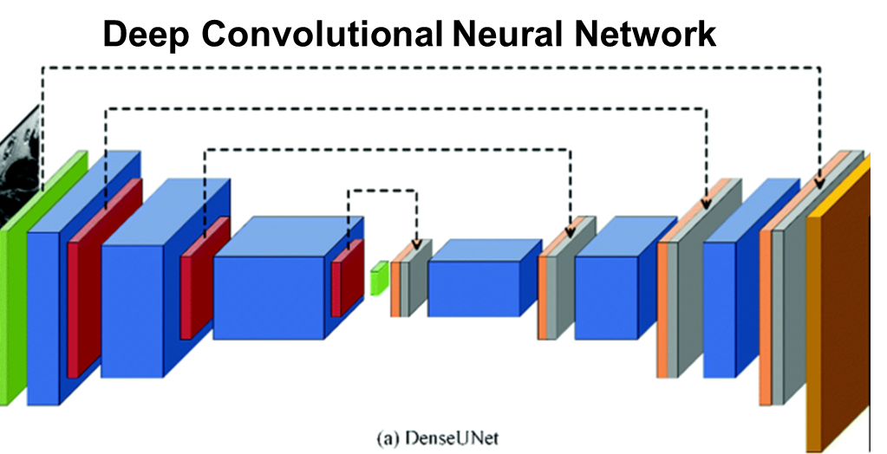
Deep Neural Networks Overview
Deep neural networks (DNN) are very powerful tools that are now ubiquitous in the technology world
  Convolutional neural networks (CNNs) operate on whole images or 3D volumes
  Denoising, superresolution, object detection, and other enhancements
DNNs exploit much richer prior statistics than conventional priors and regularizers used to solve inverse problems typically can, as in face example below
  Spatial statistics: what do typical faces – or atmospheres over a granule - look like?
  Correlated variables: How do (R, G, B) colors in faces – or (T, q) in retrievals – correlate?
Original Image
Blurred, Corrupted
Restored

Slide 5
Enhancing Existing Retrievals
This work
Program of Record Retrieval (T,q),
Single FOR or FOV
DNN Enhanced
(T, q), 3D Granule
Radiances
In this work, we enhance existing retrievals starting with v7 NN first guess (we know it well), rather than using radiances
Long-term vision is to use DNN retrieval as a prior in an OE-like fusion scheme, with radiance fit likelihood term

Slide 6
Outline
Overview: Planetary Boundary Layer retrievals
Detail Enhancement with Deep Neural Network
Initial Results
Ongoing work: Toward Optimal Estimation with Deep Network Priors

Slide 7
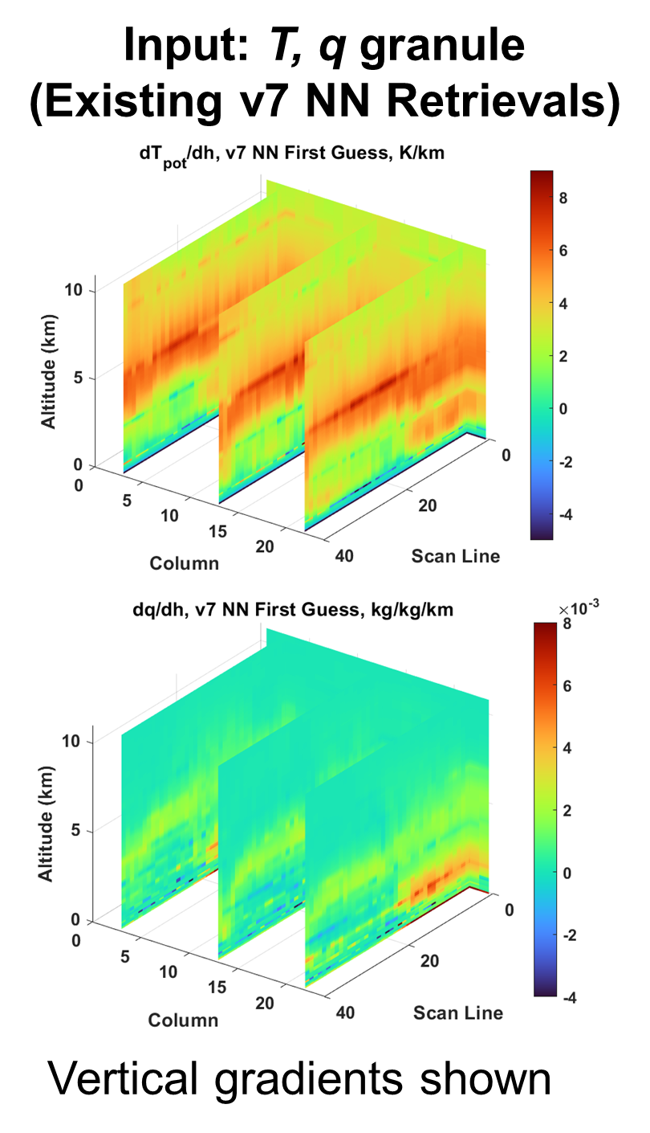
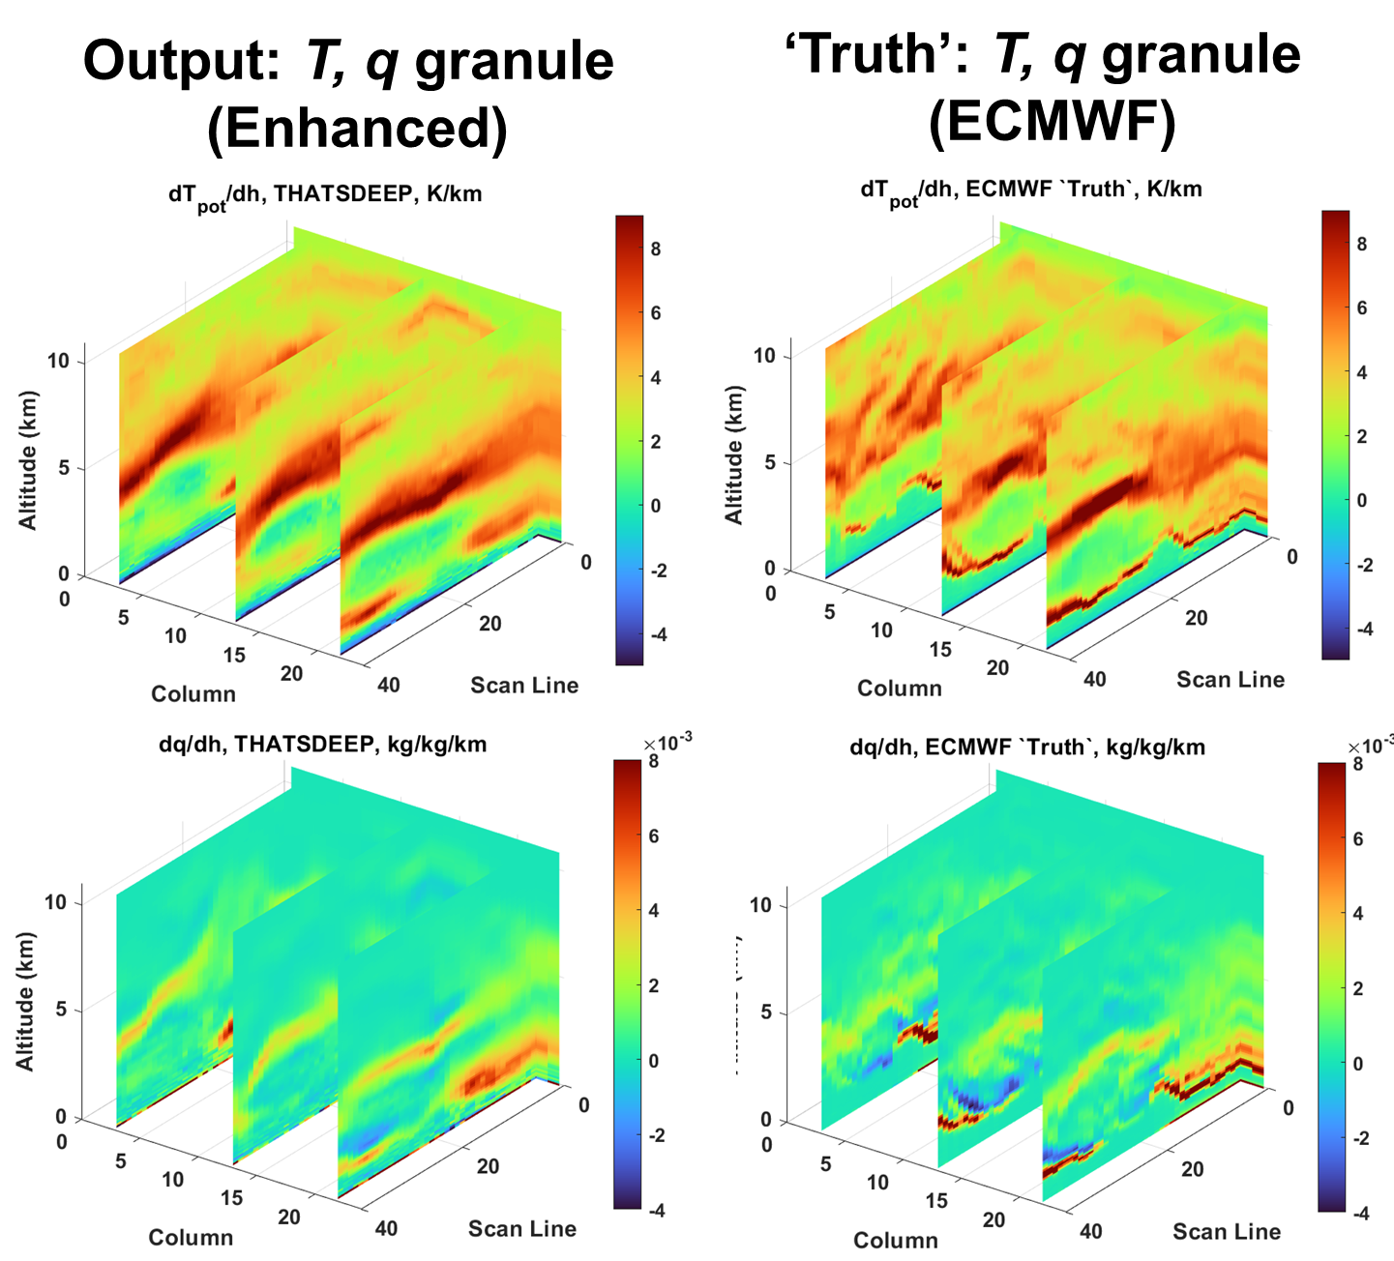
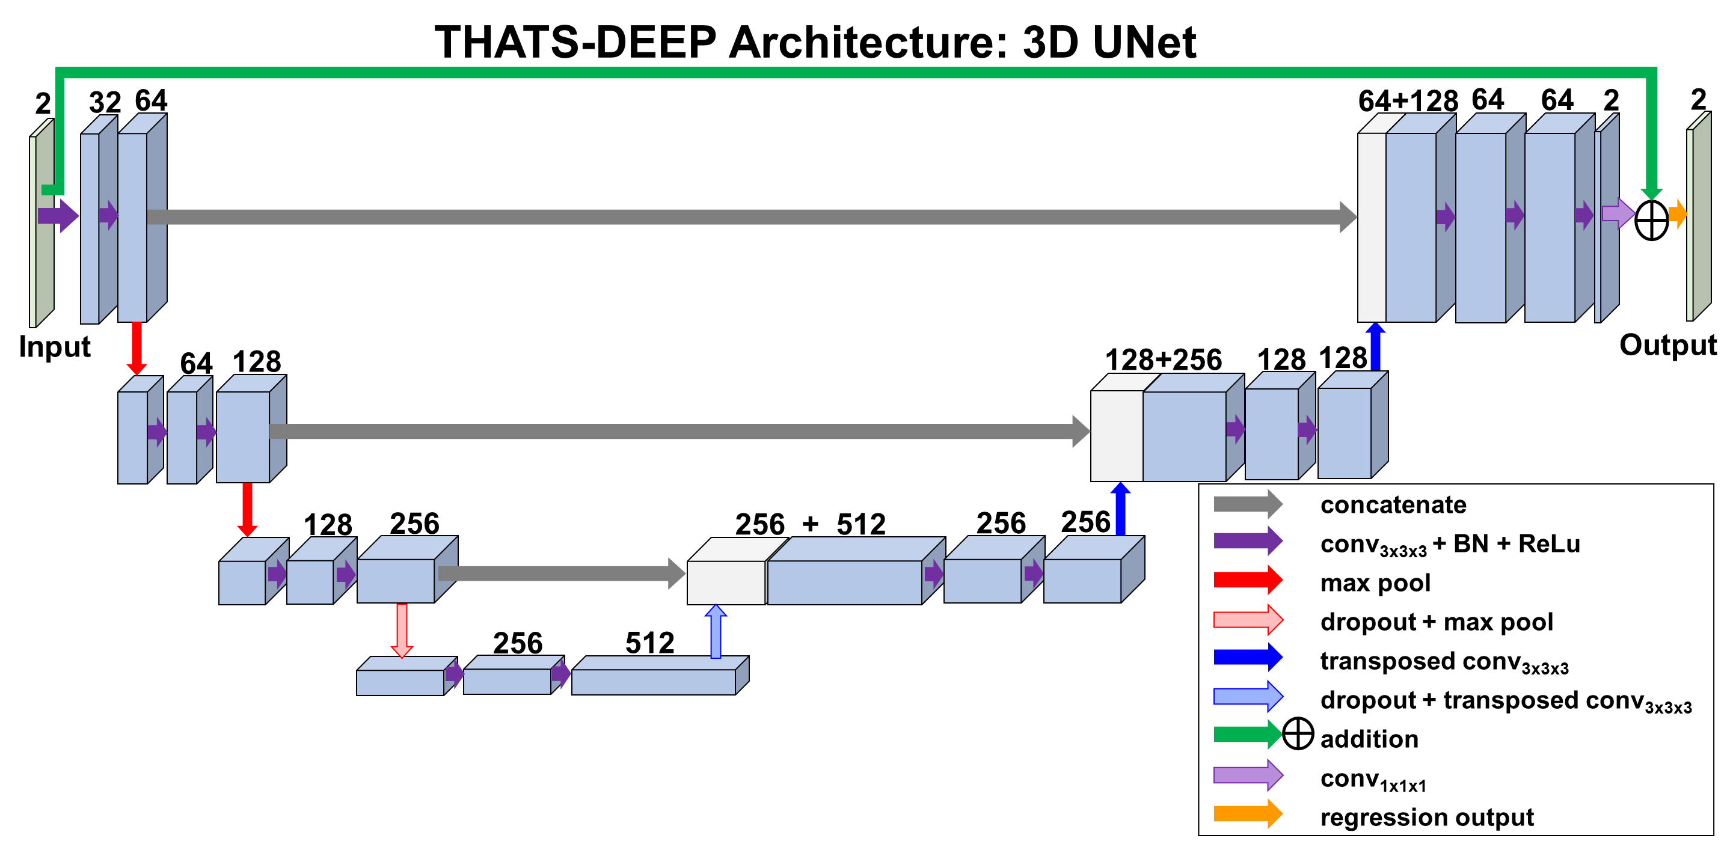






Introducing “THATS-DEEP”:
Temperature and Humidity ATmospheric Sounding DEtail-Enhancing Prior
$$T_{pot} / $h$, v7 NN
$$T_{pot} / $h$, THATS-DEEP
$$T_{pot} / $h$, ECMWF
$$q / $h$, v7 NN
$q$/ $h$, THATS-DEEP
$q$ / $h$, ECMWF
We have developed[*] a new 3D deep learning approach for enhancing SNR and detail of a granule of existing AIRS or similar retrievals (v7 NN to start with)
[*] A. B. Milstein, J. A. Santanello, and W. J. Blackwell, “Detail Enhancement of AIRS Temperature and Moisture Profiles Using a 3D Deep Neural Network”, AIES, now online

Slide 8
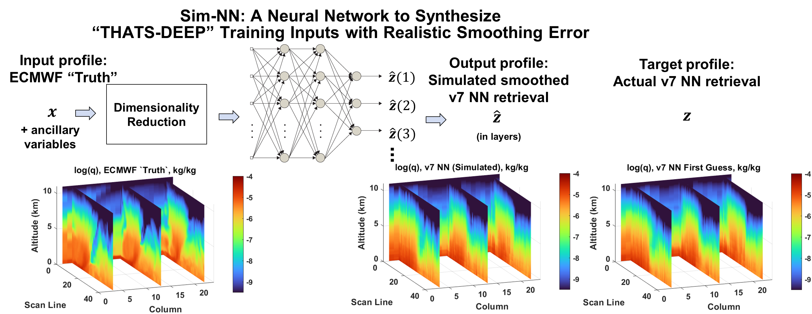
THATS-DEEP Training:
Train with Simulated Inputs, Execute with Real Inputs
ERA5 is an accurate model, but not exact ground truth.
THATS-DEEP is trained with simulated noisy/smoothed retrievals paired with ERA-5, rather than real retrievals, to avoid relying on exact accuracy or truth of ERA5
THATS-DEEP is then executed on the real retrievals as inputs
(Open to feedback on how to simulate retrieval process accurately enough at the level of cloudy radiances)

Slide 9
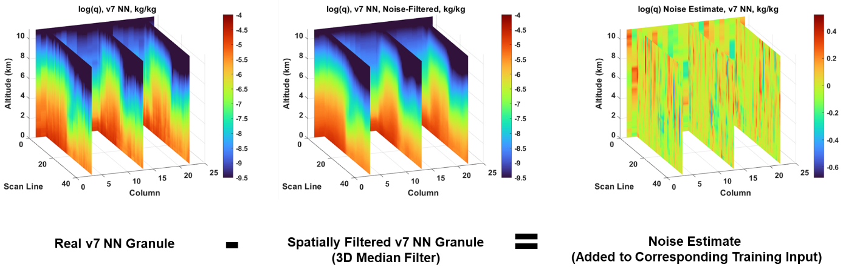
Noise Model for Training Inputs
Heuristic approach used to add noise derived from real v7 NN retrieval granules to synthetic inputs used to train THATS-DEEP

Slide 10
Outline
Overview: Planetary Boundary Layer retrievals
Detail Enhancement with Deep Neural Network
Initial Results
Ongoing work: Toward Optimal Estimation with Deep Network Priors

Slide 11
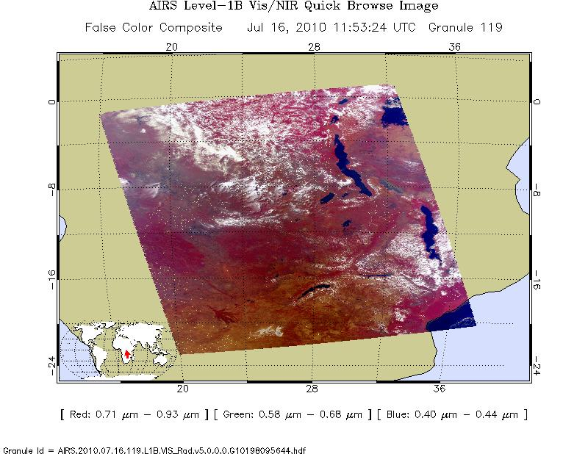
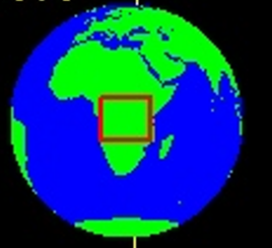
THATS-DEEP Result: Example Granule
July 16, 2010 UTC 11:53 daytime scene over Africa
We will look for convective PBL features
(Other examples in paper)

Slide 12
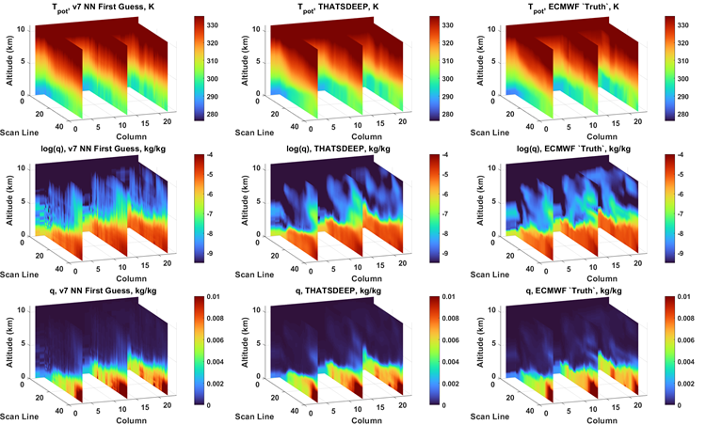
THATS-DEEP Example: T_{potential} and log(q)
THATS-DEEP enhances detail of AIRS/AMSU v7 NN granule, with results looking more like ERA-5 reference in quality

Slide 13
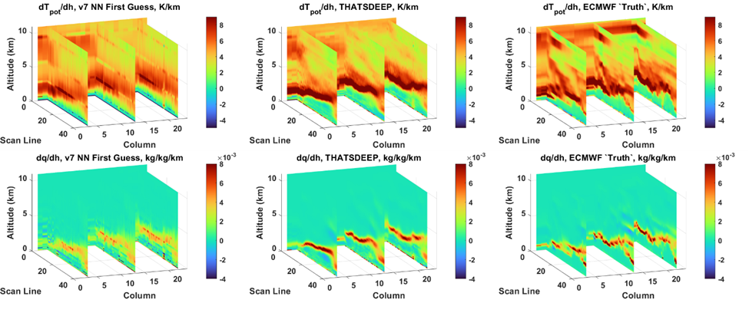
THATS-DEEP Example: dT_{potential}/dh and dq/dh
THATS-DEEP enhances detail of AIRS/AMSU v7 NN granule vertical gradients, with results looking more like ERA-5 reference in quality

Slide 14
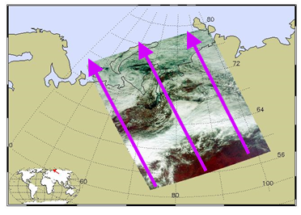
THATS-DEEP Result: Example Granule
August 21, 2010 UTC 06:53 daytime scene over northern Russia
  Contains rainy weather and low clouds. This scene also contains complex features and shows variable PBL structure and height

Slide 15
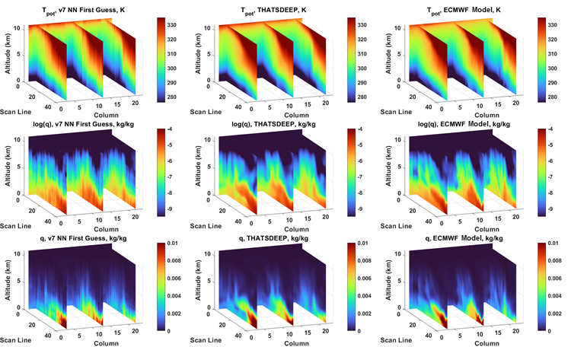
THATS-DEEP Example: T_{potential} and log(q)
THATS-DEEP enhances detail of AIRS/AMSU v7 NN granule, with results looking more like ERA-5 reference in quality

Slide 16
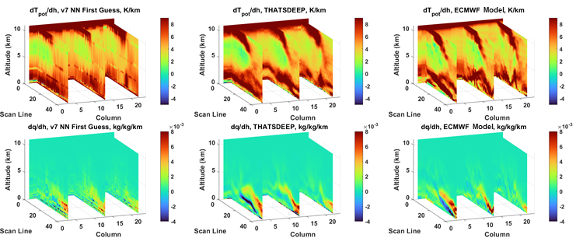
THATS-DEEP Example: dT_{potential}/dh and dq/dh
THATS-DEEP enhances detail of AIRS/AMSU v7 NN granule vertical gradients, with results looking more like ERA-5 reference in quality

Slide 17
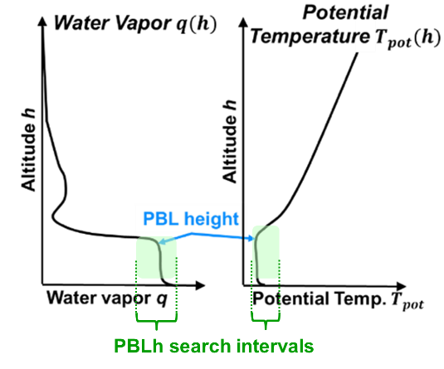
Daytime PBLH Assessment over Land
We assess PBLH for ~150,000 daytime test profiles over land (|lat|<65) from 2010, 2013
We use maximum gradient of q and of T_{pot} , inspired by previous work [*]
Gradient search is performed within a neighborhood of max(q) or min(T_{pot})
We compare v7 NN and THATS-DEEP to ERA5
[*] Seidel, D. J., Ao, C. O., & Li, K. (2010). Journal of Geophysical Research: Atmospheres, 115(D16).

Slide 18
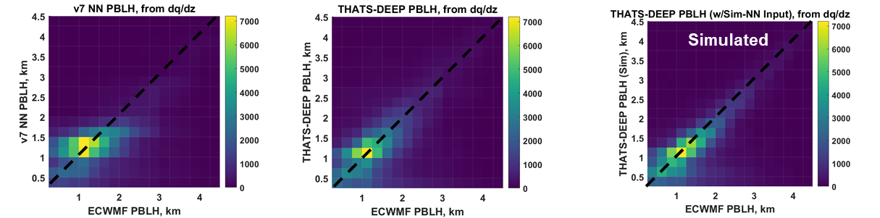
PBLH assessed using q gradient
Real Retrievals
Simulated Retrievals
THATS-DEEP improves overall PBLH agreement with ERA5 significantly for real retrievals
  All profiles included here
  THATS-DEEP with simulated input (right) and exact correspondence to ERA5 “truth” shows PBLH accuracy upper limit for this approach

Slide 19
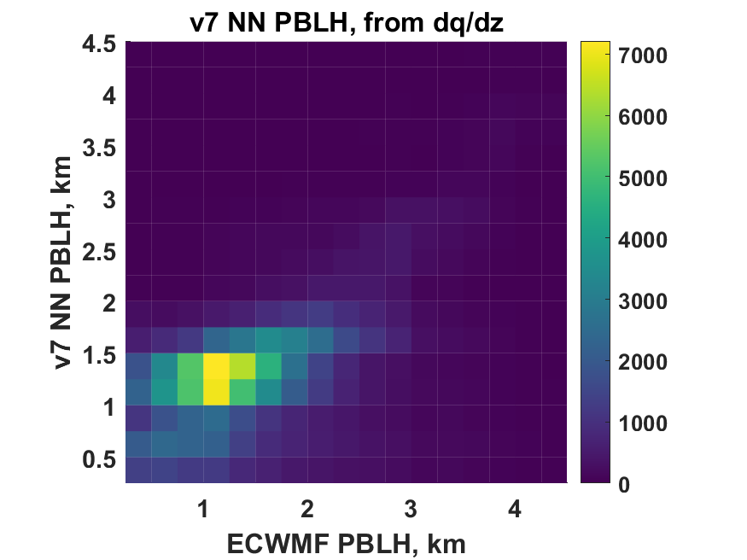
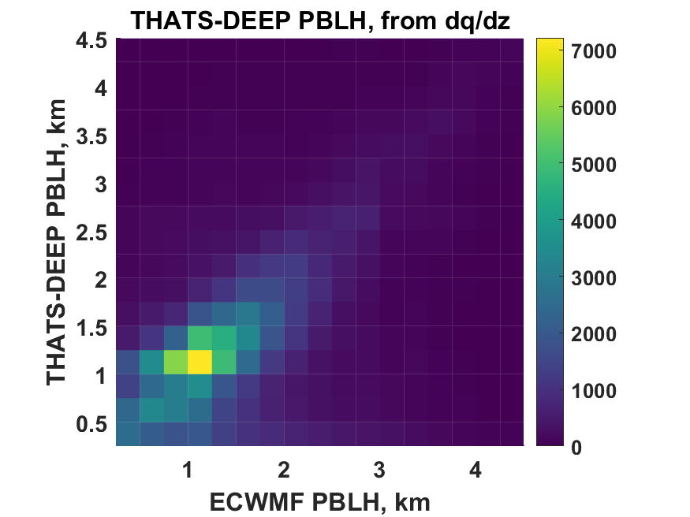
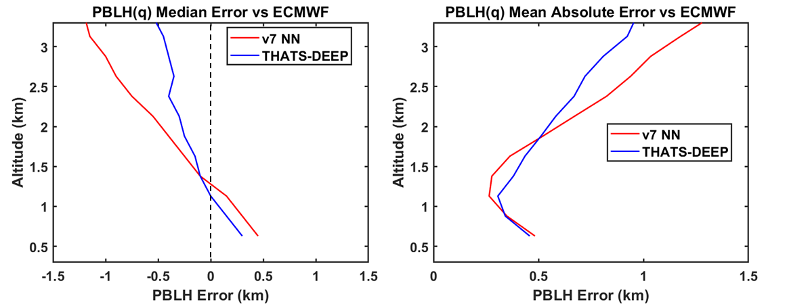
PBLH assessed using q gradient:
Before and After Enhancement
PBLH Histogram vs ERA5
PBLH Errors vs ERA5
THATS-DEEP improves overall PBLH agreement with ERA5 significantly for real retrievals, with bias and spread both largely reduced, and median errors cut in half

Slide 20
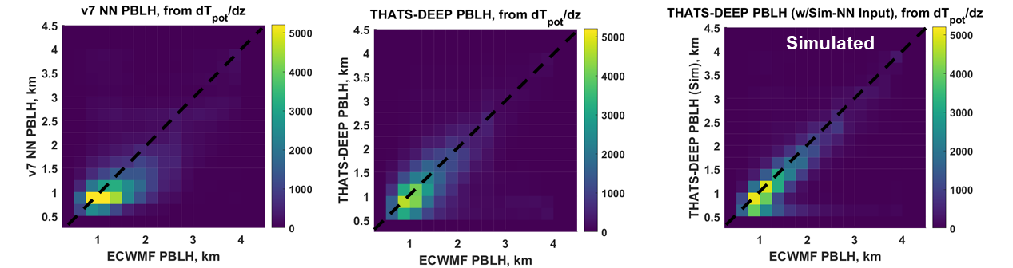
PBLH assessed using T_{pot} gradient
Real Retrievals
Simulated Retrievals
52% profiles
accepted
51% profiles
accepted
69% profiles
accepted
THATS-DEEP improves overall PBLH agreement with ERA5 significantly for real retrievals
  Suitable T_{pot} gradient local maximum not found for all profiles
  THATS-DEEP with simulated input (right) and exact correspondence to ERA5 “truth” shows PBLH accuracy upper limit for this approach

Slide 21
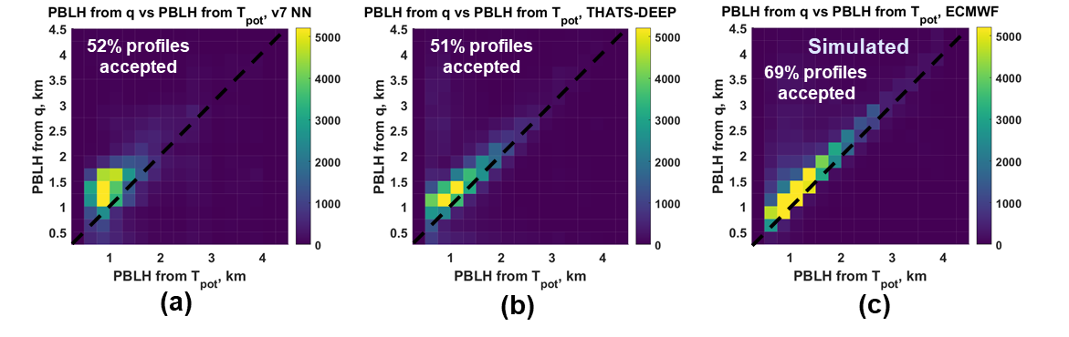
Agreement between T_{pot} and q for PBLH
Assessed PBLH in better agreement between T_{pot} and q for enhanced retrievals

Slide 22
RMS Error for T and q
Real Retrievals
Simulated Retrievals
THATS-DEEP improves overall RMS error vs ERA5 for real retrievals
  THATS-DEEP with simulated retrievals (right) and known, exact correspondence to ERA5 “truth” shows RMS error improvement upper limit for this approach

Slide 23
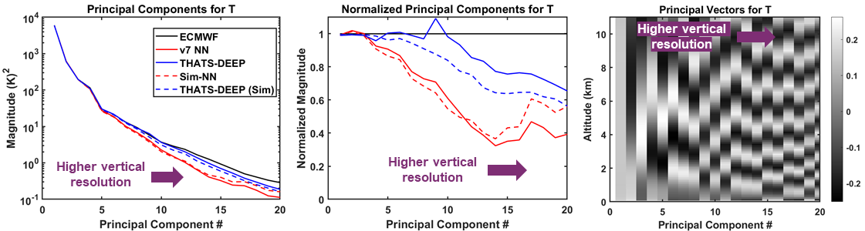
Principal component analysis of T profiles
THATS-DEEP “boosts” magnitude of principal components of v7 NN retrievals to align more closely with those of ERA5
  The boosted components correspond to principal vectors with greater vertical resolution

Slide 24
Outline
Overview: Planetary Boundary Layer retrievals
Detail Enhancement with Deep Neural Network
Initial Results
Ongoing work: Toward Optimal Estimation with Deep Network Priors

Slide 25
Limits of Current Practice
Uncertainty estimates are often computed along with the retrieval itself
However, current approaches fall short:
  Physical retrievals can estimate and attribute uncertainty, but can rely on oversimplified Gaussian assumptions
  Statistical retrievals (e.g., neural networks) are accurate and can offer empirical uncertainty estimates, but cannot easily attribute causes
    (AIRS V7 has a NN first guess and is closer to this category)
We propose to solve this problem with a “best of both worlds” approach:
  Determine ultimate limit for intrinsic uncertainty using more accurate models
  Incorporate neural network prior and physical sensing model

Slide 26
Uncertainty Estimate with Gaussian Prior Model
Measurement likelihood PDF contour
Prior PDF contour
Posterior PDF contour
Classic optimal estimation (OE) assumes Gaussian prior and measurement models
Uncertainties easy to compute, but Gaussian prior is very simplified and can lead to inaccurate estimate of posterior uncertainty
Figure adapted from Clive Rodgers, “Inverse Methods for Atmospheric Sounding”

Slide 27
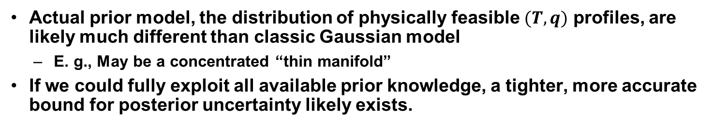
Uncertainty Estimate with Actual Prior Model
Measurement likelihood PDF contour
Prior PDF contour
Posterior PDF contour
Actual prior model, the distribution of physically feasible $(T,q)$ profiles, are likely much different than classic Gaussian model
  E. g., May be a concentrated “thin manifold”
If we could fully exploit all available prior knowledge, a tighter, more accurate bound for posterior uncertainty likely exists.

Slide 28
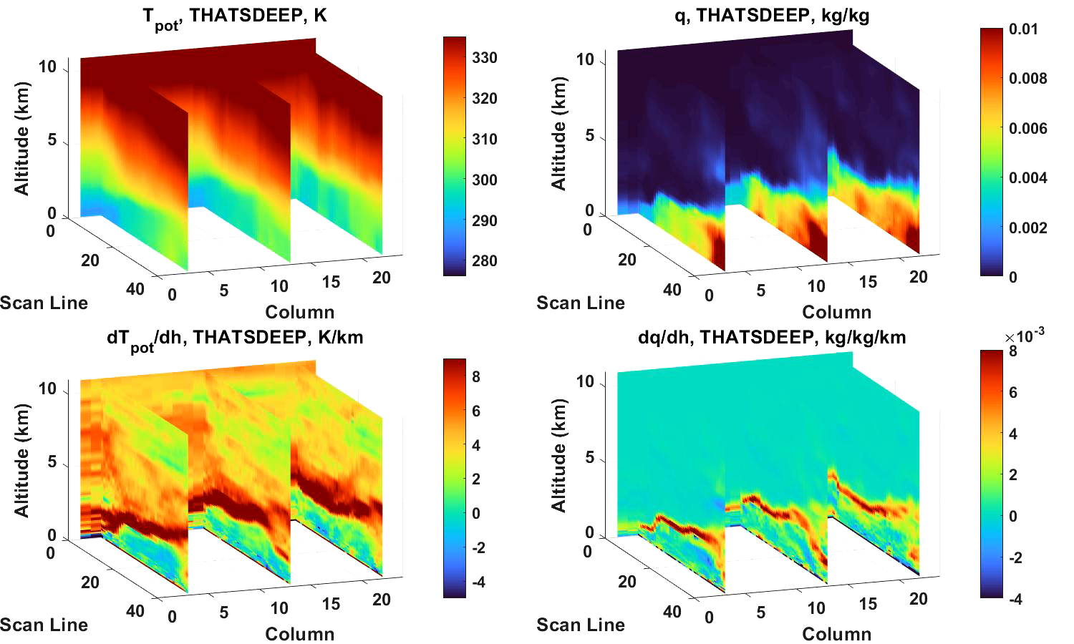
Recent Work: From Point Estimate to Conditional Distribution (in Progress)

Slide 29
Conclusion
We have presented a new DNN approach for enhancing detail and reducing noise in 3D granules containing current state of the art retrievals of temperature and humidity
We have shown that this approach improves their scientific utility, including representation of key PBL features over land such as inversions representing PBLH,
This technique, while demonstrated here on the v7 NN retrievals, can in principle be applied to enhance the scientific return from a wide variety of sensors and retrieval algorithms provided it is trained accordingly

Slide 30
THANK YOU!
milstein@ll.mit.edu

