Slide 1
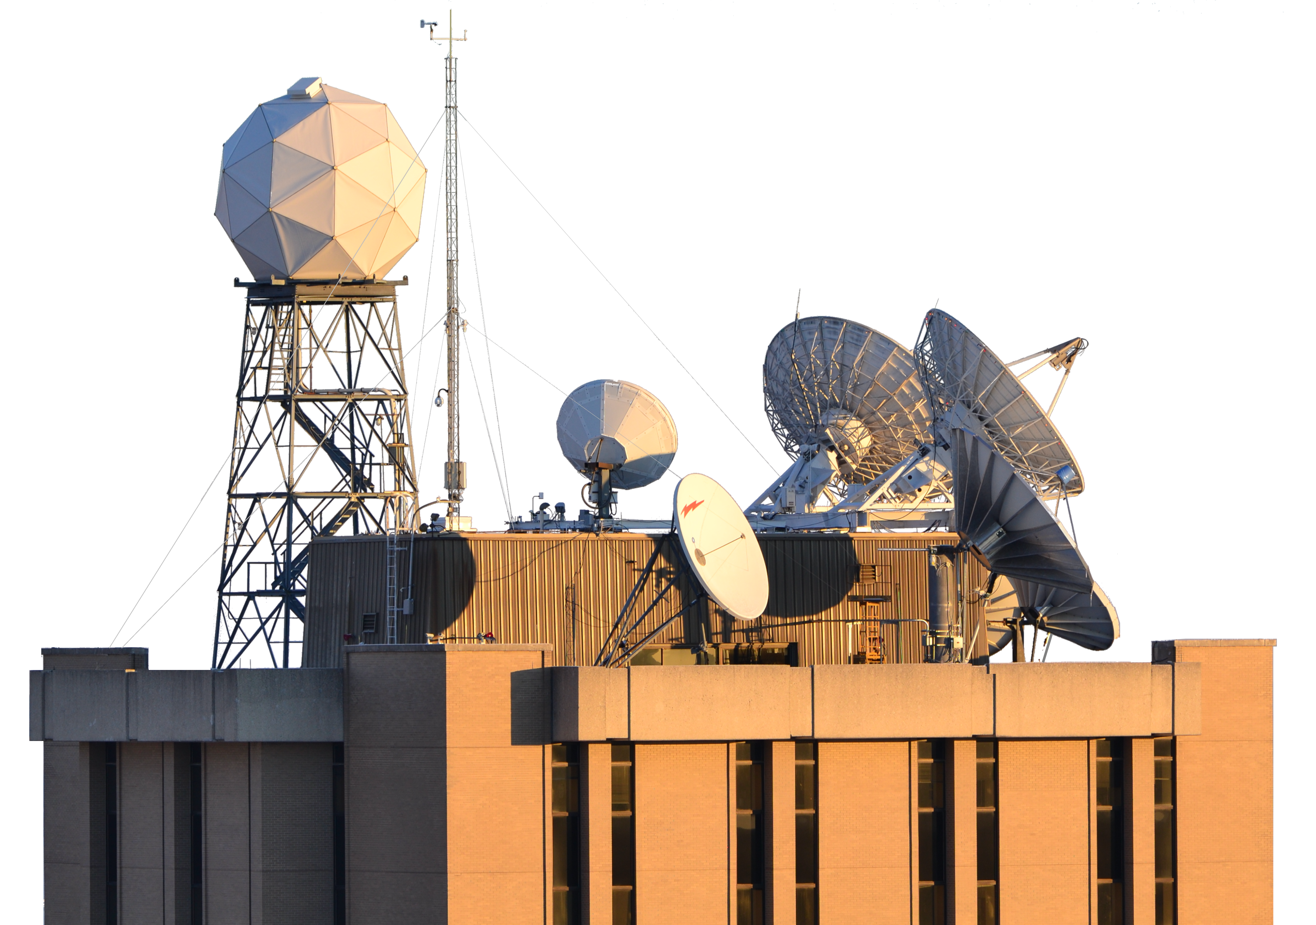




Hybrid PCA representation of CrIS spectra
David Tobin¹, Joe Taylor¹, Flavio Iturbide-Sanchez², Liam Gumley¹, Graeme Martin¹, Michelle Loveless¹, Bob Knuteson¹, Hank Revercomb¹
¹ Cooperative Institute for Meteorological Satellite Studies, Space Science and Engineering Center,
University of Wisconsin-Madison
² NOAA, NESDIS, STAR
EUMETSAT 2022
19-23 September 2022
Brussels, Belgium

Slide 2
Outline
Introduction / Methodology
Compression and Noise filtering
Example assessments
Next steps
Hybrid PCA representation of CrIS spectra, D. Tobin, EUMETSAT 2022

Slide 3
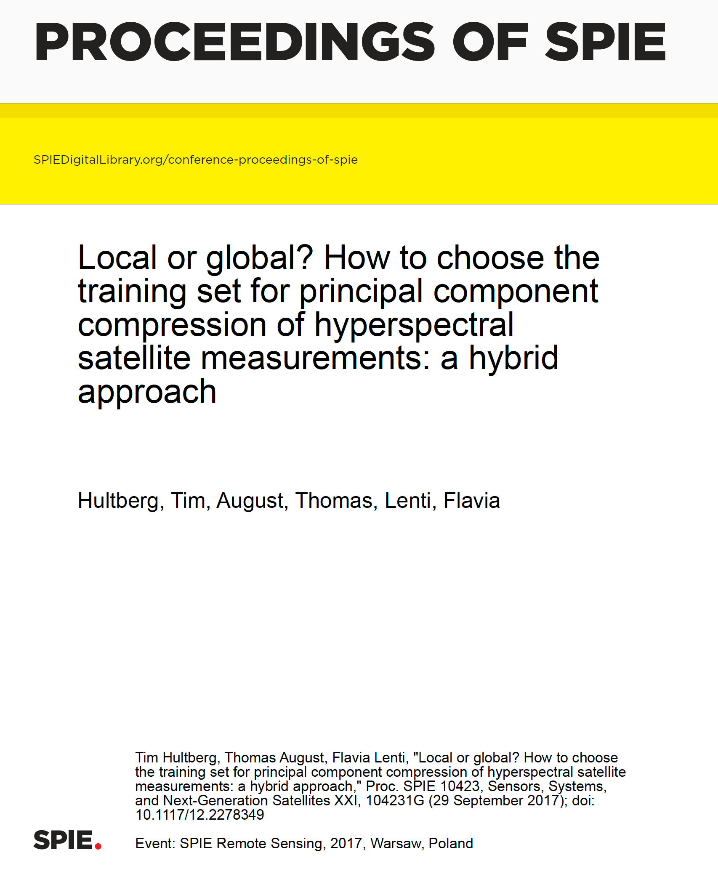
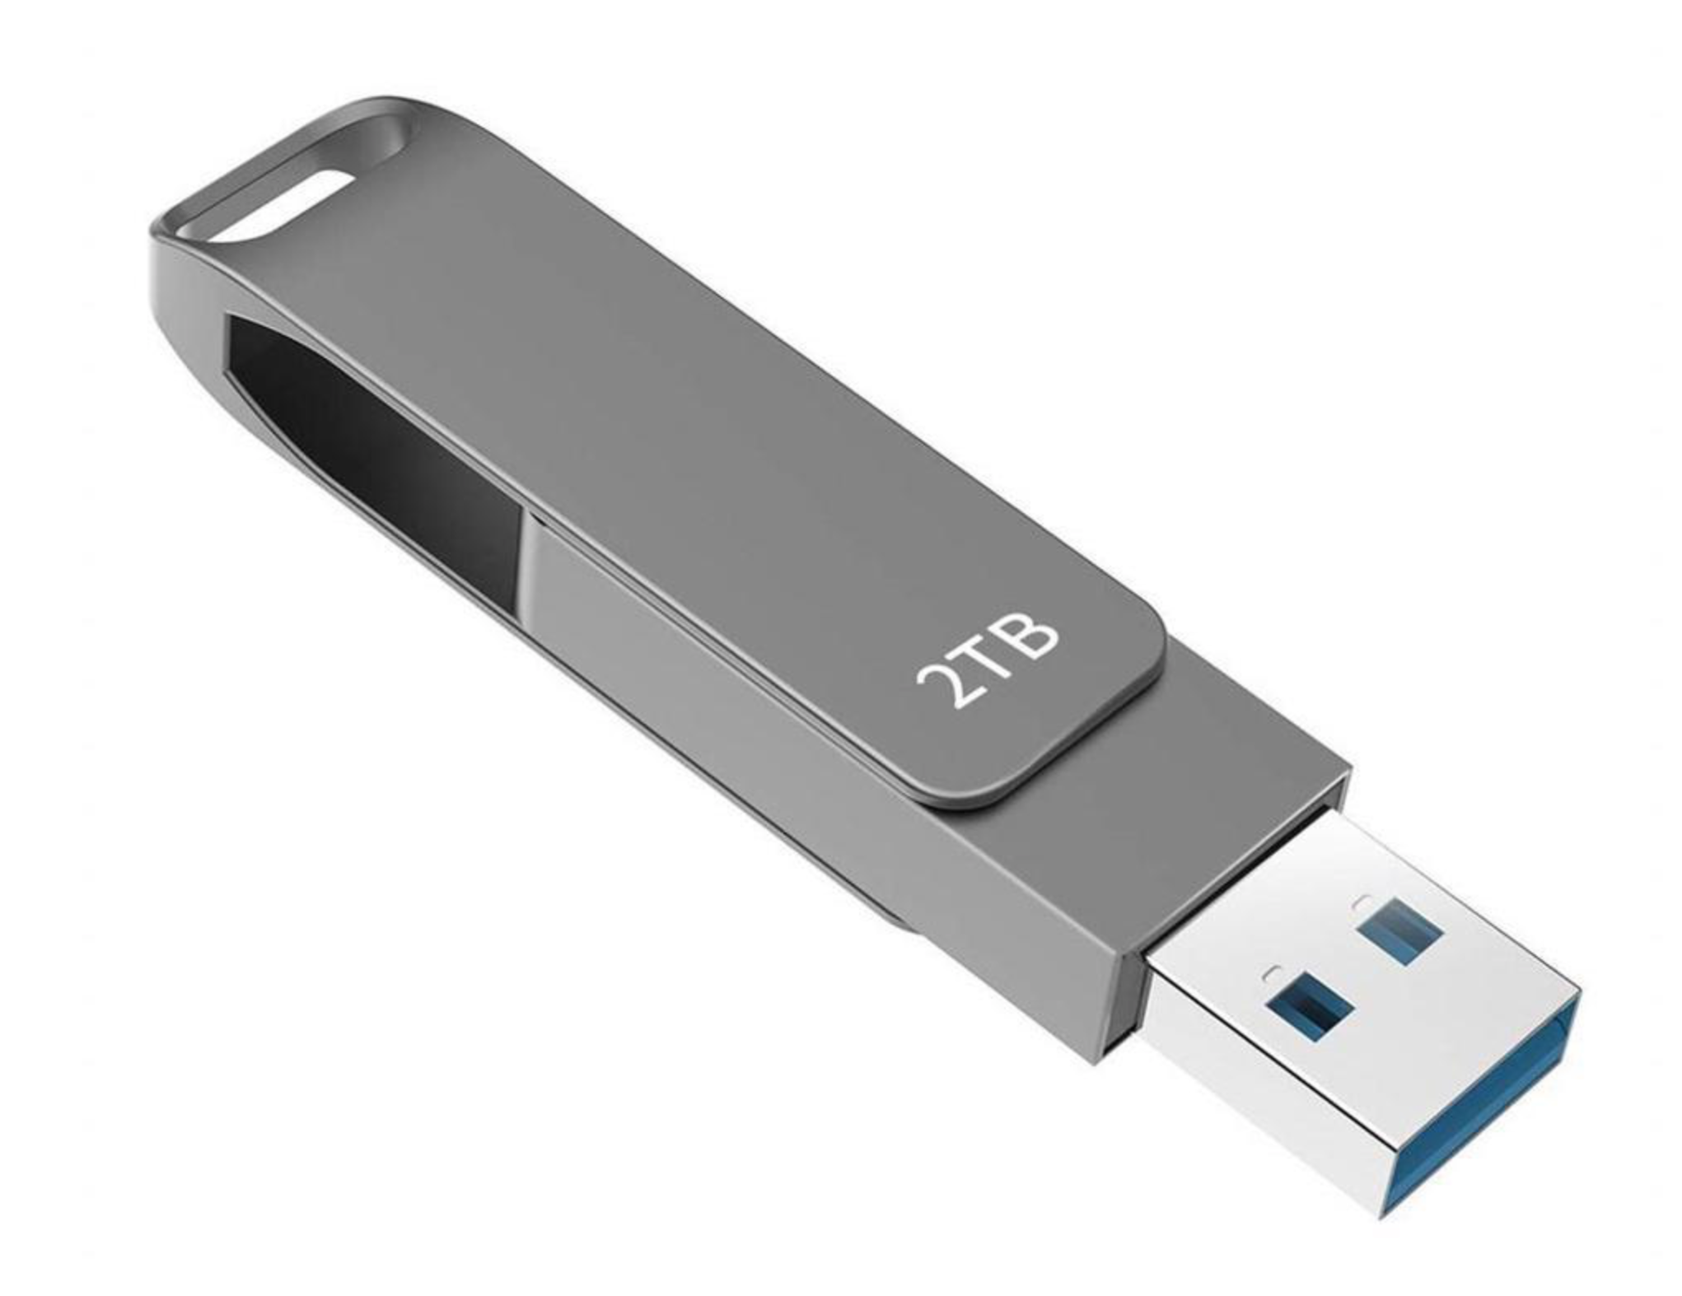
Introduction
The EUMETSAT Hybrid PCA technique
  e.g.: Hultberg et al. 2017
  Currently available for IASI, and will be used for IASI-NG and MTG-IRS
Benefits
  Data compression, up to ~50x
    CrIS data accessibility
    Preparing for future sensors
  Random Noise Filtering
  Rare Events Detection (RED)
SNPP mission
Hybrid PCA representation of CrIS spectra, D. Tobin, EUMETSAT 2022

Slide 4
CrIS Hybrid PCA Methodology
Determine a set of global PCs, “PC_{global}”
Based on a large representative set of spectra
The leading nPCs_{global} (150) global PCs are retained
These global PCs are “static” and distributed to users (and the global mean spectrum Rad_{global})
For any given granule of SCRIF data
(1) Compute Coefficients for the global PCs, “C_{global}”
(2) Compute “Local PCs” based on the global reconstruction residuals of this granule, “PC_{local}” and the corresponding coeficients “C_{local}” and retain these for the leading nPCs_{local} (10) local PCs (and the local mean residual spectrum Res_{local})
(3) Save C_{global}, PC_{local}, C_{local}, Res_{local} to a file for each granule
Final Reconstructed Radiances:
Rad_{Rec} = ( PC_{global} C_{global} + Rad_{global} ) + ( PC_{local} C_{local} + Res_{local} )
[2223xNrec] [2223x150] [150xNrec] [2223x1] [2223 x 10] [10 x Nrec] [2223 x 1]
Global Local
Hybrid PCA representation of CrIS spectra, D. Tobin, EUMETSAT 2022
Notes:
Ma

Slide 5
CrIS Hybrid PCA Methodology (Cont.)
Other considerations:
  All three spectral bands combined
  All nine FOVs combined
  150 global PCs and 10 local PCs
  Sensor independent or sensor dependent global PCs (TBR)
  Noise Normalization (FOV independent)
  Scaled integer representation of PC scores combined with NetCDF integer compression
  PC representation Quality indicators
  Individual Outliers
  Local granule size
  Missing spectral bands
Hybrid PCA representation of CrIS spectra, D. Tobin, EUMETSAT 2022

Slide 6
Global Training
global PCs
Based on a large representative set of spectra
For each sensor (SNPP and NOAA20) currently using spectra from 1 year of data (March 2018 to March 2019)
with latitude weighting
~671M spectra per sensor
PCs computed from the SVD of covariance of the radiance ensemble
Covariance matrices of subsets (single days) of the ensemble combined into a covariance matrix for the entire ensemble following:
  Pebay, P., 2008, Formulas for Robust, One-Pass Parallel Computation of Covariances and Arbitrary-Order Statistical Moments: Sandia Report
Hybrid PCA representation of CrIS spectra, D. Tobin, EUMETSAT 2022

Slide 7
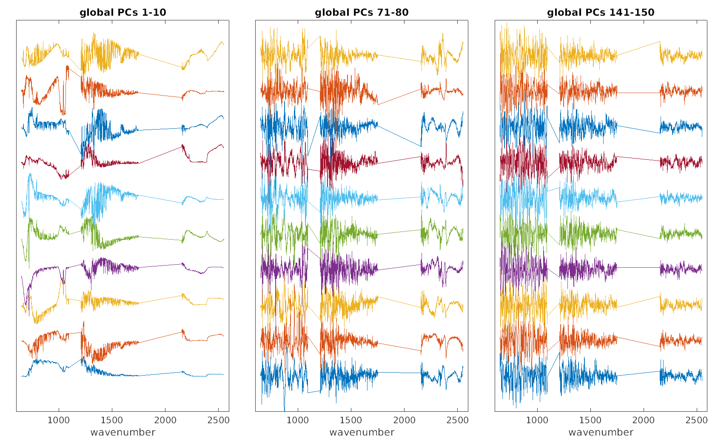
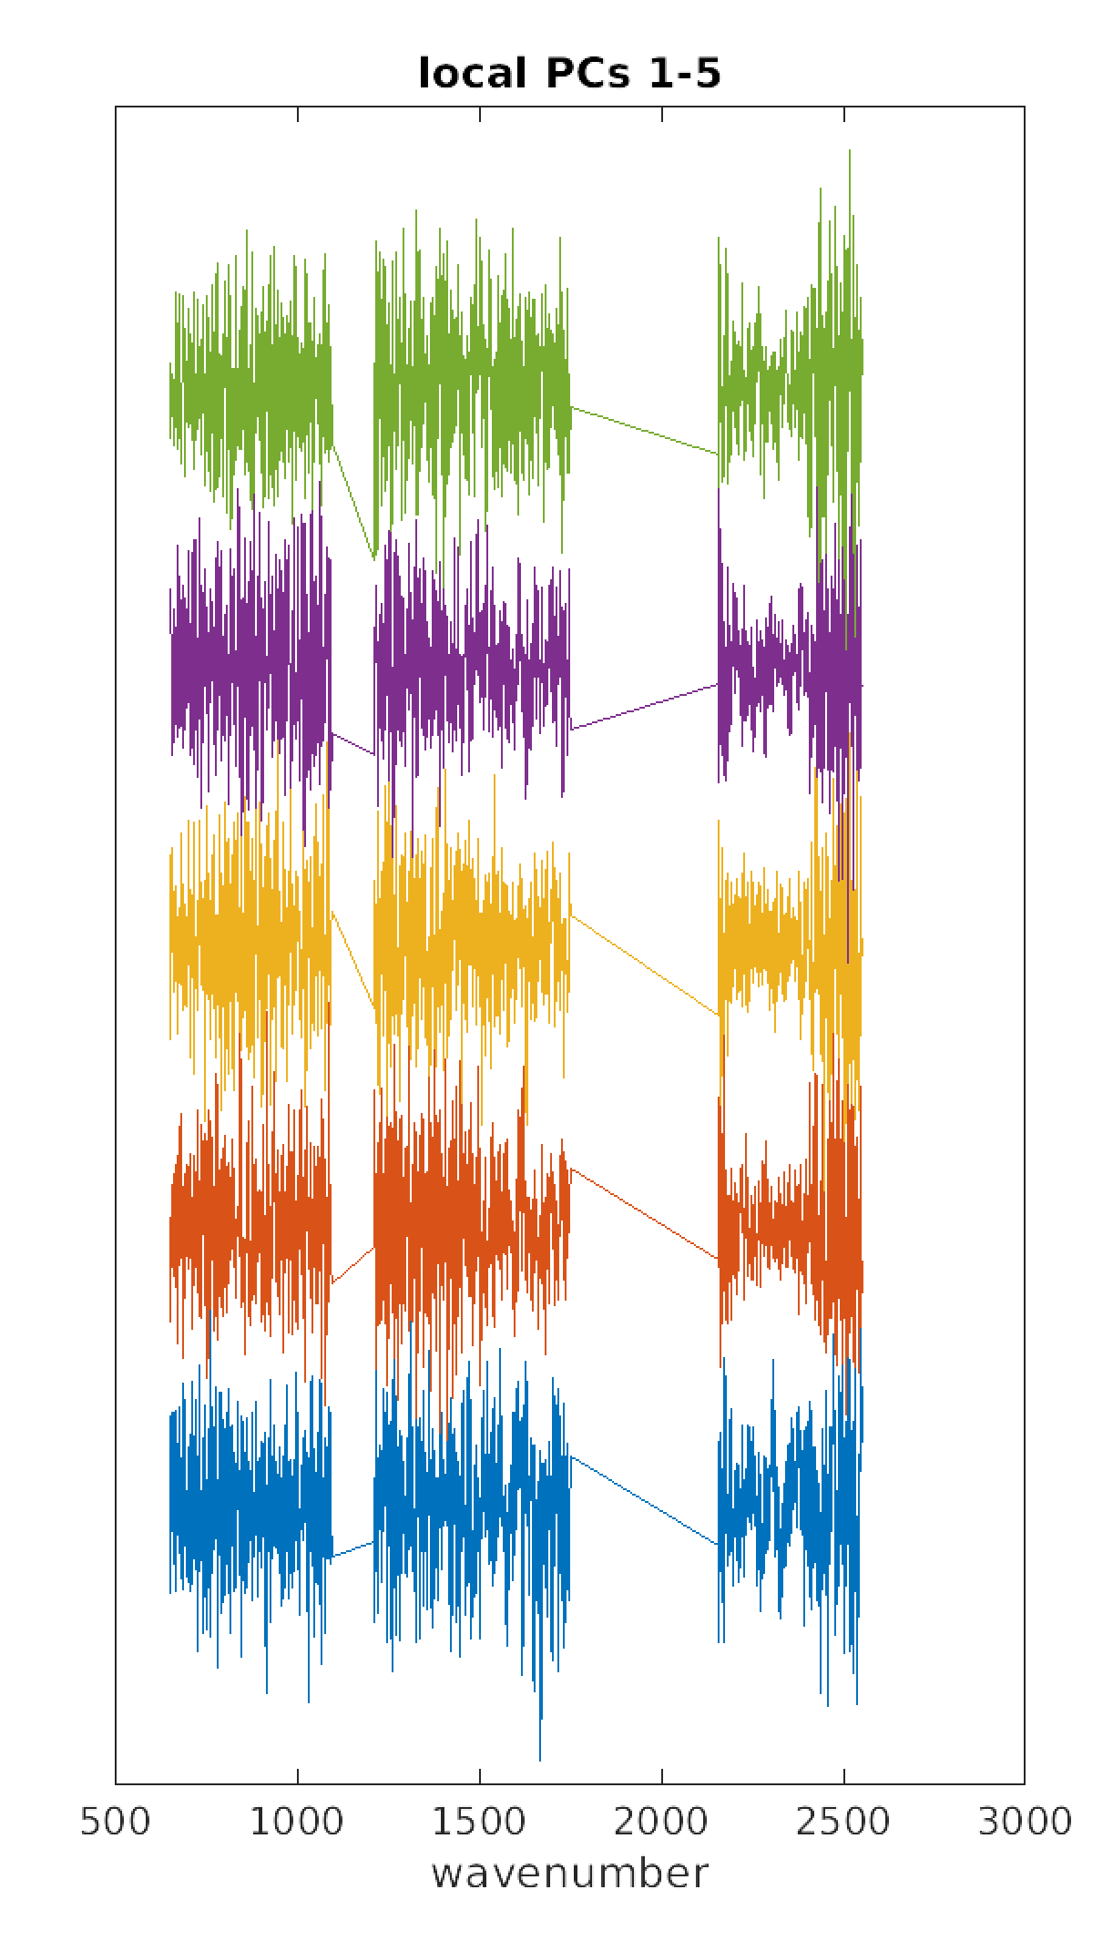
Example PCs
Global PCs
Local PCs
For a randomly selected SCRIF granule
10
80
150
1
71
141
Hybrid PCA representation of CrIS spectra, D. Tobin, EUMETSAT 2022

Slide 8
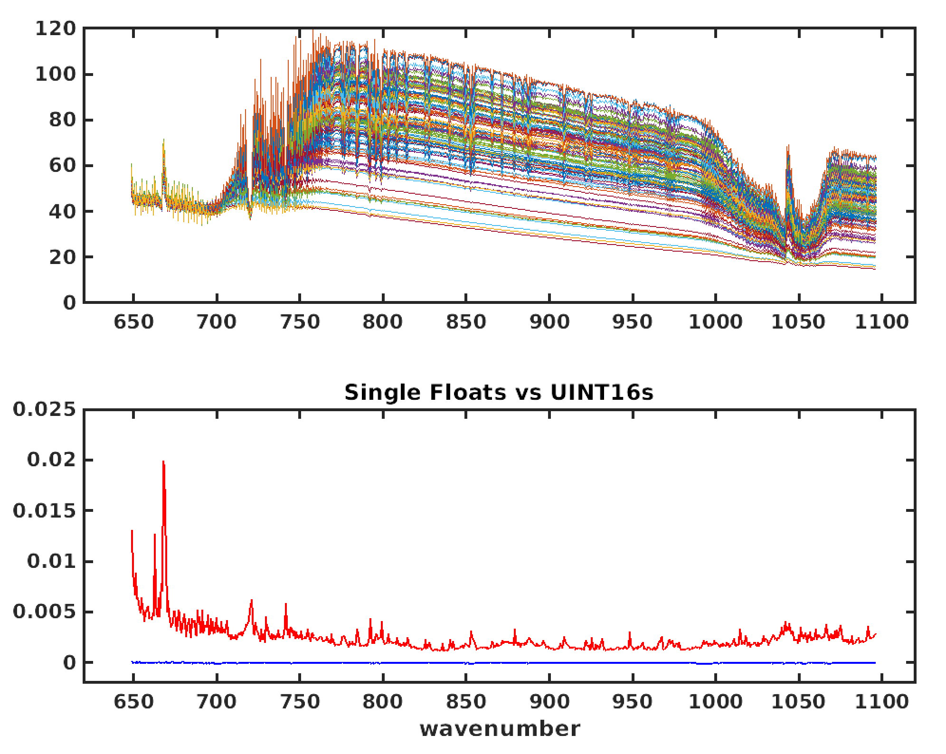
Scaled Integer representation of PC scores
Example reconstructed radiance differences
32 Bit Float vs 16 Bit Unsigned Integers
mW/(m² sr. cm⁻¹)
Mean
STDEV
mW/(m² sr. cm⁻¹)
Hybrid PCA representation of CrIS spectra, D. Tobin, EUMETSAT 2022

Slide 9
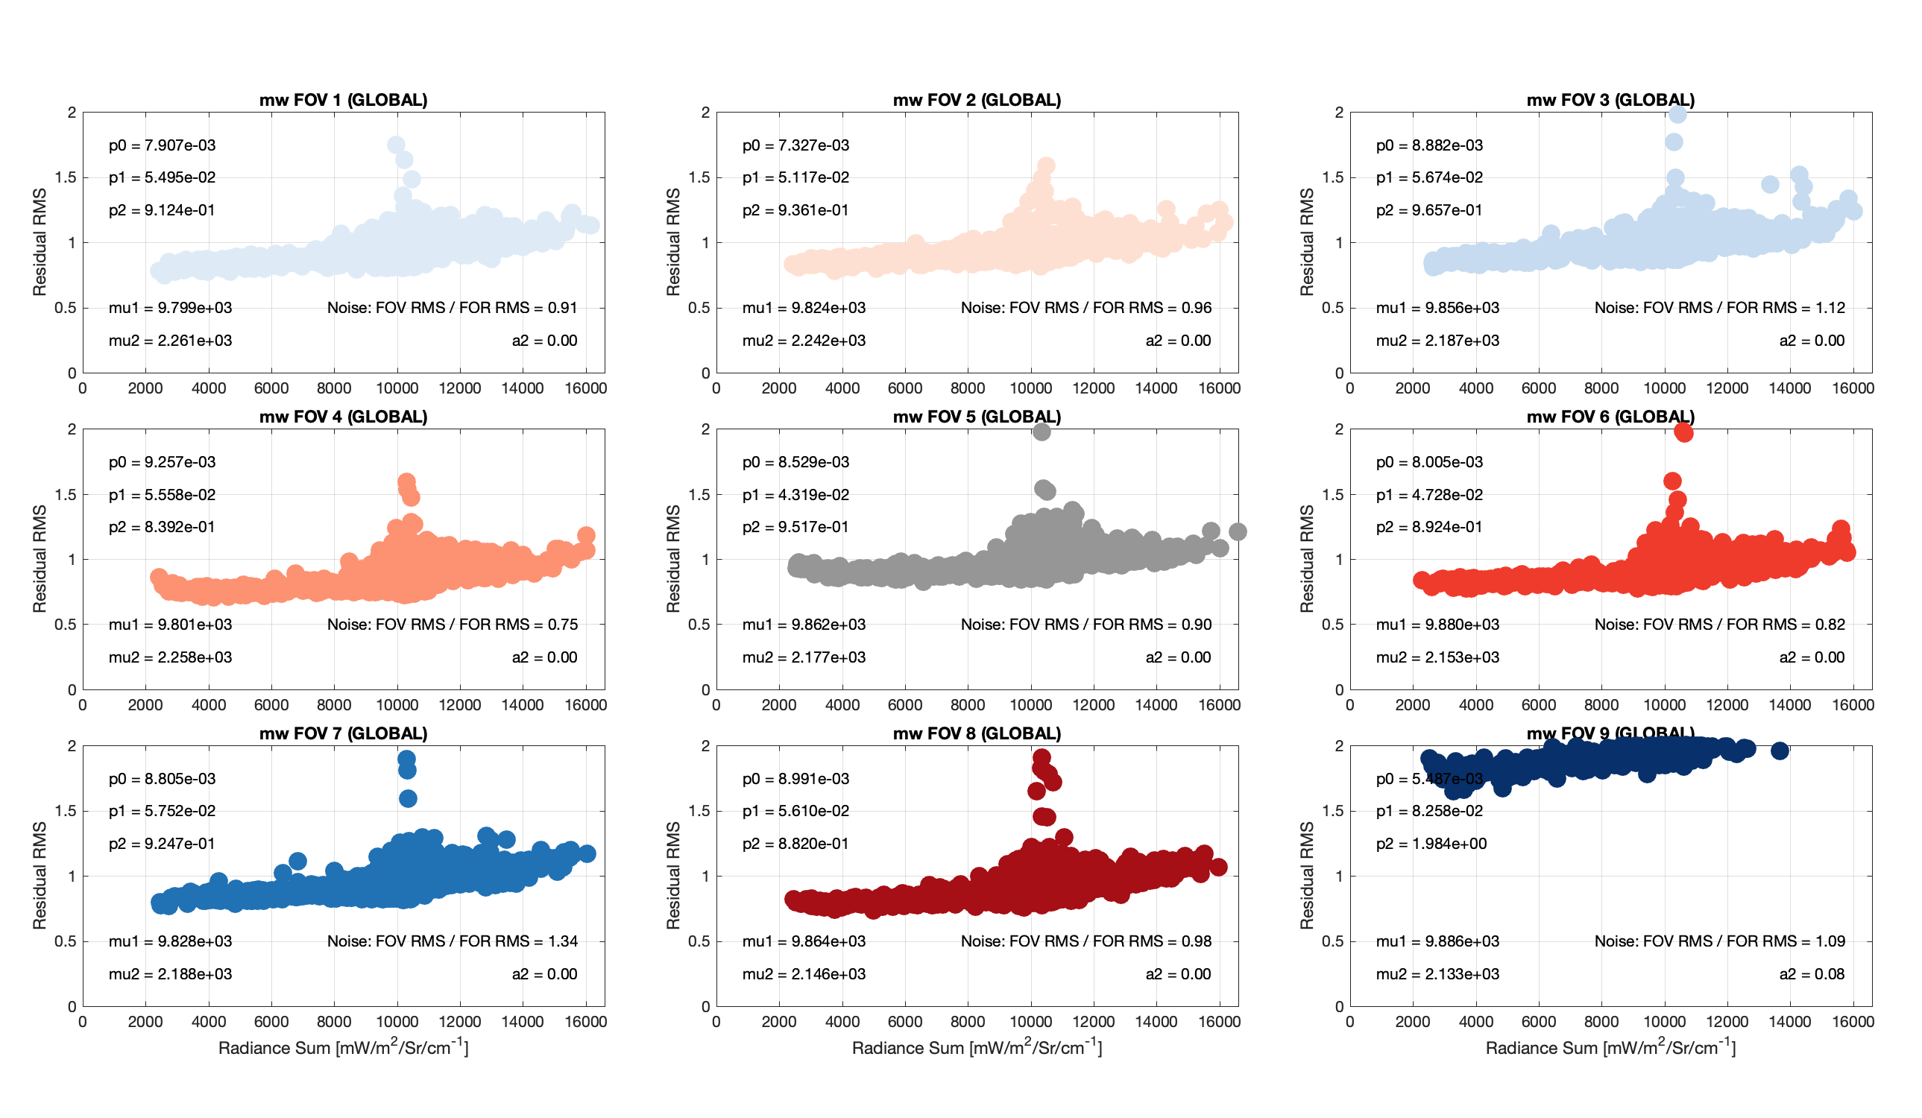
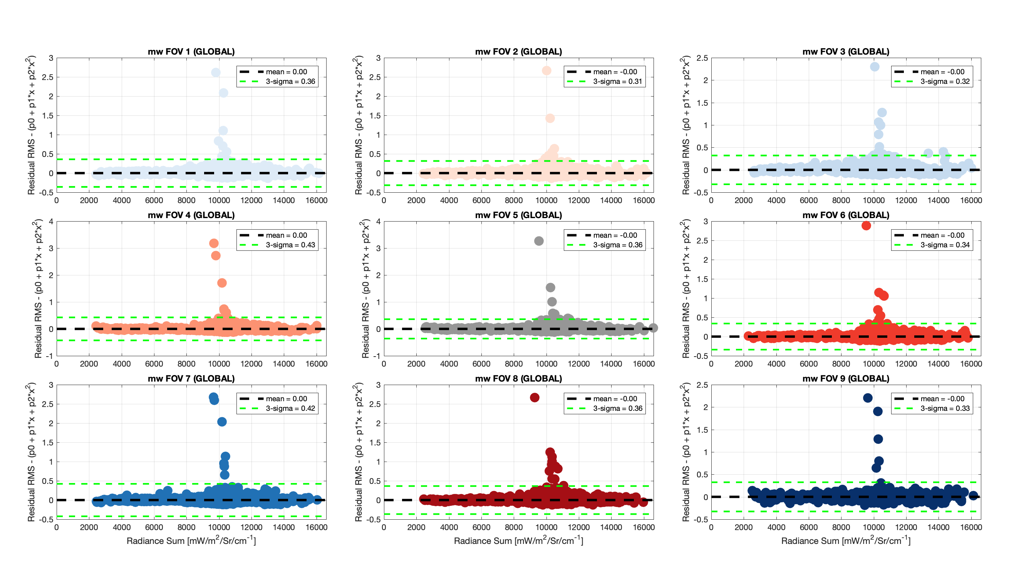
PC reconstruction Quality indicators
“De-trended” reconstruction RMS scores for each footprint and spectral band, for Global-only and Hybrid reconstructions
Corresponding Quality Flags
Original radiances for “Individual outlier” spectra, when identified, included in output PC files
Useful for “rare event” identifications
Example for 20220101 Mt. Etna eruption NOAA20 data (using Global-only PC reconstruction for demonstration)
Radiance RMS versus integrated radiance for MidWave band, by FOV:
Not de-trended
De-trended
*Following Hultberg et al: ‘IASI PC compression – Searching for signal in the residuals’ 13886-iasi-pc-compression-searching-sinal-residuals.pdf
and Hultberg, 2009, ‘IASI Principal Component Compression (IASI PCC) FAQ’ pdf_ipcc_faq.pdf

Slide 10
Compression (SDR example)
Radiances from a 4 scan line CrIS granule (1080 spectra): 9,551,520 bytes
Global PCs (150 PCs, 1 time transfer): 2,653,200 bytes
Global Coefs (per granule): 648,000 bytes
Local PCs (10 PCs, per granule): 88,440 bytes
Local Coefs (per granule): 43,200 bytes
Per granule:
FSR SDR Radiances = 9,551,520 bytes
PC representation = 648,000 + 88,440 + 43,200 bytes = 779,640 bytes
PC/SDR x100 = 8.2% ... PC data volume is ~8 percent of SDR radiance data volume
SDR/PC = 12.3 … A factor of ~12 reduction in terms of data transfer expense and data storage
And an additional compression of 2 to 4x, from scaled integer representation of the PC scores, gives total compression of up to ~50x
This large reduction is due to the lossy noise reduction/compression from the PCA …
Hybrid PCA representation of CrIS spectra, D. Tobin, EUMETSAT 2022

Slide 11
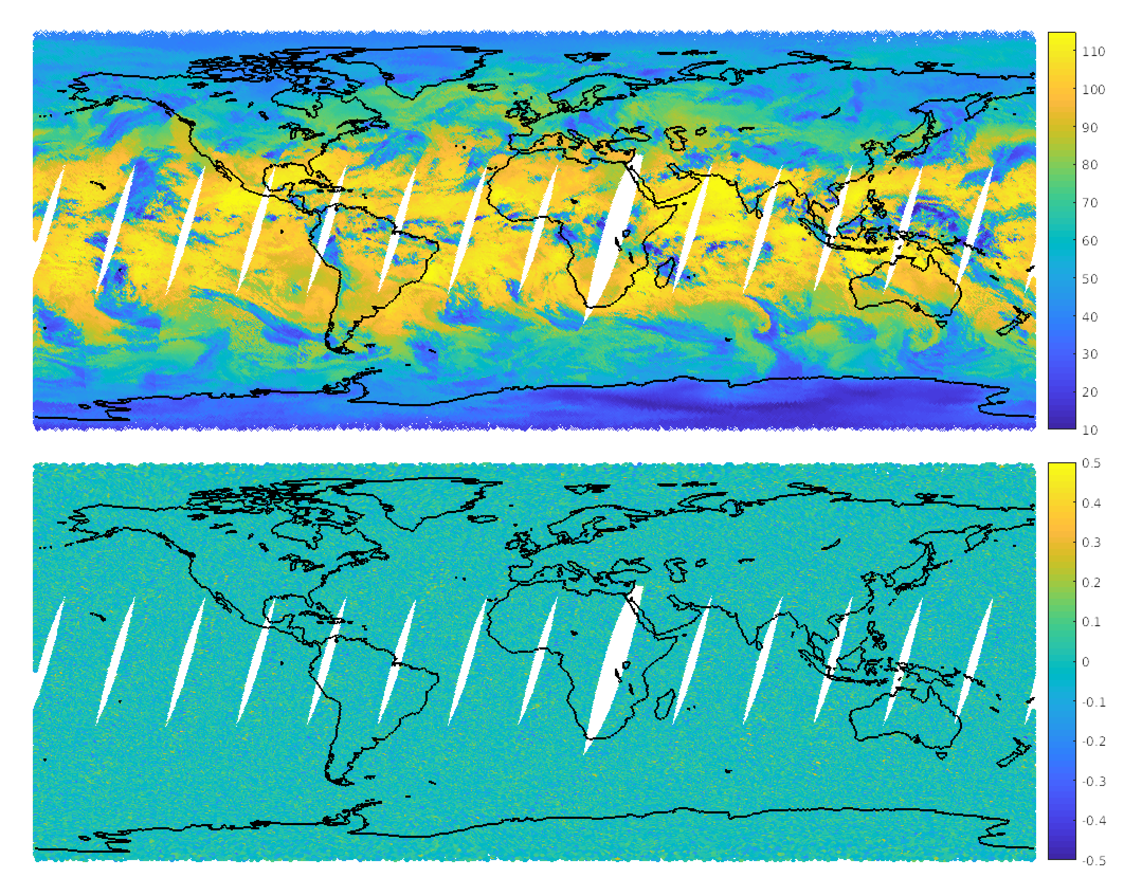
Random Noise Filtering
Example reconstruction residuals
900 cm⁻¹ radiances
20210413 NOAA-20 data
Original Radiance
mW/(m² sr. cm⁻¹)
Original minus Reconstructed Radiance
mW/(m² sr. cm⁻¹)
normalized counts
mW/(m² sr. cm⁻¹)
Hybrid PCA representation of CrIS spectra, D. Tobin, EUMETSAT 2022

Slide 12
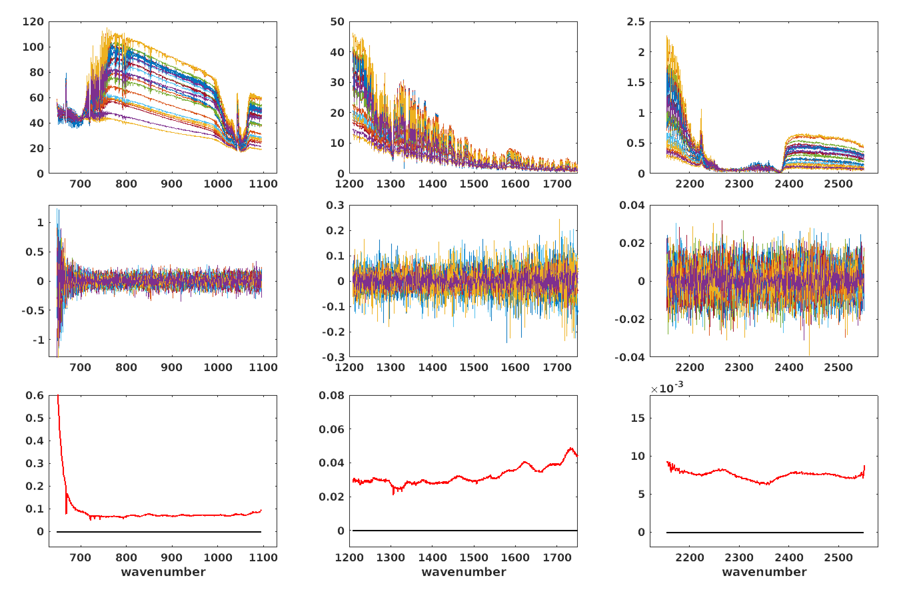
Random Noise Filtering
Example reconstruction residuals
20210413 NOAA20 radiances
~75% random Noise reduction [sqrt(160/2223)] produces data with FOV independent random noise levels
Longwave
Midwave
Shortwave
spectra
mW/(m² sr. cm⁻¹)
residuals
mW/(m² sr. cm⁻¹)
Mean residual
STDEV residual
mW/(m² sr. cm⁻¹)
Hybrid PCA representation of CrIS spectra, D. Tobin, EUMETSAT 2022

Slide 13
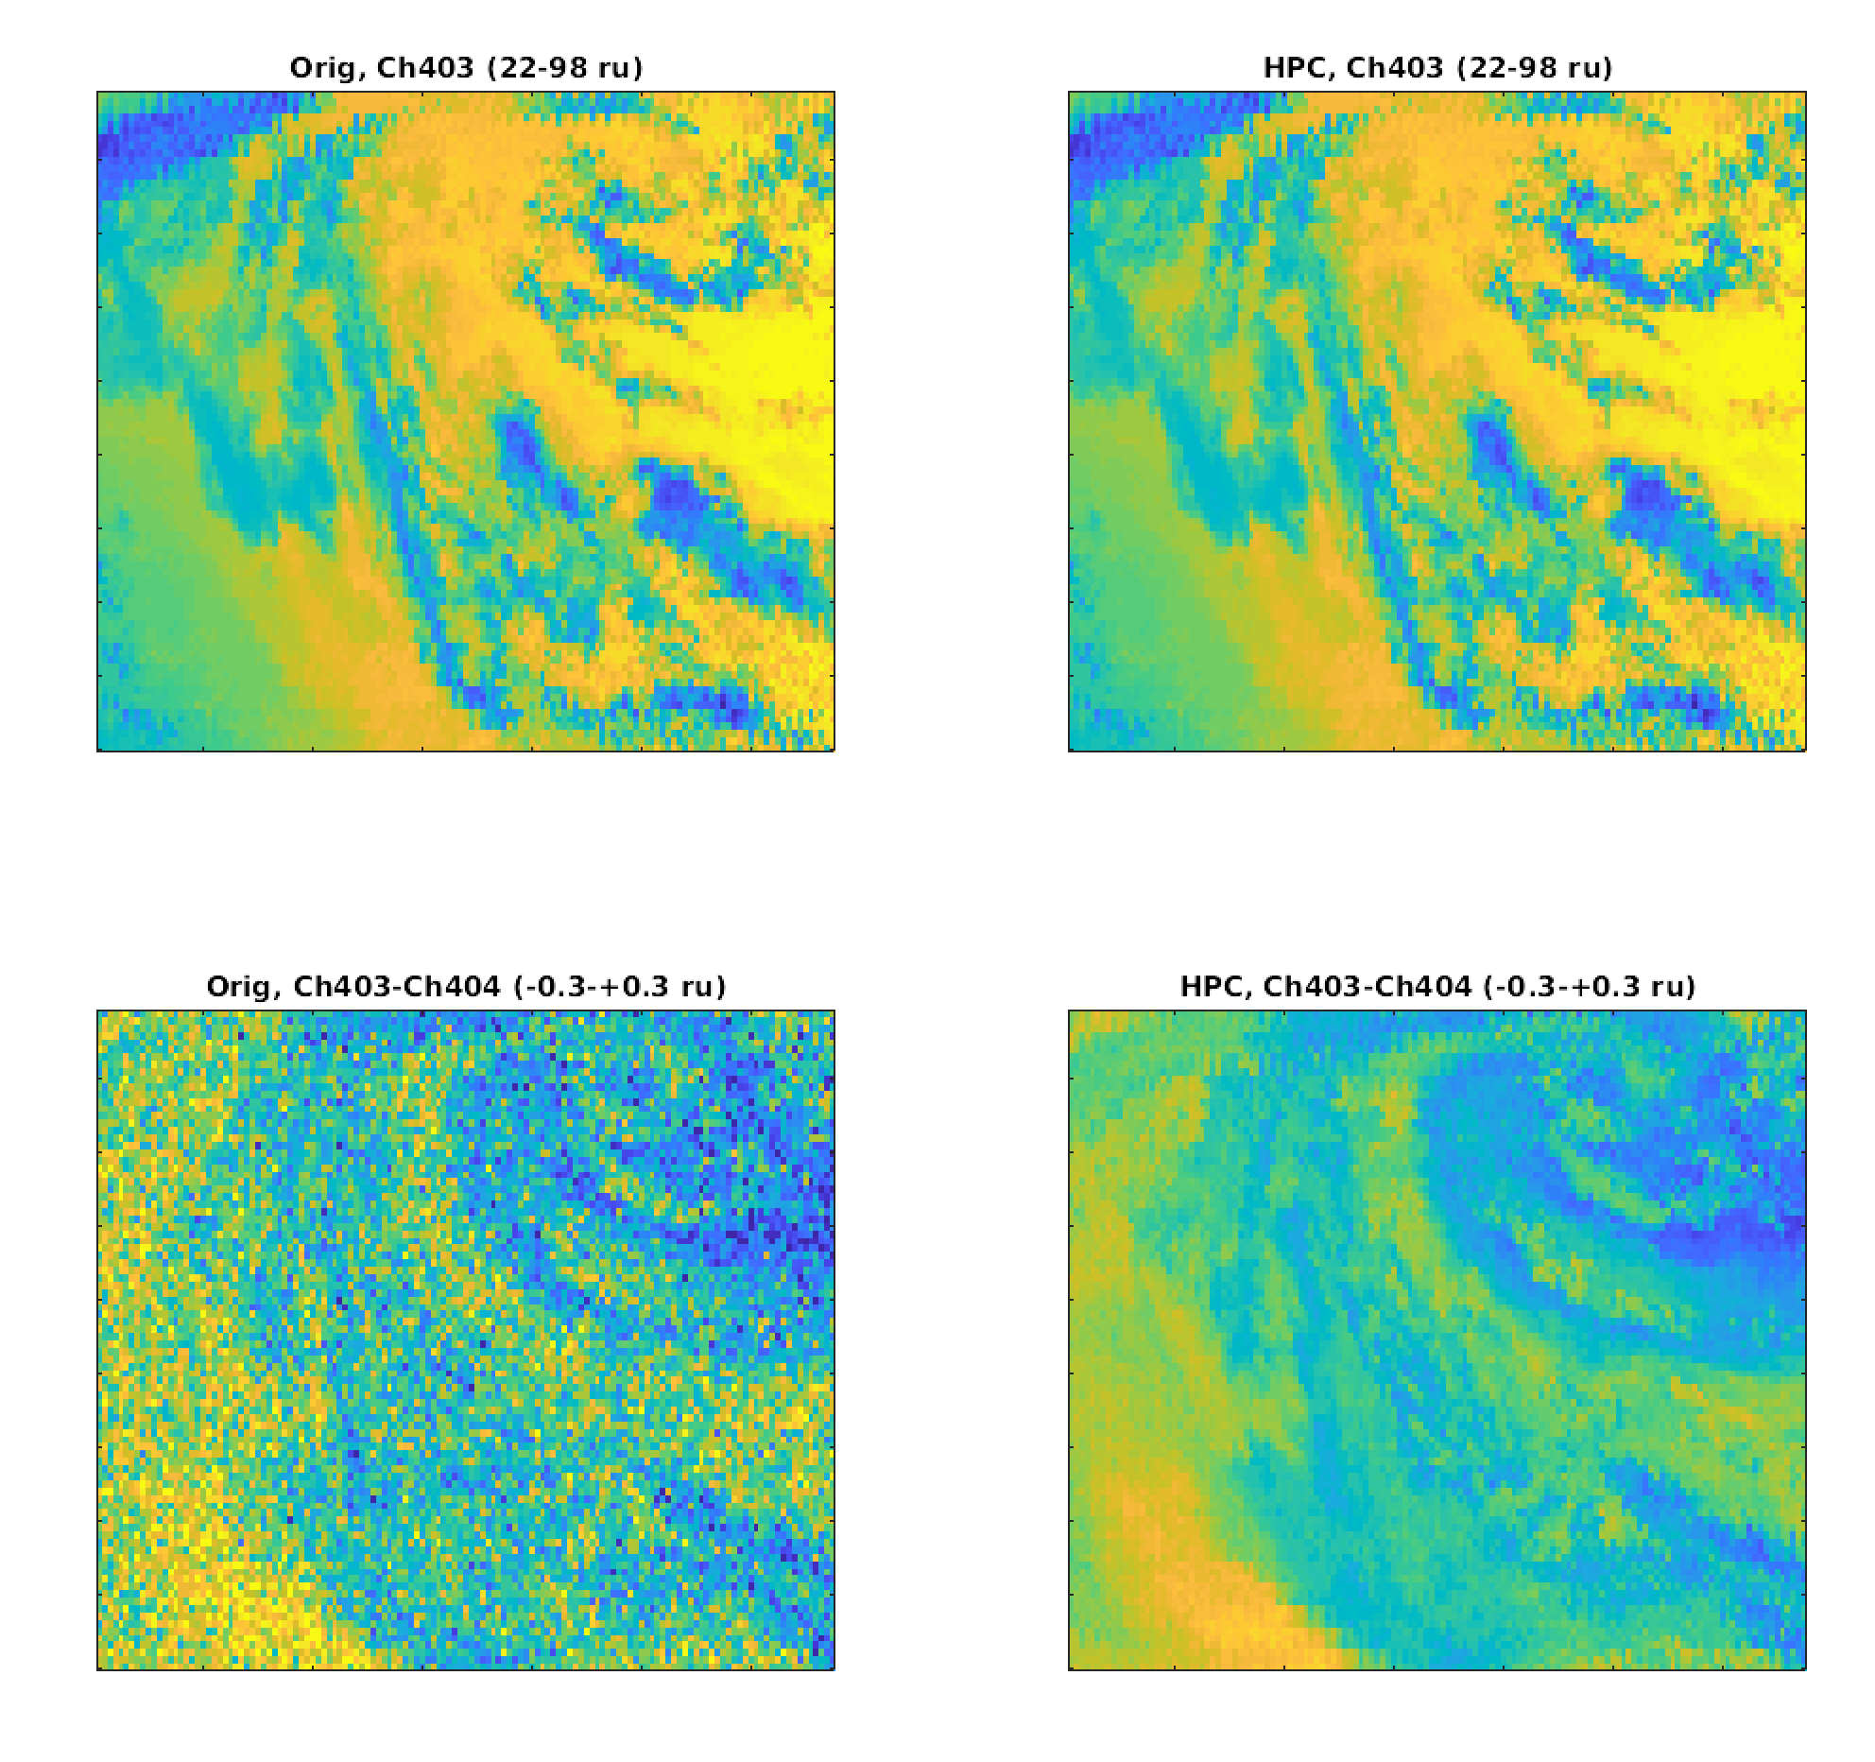
Data Compression and Random Noise Filtering
Original Radiances
PC Representation
  Example 40 scan line file
  Image of 900 cm⁻¹ radiances:
  Color scale is 20 to 100 mW/(m²sr. 1/cm)
~165Mb
~4Mb
  Channel difference image:
  900 cm⁻¹ minus 900.625 cm⁻¹:
  Color scale is -0.3 to 0.3 mW/(m²sr. 1/cm)

Slide 14
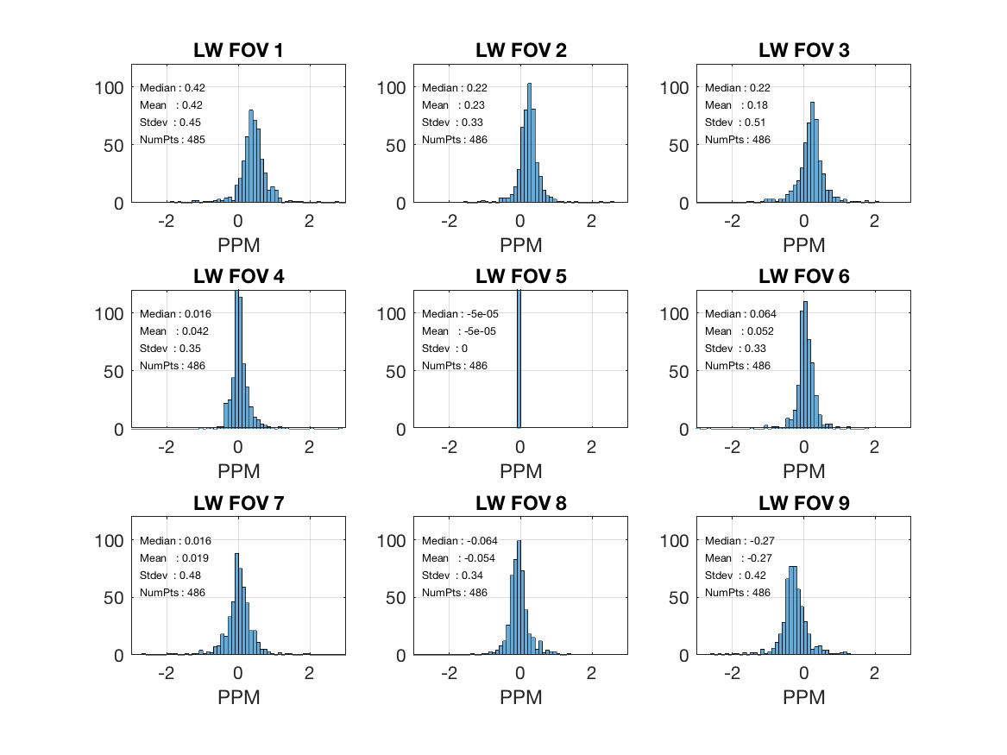
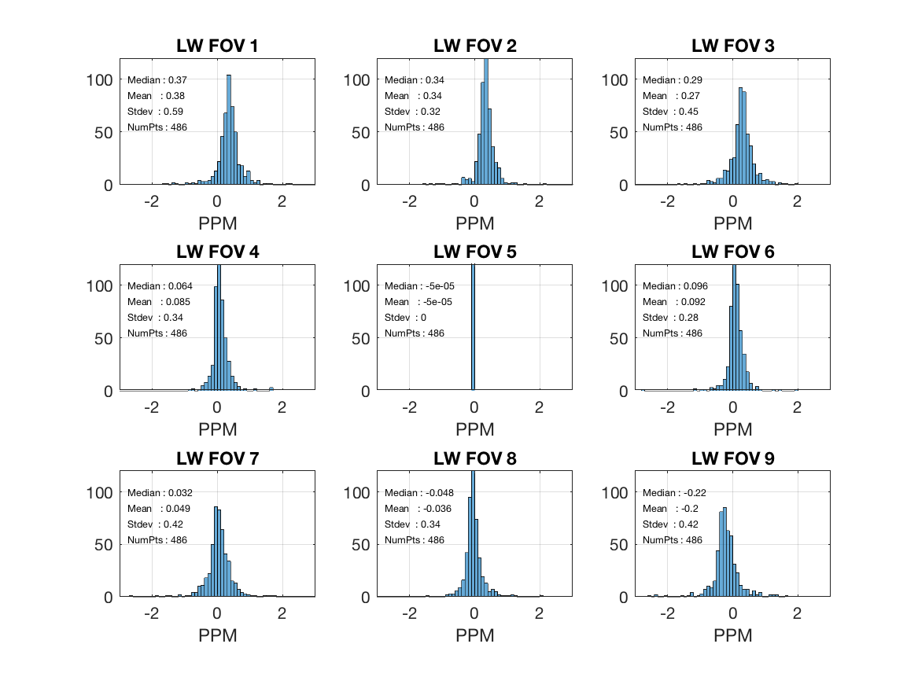
Example Assessment: Spectral Inter-FOV Analysis
Original Radiances
Reconstructed Radiances
Hybrid PCA representation of CrIS spectra, D. Tobin, EUMETSAT 2022

Slide 15
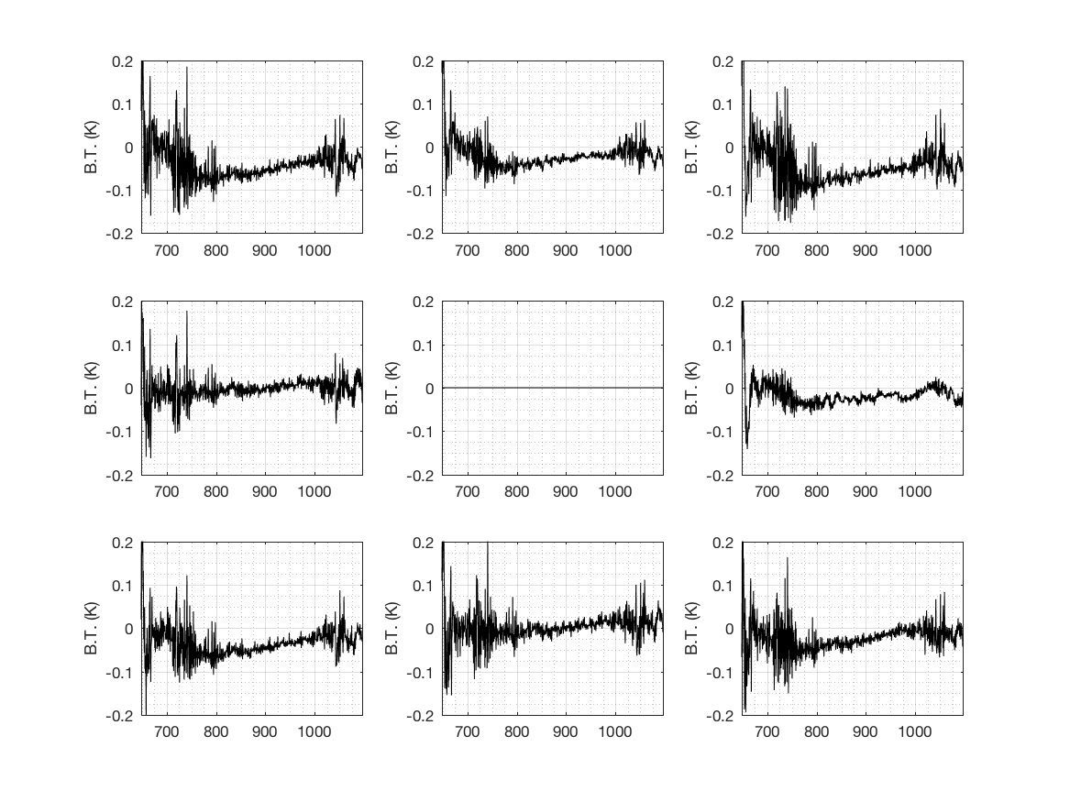
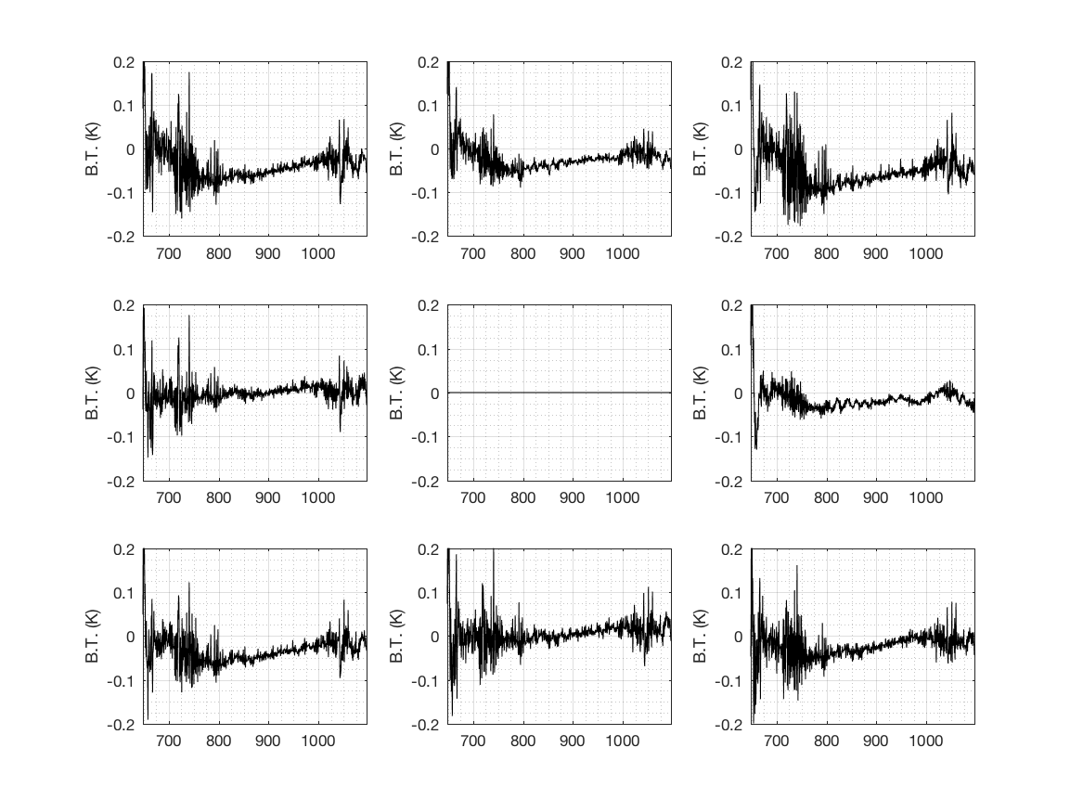
Example Assessment: Radiometric Inter-FOV Analysis
Original Radiances
Reconstructed Radiances
FOV 1 FOV 2 FOV 3
FOV 1 FOV 2 FOV 3
FOV 4 FOV 5 FOV 6
FOV 4 FOV 5 FOV 6
FOV 7 FOV 8 FOV 9
FOV 7 FOV 8 FOV 9
wavenumber
wavenumber
wavenumber
wavenumber
wavenumber
wavenumber
Hybrid PCA representation of CrIS spectra, D. Tobin, EUMETSAT 2022

Slide 16
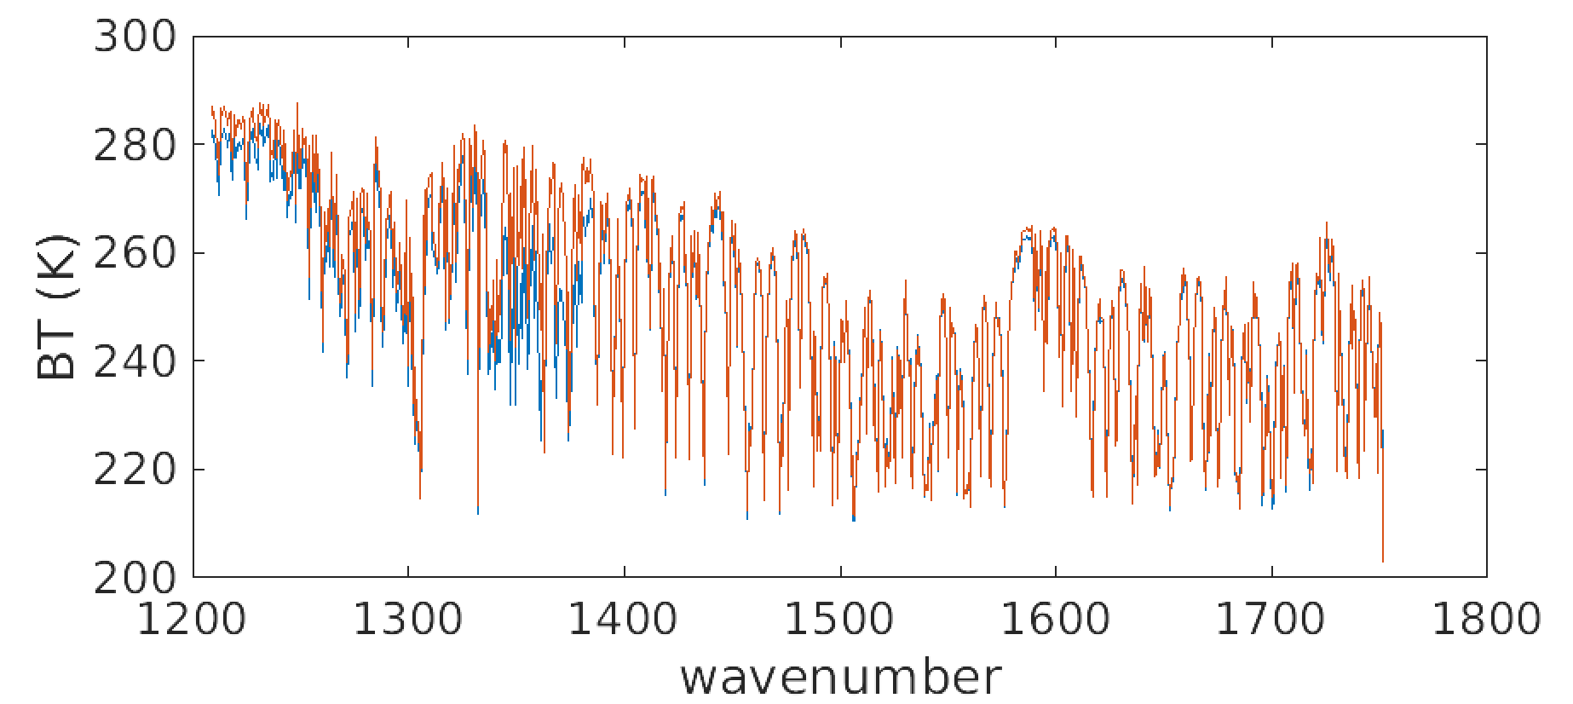
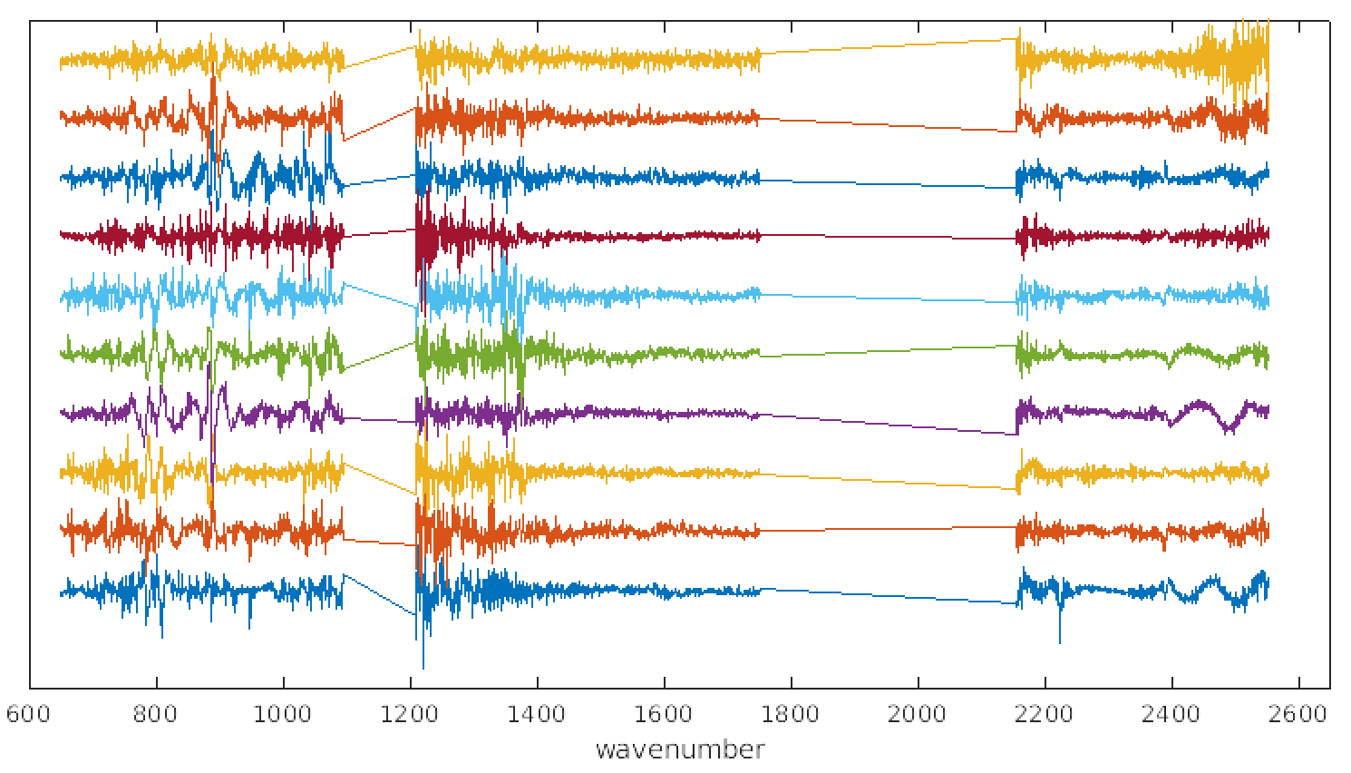
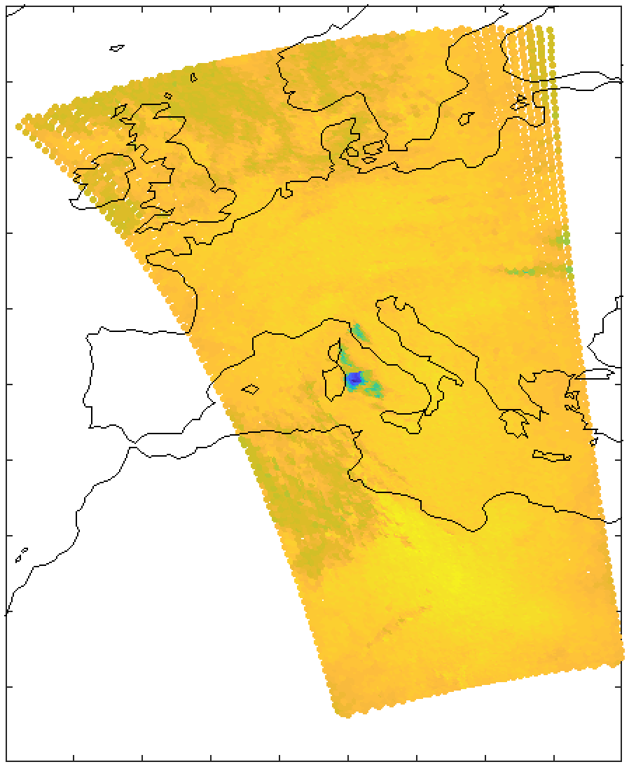
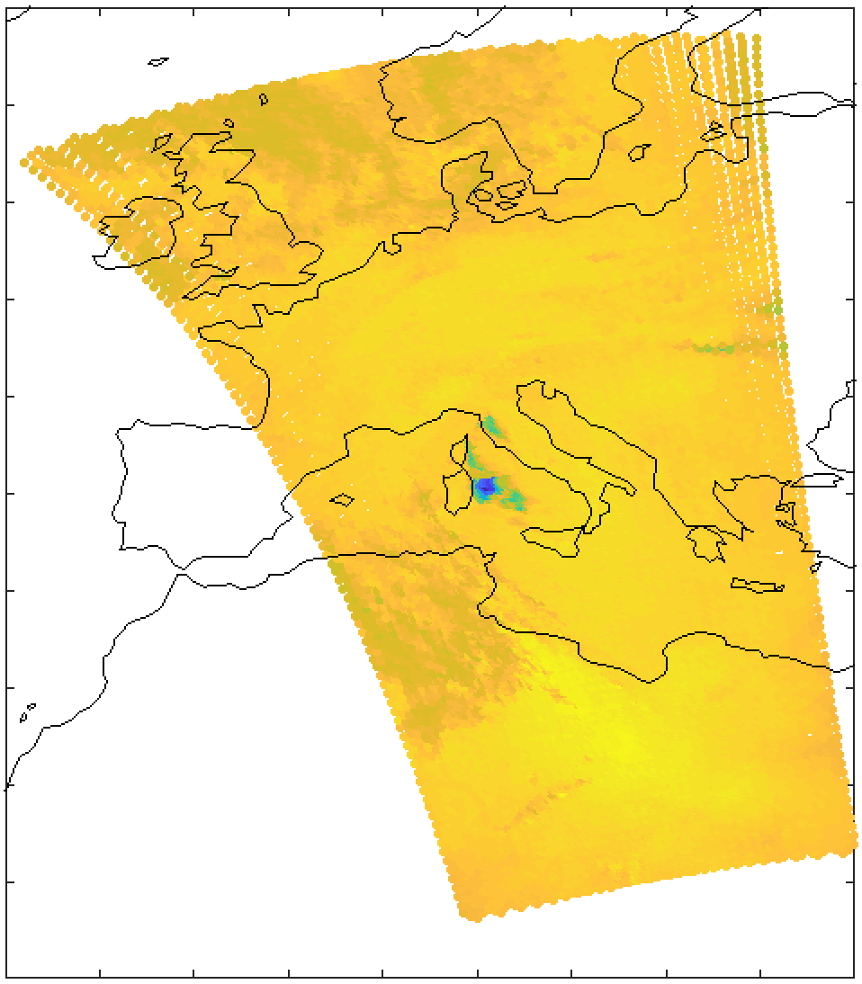
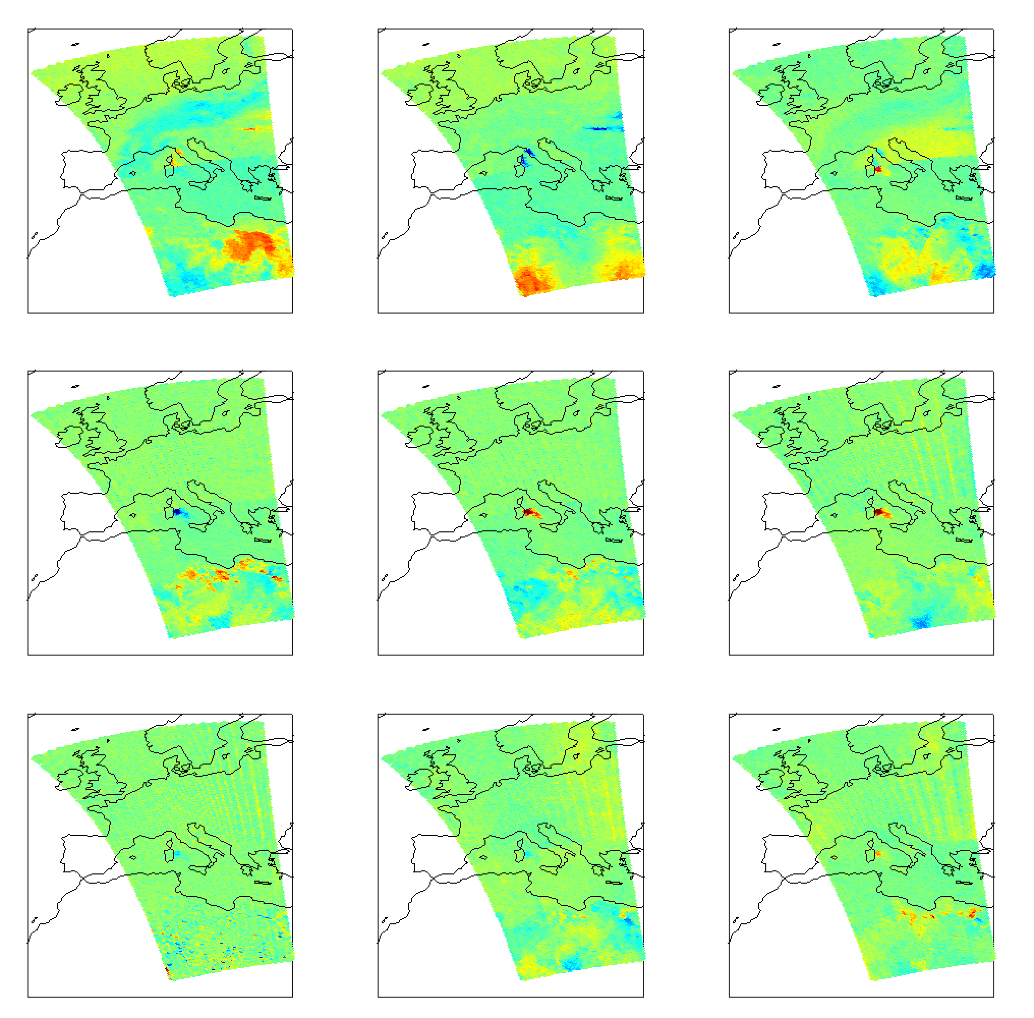
Example Assessment: Mt. Etna SO₂ plume on 23 Feb 2021
Plume
Near plume
Local PCs and Local PC scores
10
9
8
7
6
5
4
3
2
1
ΔBT(K), 1345.625 cm⁻¹ minus 1335 cm⁻¹
1 2 3
4 5 6
7 8 9
Original Radiances
Reconstructed Radiances
colorscale is -4 to +0.5 K
Hybrid PCA representation of CrIS spectra, D. Tobin, EUMETSAT 2022

Slide 17
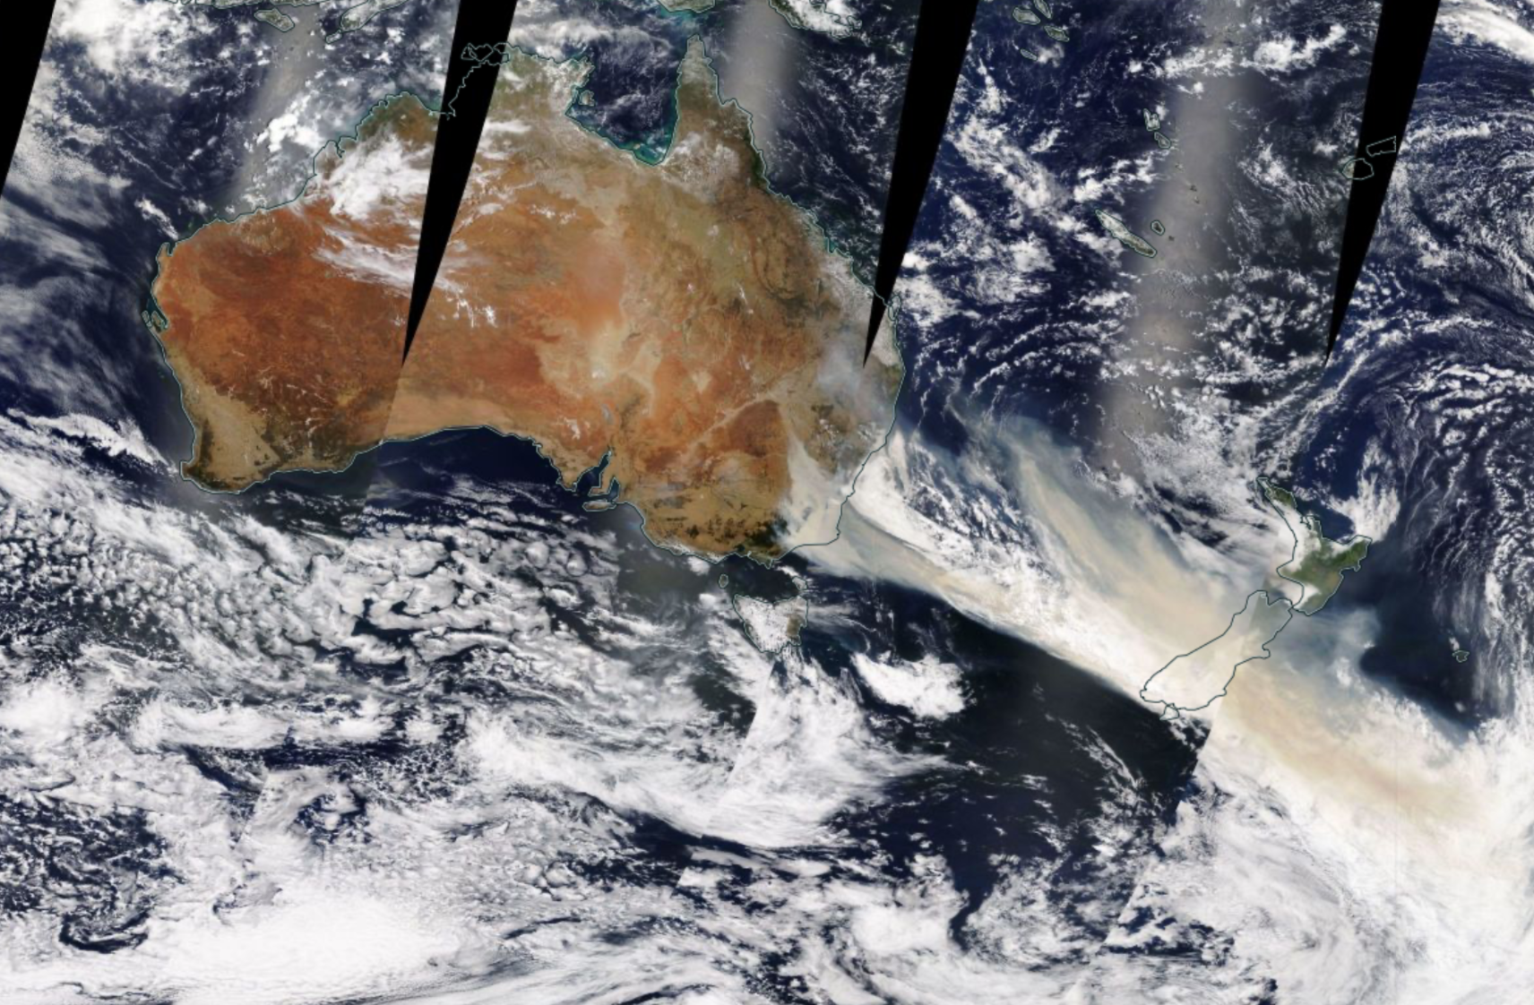
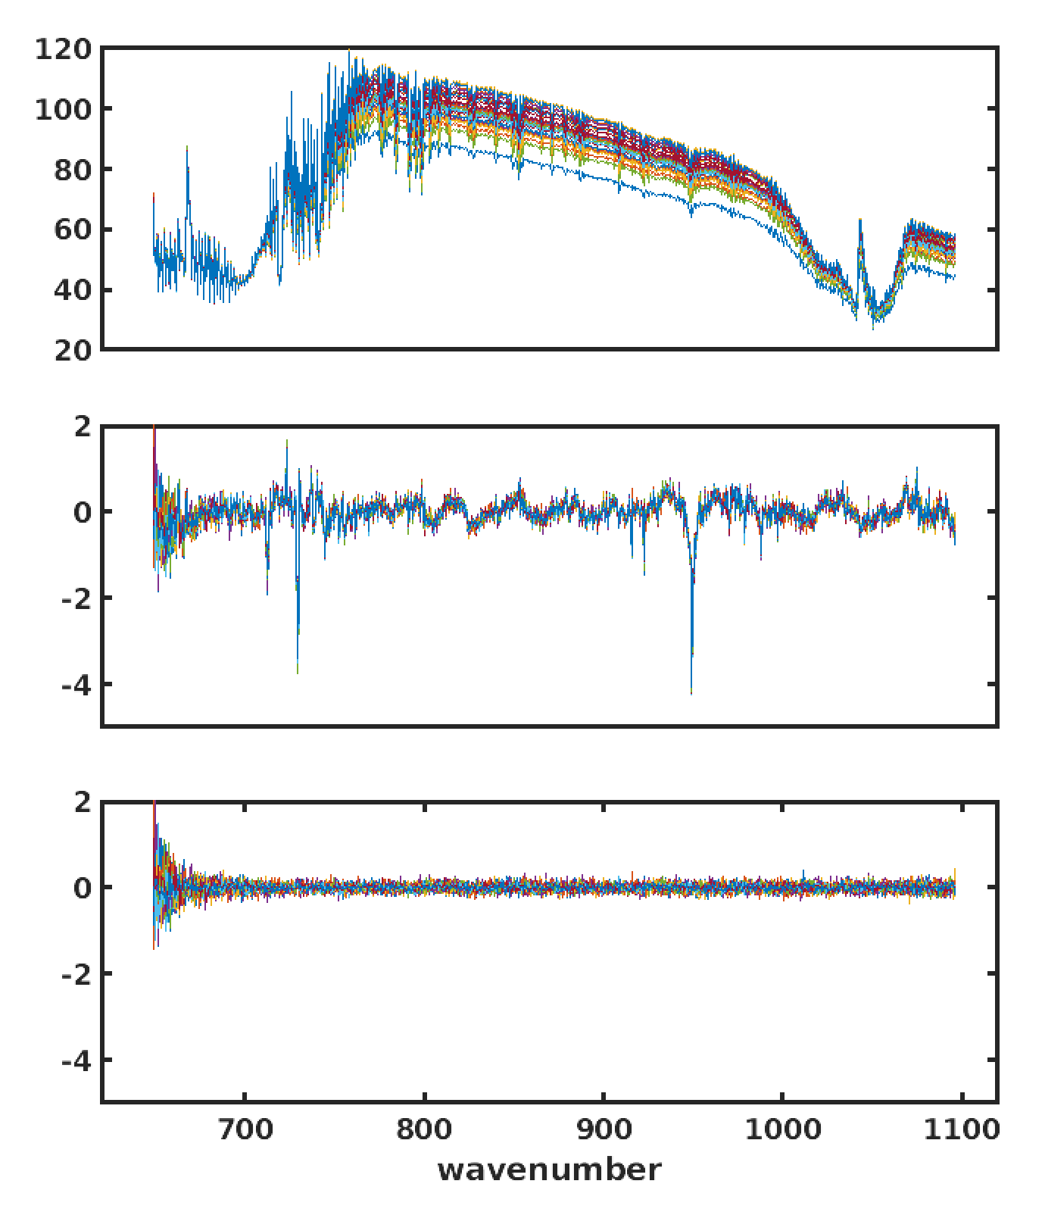
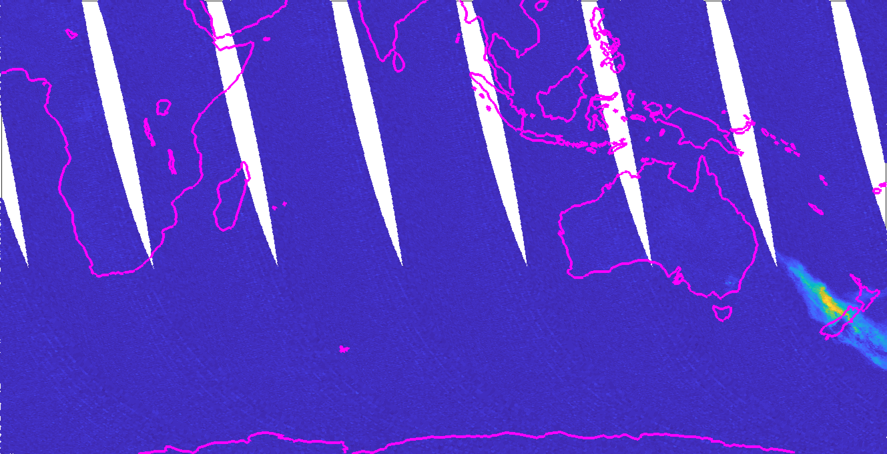
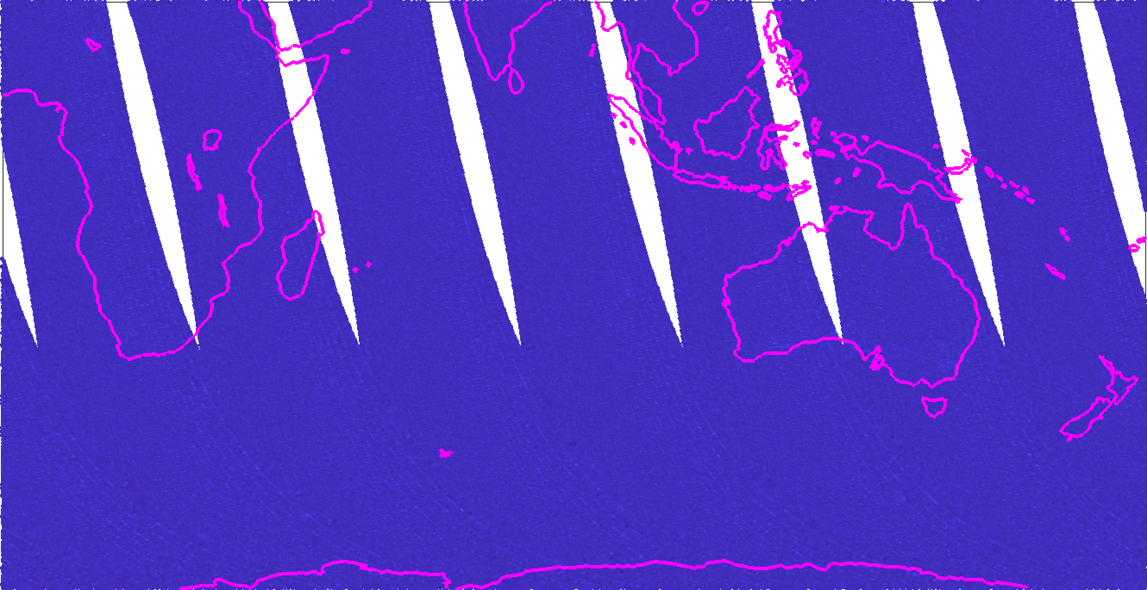
Example Assessment: C₂H₂ from Australian wild fires 1 Jan 2020
Example Fire plume spectra
Radiance Reconstruction RMS over 728 to 732 cm⁻¹
Global PC reconstruction residuals:
Global PC
mW/(m² sr. cm⁻¹)
HCN
Ethyne, C₂H₂
Ethene, C₂H₄
Hybrid PC reconstruction residuals:
Hybrid PC
Following Sarah Pipien et al. “Principal component analysis of IASI measurements for the analysis of performances of L0 & L1 processing”

Slide 18
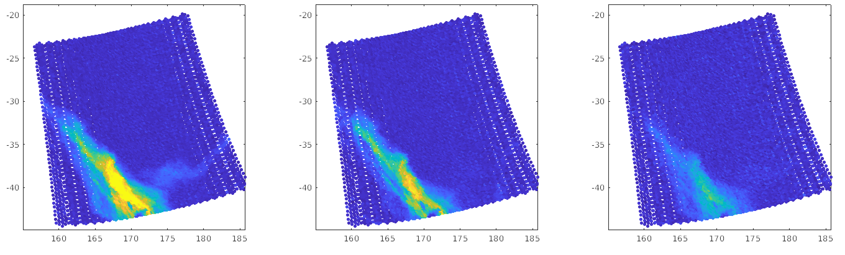
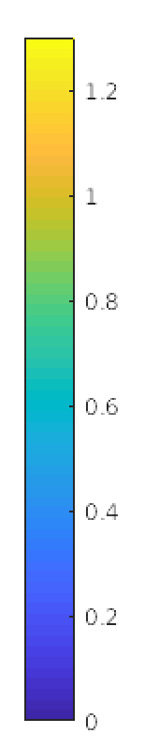
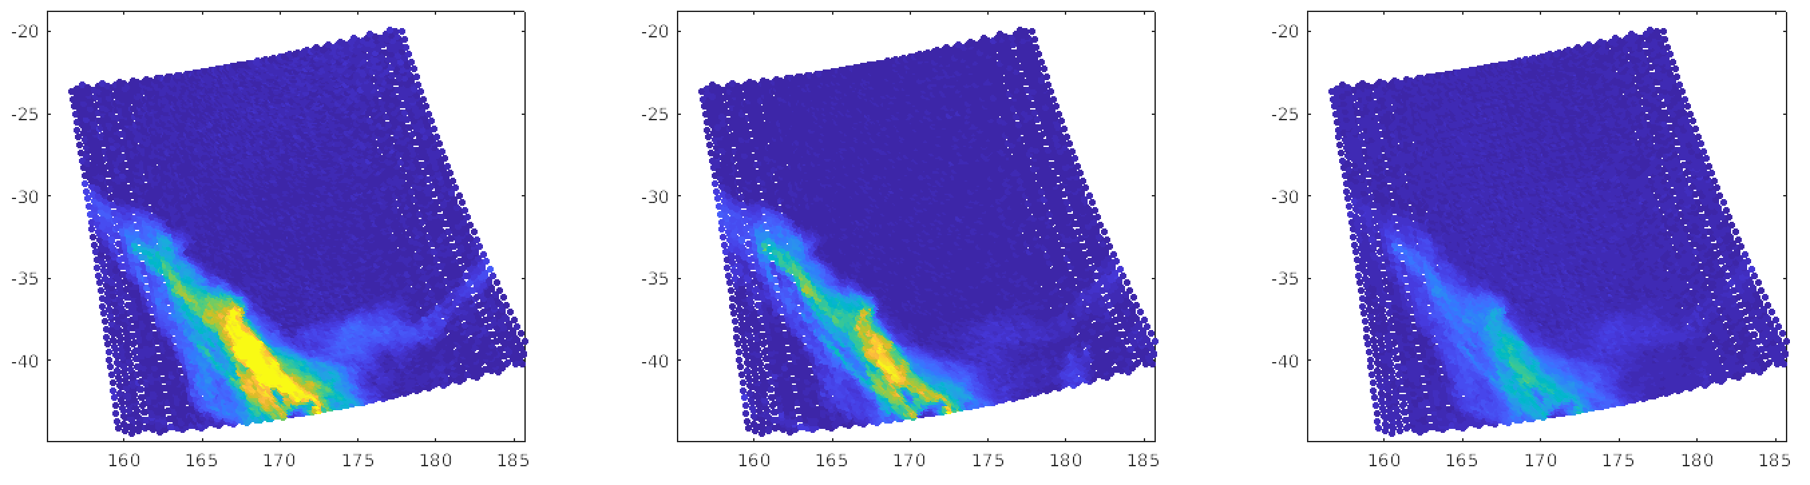
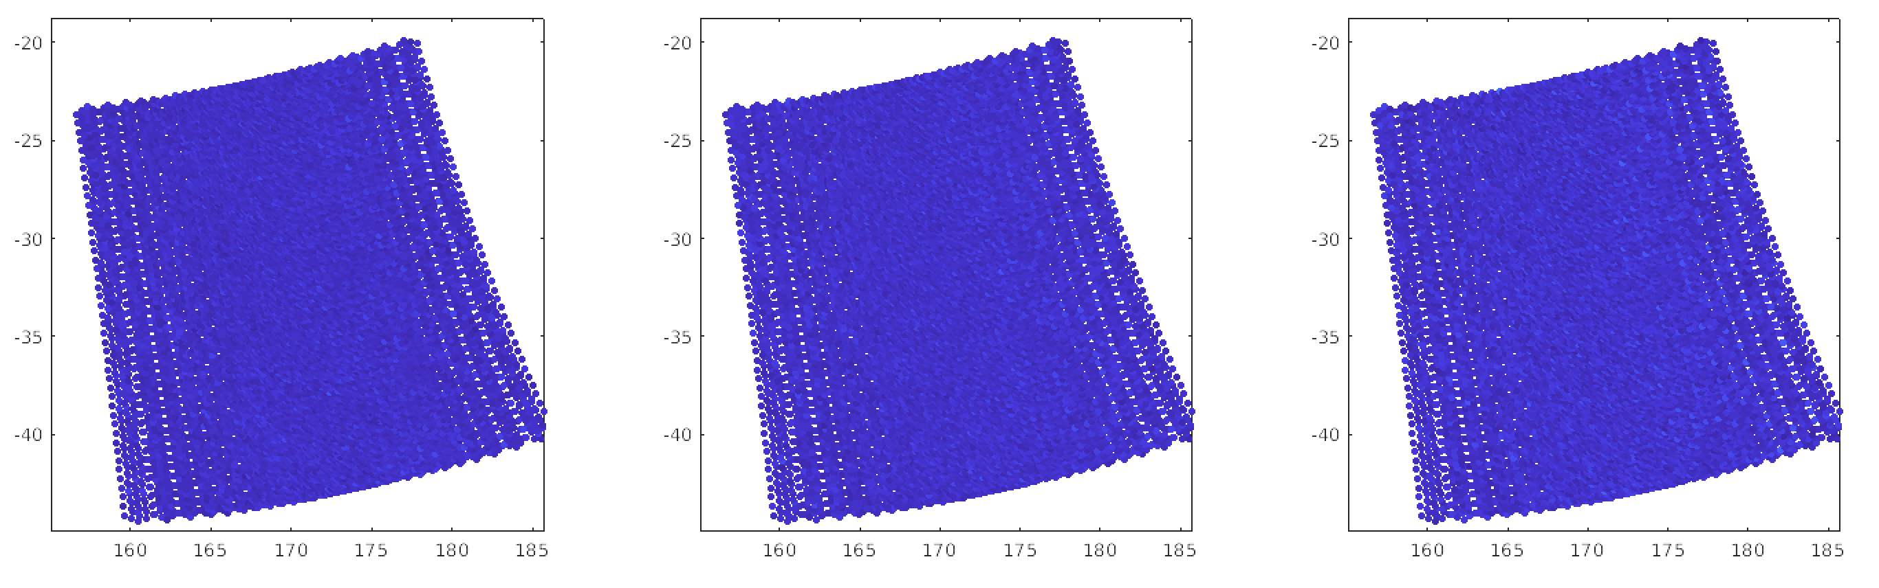
Example Assessment: Australian wild fires 1 Jan 2020 cont.
Radiance Reconstruction RMS
C₂H₂ C₂H₄ HCN
728-732 1/cm 948-952 1/cm 711-714 1/cm
Original - Global
Global - Hybrid
mW/(m² sr. cm⁻¹)
Original - Hybrid

Slide 19
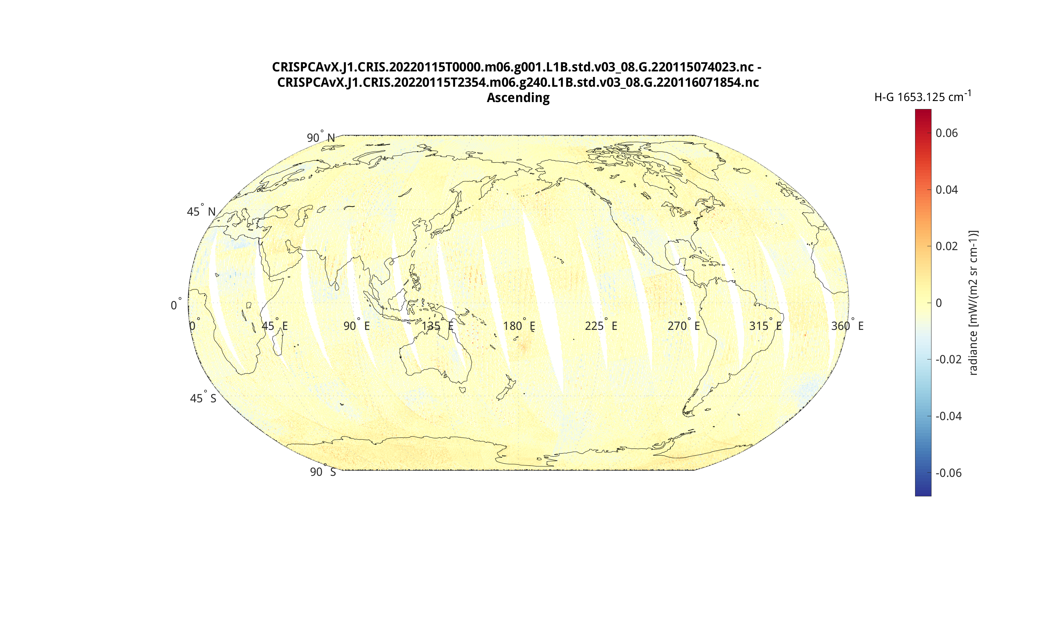
Hunga Tonga, Local contribution @ 1653.125 cm⁻¹
2022-01-15

Slide 20
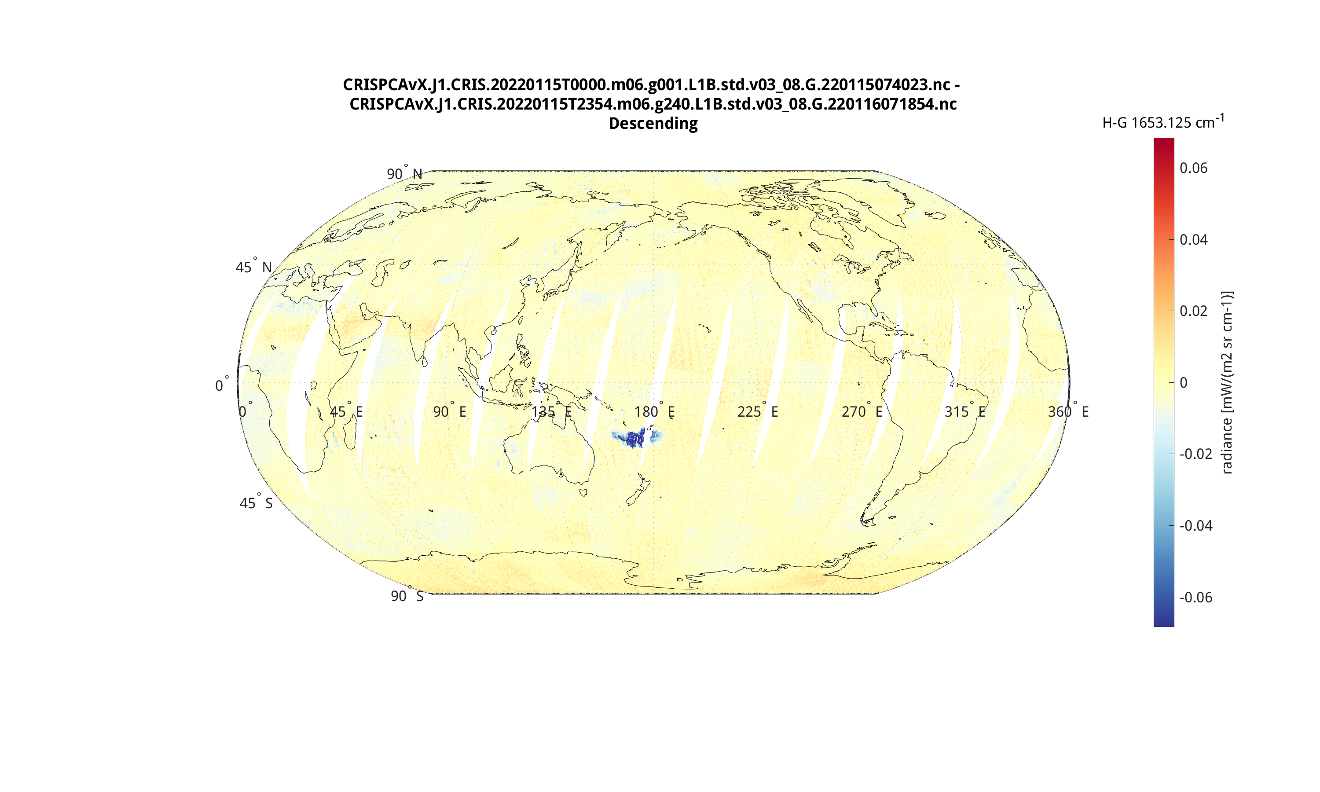
Hunga Tonga, Local contribution @ 1653.125 cm⁻¹
2022-01-15

Slide 21
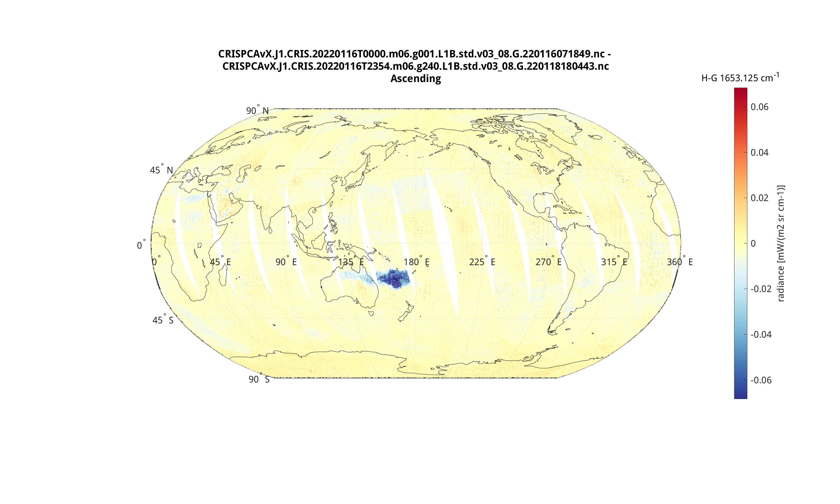
Hunga Tonga, Local contribution @ 1653.125 cm⁻¹
2022-01-16

Slide 22
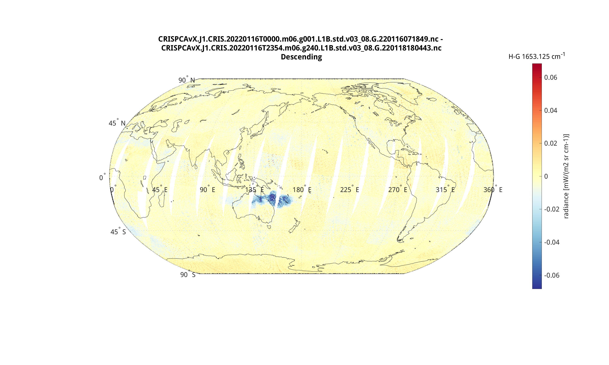
Hunga Tonga, Local contribution @ 1653.125 cm⁻¹
2022-01-16

Slide 23
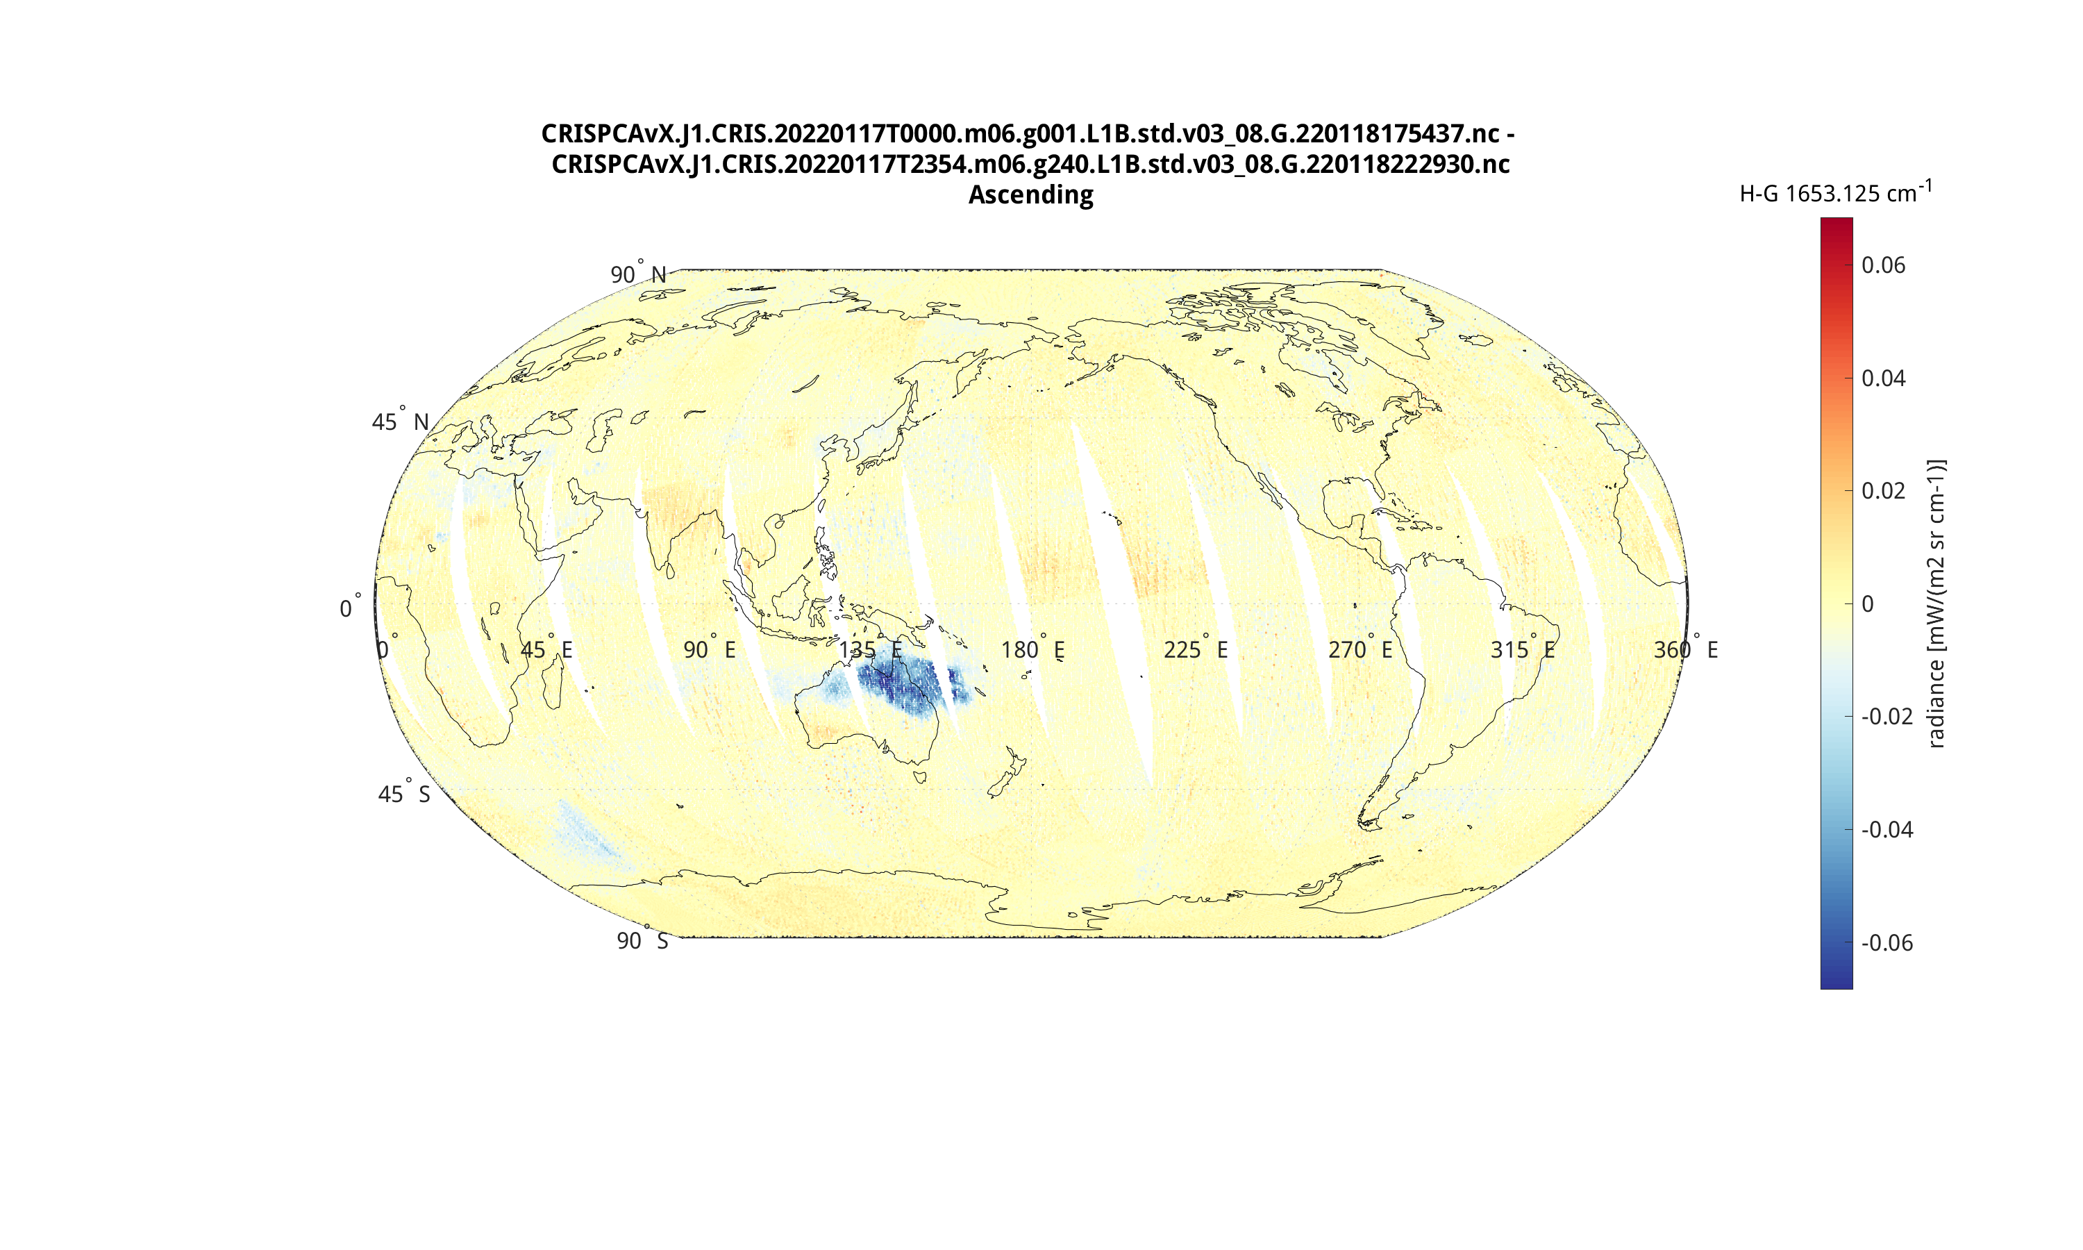
Hunga Tonga, Local contribution @ 1653.125 cm⁻¹
2022-01-17

Slide 24
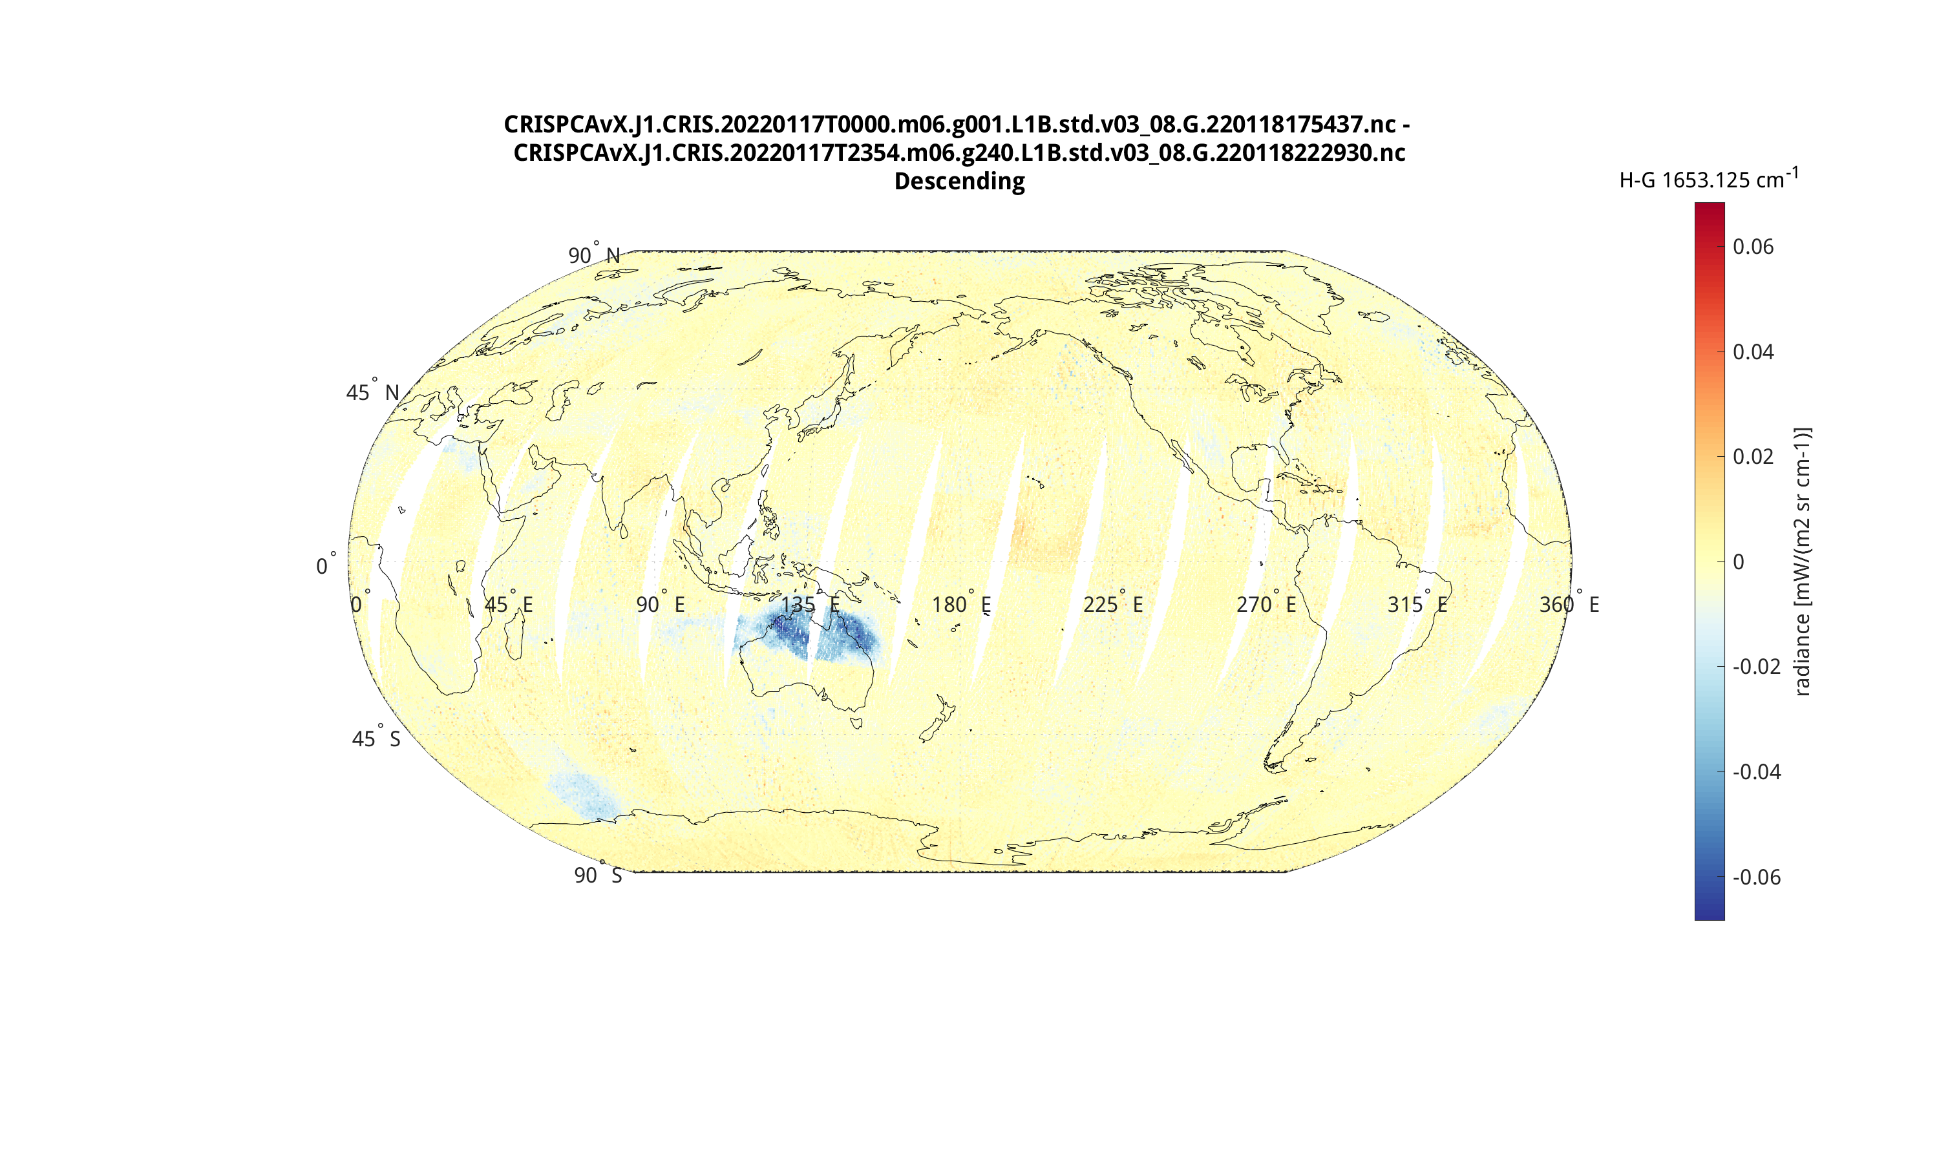
Hunga Tonga, Local contribution @ 1653.125 cm⁻¹
2022-01-17

Slide 25
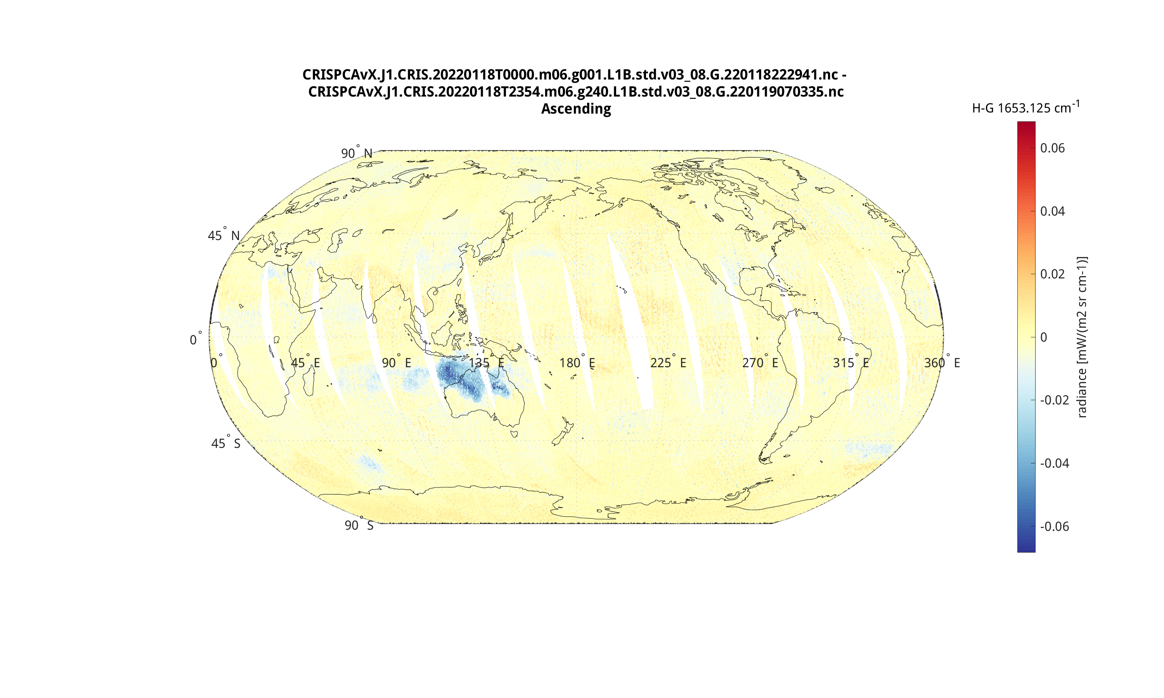
Hunga Tonga, Local contribution @ 1653.125 cm⁻¹
2022-01-18

Slide 26
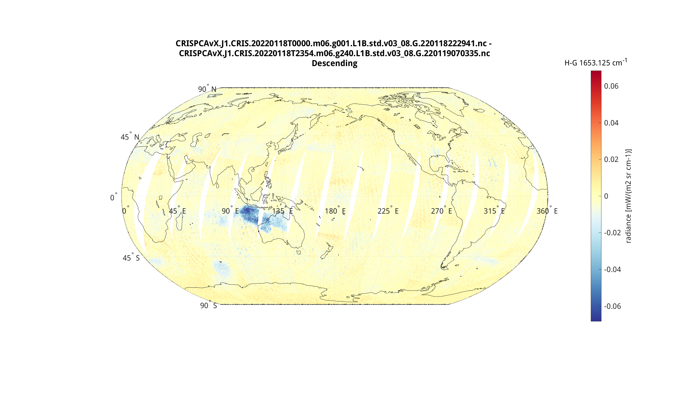
Hunga Tonga, Local contribution @ 1653.125 cm⁻¹
2022-01-18

Slide 27
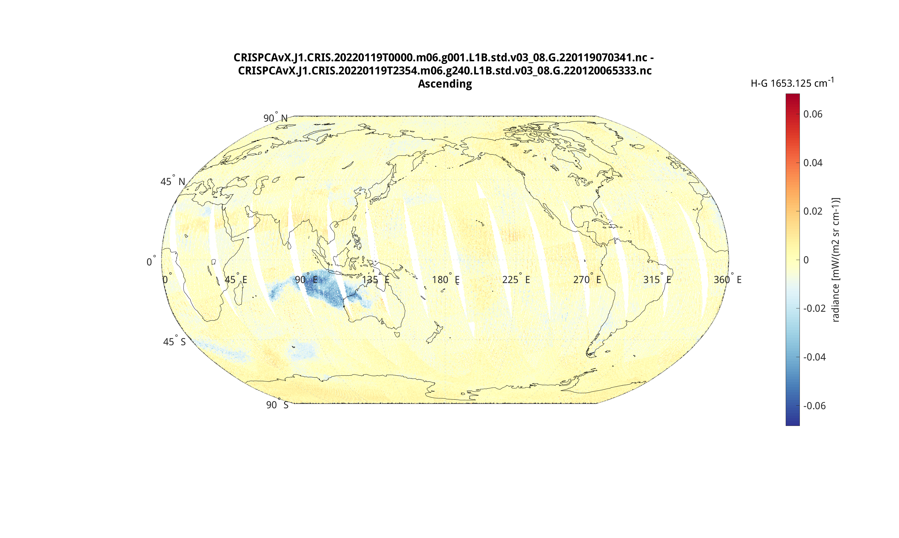
Hunga Tonga, Local contribution @ 1653.125 cm⁻¹
2022-01-19

Slide 28
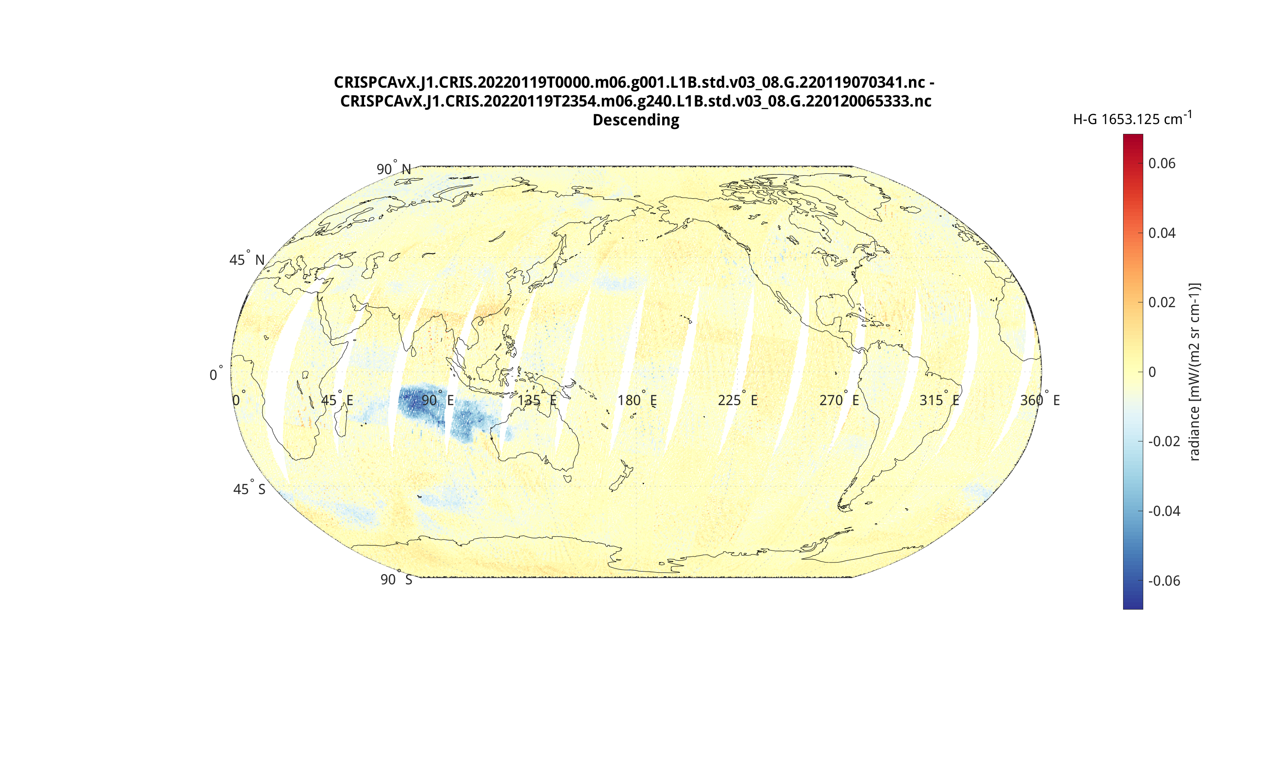
Hunga Tonga, Local contribution @ 1653.125 cm⁻¹
2022-01-19

Slide 29
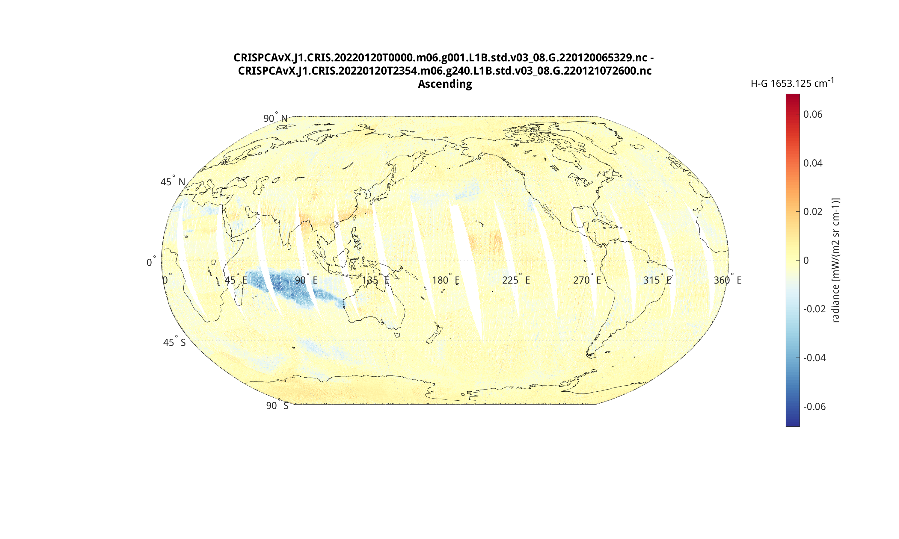
Hunga Tonga, Local contribution @ 1653.125 cm⁻¹
2022-01-20

Slide 30
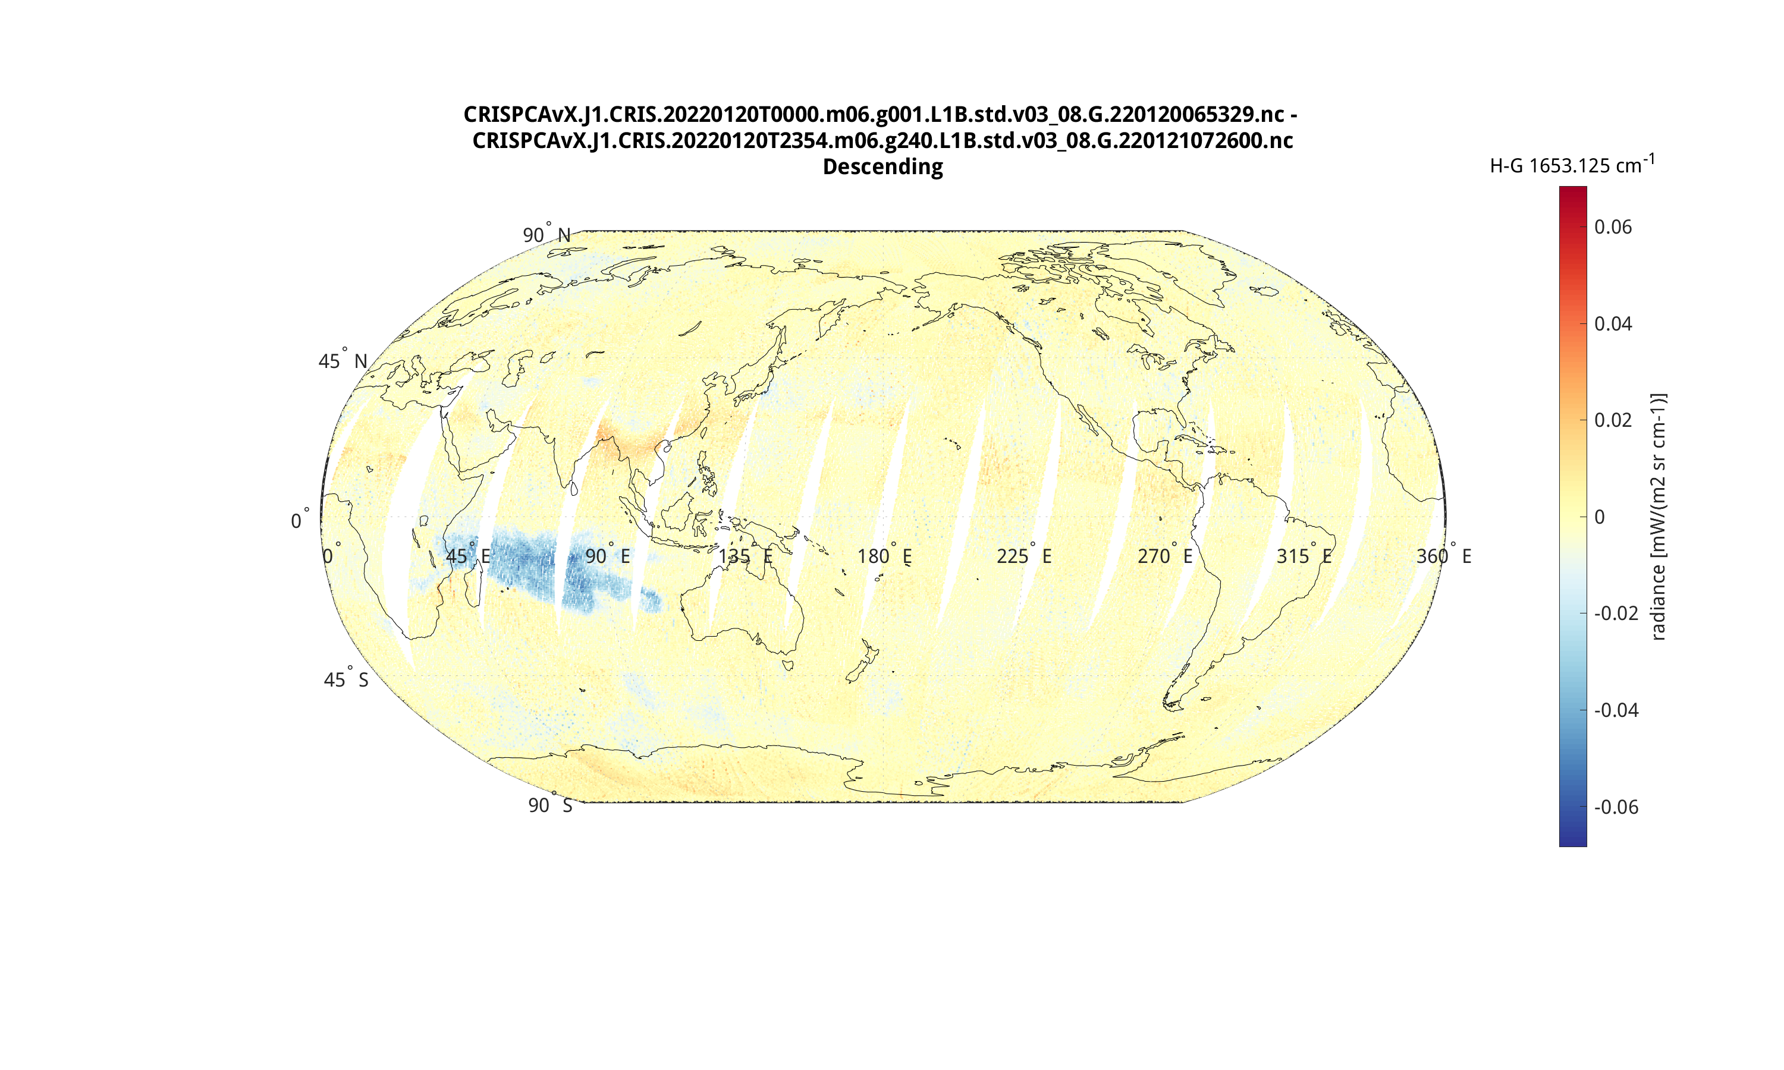
Hunga Tonga, Local contribution @ 1653.125 cm⁻¹
2022-01-20

Slide 31
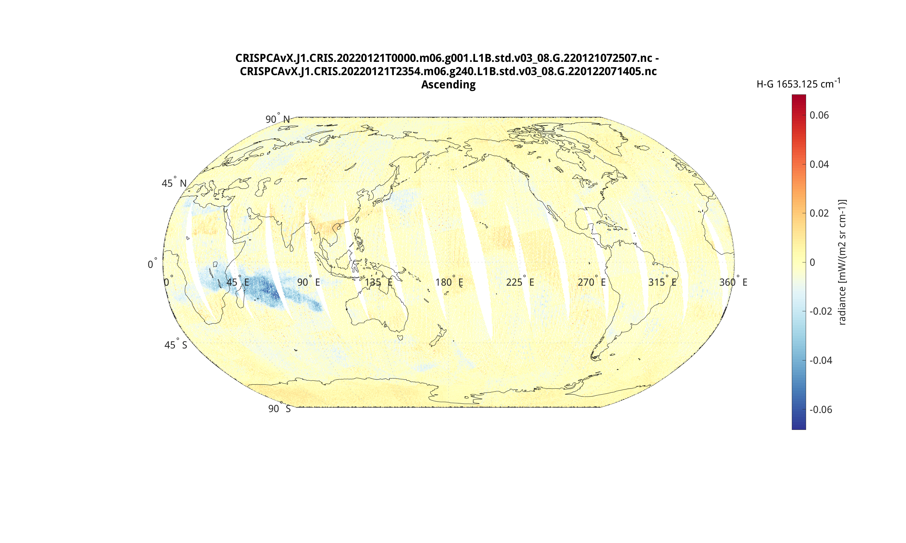
Hunga Tonga, Local contribution @ 1653.125 cm⁻¹
2022-01-21

Slide 32
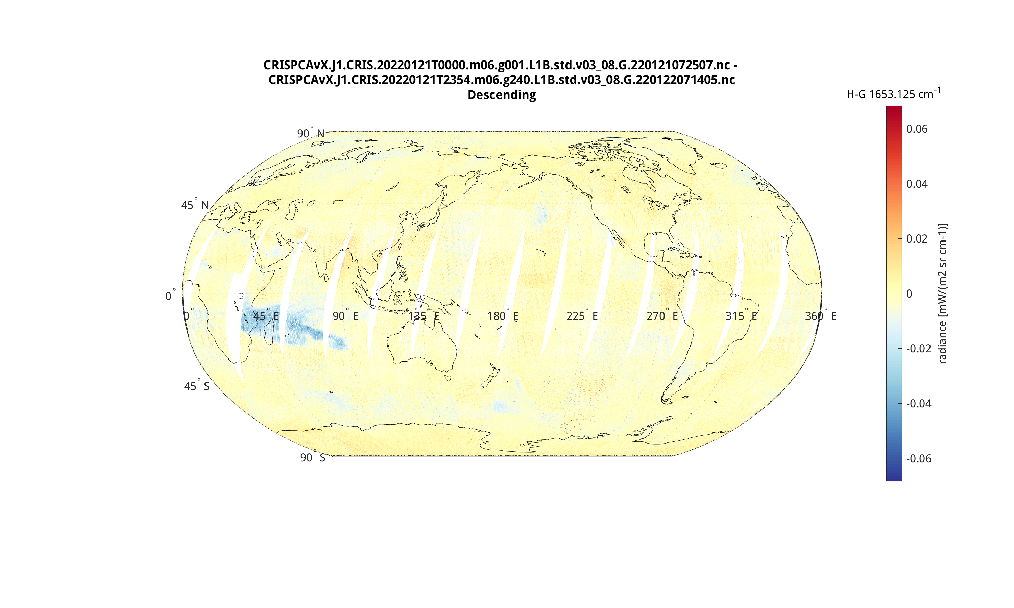
Hunga Tonga, Local contribution @ 1653.125 cm⁻¹
2022-01-21

Slide 33
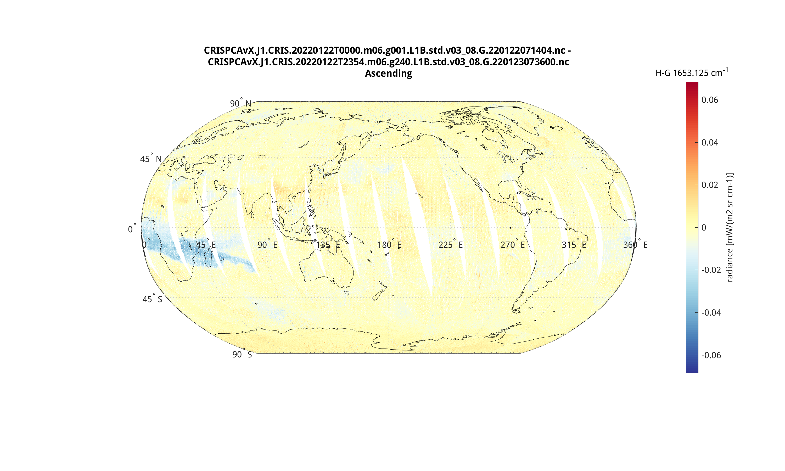
Hunga Tonga, Local contribution @ 1653.125 cm⁻¹
2022-01-22

Slide 34
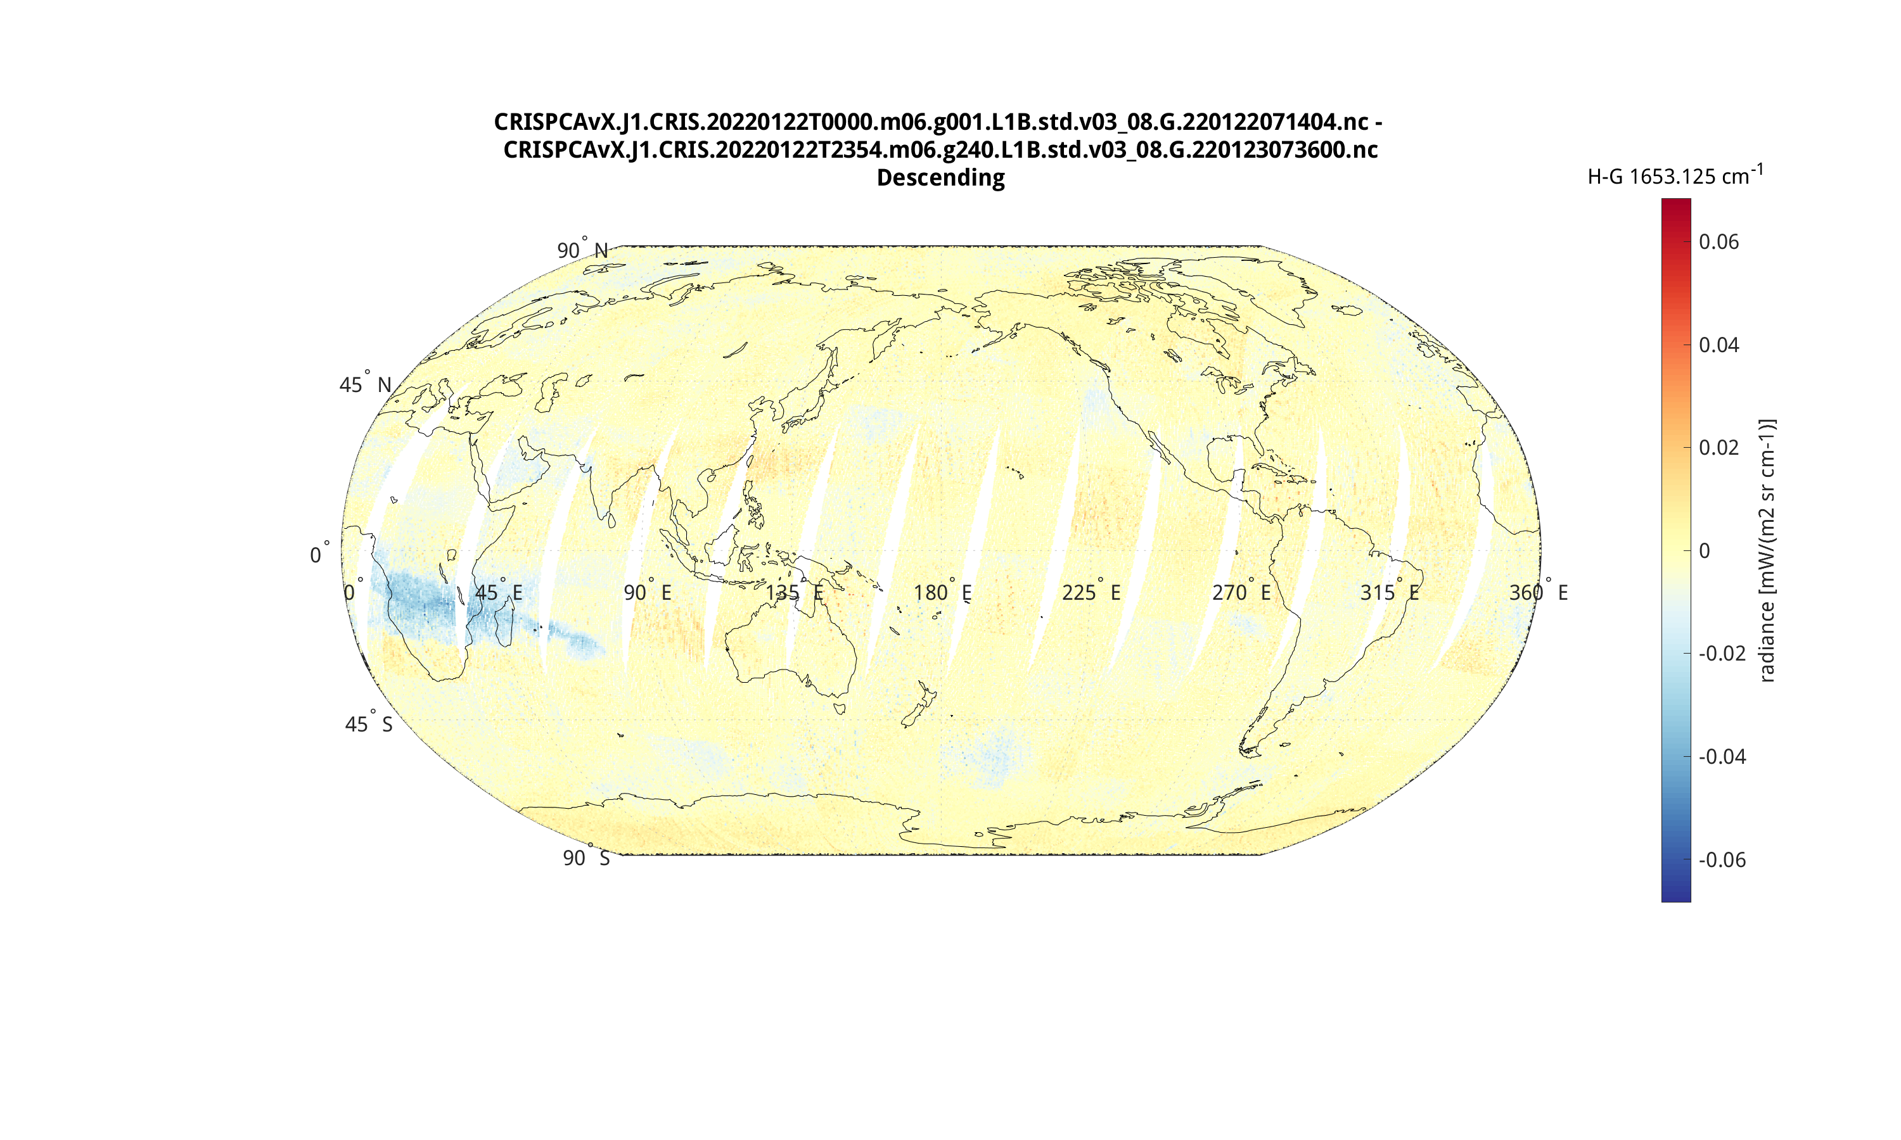
Hunga Tonga, Local contribution @ 1653.125 cm⁻¹
2022-01-22

Slide 35
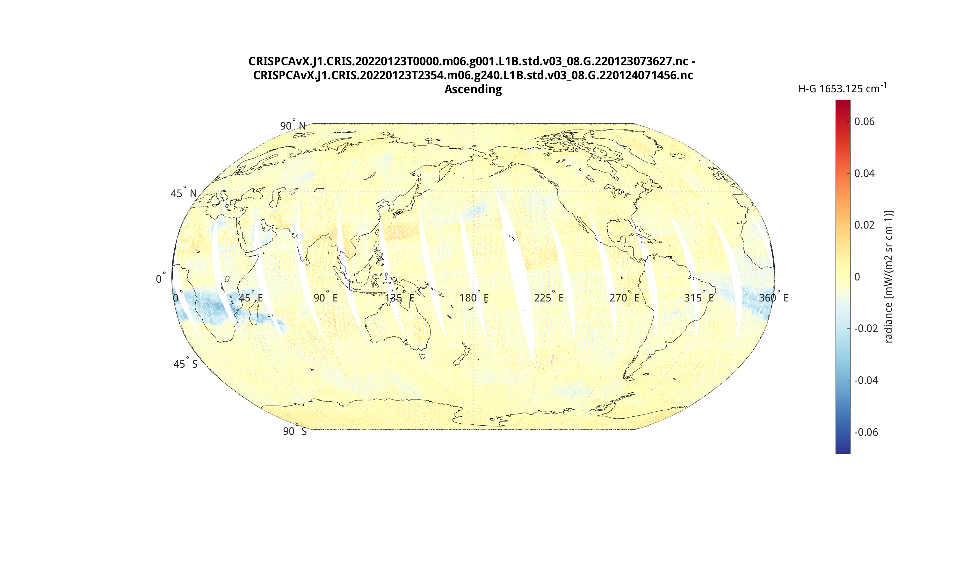
Hunga Tonga, Local contribution @ 1653.125 cm⁻¹
2022-01-23

Slide 36
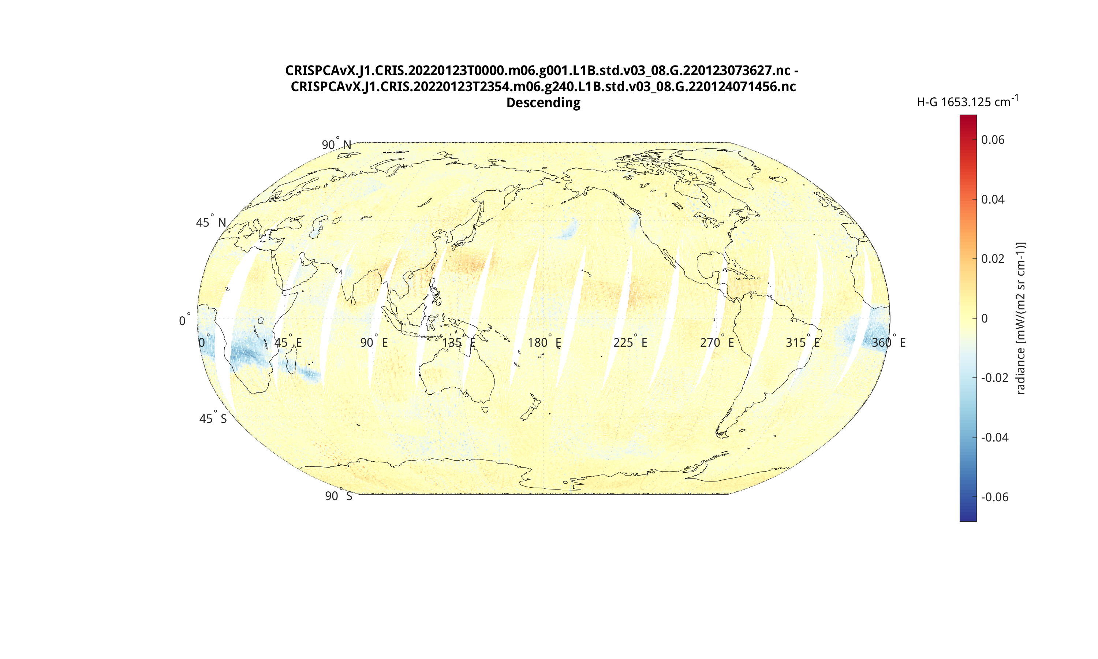
Hunga Tonga, Local contribution @ 1653.125 cm⁻¹
2022-01-23

Slide 37
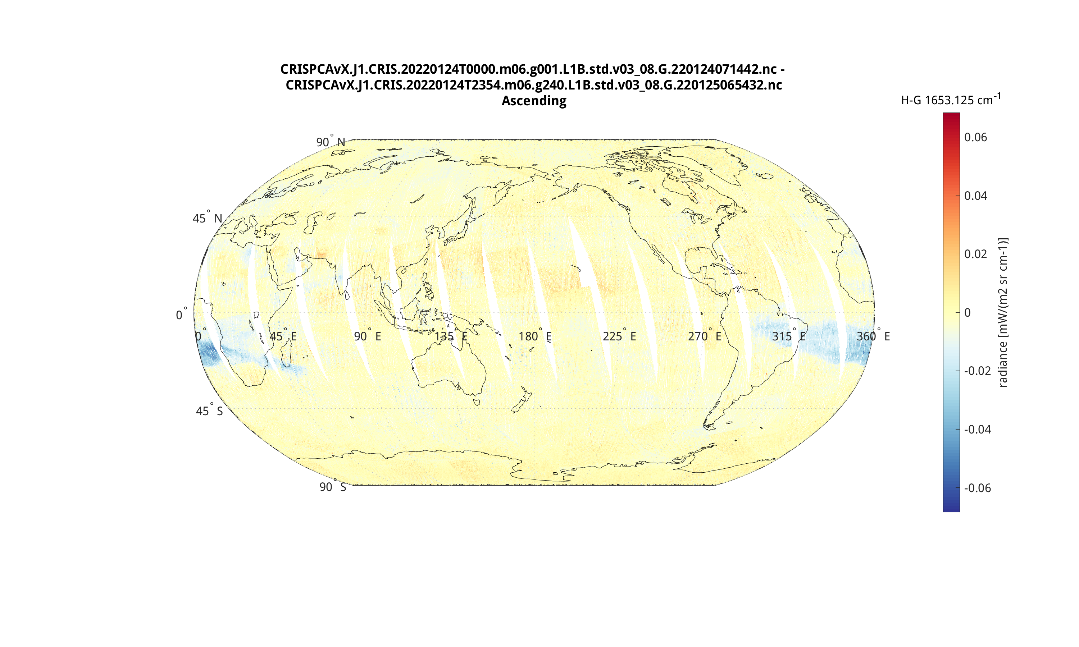
Hunga Tonga, Local contribution @ 1653.125 cm⁻¹
2022-01-24

Slide 38
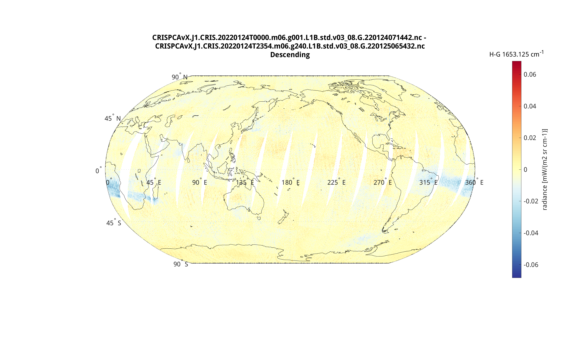
Hunga Tonga, Local contribution @ 1653.125 cm⁻¹
2022-01-24

Slide 39
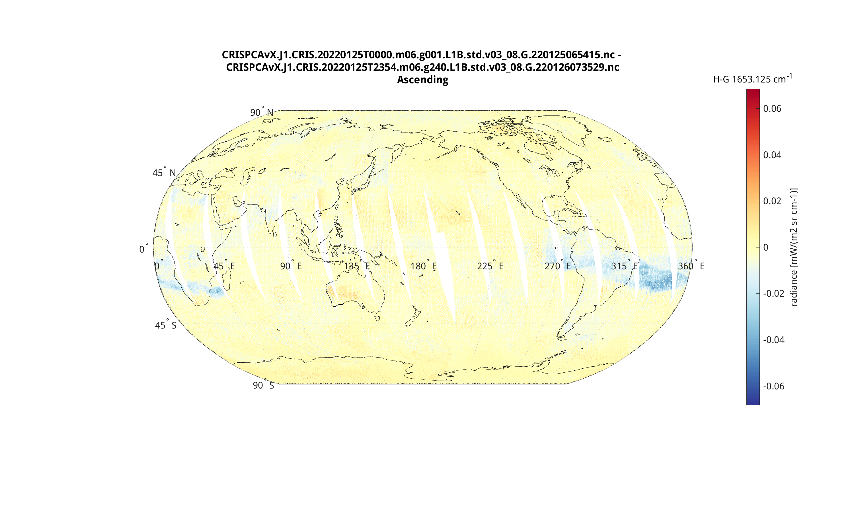
Hunga Tonga, Local contribution @ 1653.125 cm⁻¹
2022-01-25

Slide 40

Hunga Tonga, Local contribution @ 1653.125 cm⁻¹
2022-01-25

Slide 41
Next Steps
(TBR) Implement as a prototype L1B project product, and create Worldview display for Rare Event Detection (RED)
  Define product files, Documentation, provide software utilities, facilitate test users
Continue to assess the PC product quality
  A more comprehensive assessment using more data
  Including reconstructed radiances, quality variables, and compression
  Inputs from other groups (retrievals, NWP)
(TBR) Implement CrIS HPC software within the Community Community Satellite Processing Package (CSPP)
  Define product files, Documentation, provide software utilities, facilitate test users
NASA Sounder Discipline Team telecon, D. Tobin, 25 Jan 2023

Slide 42
References
Huang et al., 2001. Application of Principal Component Analysis to High-Resolution Infrared Measurement Compression and Retrieval. Journal of Applied Meteorology. 40. 365-388. 10.1175/1520-0450(2001)040<0365:AOPCAT>2.0.CO;2.
Antonelli et al., 2004, A principal component noise filter for high spectral resolution infrared measurements. Journal of Geophysical Research. 109. 10.1029/2004JD004862.
Turner et al., 2006. Noise Reduction of Atmospheric Emitted Radiance Interferometer (AERI) Observations Using Principal Component Analysis, Journal of Atmospheric and Oceanic Technology, 23(9), 1223-1238.
Tobin et al., 2007. Hyperspectral data noise characterization using principal component analysis: application to the atmospheric infrared sounder, J. Appl. Rem. Sens. 1(1) 013515 doi: 10.1117/1.2757707
Zavyalov et al., 2011. Preflight assessment of the Cross-track Infrared Sounder (CrIS) performance. Proc. SPIE Eur. Atmos. Remote Sens.. 8176. 10.1117/12.897674.
Serio et al., 2015. Infrared atmospheric sounder interferometer radiometric noise assessment from spectral residuals. Appl Opt. 2015 Jul 1;54(19):5924-36. doi: 10.1364/AO.54.005924. PMID: 26193134.
Hultberg et al., 2017. Local or global? How to choose the training set for principal component compression of hyperspectral satellite measurements: a hybrid approach, Proc. SPIE 10423, Sensors, Systems, and Next-Generation Satellites XXI, 104231G (29 September 2017); doi: 10.1117/12.2278349.
Lee et al., 2019. HIRAS noise performance improvement based on principal component analysis. Appl Opt. 2019 Jul 10;58(20):5506-5515. doi: 10.1364/AO.58.005506. PMID: 31504021.
Serio et al., 2020. Characterization of the Observational Covariance Matrix of Hyper-Spectral Infrared Satellite Sensors Directly from Measured Earth Views. Sensors (Basel). 2020 Mar 9;20(5):1492. doi: 10.3390/s20051492. PMID: 32182769; PMCID: PMC7085552.
Tremblay et al., 2022, "Radiometric Noise Assessment of the Cross-Track Infrared Sounder on the NOAA-20 Satellite," in IEEE Transactions on Geoscience and Remote Sensing, vol. 60, pp. 1-15, 2022, Art no. 5506615, doi: 10.1109/TGRS.2021.3083137.
--
EUMETSAT, 2019. Release of simulated MTG IRS Level 1B data package. https://www.eumetsat.int/simulated-mtg-irs-l1b-dataset
EUMETSAT, 2021. Changes to PC compressed IASI L1C data. https://www.eumetsat.int/changes-pc-compressed-iasi-l1c-data

Slide 43
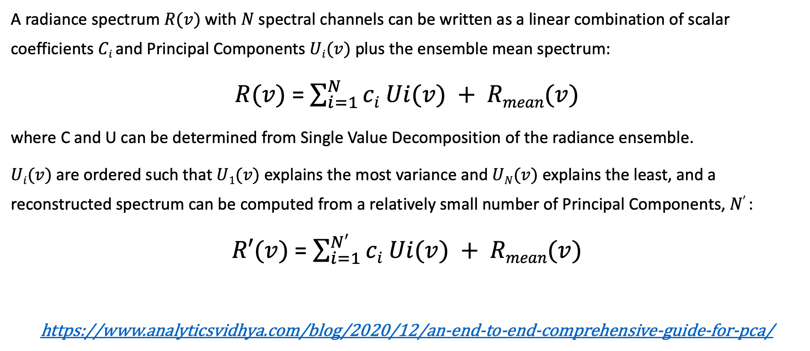
Principal Component Analysis (PCA) basics
A radiance spectrum $R(v)$ with $N$spectral channels can be written as a linear combination of scalar coefficients $Ci$and Principal Components $Ui(v)$ plus the ensemble mean spectrum:
$R(v)$ = $\sum_{i=1}^{N}{ci Ui(v) + Rmean(v)}$
where C and U can be determined from Single Value Decomposition of the radiance ensemble.
$Ui(v)$are ordered such that $U1(v)$ explains the most variance and $UN(v)$ explains the least, and a reconstructed spectrum can be computed from a relatively small number of Principal Components, $N′$:
$R′(v)$ = $\sum_{i=1}^{N′}{ci Ui(v) + Rmean(v)}$
https://www.analyticsvidhya.com/blog/2020/12/an-end-to-end-comprehensive-guide-for-pca/
Hybrid PCA representation of CrIS spectra, D. Tobin, EUMETSAT 2022

Slide 44

Global Training
Example assessment of combined covariance
Percentage difference scale: < 1e-10

Slide 45


Example Assessment: Isoprene C₅H₈ detection (?)
ΔBT(K), 893.75 cm⁻¹ minus 898.125 cm⁻¹
Original Radiances
Sample spectra with Low, Medium,and High amounts
mW/(m² sr. cm⁻¹)
Original Radiances
Reconstructed Radiances
mW/(m² sr. cm⁻¹)
Reconstructed Radiances
mW/(m² sr. cm⁻¹)
Difference
Hybrid PCA representation of CrIS spectra, D. Tobin, EUMETSAT 2022

Slide 46



The Tarfaya Oil Shale deposit
HNO₂ Nitric Acid
Example BT spectra
BT (K)
wavenumber
Local PC capturing
HNO₂ signature
Corresponding local PC scores
wavenumber

