Slide 1
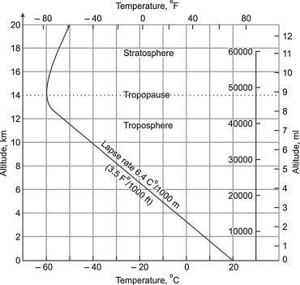
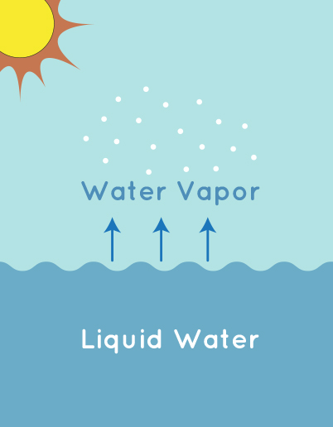
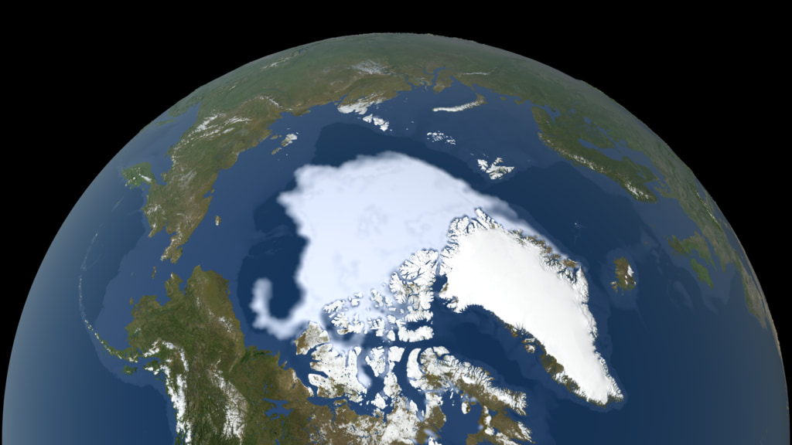
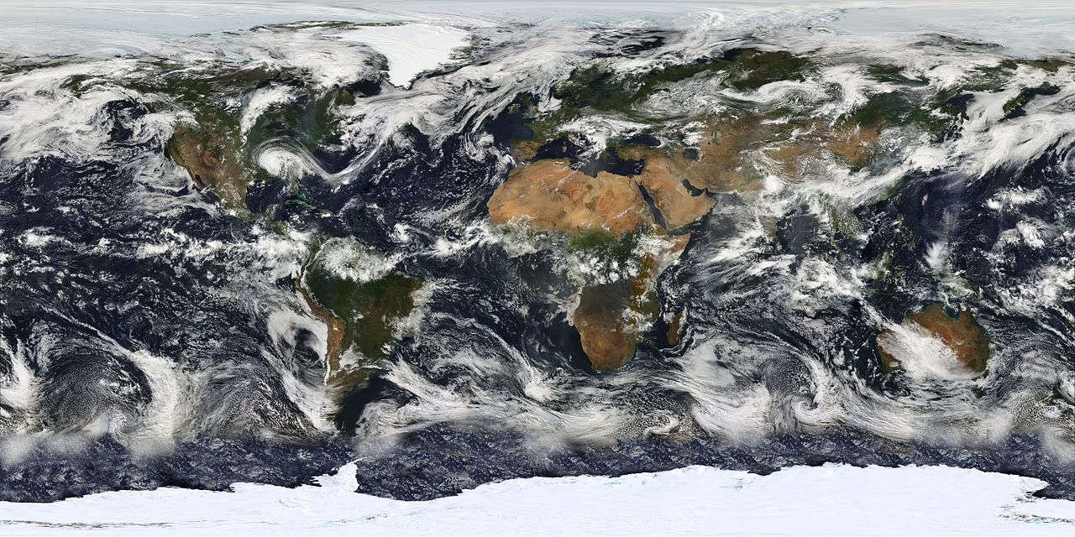
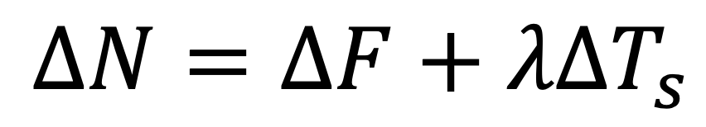
Energy Balance Equation
$$ΔN=ΔF+λΔT_{s}$$
Total Radiative
Imbalance
Radiative
Forcing
Radiative
Feedbacks
Temperature
Water Vapor
Surface Albedo
Cloud
Notes:
I think we need to explain that the warming causes more outgoing radiation, on a path towards eliminating the radiative forcing and returning to equilibrium

Slide 2
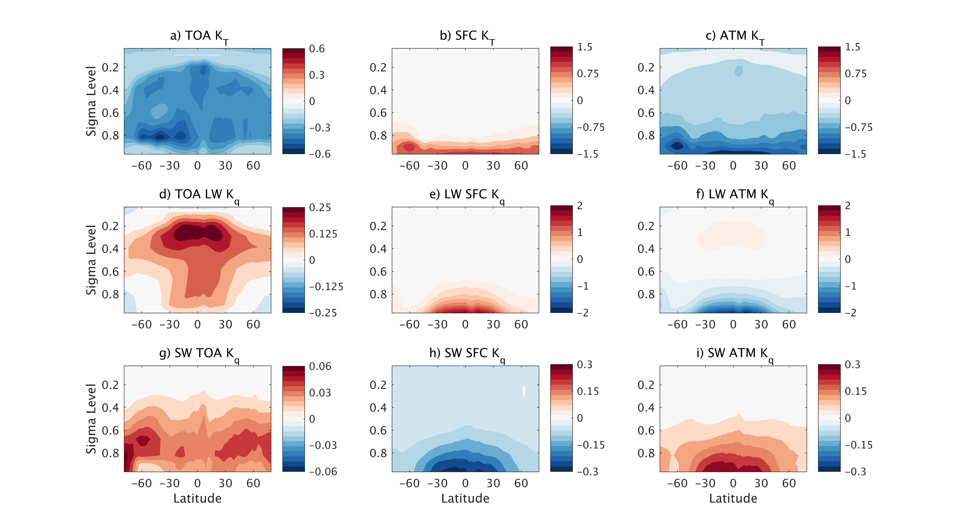
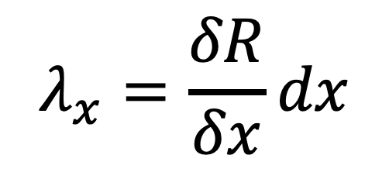
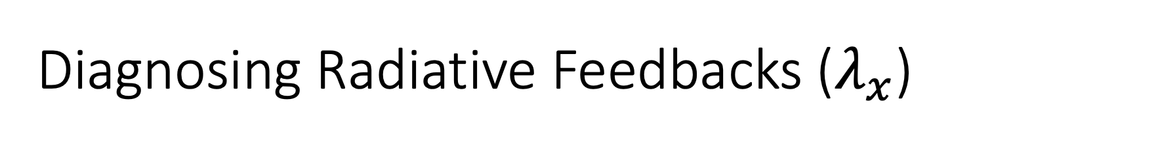
Diagnosing Radiative Feedbacks ($λ_{x}$)
$$λ_{x}=\frac{δR}{δx}dx$$
Temperature Trends
Wm⁻²K⁻¹/hPa

Slide 3
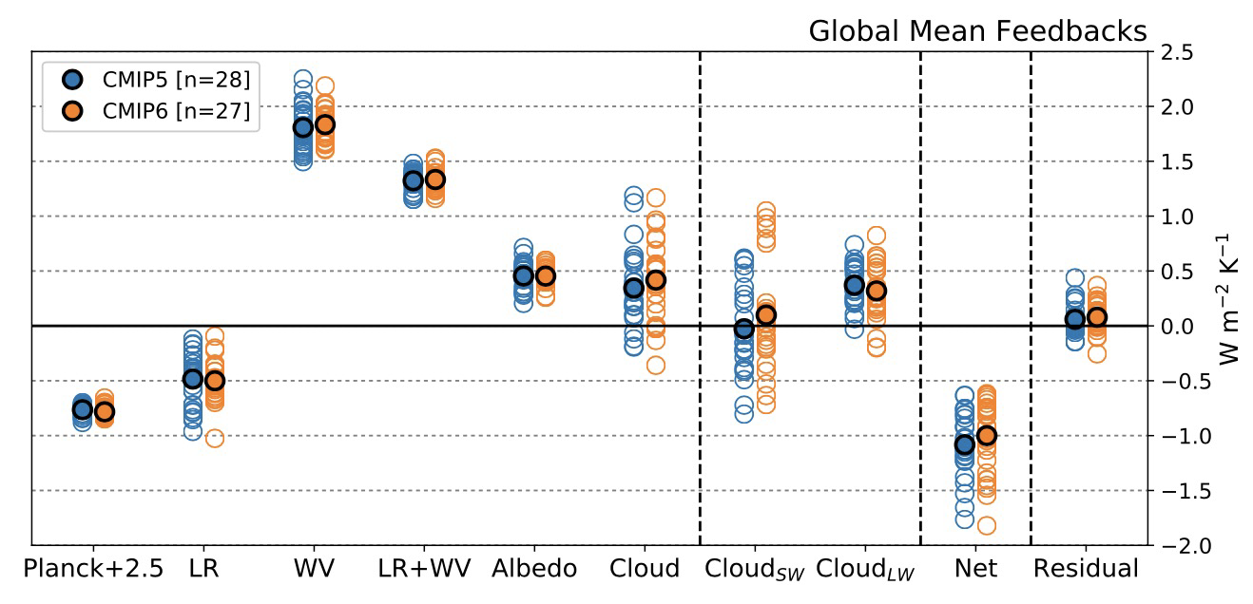
Radiative Feedbacks and Model Uncertainty
Zelinka et al. (2020)

Slide 4
Constraining Models with Observations
He et al. (2021)
Observational differences are as large as model spread

Slide 5
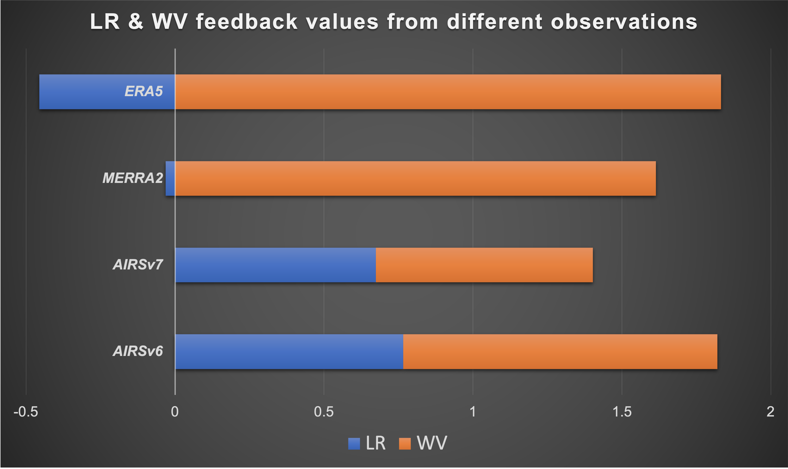
Wm⁻²K⁻¹
Haozhe He

Slide 6
Temperature Trends
Water Vapor Trends
Sergio DeSouza-Machado

Slide 7
Questions/Topics for Discussion
Without a truth, can we determine which observational dataset is ”correct”?
What retrieval/quality control/L3 development choices are particularly impactful on the observed feedback estimates?
Under what conditions to the T and WV Feedback estimate differ across observations?
  Geographically, vertically, cloud conditions, etc.
When comparing observations vs. models is it apples-to-apples?
  Do we need an “AIRS simulator” to get model output more analogous to AIRS/CrIS quantities?
Are the differences across observations a bad thing? How much of a difference is appropriate given actual uncertainties?

